Slide 1
Read to be Ready
Notes:
KATY

Slide 2
The Current Reading Landscape in Tennessee
Notes:
CANDICE

Slide 3
Where are we now?
Over the past several years, English language arts performance in grades 3-5 has remained stagnant or declined.
Historically underserved subgroups are struggling even more; less than one-quarter of English language learners and students with disabilities are proficient or above in reading on the third grade TCAP assessment.
For many students, early intervention is a key element of later outcomes.
Notes:
CANDICE
Subgroup proficient/advanced:
BHN – 3rd grade - 29.7% proficient
ED – 3rd grade – 31.8%
EL – 3rd grade – 21.9%
SWD – 3rd grade – 21.3%

Slide 4
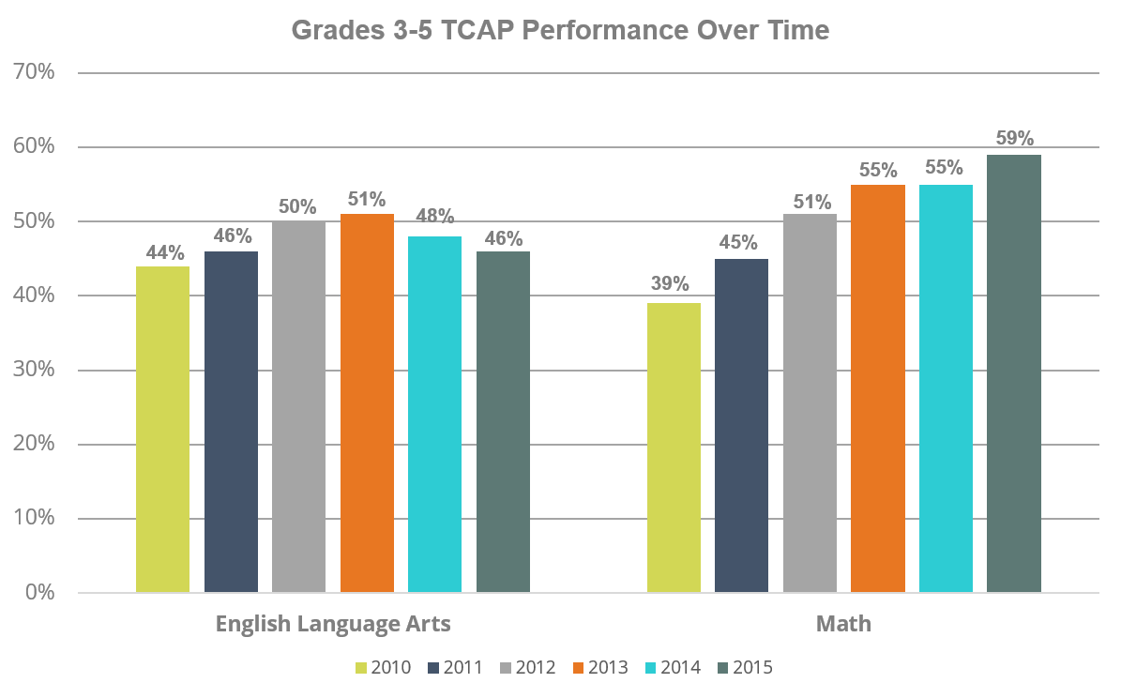
Where are we now?
Notes:
CANDICE
KB will fix the missing values on the graph

Slide 5
Where are we now?
NAEP Reading
We improved our ranking among states in grade 8 reading but went backward in grade 4 reading.
Tennessee still ranks in the bottom half of all states on the Nation’s Report Card or NAEP in grades 4 and 8 reading.
Notes:
CANDICE
Tell folks what NAEP is

Slide 6
Importance of Third Grade Reading
Third grade is a pivotal marker in the academic trajectory of a student.
National data show children who are not reading proficiently by third grade are four times less likely than their peers to graduate high school by age 19.
By the end of third grade, only 43 percent of students in Tennessee are proficient in reading.
Notes:
Karen transition to Commissioner McQueen who will talk through this slide and introduce Jayme for Read to be Ready

Slide 8
Read to be Ready
We are building a statewide literacy campaign to raise reading proficiency across Tennessee.
Reading is so much more than just connecting words on a page—it is about building thinkers.
Goal: 75 percent of third graders reading on grade level by 2025.
Notes:
JAYME
Our goal is for 75 percent of third grade students to read on grade level by 2025.
The purpose of the Read to be Ready campaign is to unite our state—educators, students, parents, community members....all of stakeholders—around a shared imperative to meet this goal.
The kick-off event will begin a statewide focus on the critical value of reading—not only the value of learning to read but also the importance of reading to learn.

Slide 9
Read to be Ready: Key Takeaways
Early literacy matters. Early language and literacy development must begin at birth because of its direct impact on later success in reading and in life.
Notes:
JAYME
I want to share with you all the key takeaways that we will present during next week’s official campaign kick-off event.
These are the main talking points around our statewide reading campaign, Read to be Ready, that we hope you help reinforce as you work with stakeholders.

Slide 10
Read to be Ready: Key Takeaways
But it’s never too late. With quality resources and support, even those who are not reading on grade level by third grade can catch up.
Notes:
JAYME

Slide 11
Read to be Ready: Key Takeaways
Reading is more than just “sounding out” words. Reading is thinking deeply about a text’s meaning and how it builds knowledge of the world around us.
Notes:
JAYME

Slide 12
Read to be Ready: Key Takeaways
Teacher knowledge and practice are critical. Educators must have a deep understanding of the art and science of literacy instruction in order to develop lifelong readers.
Notes:
JAYME

Slide 13
Read to be Ready: Key Takeaways
It takes a community. We each hold a piece of the puzzle and we must do our part to improve literacy in Tennessee.
Notes:
JAYME

Slide 14
Read to be Ready: Key Takeaways
Early literacy matters. Early language and literacy development must begin at birth because of its direct impact on later success in reading and in life.
But it’s never too late. With quality resources and support, even those who are not reading on grade level by third grade can catch up.
Reading is more than just “sounding out” words. Reading is thinking deeply about a text’s meaning and how it builds knowledge of the world around us.
Teacher knowledge and practice are critical. Educators must have a deep understanding of the art and science of literacy instruction in order to develop lifelong readers.
It takes a community. We each hold a piece of the puzzle and we must do our part to improve literacy in Tennessee.
Notes:
JAYME

Slide 15
Tennessee’s Commitment

Slide 16
Our Tennessee Succeeds Commitment
By any measures, too many kids in Tennessee struggle to read.
Our goal is to see 75 percent of third graders proficient in reading by 2025.
The Tennessee Department of Education has developed a number of strategies to help meet this goal.

Slide 17
What is the department doing?
Statewide Model of Literacy Coaching
Launch a literacy coach initiative with regional literacy coaches supporting districts and schools with grades PreK-3
Improve Literacy Instruction in Educator Preparation Programs
Support deeper literacy instruction through improved educator preparation and licensure
Kindergarten Entry Screener
Create a Tennessee-specific kindergarten entry screener for all programs with explicit benchmarks related to early literacy
Networked Improvement Communities
Bring districts together to form a collaborative network within two CORE regions to find solutions to third grade reading proficiency
Tennessee Education Research Alliance (TERA)
Create a partnership with Vanderbilt to conduct research on Tennessee’s priorities, including early reading
Notes:
Mention Read to be Ready then discuss the following 5 initiatives: coaching, EPPs, KES, NIC, and TERA.

Slide 18
1. Statewide Model of Literacy Coaching
Reading Coach Consultants in state CORE offices deliver high-quality training to district coaches
District-level Read to be Ready Coaches coach PreK-3 reading teachers
PreK-3 teachers increase their knowledge of core instruction and intervention strategies
Reading outcomes for students across the state improve
State
District
School
Students
The literacy coaching model is built on quality ongoing training combined with coaching.
Literacy training will have a substantial focus on serving our historically underserved populations.

Slide 19
2. Improve Literacy Instruction in Educator Prep Programs
Reading Standards
Certification
Reporting
Research, Data & Training
Rewrite the K-12 reading standards for EPPs
Review the state’s reading certification exams (PRAXIS)
Implement a statewide performance assessment for reading teachers
Highlight teacher preparation outcomes in ELA on the Teacher Preparation Report Card
Provide statewide reading research, data, and training opportunities to EPP faculty
Notes:
The department has a number of strategies for improving literacy in Tennessee.

Slide 20
3. Kindergarten Entry Screener
A kindergarten entry screener (KES) is a tool to measure children’s preparation and readiness for kindergarten.
Due to the limited focus of current readiness tools, as well as the inconsistency in use and purpose, it is vital that the state provide a comprehensive tool that provides a profile for every child to inform kindergarten instruction.
KES will provide valuable early information to tailor instruction and early intervention.
Tennessee will pilot a new KES in fall 2016. It will be used statewide in fall 2017.

Slide 21
4. Networked Improvement Communities
Problem of Practice: Increase 3rd grade reading proficiency
UC CORE Hub
District
District
TDOE Hub
District
District
District
District
East CORE Hub
District
District
Notes:
At the state level, we are launching two new efforts to enhance the knowledge base about how to improve reading efforts across Tennessee. The second is the creation of Networked Improvement Communities (NICs) to promote district innovation and idea-sharing. It is an experimental effort with the Carnegie Foundation for the Advancement of Teaching to initiate a series of district networks that come together using a rigorous set of improvement protocols to develop new methods and ideas for statewide reading improvement.

Slide 22
5. Tennessee Education Research Alliance (TERA)
For the past several years, TDOE has collaborated with the Tennessee Consortium on Research, Evaluation and Development (TNCRED) at Vanderbilt on several research projects, including the annual Tennessee Educator Survey.
This partnership is turning into a research alliance that will be a central actor in discussions of state policy. TERA will focus directly on stakeholder engagement and dissemination of policy relevant research findings.
TERA’s research agenda will be built from our state’s strategic plan and will focus in part on improving elementary reading.
Notes:
At the state level, we are launching two new efforts to enhance the knowledge base about how to improve reading efforts across Tennessee. The first builds on a previous partnership with Vanderbilt to create a research alliance that will consistently and directly inform state-level policies and practices.

