Slide 1
What is your role in Tennessee Succeeds?
McMinnville Rotary Club
Dr. Candice McQueen
Commissioner of Education

Slide 2
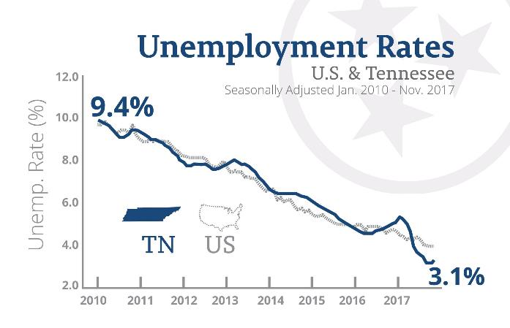
Our State is Showing Historic Success
We have incredible economic strength
Record low unemployment rate
#1 in small business job growth
Notes:
Our state is showing historic success, and we believe education is the reason why

Slide 3
Tennessee’s Progress Literally Stands Out

Slide 4
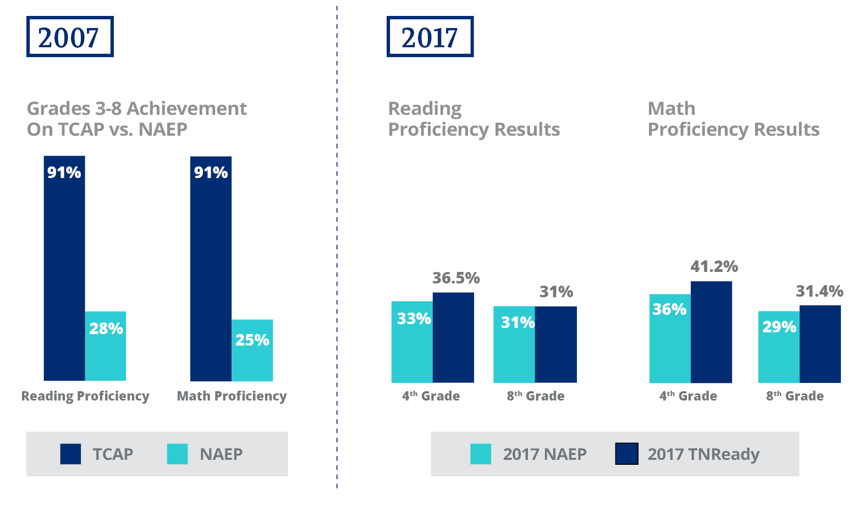
We’ve Closed the Gap Between NAEP & TNReady

Slide 5
We’ve Continued to Earn National Recognition

Slide 6
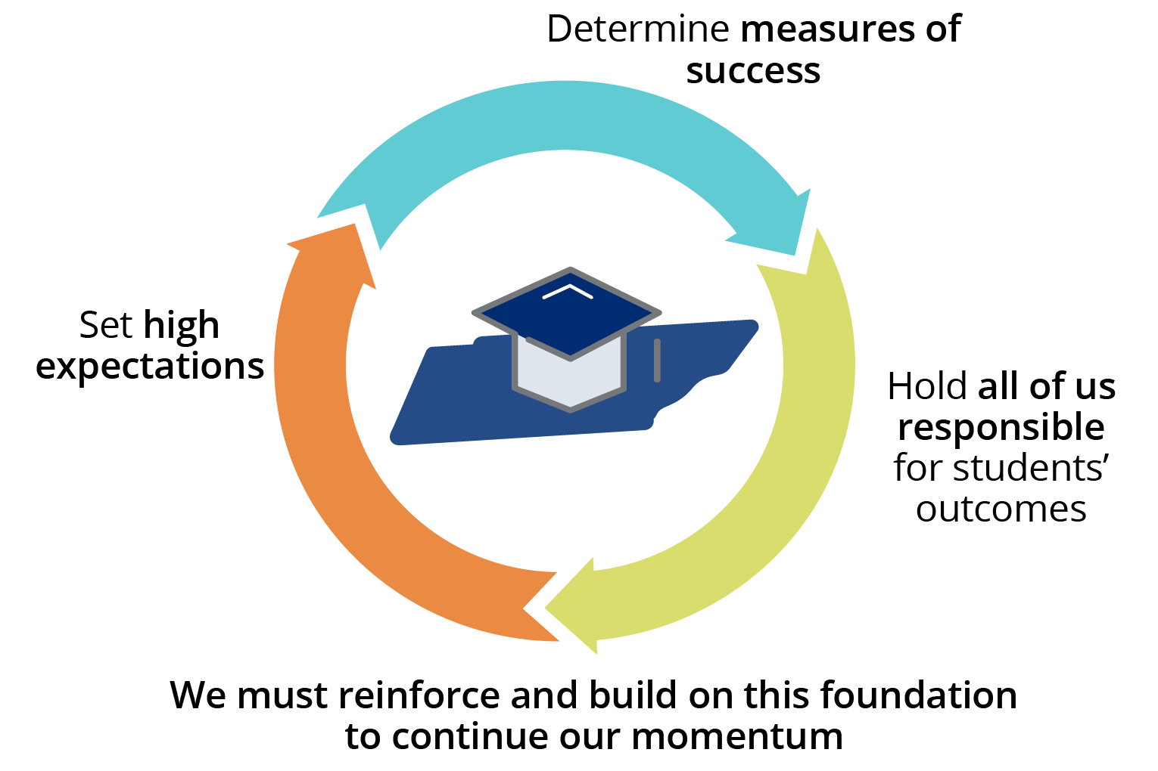
Our Policy Foundation Makes This Possible

Slide 8
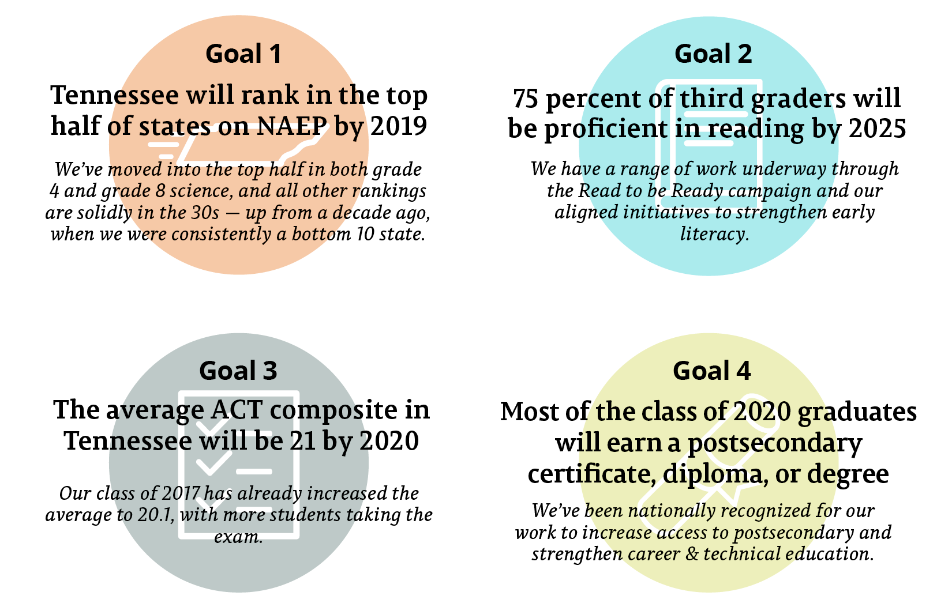
We’ve Made Progress Toward Our Goals

Slide 9
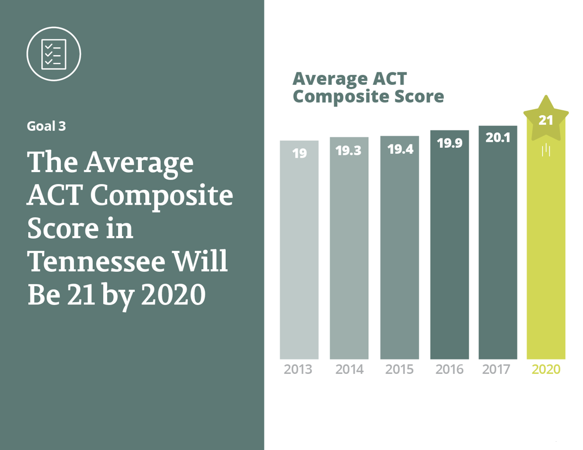

Slide 10
Overall, 2018 TNReady Scores Show Mixed Results, Encouraging Areas of Progress
TNReady results vary statewide, but there are encouraging trends – including strong growth in English language arts for elementary grades and increases in high school math.
Students in historically disadvantaged student groups also showed notable progress. Gaps between student groups narrowed in multiple areas, and students in Priority schools – including the Achievement School District – grew faster than their non-Priority school peers nearly across the board.
10

Slide 11
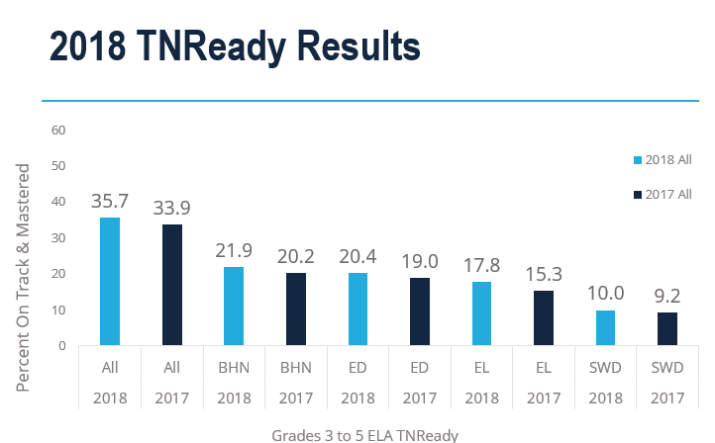

Slide 12
12
Notes:
12

Slide 13
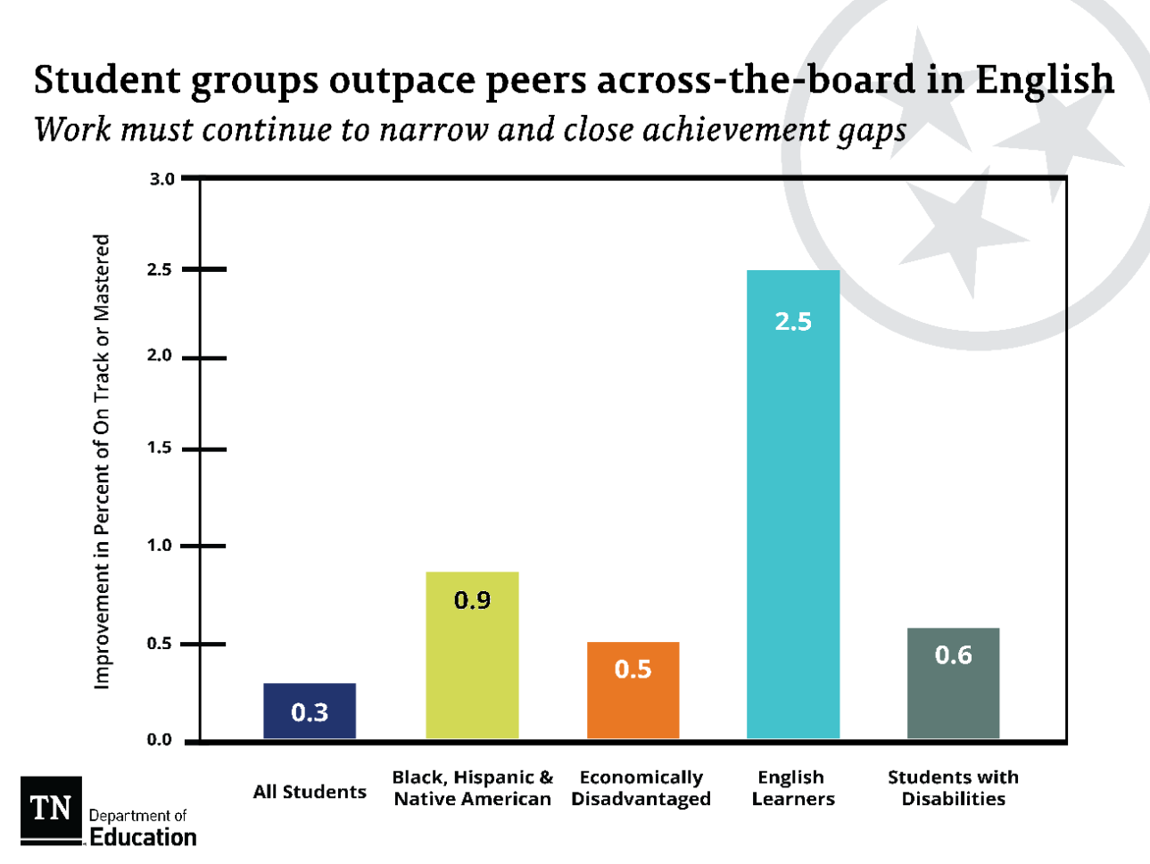
13
Notes:
13

Slide 14
This Year’s Educator Survey Results Show Continued Progress
91% of teachers report that their curriculum is an important tool in helping reach student instructional goals.
71% of educators say evaluation has led to improvements in their teaching.
2 out of 3 in 10 teachers report that they understand what the state academic standards expect of them as a teacher, and over 75% of these teachers believe that the state assessments are consistent with these standards.
65% teachers reported that they feel more empowered, versus constrained, to teach in ways that they feel are best for their students. Many teachers attributed their empowerment to having the autonomy to implement their curriculum to best meet their students’ needs, among other reasons.
Notes:
Statewide findings aligned with McMinn County educator survey results. McMinn had a 75% participation rate. Teacher responses tended to be less positive than the state average.
22 percent fewer teachers report feeling pulled in too many directions in terms of what to teach and how to teach it. This suggests that teachers are adjusting to the expectations set by new grade-level standards and are feeling more confident and better supported as they teach those.
Since 2012, there has been a steady increase in the percentage of teachers reporting that the evaluation process has led to improvements in their teaching—going from one-third of teachers to about three-fourths over the last six years. This year, 72 percent of educators say evaluation has led to improvements in their teaching. Educators also noted they desire higher quality feedback from observations, along with the time and space to work on areas of improvement. The department is using the feedback to identify areas to continue to improve, such as ensuring observation provides useful and timely feedback and reducing the time and resources burden that some educators report.
Overall, 9 in 10 teachers report that they understand what the state academic standards expect of them as a teacher, but fewer, only 6 in 10, report feeling the materials currently available to them are well-suited for teaching the standards. The survey finds that more teachers would benefit from improved access to strong instructional materials, along with receiving the training and support necessary to properly implement curriculum in their classroom. Earlier this year, the department started a new initiative – Ready with Resources – as an outgrowth of the Read to be Ready work. This will provide more teachers with access to optional high-quality instructional materials and support districts in planning for adoption of new resources.
Three out of four teachers reported that they feel more empowered, versus constrained, to teach in ways that they feel are best for their students. Many teachers attributed their empowerment to having the autonomy to implement their curriculum to best meet their students’ needs, among other reasons.

Slide 15
Grades 3-8 ELA 2018

Slide 16
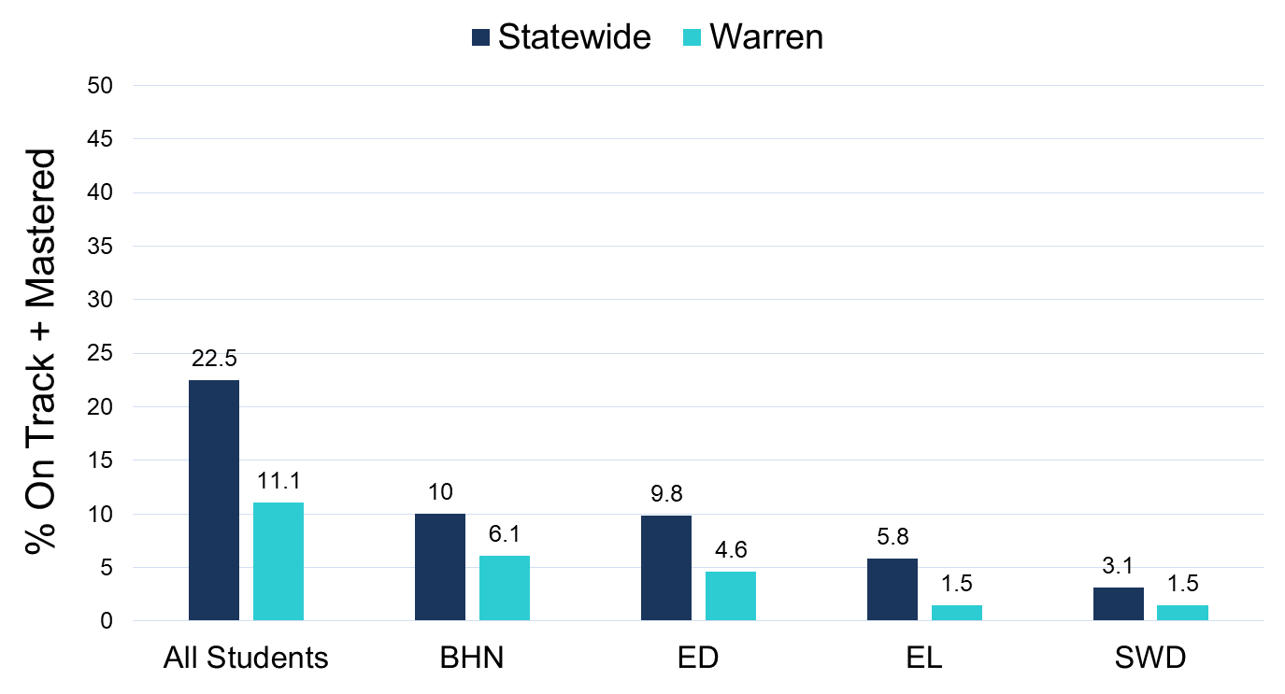
High School Math 2018

Slide 17
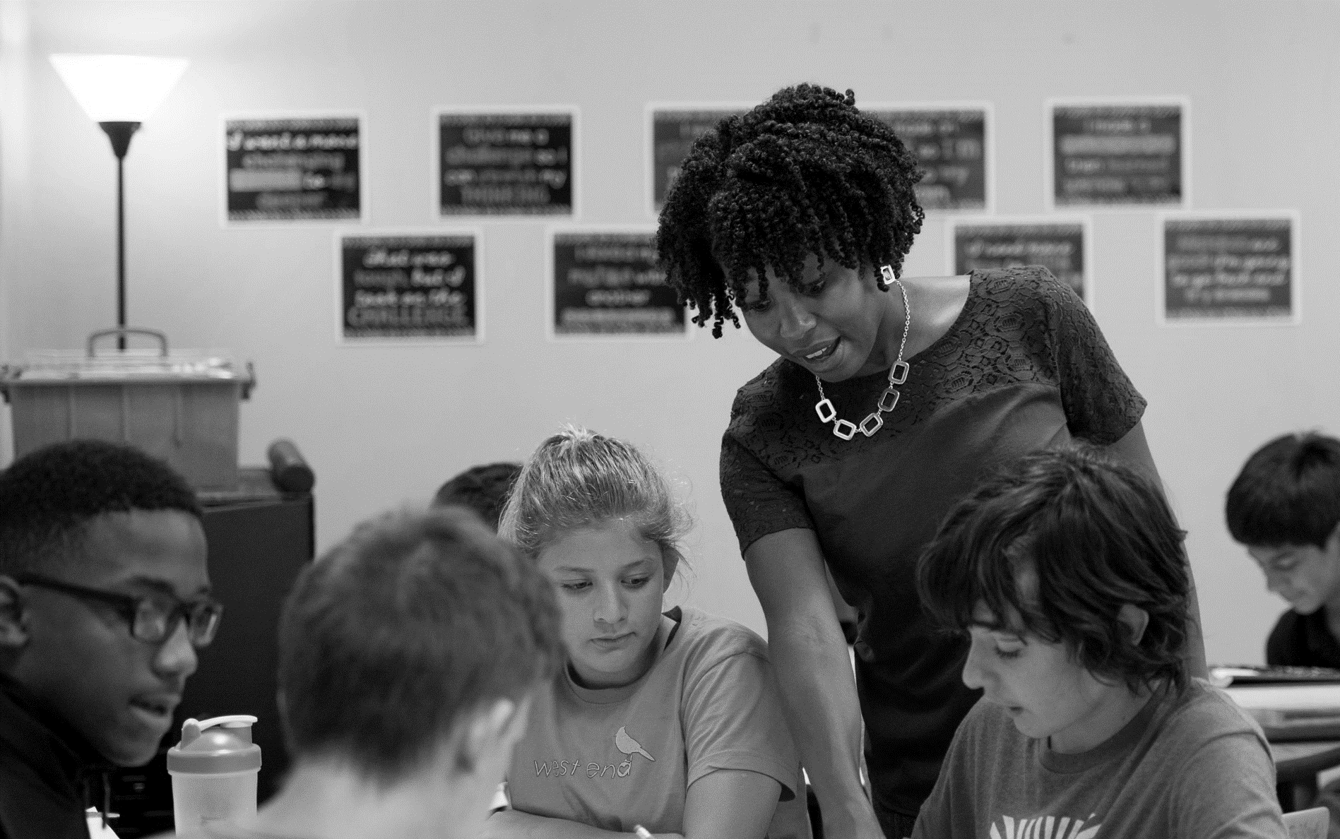
We Must Keep Moving Forward on Our Vision for What All Students Deserve
1
To be reading on grade level by the end of third grade
2
To have an effective teacher – supported by an effective principal – every year
3
To be set up for success on a path to a career
Notes:
As of last summer, we have 200+ reading coaches who support 2,500+ teachers and 44,000 students
Last summer, 8,000 students participated in RTBR summer camps and showed statistically significant gains in critical reading skills and increased motivation to read.
From 2014 report:
This figure illustrates that while 92 percent of teachers continued to teach in Tennessee schools, about 10 percent of teachers taught at a different Tennessee school in the 2012-13 school year. Early career teachers, especially highly effective early career teachers, were more likely to move to a new school.
Highly effective teachers—those who earned a score of Level 4 or Level 5—tended to be retained at a higher rate than teachers who earned a score of Level 1, 2, or 3.
Overall retention rate of Level 5 teachers was 95.2 percent
XX% more students are on the path to a career

Slide 18
State of Education

Slide 19
