Slide 1
What is your role in Tennessee Succeeds?
Beginning Superintendent Academy
Dr. Candice McQueen
Commissioner of Education

Slide 2
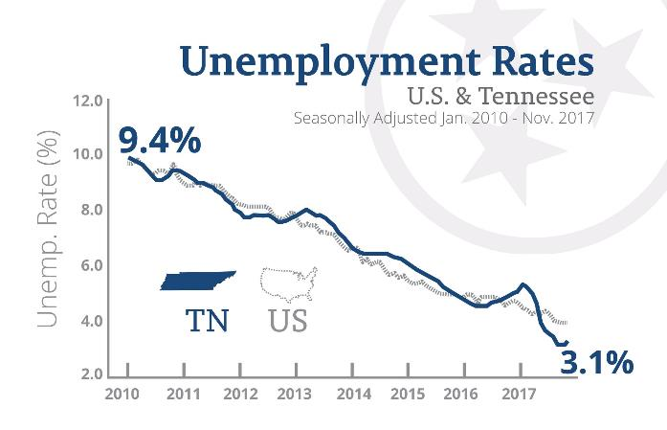
Our State is Showing Historic Success
We have incredible economic strength
Record low unemployment rate
#1 in small business job growth
Notes:
Our state is showing historic success, and we believe education is the reason why

Slide 3
Tennessee’s Progress Literally Stands Out

Slide 4
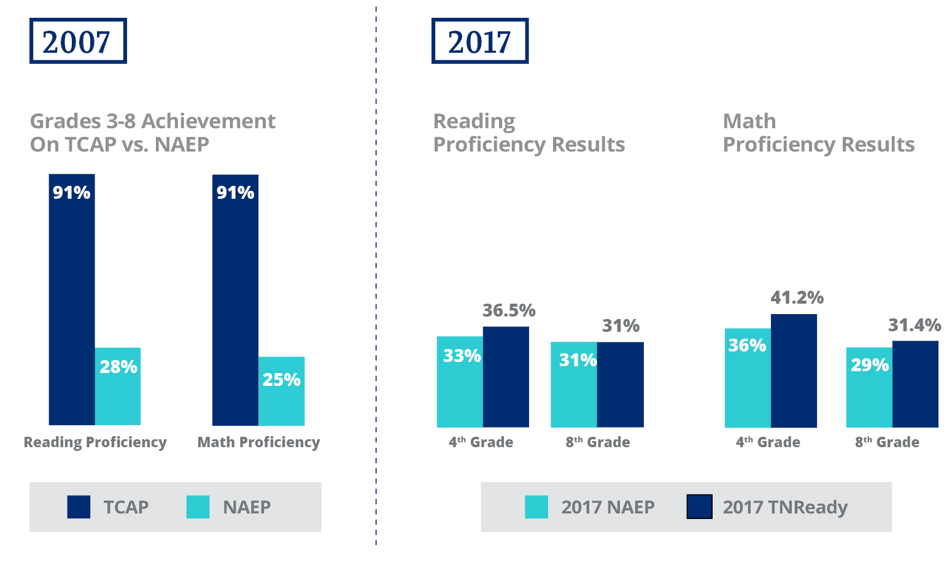
We’ve Closed the Gap Between NAEP & TNReady

Slide 5
We’ve Continued to Earn National Recognition

Slide 6
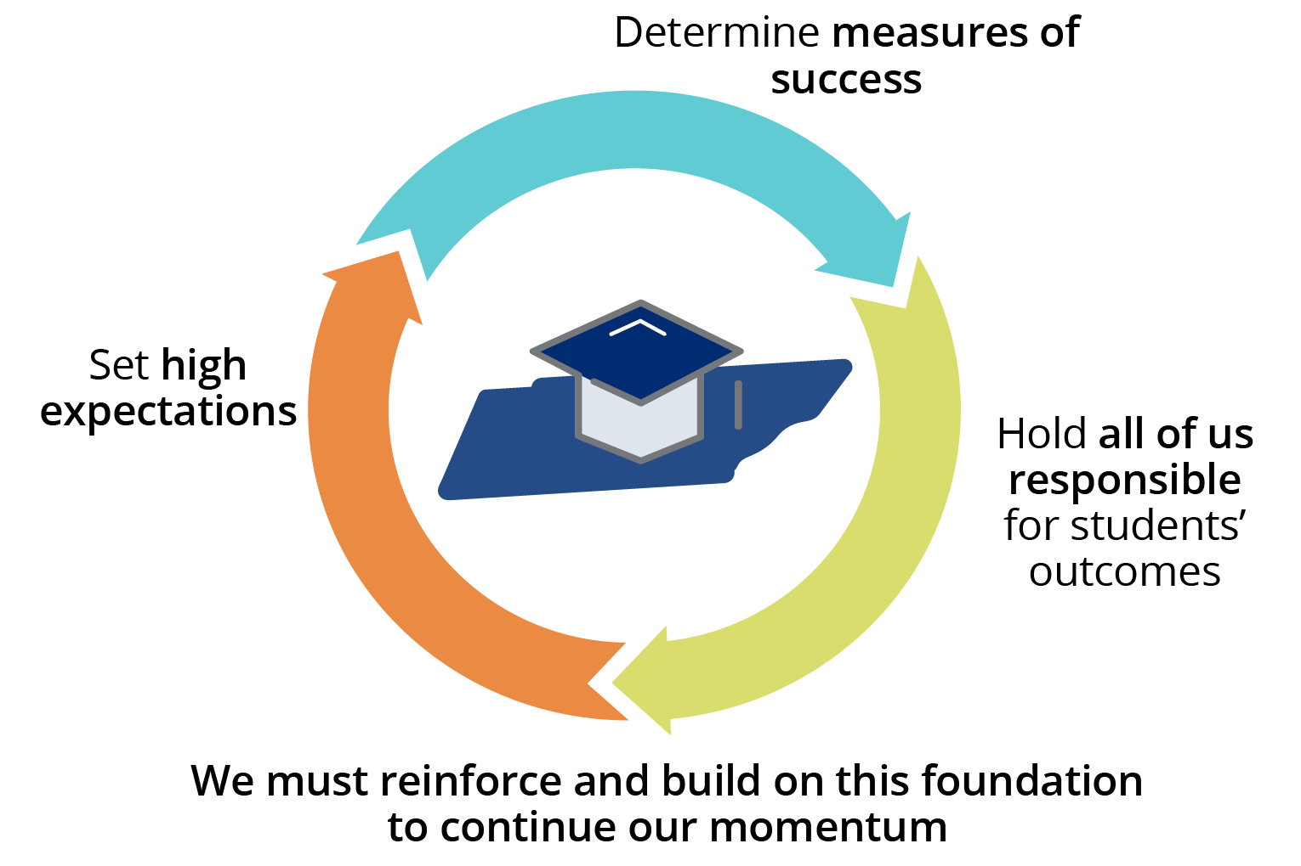
Our Policy Foundation Makes This Possible

Slide 8
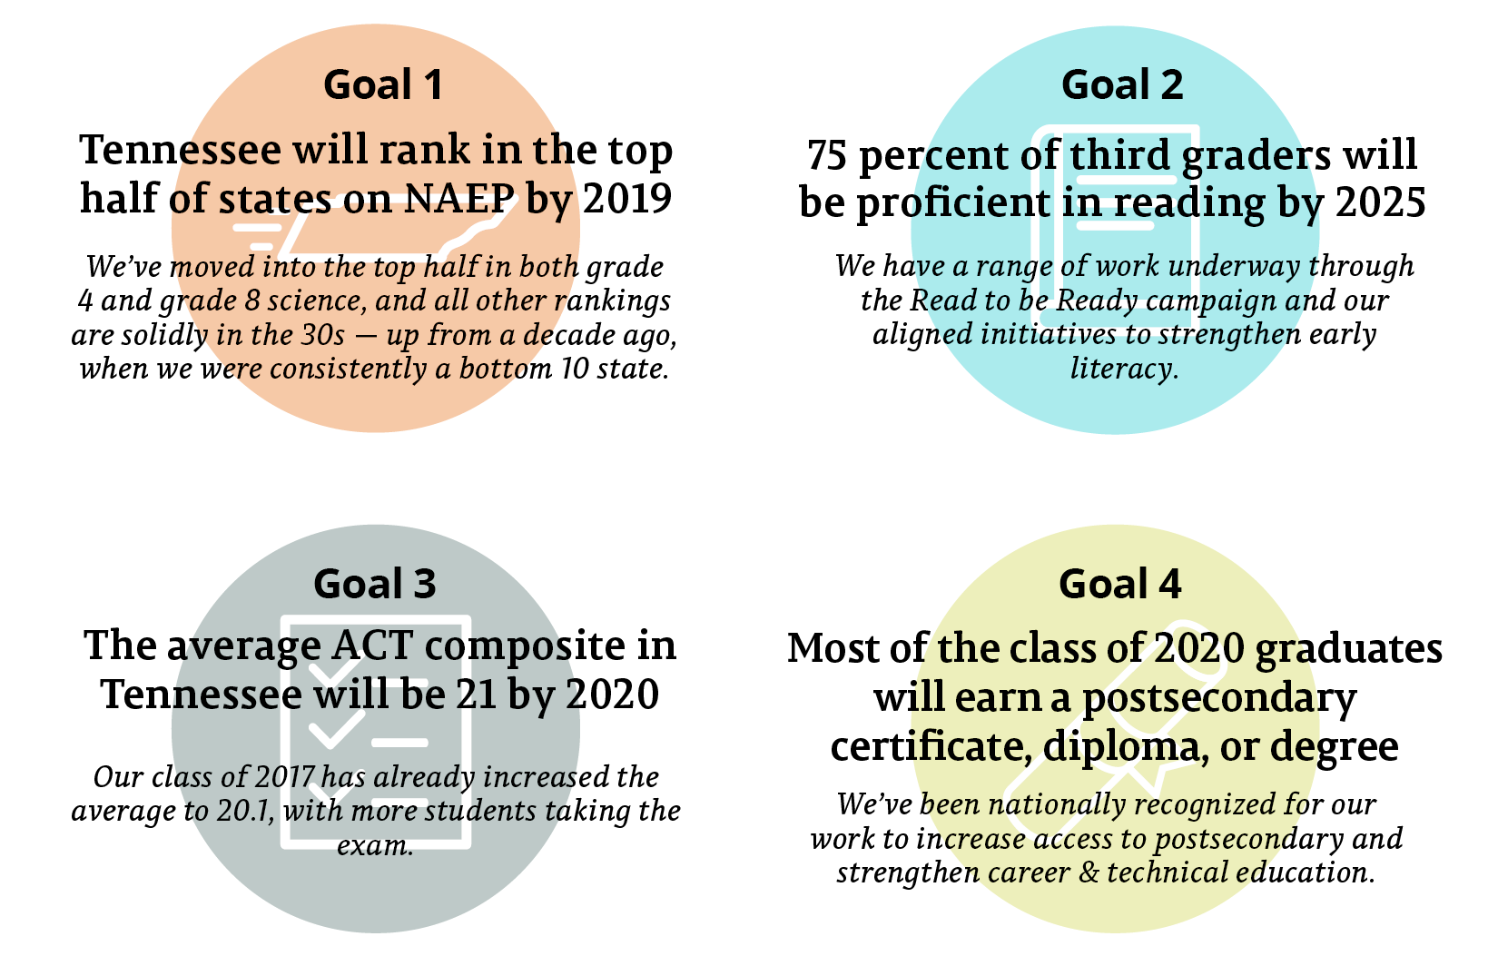
We’ve Made Progress Toward Our Goals

Slide 9
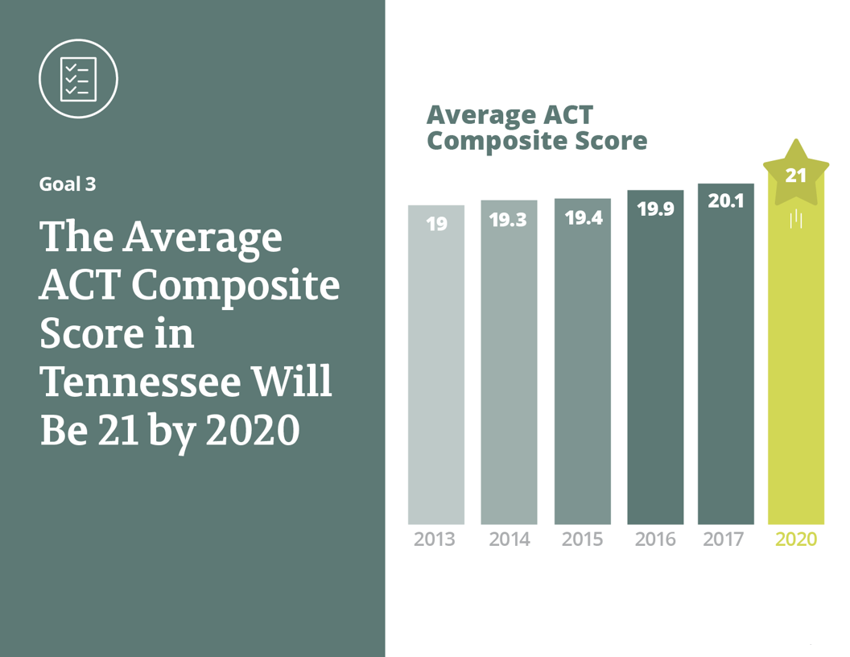

Slide 10
Overall, 2018 TNReady Scores Show Mixed Results, Encouraging Areas of Progress
TNReady results vary statewide, but there are encouraging trends – including strong growth in English language arts for elementary grades and increases in high school math.
Students in historically disadvantaged student groups also showed notable progress. Gaps between student groups narrowed in multiple areas, and students in Priority schools – including the Achievement School District – grew faster than their non-Priority school peers nearly across the board.
10

Slide 11
11
Notes:
11

Slide 12
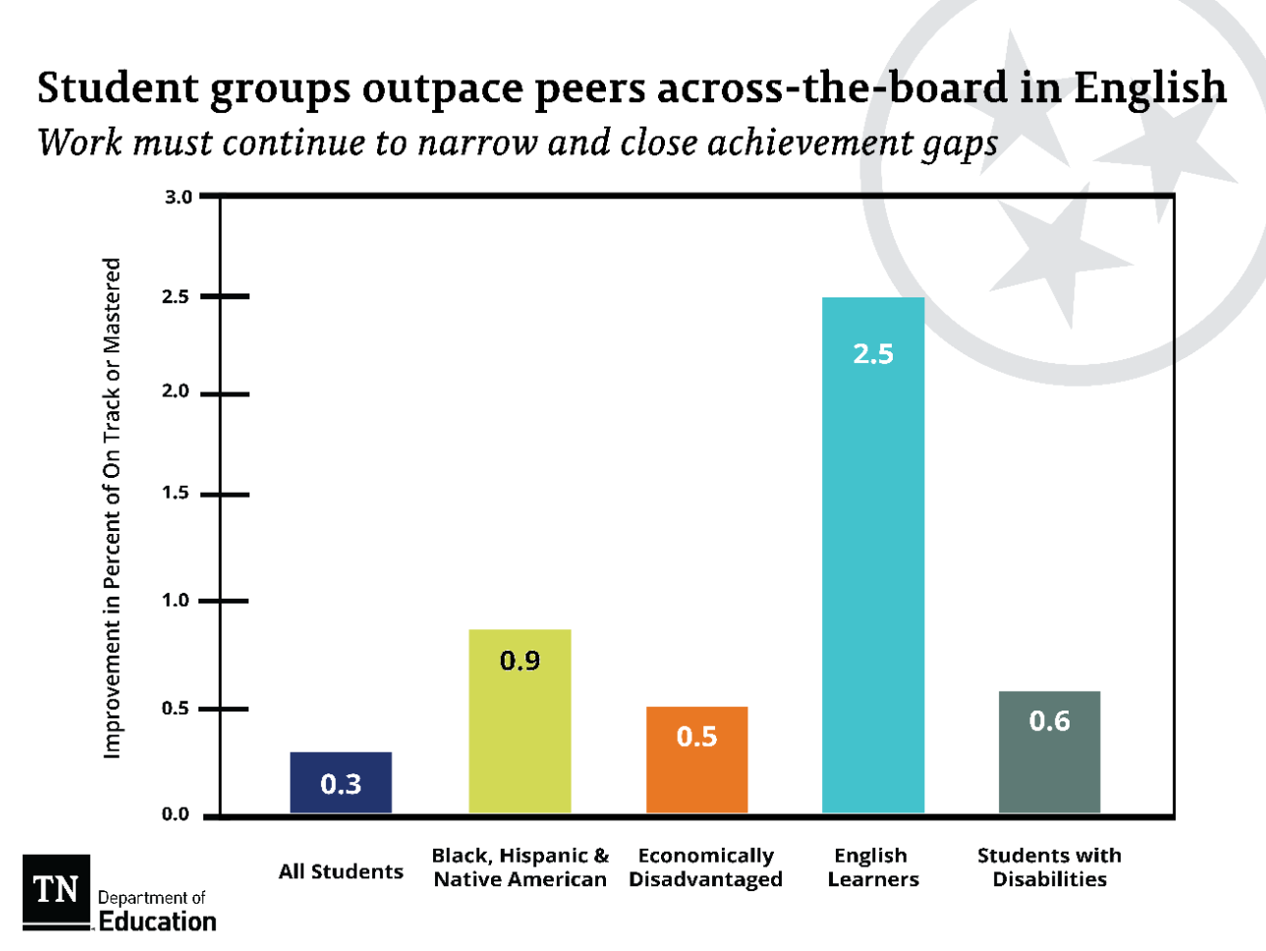
12
Notes:
12

Slide 13
2018 TNReady Results

Slide 14
School and District TVAAS Results
2018 TVAAS scores show that the majority of our 147 districts met or exceeded growth expectations.
59 districts have an overall TVAAS composite of Level 5
71 districts have an overall TVAAS composite of Level 4 or 5
88 districts have an overall TVAAS composite of Level 3, 4, or 5
For more information, please contact Tony.Pratt@tn.gov.
Notes:
Candice

Slide 15
School and District TVAAS Results
11 districts have a Level 5 for each subject-area TVAAS composite (Literacy, Numeracy, Science, and Social Studies):
Bartlett City | Loudon County
Greene County | Maryville City
Greeneville City | Oneida Special School District
Hamblen County | Roane County
Jefferson County | Sequatchie County
Johnson City
For more information, please contact Tony.Pratt@tn.gov.
Notes:
Candice

Slide 16
School and District TVAAS Results
We also saw incredible growth at most of our schools:
574 schools have an overall TVAAS composite of Level 5
738 schools have an overall TVAAS composite of Level 4 or 5
1,058 schools have an overall TVAAS composite of Level 3, 4, or 5
65 schools across 36 districts have a Level 5 for each subject-area TVAAS composite
For more information, please contact Tony.Pratt@tn.gov.
Notes:
Candice

Slide 17
This Year’s Educator Survey Results Show Continued Progress
22% fewer teachers report feeling pulled in too many directions in terms of what to teach and how to teach it.
72% of educators say evaluation has led to improvements in their teaching.
9 in 10 teachers report that they understand what the state academic standards expect of them as a teacher, but fewer, only 6 in 10, report feeling the materials currently available to them are well-suited for teaching the standards.
3 out of 4 teachers reported that they feel more empowered, versus constrained, to teach in ways that they feel are best for their students. Many teachers attributed their empowerment to having the autonomy to implement their curriculum to best meet their students’ needs, among other reasons.
Notes:
Statewide findings are listed above due to low teacher participation from Davidson this year (37%.)
22 percent fewer teachers report feeling pulled in too many directions in terms of what to teach and how to teach it. This suggests that teachers are adjusting to the expectations set by new grade-level standards and are feeling more confident and better supported as they teach those.
Since 2012, there has been a steady increase in the percentage of teachers reporting that the evaluation process has led to improvements in their teaching—going from one-third of teachers to about three-fourths over the last six years. This year, 72 percent of educators say evaluation has led to improvements in their teaching. Educators also noted they desire higher quality feedback from observations, along with the time and space to work on areas of improvement. The department is using the feedback to identify areas to continue to improve, such as ensuring observation provides useful and timely feedback and reducing the time and resources burden that some educators report.
Overall, 9 in 10 teachers report that they understand what the state academic standards expect of them as a teacher, but fewer, only 6 in 10, report feeling the materials currently available to them are well-suited for teaching the standards. The survey finds that more teachers would benefit from improved access to strong instructional materials, along with receiving the training and support necessary to properly implement curriculum in their classroom. Earlier this year, the department started a new initiative – Ready with Resources – as an outgrowth of the Read to be Ready work. This will provide more teachers with access to optional high-quality instructional materials and support districts in planning for adoption of new resources.
Three out of four teachers reported that they feel more empowered, versus constrained, to teach in ways that they feel are best for their students. Many teachers attributed their empowerment to having the autonomy to implement their curriculum to best meet their students’ needs, among other reasons.

Slide 18
Priority Area Updates

Slide 19
Standards, Assessment, Accountability
Tennessee maintained progress on NAEP, was highlighted for dramatic growth, and was named a top state to close the “honesty gap” while moving standards from an “F” to an “A” rating.
More than 7,000 teachers were trained on new science and fine arts standards, and hundreds were retrained on math.
We developed a new phase-in plan for online assessment, which maintains the state’s transition and adjusts based on proof points.
We announced new TNReady Ambassadors program, which will bring 30+ educators into a partnership with us to inform TNReady development and support implementation and communication.
We met with hundreds of stakeholders to develop a new school accountability dashboard.

Slide 20
Early Foundations & Literacy
Piloted K-3 ELA unit starters in 18 schools and released 16 unit starters for teachers to build on in their own classrooms.
Launched Ready with Resources campaign as part of larger Read to be Ready work to support access to high quality resources.
CORE engaged in over 700 Literacy Learning Walks to support district leaders in understanding the strengths and gaps in literacy instruction at the classroom level.
Built on last year’s statistically significant gains in reading skills and motivation for Read to be Ready Summer Camps with $8.8 million investment and 7,700 students participating in 2018.
Aligned the Tennessee Early Learning Development Standards to K-12 academic standards and selected new Pre-K curricula for implementation this fall.

Slide 21
High School & the Bridge to Postsecondary
About 75% of the class of 2018 took the free ACT retake, with 2,333 seniors raising their composite to above a 21.
Schools are implementing new counseling standards that incorporate academic development, social and personal development, and college and career readiness.
Introduced 21 new industry certification options that prepare students for the workforce and are aligned to Tennessee’s highest demand industry sectors.
A new high of 43% of high school graduates of the class of 2017 attempted an early postsecondary opportunity in high school.
89.1% graduation rate for the class of 2017 – a new state record.
63% of the high school graduating class of 2016 seamlessly enrolled in a postsecondary education institution – and more students in Tennessee are enrolled than ever.

Slide 22
All Means All
Released the Tennessee Leaders for Equity Playbook that outlines seven equity commitments to help leaders make significant shifts in mindset and practice that will benefit all students
Developed ACCESS materials and provided training in all CORE regions to improve teachers ability to differentiate for all students
Provided training across the state for ESL and general education teachers on new individualized learning plans for English Learners
Invested $13.4 million in funding to support RTI² interventionists with at least one for each district, and launched a listening tour to learn more about how to improve

Slide 23
Educator Support
Awarded almost $100,000 to support Diversity Innovation Grants for teacher recruitment.
New state funding in education for FY19 totaled over $200 million, including $55 million in funding for teacher salaries – bringing our total to more than $500 million in new funding for salaries over the past five years.
Revised the educator preparation literacy standards and convened a new literacy network for educator preparation programs (EPPs) to support districts and EPPs in leveraging their partnerships to strengthen educator development.
Awarded over $1 million to support nine Tennessee Transformational Leadership Alliance principal pipeline models with training for 150 aspiring leaders.

Slide 24
District Empowerment
Developed new online dashboard to transparently report school- and district-level results aligned to Tennessee's ESSA accountability model.
Invested $30 million in state funding to support school safety and security, including grant opportunities for districts, based on the Governor’s task force recommendations.
Piloted a new planning tool with 11 districts to better support data analysis and identification of needs for annual planning processes.

Slide 25
School Improvement
Established the first Partnership Network in collaboration with Hamilton County Schools to support five of the state's lowest performing schools
Completed a revised needs assessment and root cause analysis planning with eight districts to support our lowest performing schools
Hired new leader for the Achievement School District who has been a proven, dynamic leader for Shelby County Schools
Investing nearly $2 million in leadership incentives to support recruitment and retention of high effective leaders in Priority schools

Slide 26
We Must Keep Moving Forward on Our Vision for What All Students Deserve
1
To be reading on grade level by the end of third grade
2
To have an effective teacher – supported by an effective principal – every year
3
To be set up for success on a path to a career
Notes:
As of last summer, we have 200+ reading coaches who support 2,500+ teachers and 44,000 students
Last summer, 8,000 students participated in RTBR summer camps and showed statistically significant gains in critical reading skills and increased motivation to read.
From 2014 report:
This figure illustrates that while 92 percent of teachers continued to teach in Tennessee schools, about 10 percent of teachers taught at a different Tennessee school in the 2012-13 school year. Early career teachers, especially highly effective early career teachers, were more likely to move to a new school.
Highly effective teachers—those who earned a score of Level 4 or Level 5—tended to be retained at a higher rate than teachers who earned a score of Level 1, 2, or 3.
Overall retention rate of Level 5 teachers was 95.2 percent
XX% more students are on the path to a career

Slide 27
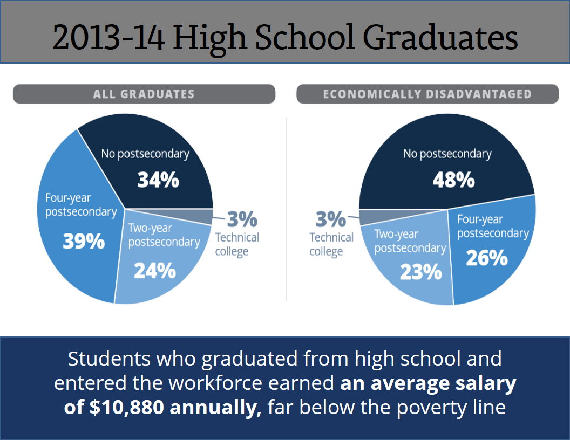

Slide 29
State of Education

