Slide 1
HELLO AND WELCOME!
Mute yourself to eliminate background noise.
Please turn on your video, if you’re able to.
Chat to everyone your name, role, and organization.

Slide 2
Best practices in quality authorizing
A virtual training for the State Charter School Commission of Tennessee
April 22, 2020

Slide 3
Welcome (10 min)
The Charter School Lifecycle: The Commissioner’s Role (20 min)
Quality Decision-Making (30 min)
Break (5 min)
Quality Practices (60 min)
Applications on Appeal (30 min)
Performance Contracting and Ongoing Evaluation (15 min)
Renewal/Revocation and Renewal/Revocation on Appeal (15 min)
Wrap up (5 min)
Notes:
[SCRIPT TO BE ADDED]

Slide 4
What does NACSA believe?
Our nation needs to provide better schools to more children by:
✓ Improving families’ access to quality schools
✓ Providing educators the autonomy they need for schools to excel
✓ Holding schools accountable for their performance
Notes:
[SCRIPT TO BE ADDED]

Slide 5
Hello and welcome
Dr. Karega Rausch
Interim CEO and Vice President of
Research and Evaluation
Erin Marwah
Associate Director
Authorizer Engagement and Advancement

Slide 6
introductions
Name
Role/Org
Share a bit of good news (personal or professional)
Notes:
Model this and invite all to participate. Each person gets no more than 30 seconds.

Slide 7
The Charter School Lifecycle: The commissioner’s role
Notes:
Commissioners will:
• Understand the unique responsibilities of the Commission’s dual authorizing role.
• Identify the appeal pathways to the Commission for new start applications, renewals, and revocations.

Slide 8
The commission’s dual roles
State Charter School Commission of Tennessee
Authorizer on Appeal
Authorizer
Hears appeals for:
--New starts
--Renewals
--Revocations
--(Charter Amendments *still currently with SBOE)
Monitors and oversees schools on appeal:
--Openings
--Performance and data
--Renewals
--School closures/revocations
Starting SY 2020-2021
Notes:
[SCRIPT TO BE ADDED]

Slide 9
The commission as “authorizer”
Authorizers are charged with the responsibility for:
• setting expectations and oversee school performance; and,
• determining which schools should continue to serve students (or not).
While always:
• maintaining high standards for charter schools;
• upholding school autonomy; and,
• protecting student and public interests.
RESPONSIBILITIES
Notes:
[SCRIPT TO BE ADDED]

Slide 10
Tennessee quality authorizing practices
Agency Commitment & Capacity
Application Appeals Process & Decision Making
Performance Contracting
Revocation & Renewal Decision Making
Ongoing Oversight & Evaluation
Commission role vs. Staff role
Notes:
[SCRIPT TO BE ADDED]
*No direct application to the Commission; cannot intentionally grow portfolio; can only oversee schools that choose to appeal

Slide 11
QUICK POLL – type in the chat box
“What are the general responsibilities of commissioners? Select all that apply”
High stakes decision-making
Receive consolidated information and recommendations from staff to aid in decision-making
Manage day-to-day activities
Interact with schools
Collect, manage, and monitor school performance information
Generate recommendations for decision-making

Slide 12
Commissioner vs. staff general responsibilities
Commissioner
High stakes decision-making
Receive consolidated information and recommendations from staff to aid in decision-making
Staff
Manage day-to-day activities
Interact with schools
Collect, manage, and monitor school performance information
Generate recommendations for decision-making
Notes:
[SCRIPT TO BE ADDED]

Slide 13
The “why” of authorizing work
Notes:
[SCRIPT TO BE ADDED]

Slide 14
Charter schools are both more nimble and more accountable than traditional models, built on the premise that it is a privilege to educate America’s children.
This privilege must be earned, not granted into perpetuity.
Notes:
[SCRIPT TO BE ADDED]

Slide 15
What questions do you have?

Slide 16
Quality decision-making

Slide 17
Decision-making based on quality
“Charter schools are not just educational institutions; they have the responsibility to manage all operations, including ensuring a balanced budget.”
Cannata, Thomas and Thombre
“Starting Strong: Best Practices in Starting a Charter School.”
Notes:
[SCRIPT TO BE ADDED]

Slide 18
Standards of review – AUTHORIZER ON APPEAL
New Start Applications
Does the application meet or exceed metrics in TNDOE’s application scoring rubric?
Is the application in the best interests of students, LEA, community?
Does the school have a negative fiscal impact on the LEA contrary to best interests of students, LEA, community?
Renewal
Is the application in the best interests of students, LEA, community?
Revocation
Is the decision contrary to T.C.A. § 49-13-122?

Slide 19
Court of public opinion
Notes:
[SCRIPT TO BE ADDED]

Slide 20
Which of these elements are you most worried about getting right?
Evidence-based
Transparent
Quality Decision
Fair
Notes:
[SCRIPT TO BE ADDED]
Which of these elements do they feel worried about “getting right”?
Dig deeper – what does it mean to be “fair?”

Slide 21
Closing a failing charter school is difficult. It should be difficult.
Yet that difficulty must not stop us from making the tough decisions in the best interests of children.
Far too many children in America, especially low-income children and children of color, are attending schools that are failing them—both charter schools and traditional district schools.
As Commissioners of an authorizing agency, you are entrusted by the public with unique and extraordinary powers to approve new good charter schools and to close those that fail.
-Accountability in Action
Notes:
[SCRIPT TO BE ADDED]

Slide 22
Quality practices: Application on Appeal Decision-Making

Slide 23
Commissioner key roles – application APPEAL process
Agency Commitment & Capacity
Application Appeal Process & Decision Making
Performance Contracting
Revocation & Renewal (Appeal) Decision Making
Ongoing Oversight & Evaluation
Commissioner
Receives application packet, criteria, and appeal recommendations from staff
Overturns appeals that meet or exceed metrics in TNDOE’s application scoring rubric and is in the best interests of students, LEA, and the community.
Notes:
[SCRIPT TO BE ADDED]

Slide 24
The commission as “authorizer on appeal”
Appeal to Commission
10 days after local board’s decision
Commission or original local education board can authorize.
A denial on appeal is final and not subject to appeal
Hold open meeting
Conduct de novo review
New Start Appeal Process – starting December 31, 2020
Standard of Review
Does the application meet or exceed metrics in TNDOE’s application scoring rubric?
Is the application in the best interests of students, LEA, community?
Notes:
QUICK REFRESHER
After receiving notice of appeal, the commission shall:
Hold an open meeting in the LEA in which the proposed school submitted the application
Conduct a de novo review
Must make decision within 75 days of appeal receipt

Slide 25
Core elements of a quality de novo review
TNDOE Charter Application*
TNDOE Application Scoring Rubric*
Due Diligence
Capacity Interviews
Evidence-based recommendations
Internal & External Evaluators
Open Meeting
Authorization Decision
Notes:
*Will want to note that this will not be the exact application/rubric the Commission will use in 2021.
TS: Happy to share that annually the TDOE updates the application/rubric. Won't see drastic changes but there will be a few updates.
Emphasize Commissioner vs staff roles
[SCRIPT TO BE ADDED]

Slide 26
What goes into an education program plan?
This section should provide a complete description of the school’s educational philosophy and methodologies- both in theory and in practice.
It should also include information about how the school will assess the success of its program- and hold itself accountable for performance results.
Curriculum and Instructional Design
Pupil Performance Standards
Graduation Requirements (HS only)
School Calendar/Schedule
School Culture
Supplemental Programming
Special Populations and At-risk Students
Student Recruitment/Enrollment
Student Discipline
Parent/Community Involvement
Notes:
[SCRIPT TO BE ADDED]
Maybe do this as a discussion?
Divide and go into a break out rooms?

Slide 27
What goes into an operations plan?
The Operations plan provides critical information about the school’s legal status and governance structure.
It should also include how the school plans to open successfully and maintain stability and growth over the term of the charter.
Legal Status and Governing Documents
Organizational Charts
Governing Board
Grievance Process
Staffing Structure
Staffing Plans, Hiring, Management, and Evaluation
Professional Development
Performance Management
Facilities
Start-up and Ongoing Operations
Notes:
[SCRIPT TO BE ADDED]

Slide 28
What goes into a financial plan?
1. Financial Plan
Start-up and 5-year cash flow projections with assumptions and contingencies included
Budget workbook
Plans for audit
Insurance
2. Capacity to Conduct Fiscal Oversight
Qualifications of founding team to oversee required work
Experience in financial management, fundraising, accounting (or plans to hire)
Notes:
[SCRIPT TO BE ADDED]

Slide 29
Internal (STAFF) & external evaluators
Objectivity
Expertise
Feedback
Integrity
A quality authorizer…
Engages, for both written application reviews and applicant interviews, highly competent teams of internal and external evaluators with relevant educational, organizational (governance and management), financial, and legal expertise, as well as thorough understanding of the essential principles of charter school autonomy and accountability.
Reviewers should know what it takes to launch and sustain high-performing schools.
Notes:
[SCRIPT TO BE ADDED]

Slide 30
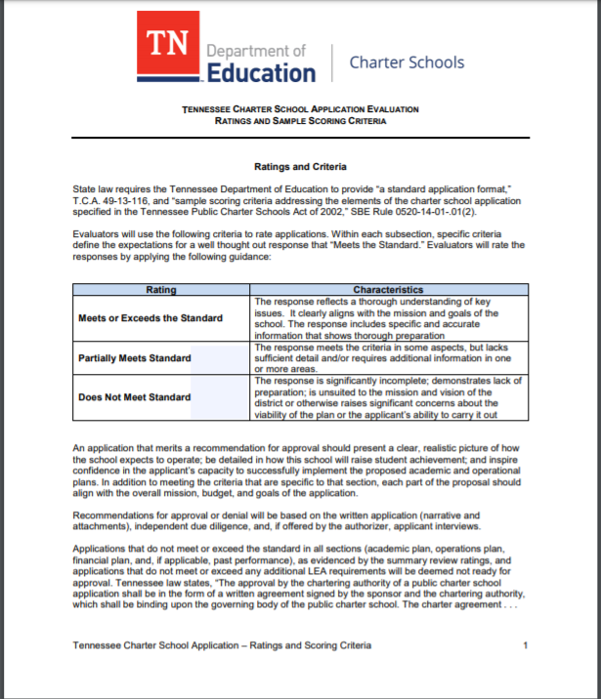
TNDOE Application scoring rubric
The Commission may overturn an appeal if:
It finds that the application meets or exceeds the metrics outlined in the application scoring rubric, and
The approval of the application is in the best interests of the students, LEA, or community.
Notes:
[SCRIPT TO BE ADDED]

Slide 31
What are staff/evaluators looking for?
Internal alignment
Cohesion of elements
Mission/vision connected
External validation
Evidence based
Demonstrated track record
Sufficient detail
Practicality
Capacity
Notes:
[SCRIPT TO BE ADDED]

Slide 32
Due diligence
Staff may verify information provided by charter applicants and collect and evaluate additional information to determine the applicant group’s capacity to run a quality school in the district of application.
Notes:
[SCRIPT TO BE ADDED]

Slide 33
Core elements of a quality de novo review
TNDOE Charter Application*
TNDOE Application Scoring Rubric*
Due Diligence
Capacity Interviews
Evidence-based recommendations
Internal & External Evaluators
Open Meeting
Authorization Decision
Notes:
[SCRIPT TO BE ADDED]

Slide 34
Purpose of the capacity interview
Staff will conduct applicant interviews to determine the following:
Is the proposed educational program sound?
Are plans sufficiently comprehensive and cohesive?
Even if the above two standards are met, are these the right people to implement the proposed program successfully?
Vet
Follow-up
Probe
Revaluate
Notes:
[SCRIPT TO BE ADDED]

Slide 35
At least 1 week prior, notice must be published in LEA’s newspaper and on Commission website
Post full application online for review
Applicant group may provide overview/ answer questions
Collect feedback on potential impact of charter on community
Hold meeting in LEA where application was submitted
Best practices and requirements for open meetings
T.C.A. § 49-13-108(B)(i)
Standard of Review
Does the application meet or exceed metrics in TNDOE’s application scoring rubric?
Is the application in the best interests of students, LEA, community?
Notes:
[SCRIPT TO BE ADDED]
Hold public hearings to allow for comments from community members about application submissions.
Tie to standard of review. Challenge of sorting through the noise and emotion.
May also want to emphasize that this will likely be a staff driven function.

Slide 36
Evidence-based recommendations from staff
Internally Aligned
Cohesion of elements
Externally Validated
Evidence based
Mission/vision connected
Demonstrated track record
Consider ALL Information
Full application and attachments
Due Diligence
Public Hearing Commentary
Capacity Interviews

Slide 37
Authorization decisions
What the appeal recommendation report contains:
Recommendation to the Commission to approve or reject appeal
Analysis of strengths/concerns
What the appeal recommendation report does not contain:
A decision
Standard of Review
Does the application meet or exceed metrics in TNDOE’s application scoring rubric?
Is the application in the best interests of students, LEA, community?
Does the school have a negative fiscal impact on the LEA contrary to best interests of students, LEA, community?
Notes:
[SCRIPT TO BE ADDED]

Slide 38
NACSA’s Analysis: Reasons for 1st year closures
Low enrollment & Failure to Pay Obligations
2/3 of all closures
Unapproved & Unsuitable Facility
Facilities differ from application-stated facilities
Not meeting health and safety requirements
Ineffective Relationships with Management Organizations
Management company financial collapse
Financial dependence on mgmt company
Improper Policy & Operational Decision-Making
Not conducting criminal background checks
Not identifying ELLs
Notes:
Why are quality decisions important? School closure. NACSA’s own analysis revealed 4 broad reasons for 1st year closures.

Slide 39
What questions can we answer?

Slide 40
5 min break

Slide 41
Performance Contracting and Ongoing Evaluation
Measure what you value (or you’ll only value what you measure)
Notes:
Commissioners will:
• Understand staff’s responsibilities for evaluating school performance data in relation to the charter school contract.
• Identify the types of school performance information and issues Commissioners will receive from staff.
• Orient to TNDOE’s Performance Framework and SBOE’s Performance Framework.

Slide 42
Commissioner key roles – performance contracting
Agency Commitment & Capacity
Application Process & Decision Making
Performance Contracting
Revocation & Renewal (Appeal) Decision Making
Ongoing Oversight & Evaluation
Commissioner
Executes a charter contract with a legally incorporated governing board independent of the authorizer.
Ensures mutual understanding and acceptance of the terms and performance expectations of the charter contract by the school’s governing board.
Notes:
[SCRIPT TO BE ADDED]
Important to note there that performance contract is where performance expectations are laid out

Slide 43
Commissioner key roles – ongoing evaluation & oversight
Agency Commitment & Capacity
Application Appeal Process & Decision Making
Performance Contracting
Revocation & Renewal (Appeal) Decision Making
Ongoing Oversight & Evaluation
Commissioner
Reviews annual school performance reports and any intervention actions (as relevant)
Articulates and enforces stated consequences for failing to meet performance expectations or compliance requirements.
Notes:
[SCRIPT TO BE ADDED]

Slide 44
Staff monitor schools throughout the year
Establish Expectations
Monitor Performance
Intervene (if necessary)
Decide Renewal
Pre-opening
Ongoing reporting
Intervention protocol
Renewal application and process
Charter contract
TNDOE Performance Framework
Site visits
Notes:
[SCRIPT TO BE ADDED]

Slide 45
TNDOE/SBOE performance framework helps staff to answer 3 questions:
Academic Performance
Is the educational program a success?
Financial Performance
Is the school financially viable?
Organizational Performance
Is the organization effective and well run?
Notes:
[SCRIPT TO BE ADDED]
Also, the State Board has a performance framework (which is close to the model framework) and the Commission will need to renegotiate are they using that PF or changing it with their schools.

Slide 46
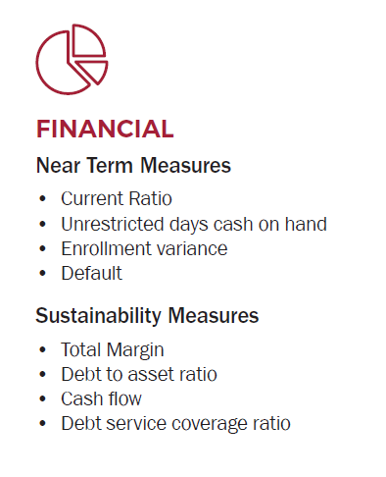
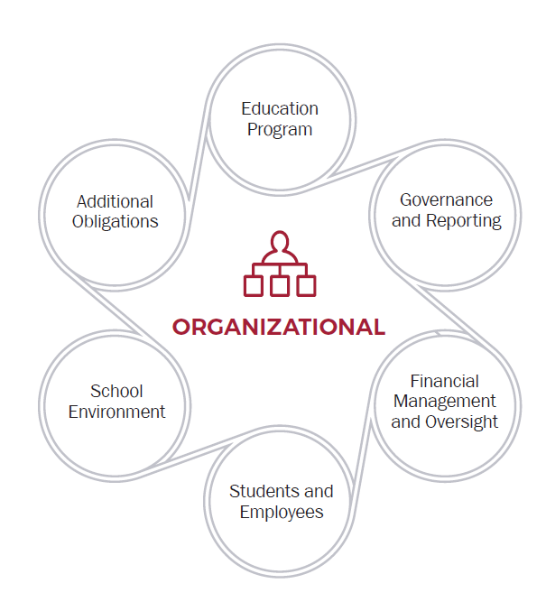
Monitoring performance –
What do staff measure?

Slide 47
Monitoring performance: Staff’s toolkit
Pre-Opening Checklist/ Protocol
Reporting Timeline
Desk Audits
Site Visits
Annual Reports
Notes:
[WEBEX AUTO POLL]
“Which tool would provide the most useful information about a school’s performance for a Commissioner?”
Pre-opening checklist
Reporting timeline
Desk audits
Site visits
Annual reports
Pre-opening – so the time between when you approve a school and when the school opens its doors.
Reporting timelines/desk audits – so what kind of data are you requiring schools to submit and then how are you analyzing that data?
Site visits – getting out of your offices and into the schools to really see what’s happening on the ground.
Annual reports – producing a summary of performance over the course of a school year – this helps the school, the community, and you to understanding where the school stands. Consistent annual reporting also makes your life A LOT easier at renewal time.

Slide 48
What performance information will commissioners receive from staff?
Notices of Concern
When a school is not meeting the terms of its charter contract.
Annual performance reports
Written summary/public presentation of school performance based on the standards within the performance framework.
Notes:
We have provided the State Board with: notices of concern and annual performance reports both in terms of written and a public presentation. So I think this is sufficient.
Annual performance reporting is an essential authorizing practice for effective oversight, communication with charter schools, and public accountability and transparency.
Authorizers should prepare school-specific performance reports for distribution each year.
Annual reporting is the culmination of the data collection you’ve done over the past year.
It’s a great tool for the school and it also helps keep you organized each year as you get closer to renewal.
Reason #1: It lets a school know how it’s doing.
Reason #2: Issuing annual reports, and making them publicly available, provides transparency.
Reason #3: Identify school strengths and areas for improvement (without prescribing solutions).

Slide 49
Can we answer any questions?

Slide 50
Renewal and Revocation (and APPEAL) Decision-Making
Notes:
Before we dive in, any questions/thoughts that came up during the break?
Commissioners will:
• Understand what it means to make merit- and evidence-based decisions for (1) renewals and revocations and (2) renewals and revocations on appeal.
• Orient to TNDOE’s Charter Renewal Application.

Slide 51
The commission’s dual roles
State Charter School Commission of Tennessee
Authorizer on Appeal
Authorizer
Hears appeals for:
--New starts
--Renewals
--Revocations
--(Charter Amendments *still currently with SBOE)
Monitors and oversees appealed school:
--Openings
--Performance and data
--Renewals
--Revocations/School closures
Starting SY 2020-2021
Notes:
[SCRIPT TO BE ADDED]
Emphasize dual roles for renewal on appeal and regular renewal process as authorizer.

Slide 52
Commissioner key roles – revocation & renewal (and APPEAL) decision-making
Commissioner
Receives recommendations and appeal recommendations from staff.
Revokes a charter during the charter term if evidence of extreme underperformance or violation of law. (TN Quality Authorizing Standards)
Grants renewal only to schools that have achieved the targets stated in the charter agreement. (TN Quality Authorizing Standards)
Agency Commitment & Capacity
Application Appeal Process & Decision Making
Performance Contracting
Revocation & Renewal (Appeal) Decision Making
Ongoing Oversight & Evaluation
Notes:
[SCRIPT TO BE ADDED]
Is the decision in contrary to T.C.A. 49-13-122

Slide 53
Renewal decision-making
“A quality authorizer grants renewal only to schools that have achieved the standards and targets stated in the charter agreement, are organizationally and fiscally viable, and have been faithful to the terms of the contract and applicable law.
-Tennessee Quality Authorizing Standards
Notes:
[SCRIPT TO BE ADDED]

Slide 54
Renewal best practices
Staff should:
Use the TNDOE’s Charter School Renewal Application as part of a fair and transparent process.
Provide each school a public, cumulative performance report prior to the school’s renewal application, which states the authorizer’s summative findings concerning the school’s performance and its prospects for renewal.
Notes:
[SCRIPT TO BE ADDED]

Slide 55
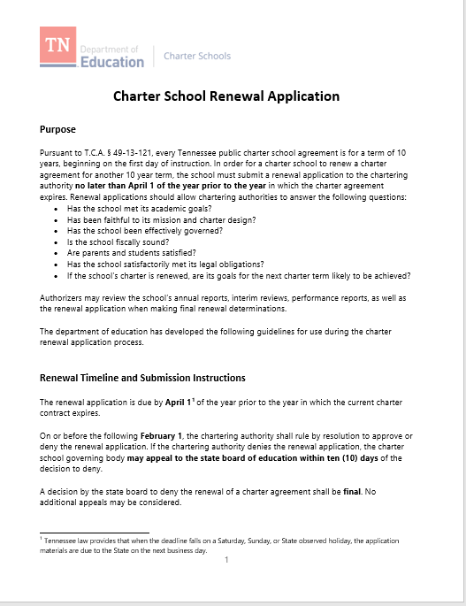
TN DOE Charter school renewal application
Notes:
[SCRIPT TO BE ADDED]

Slide 56
The Commission as “Authorizer”:
Renewal process steps
Staff compiles body of evidence on school performance
(3 months prior)
School submits renewal application
by April 1
Renewal Recommendation from staff
(based on body of evidence and performance expectations in contract)
Renewal Decision
By February 1
Notes:
[SCRIPT TO BE ADDED]

Slide 57
The commission as “authorizer on appeal”
Renewal Appeal Process – starting December 31, 2020
Appeal to Commission
10 days after local board’s decision
Commission shall become authorizer if overturns decision
If approved - 10 year charter term
A denial on appeal is final and not subject to appeal
Standard of Review
Is the application in the best interests of students, LEA, community?
Notes:
QUICK REFRESHER

Slide 58
Revocation and revocation on appeal
Notes:
Any questions/thoughts that came up during the break?
Add questions at the end of each section?

Slide 59
QUICK POLL – type in the chat box
“When do most school closures occur?”
During renewal
Outside renewal (i.e. mid school year)

Slide 60
Commissioner key roles – revocation & renewal (APPEAL) decision-making
Commissioner
Receives recommendations and appeal recommendations from staff.
Revokes a charter during the charter term if evidence of extreme underperformance or violation of law. (TN Quality Authorizing Standards)
Grants renewal only to schools that have achieved the targets stated in the charter agreement. (TN Quality Authorizing Standards)
Agency Commitment & Capacity
Application Appeal Process & Decision Making
Performance Contracting
Revocation & Renewal (Appeal) Decision Making
Ongoing Oversight & Evaluation
Notes:
[SCRIPT TO BE ADDED]
Is the decision in contrary to T.C.A. 49-13-122

Slide 61
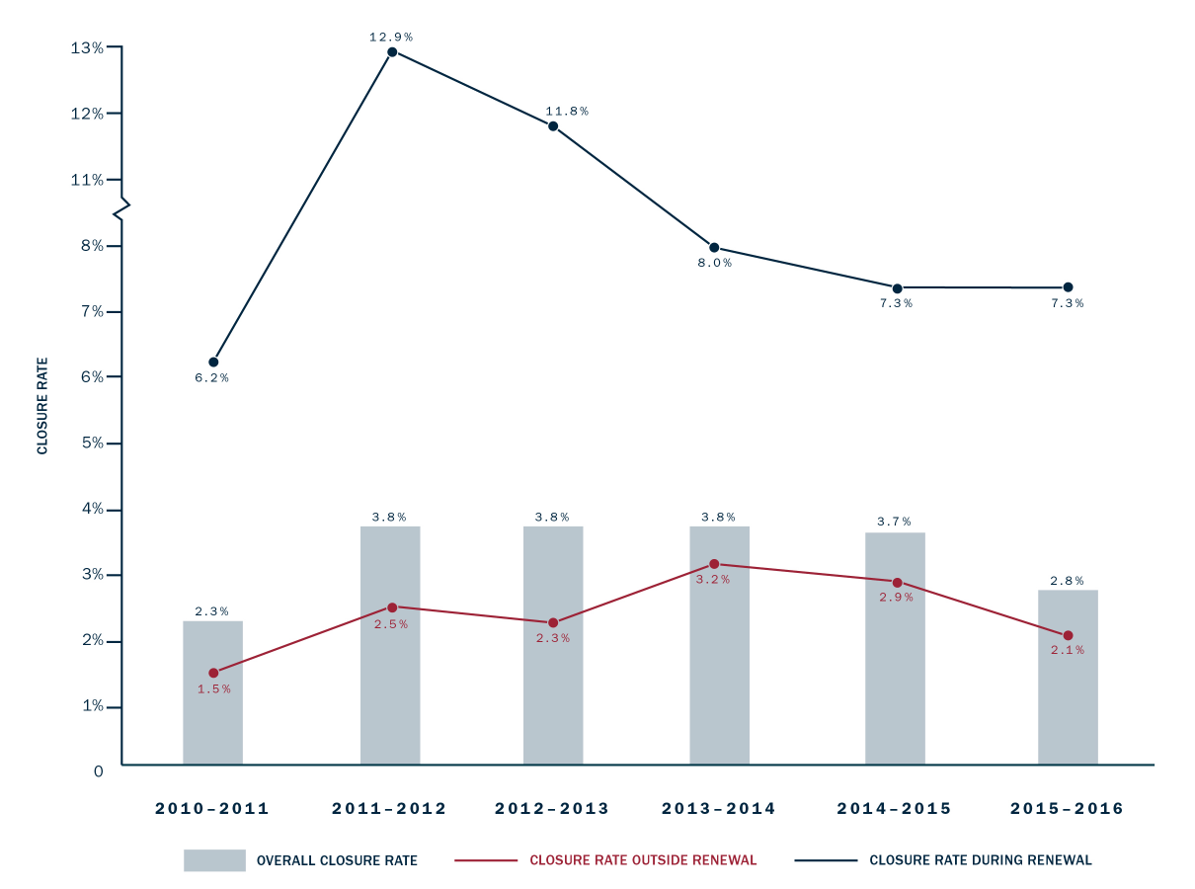
Most school closures occur during renewal
Notes:
[SCRIPT TO BE ADDED]

Slide 62
The commission as “authorizer on appeal”
Appeal to Commission
10 days after local board’s decision
De novo review
Commission *does not* become authorizer if overturns
Commission’s decision is final and not subject to appeal
Public hearing
Within 60 days of receipt of appeal
Revocation Appeal Process – starting December 31, 2020
Standard of Review
Is the decision contrary to T.C.A. § 49-13-122?
Notes:
QUICK REFRESHER

Slide 63
The Commission as “authorizer”: revocation criteria
Committed a material violation of any conditions, standards, or procedures in charter agreement
Failed to meet or make sufficient progress toward the performance expectations set forth in the charter agreement
Failed to meet generally accepted standards of fiscal management
Notes:
[SCRIPT TO BE ADDED]
The Commission can revoke a charter school agreement if the school

Slide 64
The “why” of authorizing work
Notes:
[SCRIPT TO BE ADDED]

Slide 65
Thank you! We look forward to your feedback on our survey

