Slide 1
SMART Goal Overview 2019-2020
Training Plan
Facilitator information
Facilitator timing on each slide.
Total time: 60 minutes without root cause example.
Facilitator notes on each slide
Be aware of:
Timing. There is a lot of content for this month. Ensure that conversations stay on track and on the objectives. Top priorities – make sure advisory councils are updated and explore CLNA Guide
‘How it used to be’. We need to model the Perkins V way – yes it is different. It is OK to connect to Perkins IV for those who need the connection, but be aware of spending too much time on this.
Root Cause. We are starting the conversation with root causes. Encourage directors to work with their counterparts in their district who have gone through training with other CORE staff.
Participant Printed Materials:
Agenda
CLNA Stakeholder Engagement Tracker
Bring these supplies:
Perkins V book
Small Post-its
Pens
Highlighters
Feedback to CTE
A conversation will be had between CTE and CORE Consultants prior to the Fall CTE Director Meeting to identify areas of understanding and possible areas of additional focus.

Slide 2
Comprehensive Local Needs Assessment
CLNA

Slide 3
Objectives for Today
By the end of the meeting, CTE directors will be able to:
Identify key stakeholders for engagement in CLNA.
Explain the importance of the CLNA in relation to the local application.
Identify the five sections of the CLNA.
Notes:
2 min | Information Sharing slide
Say: “Today is going to be a busy but good day…” review objectives.

Slide 4
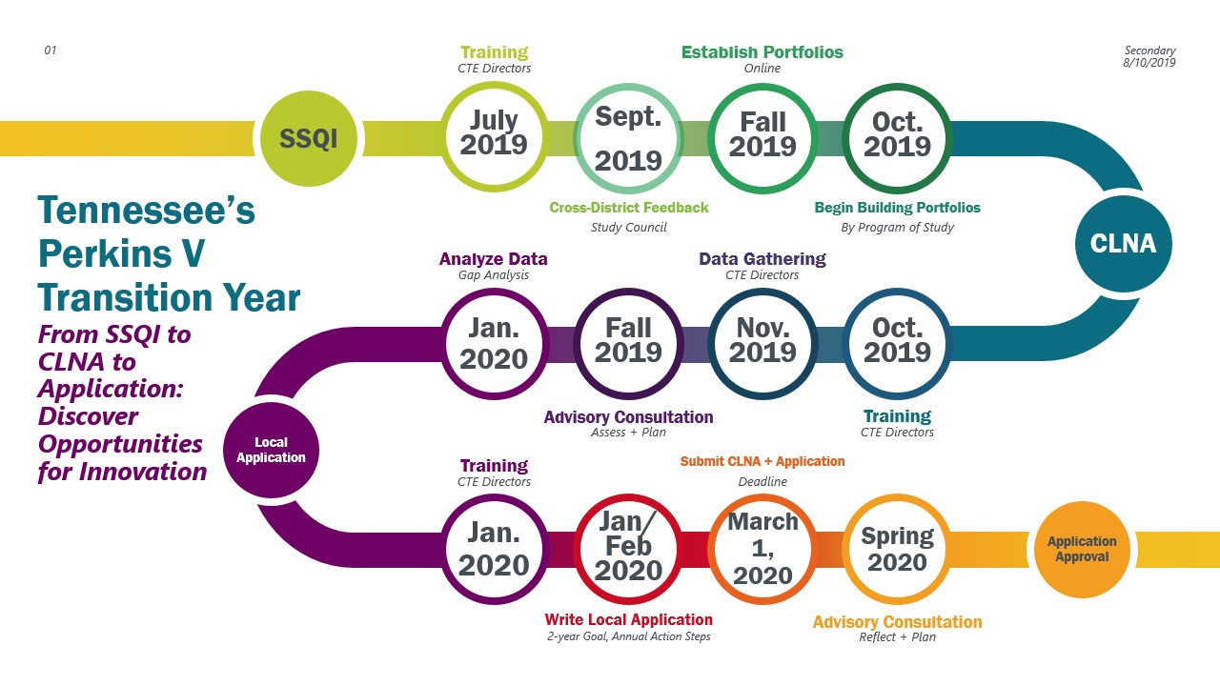
Tennessee’s Perkins V Transition Year
Notes:
3 min | Information Sharing slide
Review this new graphic with directors. Note that during this meeting we are growing on the size, scope, and quality indicators to turn and focus on the local needs assessment, which will inform all goals in future local applications.

Slide 5
CLNA
Perkins V legislation
Section 134(c)
Must be completed at least every two years
Purpose
Identifies areas of strength in CTE system and programs of study.
Identify areas of weakness and gaps in CTE system and programs of study.
Informed and validated by stakeholders and partners.
Notes:
5 min | Information Sharing slide
The requirement for the CLNA is referenced on the following pages of the Perkins V book.
Page 39 | narrative from Brustein with references to law
Page 209 | beginning of the law, section 134(c)
The last bullet point is pivotal to get across. Below

Slide 6
CLNA + Advisory Councils
Minimum required members of advisory councils
Representatives of CTE education programs in LEAs
Secondary teachers and administrators
Postsecondary teachers and administrators
Career and academic counselors
School leaders
Specialized instructional support staff
State, regional, or local workforce development boards
Local or regional business leaders
Parents and students
Representatives of special populations
Representatives of agencies serving out-of-school youth, homeless children and youth, at-risk youth
Representatives of Indian tribes and tribal organizations, as appropriate
Notes:
5 min | Information + Activity Slide
Activity: Have this slide printed. Give participates 1-2 minutes to identify members that are not currently represented on their advisory councils. Some answers may include: counselors, parents/students, representatives of special populations (beyond special education), representatives of agencies serving out-of-school youth, homeless children and youth, and at-risk youth, representatives of Indian tribes and tribal organizations.

Slide 7
CLNA + Advisory Councils
Strategies for traditionally marginalized
Utilize local chambers as intermediaries
Reach out to economic development agencies
Ask for assistance from postsecondary partners
Utilize WIOA to initiate conversations
Student focus groups
Having conversations with special education students and teachers
Electronic surveys of all county stakeholders
Engaging with middle school administrators
Notes:
5 min | Information Sharing Slide
This information comes directly from the questions asked after September’s Study Council regarding stakeholder engagement. As we review the comments left by your peers, make note of strategies you can use to reach out to those that have not previously been on your advisory councils and/or have been marginalized.
Survey Question 1: What strategies have you taken to reach stakeholders who are traditionally been marginalized and the new stakeholders identified in Perkins V? How have you diversified and expanded the voices at the table? What have you gained from these efforts thus far?

Slide 8
CLNA + Advisory Councils
Takeaways to-date
Excited about CTE programs of study and reviewing POS with labor market data
Dig deeper into all areas of workforce preparation and program of study development
Advise on employability skill needs
Stakeholders have a shared vision of wanting a strong educational community
Notes:
5 min | Information Sharing Slide
This information comes directly from the questions asked after September’s Study Council regarding stakeholder engagement. Here are some takeaways that your peers who have expanded their advisory councils have heard back from their stakeholders.
Survey Question 3: What are the most important takeaways you have gotten from stakeholder engagement to date?

Slide 9
CLNA
Connection to Local Application
Supports data-driven decision making
Support more closely aligned planning, spending, and accountability activities
Results of CLNA must form the foundations of the local application and drive spending decisions.
Seamlessly connect to the strategies and activities outlined in the local application
Notes:
5 min | Information Sharing Slide
Note:
You can not stress strongly enough the last two points. The CLNA will inform the goals, action steps, and spending of funds in the local application. There will be no deviation or exception. It must connect – and connect clearly.

Slide 10
CLNA Guide Overview
Purpose:
provide questions that LEAs will respond to within ePlan as part of the overall local application.
Identify data sources that can be used to answer questions
Layout
Five sections
State provided data
LEA provided data
Questions to be answered in ePlan
Deep Dive Questions
Stakeholder Engagement
Notes:
3 min | Information Sharing Slide

Slide 11
Section 1 | Performance
Purpose: Evaluation of your learners’ performance on state accountability measures in the aggregate and disaggregated by race, gender, migrant status, and special population groups.
Data Source(s): Core Indicator Report
Number of Required Questions: 3
Notes:
5 min | Exploring Slide
Using the CLNA Guide, review the questions in section 1.
Activity: Have participants identify at least one question where they need input from advisory council members.
Possible answer(s):
Question 2 – need input/information/solutions from counselors
Question 3 – need input/information/solutions from special population representatives

Slide 12
Section 2 | Justify Alignment
Purpose: In this section, Perkins V requires LEAs to evaluate their programs of study, as a whole and individually, to address industry demand, student need, and meet the definition of “size, scope, and quality.”
Data Source(s): regional labor market data, local labor market data, LEA POS offered, middle school course offerings and enrollment, CTSO members, WBL participation
Number of Required Questions: 7
Notes:
5 min | Exploring Slide
Before investigating this section further, make the connection to the SSQI indicators. Note that this section is looking at size, quality, and alignment. The connection to the SSQI is strong though the vocabulary switches out scope/alignment. Note that the last question is looking at the SSQIs.
Using the CLNA Guide, review the questions in section 2.
Activity: Have participants identify at least one question where they need input from advisory council members.
Possible answer(s):
Question 2 – counselors and industry partners
Question 3 – counselors
Question 6 – counselors
Question 7 – postsecondary partners

Slide 13
Section 3 | Growth Opportunities
Goal: Evaluate alignment between programs of study offered and labor market needs of the local area and region – now and in the future.
Data Source(s): regional labor market data, local labor market data, LEA POS offered, middle school course offerings and enrollment, CTSO members, WBL participation
Number of Required Questions: 5
Notes:
5 min | Exploring Slide
Using the CLNA Guide, review the questions in section 3. As a reminder, Perkins IV was focused on sustaining programs, Perkins V is focused on innovation. This is highlighted best in this section. Here, LEAs will use data to forcast shifts in workforce needs and then develop long-term plans to meet those needs. This could identify programs that need to be phased out and new programs to bring on board. When used to the fullest, this section will help guide the conversation of planning for those changes to support the labor market needs.
This section will rely heavily on industry partners, workforce boards, and similar members of the advisory council.

Slide 14
Section 4 | Recruitment, Retention, and Training of Educators
Goal: Assess and develop plans to improve quality of staff through recruitment, retention, and professional development, with particular attention paid to diversity in the profession
Data Source(s): teacher history, teacher earned certifications, teacher professional development hours and activities.
Number of Required Questions: 3
Notes:
5 min | Exploring Slide
Using the CLNA Guide, review the questions in section 4.

Slide 15
Section 5 | Access and Equitable Participation
Goal: Evaluate progress in providing equal access to CTE programs, particularly CTE programs that lead to strong positive outcomes for learners, and in providing CTE in ways that maximize success for special populations, especially in programs of study leading to high-skill, high-wage, or in-demand industry sectors or occupations.
Data Source(s): Core Indicator Report
Number of Required Questions: 4
Notes:
5 min | Exploring Slide
Using the CLNA Guide, review the questions in section 5.

Slide 16
Why Conduct a Root Cause Analysis?
A root-cause analysis attempts to identify the underlying factors that explain why a performance gap exists. It:
Identifies factors that are within the school or district’s control to act on, and if addressed, would result in improved performance
Helps target strategies to address the root causes behind gaps and school/student needs
A strong root cause analysis should:
Be based on data
Involve the team of leaders developing the plan
Keep asking why until getting to the source of the problem
Notes:
3 min | Information Sharing Slide
This month we will explore the idea of Root Cause Analysis. How familiar are directors with root cause analysis? While there are a number of slides for this section, the intention for this session is to introduce the idea and start a conversation. We will practice at the Fall CTE Director’s Meeting. The expectation is that each district do at least one root cause analysis this year.

Slide 17
Overview: The 5 Whys
There are many protocols and frameworks for conducting a root cause analysis, all of which ultimately boil down to asking "why?"
“5 Whys” is an iterative process developed by the founder of Toyota in 1930s whereby teams ask “why” at least five times to identify why something is happening
5 is a rule of thumb. Key point is to stop asking “why?” when the useful responses stop coming or the solution falls outside of school control.
Notes:
3 min | Information Sharing Slide
Using the CLNA Guide, review the questions in section 5.
You have likely used different protocols and processes to conduct a root cause analysis - and many of them will lead to the same answers. Through our district planning work we have emphasized use of the 5 Whys protocol for its simplicity. In our TELN work we used the fishbone diagr

Slide 18
How to Use 5 Whys (or any protocol!) Effectively
Schools ≠ Assembly lines: Don’t expect the problem to boil down to a single root cause!
Start with hypotheses: Complex problems likely have multiple root causes; identify 2-4 distinct “why” responses and work through each separately
Prioritize: When multiple root causes exist, don’t be afraid to focus on the most important one or two and address the others later
Focus on systemic causes: Root causes should make it clear how the system can improve, not the individuals in the system.
Check the final responses: Is it within the school or district’s control or influence? If it was dissolved, would it result in improvement of performance?
Notes:
5 min | Information Sharing Slide

Slide 19
Cause Mapping

Slide 20
Goal of Root Cause Analysis
What is the goal of root cause analysis?
How might you know when to stop analyzing a problem?
How might you know when to switch gears or redirect the analysis of the problem?
Notes:
3 min | Information Sharing Slide

Slide 21
Goal of Root Cause Analysis
Strong Root Cause Analysis
Impactful Theory of Action
Strategy for Change
Addresses Root Causes
Positively Impacts Needs
Notes:
3 min | Information Sharing Slide
A strong root cause analysis should lead to an impactful theory of action.
That theory of action should help us select an aligned strategy for change.
Implementing that strategy should address the root causes.
Addressing the root causes should positively impact the areas of need.

Slide 22
Example
How are EL students performing in your CTE programs? At the recipient, career cluster, and program levels?
Where do the biggest gaps exist for this group of students?
What is the root cause of these gaps?
Notes:
OPTIONAL | 3 min | Information Sharing Slide
What data might I have asked this CTE director to bring to the conversation? How might that assist in this conversation?
Possible hypotheses I thought of ahead of time: For EL population is this potentially about Access? Instruction? Family Engagement?

Slide 23
Exploring EL Performance
EL Performance
Inadequate Differentiation of Instruction
Culture of Course Options
Scheduling into Courses
Teacher Knowledge and Skill
Counselor Knowledge and Skill
Principal Expectations
Data Access/Insufficient warning system
Notes:
OPTIONAL | 3 min | Information Sharing Slide
What stands out to you in this example?
Is this root cause focused on the greatest area of need? How do you know?
What might you do next if you were working with this leader?
Distinguish the low hanging fruit here…acknowledge when/how it could be addressed…refocus to the greater need.

Slide 24
5 Whys Example
Area of Greatest Need: Access to courses that align to high-wage, high-skill, and in-demand industry sectors and occupations
Framing Question: Why aren’t students enrolling in courses that align with high-wage, high-skill, and in-demand industry sectors and occupations?
 | Hypothesis 1 | Hypothesis 2
Why? | Counselors don’t know about the courses | Desire to maintain “legacy” programs over creation of new programs
Why? | Limited opportunities for counselors to experience the courses and understand what they offer | Principal understanding of the goals of their programs and industry needs
Why? | Lack of expectations around developing expertise in course offerings due to role expectations and other demands | Unclear communication and expectations to principals on the program goals they should be striving towards and the role of industry needs
Why? | Principal understanding of the courses and the goals of their programs | District vision for the program goals and alignment to industry needs has not been clearly communicated
Enrollment structures aren’t supporting enrollment in these courses
Courses aligned to high-wage, high-skill, and in-demand industry sectors and occupations are limited
Notes:
OPTIONAL | 3 min | Information Sharing Slide
Second example- using the 5 whys protocol
What are the strengths of this analysis? What are the gaps?
When and how might this protocol be helpful?

Slide 25
Access to Courses that Align to High Wage, High Skill Employment Opportunities
Course Access
Enrollment Structure
Data Access
PL Opportunities
Principal Expectations
Principal understanding of industry
Understanding of program goals
Role Expectations
Limited Options @ schoosl
Time Use
Notes:
OPTIONAL | 3 min | Information Sharing Slide
One of the things I did as a coach was to label and synthesize the director’s thinking…I paraphrased a lot…you said…let’s call that…does that sound right?

Slide 26
Theory of Action
If we build principals’ vision for high quality CTE programming, then
they will provide more courses that align with high skill, high wage employment opportunities;
they will redefine the role of the school counselor to support enrollment in these courses; and
they will plan for the resources and people needed to support increased enrollment in these courses.
Notes:
OPTIONAL | 3 min | Information Sharing Slide

Slide 27
Strategy: Principal Vision Cohort
Develop a cohort of 4 principals (School A, School B, School C, School D) to co-develop a new vision for CTE programming and goals.
Take the 4 principals on tours of high performing programs.
Debrief tours to identify characteristics of high quality CTE programs.
Provide training to 4 principals on current industry needs in the area.
Work with 4 principals to generate vision for CTE programming and course offerings.
Support 4 principals in creating school plans for redesigning program offerings based on new vision.
Include activity for redesigning the role and expectations of the counselors.
Notes:
OPTIONAL | 3 min | Information Sharing Slide
CTE Director decided to start small so he could potentially leverage these leaders and possibly exemplar programs they create together to scale these improvements district wide in the future.

Slide 28
Don’t Have to Ask Only Why
What do you think is contributing to low performance for this group of students?
What is creating a barrier in counselor’s abilities to enroll students in these courses?
What might need to change to help counselor’s better understand the programs that are available?
What is contributing to that mindset?
Is this true for just this student group or is this a larger issue?
Notes:
3 min | Information Sharing Slide

Slide 29
Goal of Root Cause Analysis
Strong Root Cause Analysis
Impactful Theory of Action
Strategy for Change
Addresses Root Causes
Positively Impacts Needs
Notes:
3 min | Information Sharing Slide

Slide 30
What’s Next
Fall CTE Director Meeting
November 5, Music City Center in Nashville
Receive data and how-to-use data guide
Advisory Council Engagement
Develop an actionable plan to engage with all your stakeholders in the appropriate sections of the CLNA.
Work on your CLNA
Partner with your district planning partners to conduct root cause analysis
Word document available in ePlan document library
Answers and advisory council members will be submitted via ePlan during the local application

