Slide 1
CDBG Application Workshop for Application Preparers
2022 Regular Round
December 15, 2021

Slide 2
Program Staff
Community and Rural Development Staff
Brooxie Carlton, Assistant Commissioner
Kent Archer, CDBG Director
Tracey Davis, Grants Coordinator
Allison Fox, Grants Analyst
Lee Peterson, Grants Analyst
Jill White, Grants Analyst
Lindsay Gainous, ARC Program Coordinator

Slide 3
Schedule
Final change orders due February 25, 2022
Final RFPs due March 11, 2022
Closeouts due March 18, 2022
Public Meetings held by March 4, 2022
Applications due April 15, 2022
Account for holidays
January 18: Martin Luther King Jr. Day
February 15: President’s Day

Slide 4
Changes for 2022
Revised Community Need Score (still 100 pts)
2019 ACS PCI
2022 Target Area PCI / 2019 ACS PCI (Census)
3 Year Unemployment Rate (7/18 – 6/21)
2019 ACS Poverty Rate
Water and Sewer System applications limited to 2,500 residential connections and fewer
No large and small population for system applications
No Water or Sewer Line Extension applications this year
System applications will cap at 30% of total funding

Slide 5
Changes for 2022
Community Livability has been revised to three new categories:
Community Infrastructure
Community Revitalization
Public Health and Safety
Applications that will be Exempt environmentally if funded will complete a form to submit with the application.
Reduction in work means ERR for Exempt projects will not be reimbursable
All applicants funded in 2021 are not eligible for the 2022 application round.

Slide 6
Process
Online application; same as last year
Working on application now
Jurisdiction calculations are in Excel again
New Community Need score
New eligible projects
Restrictions this year for water and sewer
Use this and the Application Notices (to be published in the coming weeks) as a guide
NOTE: If any information is inconsistent, the information in the Application Notices will supersede.

Slide 7
Jurisdictional Calculations
Six different options
Single Jurisdiction (Direct Beneficiary)
Single Jurisdiction (Indirect Beneficiary)
Multi-jurisdiction, One County (Direct Beneficiary)
Multi-jurisdiction, One County (Indirect Beneficiary)
Multi-jurisdiction, Multiple County (Direct Beneficiary)
Multi-jurisdiction, Multiple County (Indirect Beneficiary)
Read instructions on each sheet
Information can only be entered in blue fields
Sheets to be completed are in green
Reference and informational sheets are in black

Slide 8
Title Page
Same as previous year
ATP is auto-filled based on the first entry on the Beneficiary sheet
Sign and scan. Issues with digital signatures

Slide 9
Beneficiary Information
List the applicant jurisdiction first
Each jurisdiction must qualify through Census or Survey
This will drive PCI calculations
LMI calculations will auto-fill for indirect; must be manually entered for direct
Project Impact calculations will show at the bottom
If MJ do not double count population
NOTE: Contact ECD for anything other than city or county (i.e. Census Tract)

Slide 10
PCI Worksheet
PCI and points will auto-calculate
PCI points for Census will be the same for 2019 and 2022
If reusing Target Area Surveys from a previous year, the target area PCI score from that year will be used.
Community Need score will show at bottom

Slide 11
PCI Calculations (MJ only)
No information is entered on this page
Everything auto-calculates
Information is dependent on Beneficiary sheet
Weights PCI points based on Census or Survey and percentage of beneficiaries

Slide 12
Unemployment Rate (MJ multi-county only)
Similar to PCI Calculations
No information is entered on this page
Everything auto-calculates
Information is dependent on Beneficiary sheet
Weights UE points based on percentage of beneficiaries

Slide 13
TASS
Complete the sheet based on the target surveys
A separate TASS must be completed for each target area plus and overall TASS
Follow the directions on the sheet to create a copy
Additional auto-calculation at bottom for LMI persons if using Census
LMI percentage for total persons and total households must be at least 51%

Slide 14
Racial Breakdown
This has been altered to separate race and ethnicity
Hispanic is not a race
The total of Hispanic and Non-Hispanic should equal the racial total
Enter the values for all races, not just minorities
Must add up to Total Persons in box CC
A flag will appear if the totals don’t match

Slide 15
LMI Breakdown
Nothing new here
Total should equal Box DD on TASS
30% may not be available if using Census

Slide 16
Rate Factor
This is dependent on the Beneficiary sheet
Rate factor will now be calculated off the Census PCI
Utility rate is all that needs to be entered

Slide 17
Map Survey Form
Totals will auto calculate at top
Use the one form for all target areas
Complete all fields for each line
“Survey Number” should correspond with the unique number on each income survey

Slide 18
Online Application
If you are new, you must create a username and password to submit applications
Previous users should still be active
Can start applications and pick up later
Can manage multiple applications
Will upload attachments in system

Slide 19
Page 1 - Online Application
General items stay the same
Application information
Project Funding
ThreeStar community
Enter the base ATP rate. The reductions will be applied automatically
Brief project description
One or two sentences
Refer to scopes of previous contracts
Beneficiary Information
Total people, should match Beneficiaries tab in workbook

Slide 20
Page 2 – Project Narrative
Project description
What the project will accomplish, and what problem will be solved?
Note anything unusual
Tell us how this fits with prior projects, other current projects, and any projects in the future (not only CDBG) – show that you are strategic
Do not copy narrative from technical document
Be specific describing economic development
Job creation or loss
Sites passed over
Inability to expand
Provide backup documentation

Slide 21
Page 3 – National Objective
Clearly explain how the selected National Objective is being met
If LMI benefit is selected
How is LMI met?
Census
Target Area Survey
Both
If using Target Area Survey
Explain the randomness methodology
Contact information for those who conducted surveys
Dates or date range surveys were conducted

Slide 22
Page 4 – Benefit to Minority Populations
Discuss how the proposed project benefits minority populations within the service area.
Are there areas of minority concentration?
Are there any adverse or negative impacts?
Could another project have provided more benefit?
Why was this project selected over others?
Use PolicyMap https://www.policymap.com/newmaps
Discuss how minority populations were engaged during project selection.
Were additional actions taken to encourage participation at the public meeting? If so, what actions?
Were any other actions or outreach undertaken?

Slide 23
Page 5 – HCD Needs and Initiatives
Describe housing needs and how they are being addressed
Do not only include funding actions
Are any policies or community initiatives underway?
Are any non-profits addressing housing needs?
Describe community development needs and how they are being addressed
Do not only include funding actions
Are any policies or community initiatives underway?
Are any non-profits addressing community development needs?

Slide 24
Page 5 – HCD Needs and Initiatives
Does the community have any plans or planning underway?
How do they fit in with the HCD Needs?
How do they fit in with the proposed project?
Describe needs to LMI, disabled, elderly, and other underserved and underrepresented populations.
This is not the same as the Benefit to Minority Populations
How these needs being met?

Slide 25
Page 6 – Performance Measures
Improvements toward more standard measures
At least one measurable output and outcome to be measured over the life of the project is required
Options contingent of project type
Output - This is a measure of the direct result of the grant funds.
Outcome - This is a quantitative measure of how the project is impacting a goal of the community.

Slide 26
Page 7 – Construction Information
If a construction project tell us length of construction in months (not length of grant)
If not a construction project enter “0”
Indicate level of construction inspection

Slide 27
Page 7 – Property Acquisition
Will the project require any acquisition of property?
What is the estimated cost of acquisition?
Are there any unique details related to acquisition?

Slide 28
Page 8 – Additional Information
Year of most recent audit
FEIN
DUNS
SAM ID

Slide 29
Page 9 – Contact Information
Local Elected
Application Preparer / Administrator
Engineer / Architect

Slide 30
Page 10 – State Legislators
State Senator
State Representative
Other State Legislator
* Do not include U.S. Congressional members or Senators

Slide 31
Page 11 – App Documents and Submission
List of additional documents that must be included with the submission of the application
Additional documentation upload
Application “Save” or “Submit”

Slide 32
Additional Documents
The CDBG Anti-displacement Plan is a separate document
2022 Budget Template
Equipment $5,000+ goes in Capital Purchase
Equipment under $5,000 goes in Other Non-Personnel
Permit costs should go in Other Non-Personnel
Remember to include costs on Budget Detail tab
* Disclosure Report (HUD-2880) no longer required

Slide 33
Additional Documents
Procurement letters
Use up-to-date letters
Send to firms with a reasonable expectation to do the work
Jurisdiction maps
Must show project location (similar to ERR maps)
Must show target areas
Show jurisdictional boundaries
Minority Concentration maps
Not needed for water/sewer system-wide projects;
Important for DB applications; scale should be appropriate
Show project location
Must include all non-white populations

Slide 34
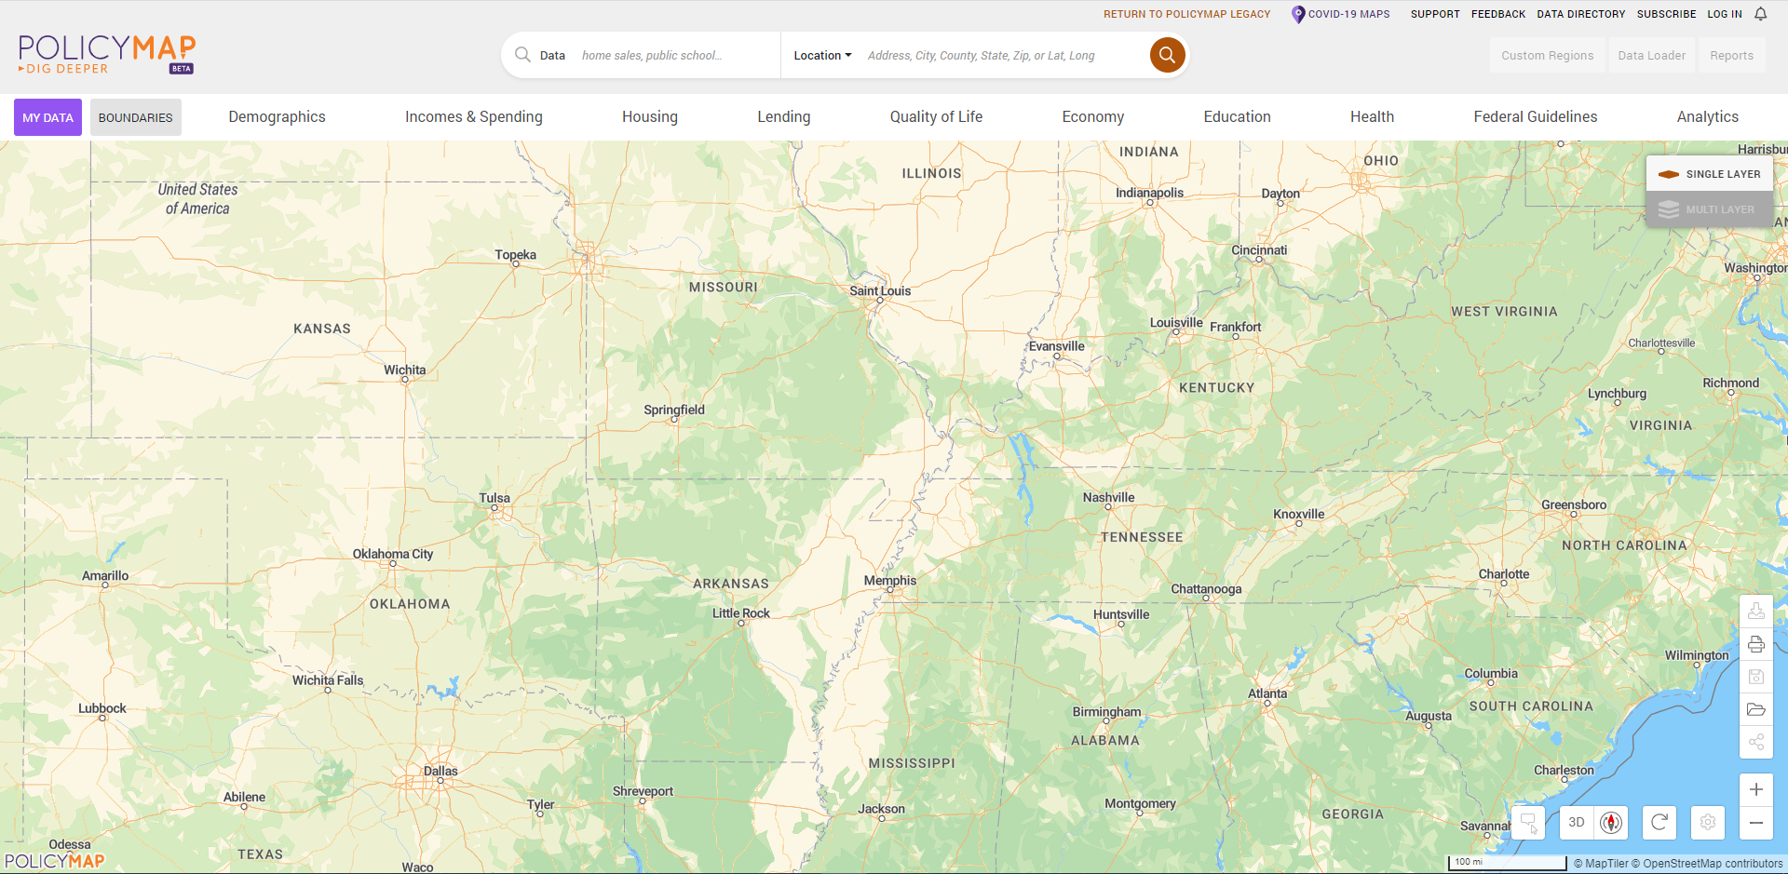
Minority Concentration Map
https://www.policymap.com/newmaps

Slide 35
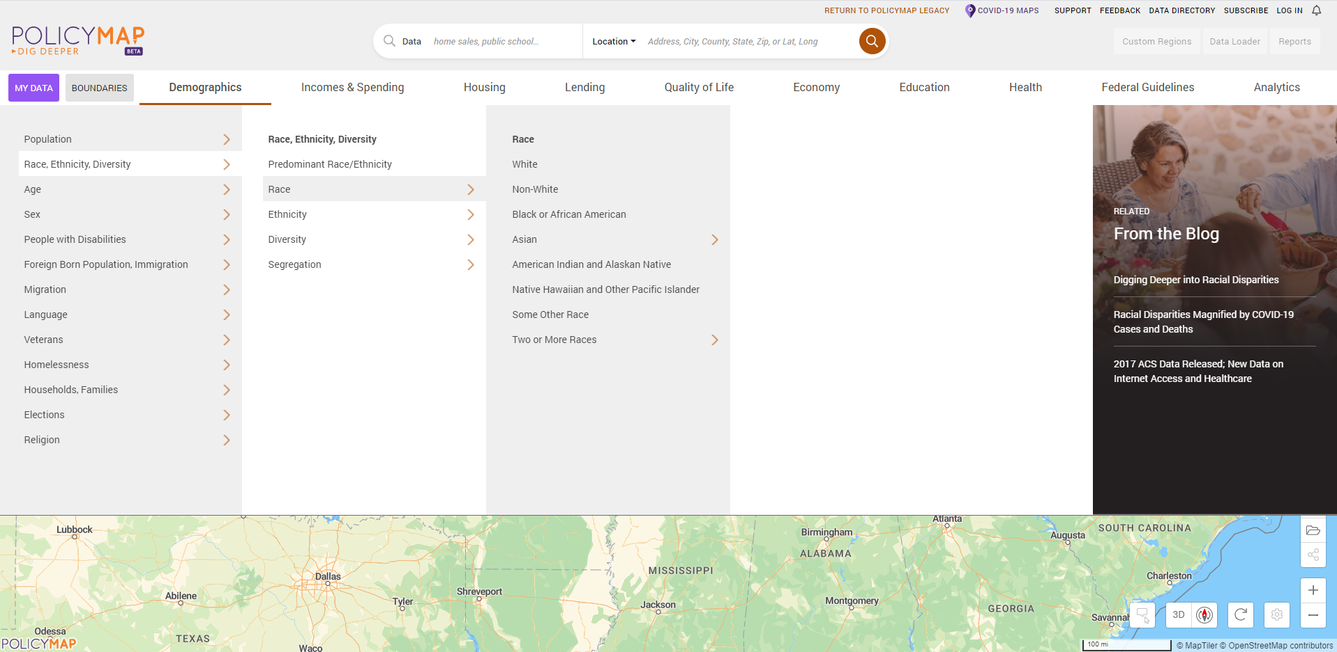
Minority Concentration Map
Select Non-White population under Demographics
1
4
2
3

Slide 36
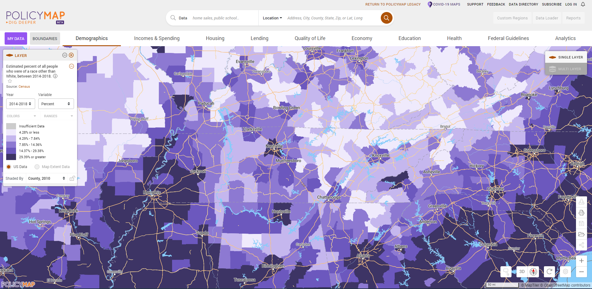
Minority Concentration Map
Zoom to the appropriate level for the application or use the search bar

Slide 37
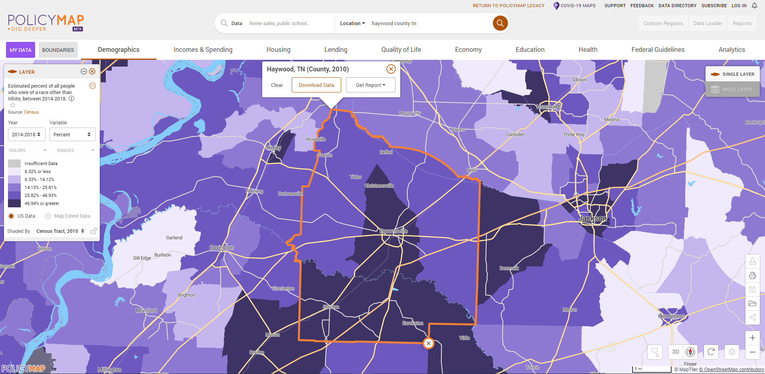
Minority Concentration Map
Select the most granular level of geography
(Block group for SJ or MJ One County)

Slide 38
Additional Documents
Utility Letters
Must be filled out and signed by the Utility Manager
Even if system is owned by the city, the utility manager needs to sign
Still base the rates on 5,000 gallons of water/wastewater
Include taxes and fees where applicable
Rate structure must be included
Show rate calculations with tax as a separate line (include tax rate)
Resolutions must be passed prior to submission
Avoid exact match amounts if able
Make sure language is up to date
* Applications without executed resolutions will not be accepted

Slide 39
Public Meetings
2 ads for the application meeting, one at least 14 days before the meeting
Should be a display ad (stands out)
Submit a copy of the ad. Affidavits do not take the place of the ad
Should be in the legal section if possible
Include statement of non-discrimination
Also add information about the meeting to the city/county website and make (and document) other attempts to reach out to minorities

Slide 40
Public Meetings
Public meetings are back in-person
May also stream broadcast virtual
Make sure at least one person from the community attends
Schedule to maximize participation
Minutes
You must document feedback in the minutes
Need greater detail in the minutes
Explain the CDBG process and ask for potential projects

Slide 41
Application Process Flow
Public Meeting
Professional Services Procurement
Project development and cost estimate
Execution of resolution
Submission of application

Slide 42
Ability to Pay
New for 2022
Updated annually
Match rates still 10-30%;
4% ThreeStar reduction
Data factors:
Median household income
Poverty rate
Food stamp dependence
Unemployment rate

Slide 43
Additional Questions – Public Health and Safety
Fire Protection
Emergency Equipment/Ambulances
Communications Equipment
Buildings (EMS Stations, Clinics, etc.)
Basically, Community Livability from previous years
Seriously consider alternatives
Provide backup documentation
Lack of or sparse documentation will cost points

Slide 44
Additional Questions – Community Infrastructure
Drainage/Flood Control
Direct vs Indirect area benefits
Flooding frequency and trends
Efforts taken to mitigate or correct the problem
Other agency action
Street Projects (Local Roads Only)
How critical are the proposed streets?
Do current conditions present safety hazards?
Last time streets where resurfaced
Road studies
AADT
Efforts taken to address the problem

Slide 45
Additional Questions – Community Revitalization
Community Facilities (Community Institutions)
Direct vs Indirect area benefits
Importance as a community asset
Historic building? (N/A if new construction)
Efforts taken to address the need
Local Parks and Recreation
Direct vs Indirect area benefits
Describe problem and severity
Park plan? (Not required, but checking to see if it fits)
Efforts taken to address the need
Are safety hazards being addressed?
Other agency action
Co-benefits of the project (cont. to next slide)

Slide 46
Local Parks and Recreation Co-benefits
Applications for a local parks and recreation improvement must have at least one clearly defined co-benefit
Stormwater/flood mitigation
Community health impacts
Economic benefit
Etc.
Not just a grant to build a playground or splashpad

Slide 47
Additional Questions – Water and Sewer
Additional questions inform Project Need scoring
If a question does not apply to the project (such as failing septic tanks), an answer does not need to be provided. Scores will not be affected.
Multiple scores may be calculated, and the highest score will be applied.
Water Loss or I/I projects are not eligible for the Quality and Operations score
Include documentation as verification for points

Slide 48
Specific Projects – Water and Sewer System
Water and Sewer System projects are only eligible for systems with 2,500 or fewer residential connections
No large and small split this year
Number of connections will be collected in online applications and additional questions
Water and Sewer Rehabilitation costs must include service laterals to the property line

Slide 49
Specific Projects – Public Health and Safety
Use numbers whenever possible
Use 2-3 years of calls and amount of loss
Insurance savings for a home should be based on a $150,000 house
Provide detail to separate an application from the pack
Number of calls,
Property loss,
ISO improvement,
Age of truck
Maintenance records (not regularly scheduled)
Photographs showing condition
DON’T ASSUME WE KNOW

Slide 50
Specific Projects – Community Infrastructure
Use numbers and data whenever possible
Think and plan. What has been the traditional approach? Is there a better way?
Does project make the community more resilient or safer?
How will the improvement be sustained and maintained?
Documentation is necessary to support your narrative

Slide 51
Specific Projects – Housing Rehab
Housing
How do you choose houses – need, who will complete survey, something else?
Most successful projects are between 3 and 8 houses
Be conservative now so we don’t have to rescore later

Slide 52
General Information
Formatting
Use the Attachment Naming Standards on the website
Applications will not be reviewed until attachments are submitted using these naming standards
Reapplying
Procurement is good for 2 years
Indirect beneficiary surveys are good for at least 3 years (adjust to new PCI intervals)
Direct beneficiary surveys need to be done every year
Public meetings and resolutions need to be done every year

Slide 53
General Information
Income Surveys
All surveys are good for at least 3 year (March 2019 and newer)
Surveys are good for 4 years (March 2018 and newer) if the most recent ACS population estimates deviate less the 10% from the latest HUD published population figures.
Procurement
We are pushing for more detail in the procurement letters
List all services being procured
Engineering design
Construction inspection
System evaluation
Etc,
Submit scoring with procurement documentation

Slide 54
Project Need Scoring - Water System
100 points total
Format (1)
Measurement (2 points)
Mapping (4 points)
Planning/Repair (3 points)
Project Need (90 Points)
Source Capacity (50% – 90% or greater)
Treatment Plant Capacity (50% – 90% or greater)
Storage Capacity (150% – 59% or greater)
Water loss (Leakage) (20% – 60% or greater)
Pressure ≤20 psi (20% – 50% or greater, customers)
Quality and Operational Issues
Aging Equipment (50% - 120% or greater)
(Age / Life Expectancy)

Slide 55
Project Need Scoring - Sewer System
100 points total
Format (1)
Measurement (3 points)
Mapping (3 points)
Planning/Repair (3 points)
Project Need (90 points)
Treatment Plant Capacity (50% – 90% or greater)
Infiltration/Inflow (20% – 60% or greater)
Lift Station Capacity (450 – 800 min or greater)
(Avg run time / day)
Failing Septic Tanks (10% – 100%)
Quality and Operational Issues
Aging Equipment (50% - 120% or greater)
(Age / Life Expectancy)

Slide 56
Kent Archer
(615) 354-3591
kent.archer@tn.gov

