Slide 1

YOUTH DEVELOPMENTAL CAMP GRANT APPLICATION OVERVIEW

Slide 2

LIVE CAPTION
To access live captions:
Click the “CC” icon in the top right or bottom left corner of WebEx or your browser
This presentation will be recorded and made available.

Slide 3

YOUTH CAMP GRANT POINT OF CONTACT
440-3188
Trey King
Director of TN Strong Families & Homes
Trey.King@tn.gov
(615) 440-3188
Babs Tierno
Deputy Director of TN Strong Families & Homes
Babs.Tierno@tn.gov
(629) 224-7263
*Please hold all questions until the end of the presentation.

Slide 4


YOUTH CAMP GRANT
Purpose
Grants are awarded to non-profit institutions in an effort to build capacity for non-academic recreational programs that serve school age youth (ages 5-22) with intellectual and/or developmental disabilities.
History
This is a new one-time grant.
Grant Funding
Governor Lee and the Tennessee General Assembly provided funding to DDA to continue the initiatives of the TN Strong Homes and Families program in 2026 to serve children and youth with I/DD who are in DCS custody or at-risk.
Approximately $500,000 is available.
Special thanks to Shelby Marx for her effort in establishing these grants.

Slide 5
IMPORTANT DATES
Request for Applications | April 24, 2026
Overview of Application Process / Webinar Q&A | May 8, 2026
Application Submission Deadline | June 8, 2026
Evaluation Team completes the evaluation and submits recommendations | June 26, 2026
Notification and clarifications between the Department and prospective Grantees completed | July 10, 2026
Execute Grant Contracts | September 1, 2026
*The grant application shall be submitted no later than 4:00 p.m. (Central Time), June 8, 2026
Submit applications to:
Trey King
Director of TN Strong Families & Homes
Trey.King@tn.gov
(615) 440-3188

Slide 6


APPLICATIONS
Who should apply?
Non-profit organizations seeking to expand capacity for non-academic recreational programs that serve school age youth (ages 5-22) with intellectual and/or developmental disabilities
Data Reporting Requirement
Two reports will be required for grant recipients.
1st report due May 1, 2027
2nd report due August 31, 2027
Additional Information
Preference will be given to programs that serve youth in foster care.
W9 and IRS Determination Letter for 501c3 status should be submitted with the application.

Slide 7



PROGRAM OVERVIEW
Instructions
In this section, please provide a comprehensive overview of your program’s history and development. Please address the original program vision, how the program’s mission has adapted to modern community needs, and key milestones of the program. Provide evidence of how the camp has historically served underrepresented or high-need youth populations.

Slide 8



IDENTIFICATION OF NEED
Instructions
In this section, explain the need you have seen within your organization or community that leads you to expand a non-academic recreational disability program. Outline the number of families you have seen in need of this program, and why you believe the expansion of a program at your organization will provide non-academic recreational opportunities for children and adults with intellectual and developmental disabilities.

Slide 9




PROGRAM DESCRIPTION
Instructions
In this section, describe what services, programs, and offerings your organization will provide for school-aged individuals and families with intellectual and developmental disabilities. Explain how these services/offerings will provide non-academic recreational opportunities for the people you are serving, and where they will take place. In addition, provide an estimate as to when and how often these services will be available for the individuals you are serving. Finally, estimate the number of qualified staff/volunteers that will assist in the program.

Slide 10

HEALTH & SAFETY PROTOCOLS
Instructions
In this section, provide an outline for how your organization will ensure the health and safety of all individuals involved in this program.
Confirm that your facilities are ADA compliant and that your building codes are compliant with applicable codes and regulations.
Provide explanation of program experience and training serving medically fragile youth.
Lastly, confirm that your staff/volunteers have experience and/or training supporting individuals with intellectual and developmental disabilities, and explain the process by which additional new staff/volunteers will be trained to support the individuals they will be serving.

Slide 11
BUDGET AND FINANCIAL RESOURCES
Instructions
In this section, provide a brief explanation of how much funding you are requesting and how you plan on using the grant funding. Provide estimates of the expenditures you plan on accruing (Please make these estimates as accurate as reasonably possible, but we understand that you may not know the exact dollar amounts for every purchase). Finally, provide an outline of how you plan on making this program financially self-sustaining after grant funding is expended (this can be through tithes, donations, etc.).
Applicants must clearly state the total funding requested (up to $25,000) and describe how funds will be used to support program expansion and increase the number of individuals served. Provide reasonable cost estimates and ensure all expenses align with the purpose of expanding non-academic recreational opportunities.
Include a budget breakdown (materials, equipment, staffing, accessibility, outreach)
Identify one-time vs. ongoing expenses (grant funds should support expansion)
Describe how funds will be tracked and managed for accountability and ensure there is an auditable record of all services and goods purchased with the Youth Developmental Camp Grant funds.
Because this is a non-recurring grant, applicants must outline how the program will be financially sustained after grant funds have been expended. This may include strategies such as partnerships, fundraising, donations, program fees, or other revenue sources to maintain the expanded level of service.

Slide 12
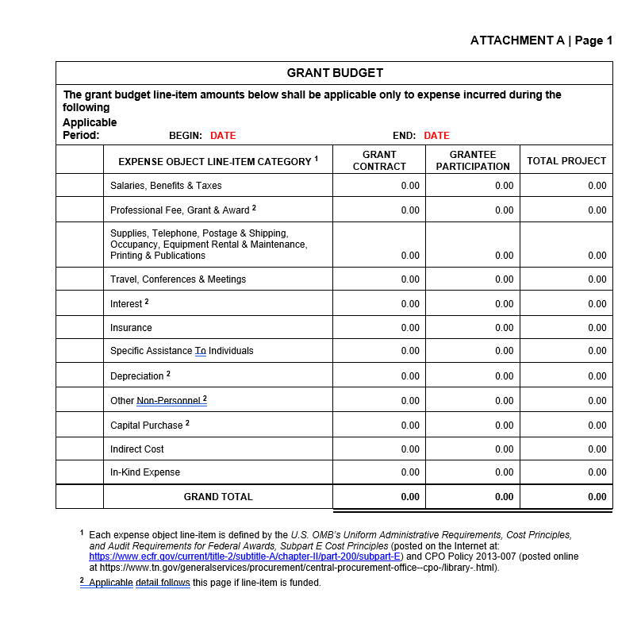
GRANT BUDGET
Submitting the Budget
Attachment A, the grant budget, from the Proforma can be used to provide the State with your proposed budget. Office of Management and Budget’s (“OMB’s”) Uniform Administrative Requirements, Cost Principals should be used when drafting this. (See the link at the bottom of Proforma, Attachment A, page 1.)
Each expense object line-item is defined by the U.S. OMB’s Uniform Administrative Requirements, Cost Principles, and Audit Requirements for Federal Awards, Subpart E Cost Principles (posted on the Internet at: https://www.ecfr.gov/current/title-2/subtitle-A/chapter-II/part-200/subpart-E) and CPO Policy 2013-007 (posted online at https://www.tn.gov/generalservices/procurement/central-procurement-office--cpo-/library-.html)
Applicable detail follows this page if line-item is funded.

Slide 13

GRANT EVALUATION Considerations
Mirror the structure, terminology, and order of the Request for Applications (RFA). Use the same headings and subheadings.
Answer every part of multi‑component questions.
Provide responses that address each category independently and exclusively. Avoid vague language. Avoid jargon or internal acronyms.
Use quantifiable details whenever possible.
Use data from credible sources to support claims.
Identify the mission and objectives.
Show how your project advances the program’s goals.
Describe relevant experience, past performance, and partnerships.
Showcase staff expertise and infrastructure.
Distinguish between outputs (activities) and outcomes (impact).
Show cost‑effectiveness and stewardship of public funds.
Reference proven models or frameworks when applicable. Explain how the project will continue after the grant period.
Identify future funding sources, partnerships, or institutional commitments. Describe your experience or strategies for engaging children in custody or at-risk.
Be sure to submit all required documents including the W9 and IRS Determination Letter.

Slide 14
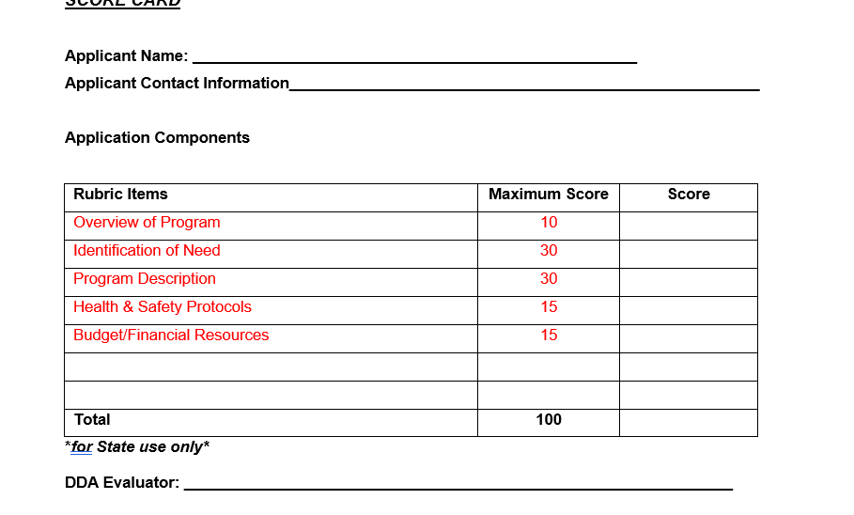
GRANT EVALUATION
Grant awards shall be made beginning with the highest-scoring applicants and shall continue in descending order of total score until all available program funds have been exhausted. The applicant’s proposed budget will be awarded as determined appropriate by the Department. The Department reserves the right to:
Determine final award amounts based on the availability of funds, reasonableness of the proposed budget, and alignment with program priorities;
Make partial or conditional awards; and
Deny or adjust any proposed budget that includes unallowable or unsupported costs.
In the event that available program funds remain following the initial round of awards, such funds may be disbursed to the next highest-scoring applicant(s) in rank order until all funds have been obligated.

Slide 15
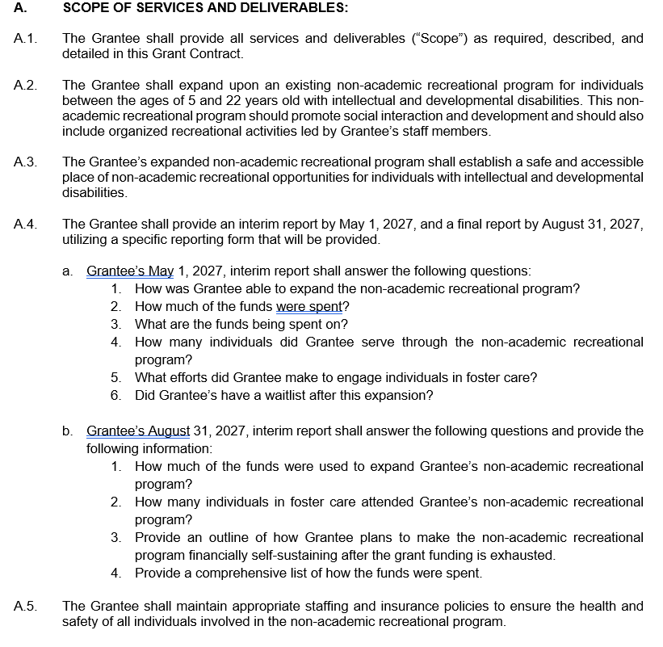
CONTRACTS
Pro Forma Grant Contract
This represents the final form of the contract that will be executed between the State and the Grantee:
Sections
Coversheet
Section A – Scope of services
Section B – Term of contract
Section C – Payment terms
Section D – Standard terms and conditions
Section E – Special terms and conditions Signatures
Attachment A – Grant budget
Attachment B – Original grantee proposal
Note: Sections A-E are non-negotiable.
*It is important to read and understand the terms and expectations of the State in the Pro Forma Grant Contract.

Slide 16
FREQUENTLY ASKED QUESTIONS
Can the funds be used for general operating expenses? No. These funds are specifically earmarked for growth-related costs. While the grant can cover staff salaries for new positions required by the expansion, it is not intended to cover the existing overhead of current operations. Provide sustainability plan.
How do I submit invoices? Invoices should be submitted to DDA.Invoicing@tn.gov with the designated point of contact copied.
What are the reimbursement timeframes? Reimbursements are typically processed within approximately 4–6 weeks.
Is this a reacurring grant? No. Not at this time.
Are there data reporting requirements? Yes. Data reporting requirements apply.
What file format should I use to submit the application? PDF format is preferred.
Is double‑spacing required for the application format? No. Double‑spacing is not required.
What should I do if the file is too large to send in one email? Please send the documents in multiple emails and indicate the total number of files/emails in the subject line or message (e.g., “1 of 2,” “2 of 2”).

Slide 17

QUESTIONS & ANSWERS
Division of Program Operations
Trey King
Director of TN Strong Families & Homes
Trey.King@tn.gov
(615) 440-3188
Babs Tierno
Deputy Director of TN Strong Families & Homes
Babs.Tierno@tn.gov
(629) 224-7263
Fiscal and Administrative Services
Benita Chapman | Chief Administrative Officer
Hany Ghabious | Deputy Chief Administrative Officer
Eli Rousey | Contracts and Grants Director
Braden Odom | Director of Special Projects
Elizabeth Barrows |Grant Application Manager
*Please submit your questions in the chat box or click the hand icon to “raise your hand" to be unmuted.

