Slide 1
Evidence-Based Practice Part 2:
EI Focused Resources
LeeAnn Finnegan, Provider Support Specialist, April 24, 2025

Slide 2
Welcome!
Evidence-Based Decision-Making in Early Childhood
Evidence-Based Repositories for Early Intervention
Professional Organizations
Other Ways to Access EBPs
Wrap-Up/Questions

Slide 3
Evidence-Based Decision-Making

Slide 4
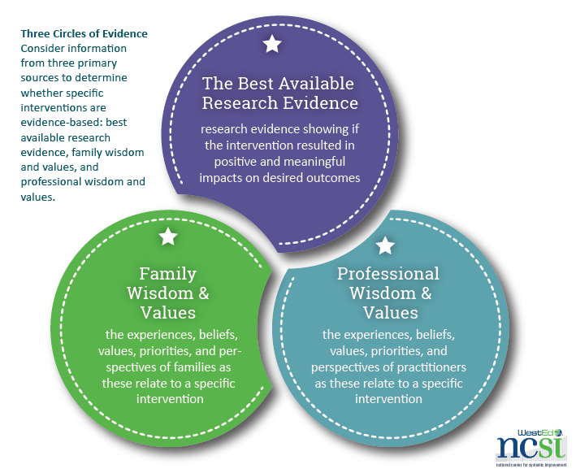
National Center for Systemic Improvement
https://ncsi.wested.org/wp-content/uploads/2023/10/NCSI-Three-Circles-of-Evidence-Based-Decision-Making-to-Support-Students-with-Disabilities_FINAL.pdf
Notes:
A lot of their website is focused on school age children with disabilities, but this is applicable to us as well in EI

Slide 5
Steps of Evidence-Based Decision-Making
Define your question including:
  Characteristics of children and families
  Type of intervention
  Desired child or family outcomes
https://ncsi.wested.org/wp-content/uploads/2023/10/NCSI-Three-Circles-of-Evidence-Based-Decision-Making-to-Support-Students-with-Disabilities_FINAL.pdf ​

Slide 6
Steps of Evidence-Based Decision-Making
Consider the evidence from all three circles of evidence.
        Search websites that provide intervention effectiveness summaries to identify potential interventions in early childhood.
        Judge the research evidence for these interventions in terms of impacts on outcomes of interest and relevance for children and families that would participate in this intervention.
        Examine any biases or assumptions that may have influenced the research questions or methods.
The Best Available Research Evidence
https://ncsi.wested.org/wp-content/uploads/2023/10/NCSI-Three-Circles-of-Evidence-Based-Decision-Making-to-Support-Students-with-Disabilities_FINAL.pdf ​

Slide 7
Steps of Evidence-Based Decision-Making
Consider the evidence from all three circles of evidence.
        Consider consensus documents such as position statements and practice guides to tap into families' collective wisdom and values.
        Consider the culture, values, experiences, and priorities of the families with whom you work who would be participating in this intervention.
Family Wisdom and Values
https://ncsi.wested.org/wp-content/uploads/2023/10/NCSI-Three-Circles-of-Evidence-Based-Decision-Making-to-Support-Students-with-Disabilities_FINAL.pdf ​

Slide 8
Steps of Evidence-Based Decision-Making
Consider the evidence from all three circles of evidence.
        Consider consensus documents such as position statements, program and professional standards, and practice guides to tap into the field's collective wisdom and values.
        Consider your own culture, values, experiences, and priorities to tap into your professional wisdom and values.
Professional Wisdom and Values
https://ncsi.wested.org/wp-content/uploads/2023/10/NCSI-Three-Circles-of-Evidence-Based-Decision-Making-to-Support-Students-with-Disabilities_FINAL.pdf ​

Slide 9
Steps of Evidence-Based Decision-Making
Determine if an intervention meets the FAIR test.
Is an intervention:
  Feasible to implement?
  Acceptable to families/professionals?
  Impact: Effective in producing a positive impact?
  Relevant for your identified context?
https://ncsi.wested.org/wp-content/uploads/2023/10/NCSI-Three-Circles-of-Evidence-Based-Decision-Making-to-Support-Students-with-Disabilities_FINAL.pdf ​

Slide 10
Steps of Evidence-Based Decision-Making
Make an evidence-based decision.
  Once you have identified one or more interventions that meet the FAIR test, combine and consider all the information you have gathered, make a decision, and begin planning for implementation.
https://ncsi.wested.org/wp-content/uploads/2023/10/NCSI-Three-Circles-of-Evidence-Based-Decision-Making-to-Support-Students-with-Disabilities_FINAL.pdf ​

Slide 11
Evidence-Based Repositories for EI
Notes:
This is not an exhaustive list, and there are more out there that are evidence-based that I did not include. These are ones I have used a lot or recommended for use by others.

Slide 12

Autism Focused Intervention Resources and Modules (AFIRM)
https://afirm.fpg.unc.edu/
AFIRM Modules are designed to help you learn the step-by-step process of planning for, using, and monitoring an evidence-based practice with learners on the autism spectrum.

Slide 13
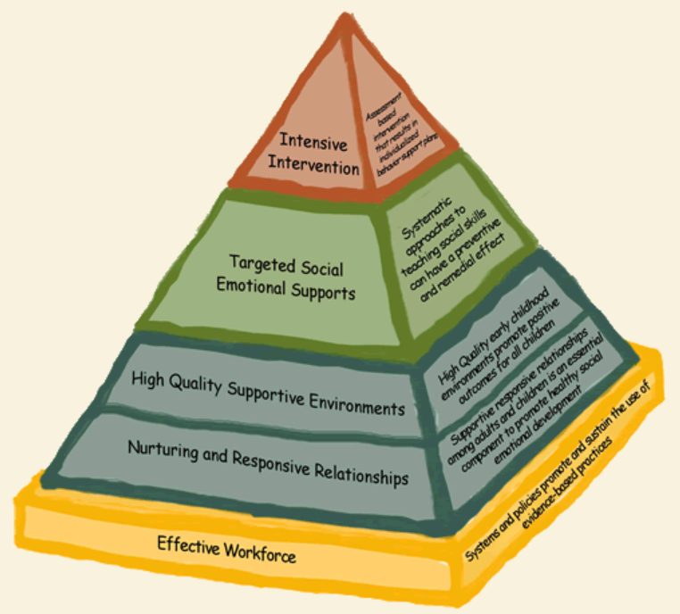
Center on the Social and Emotional Foundations for Early Learning (CSEFEL)
https://csefel.vanderbilt.edu/
Promoting the social emotional development and school readiness of young children birth to age 5.

Slide 14
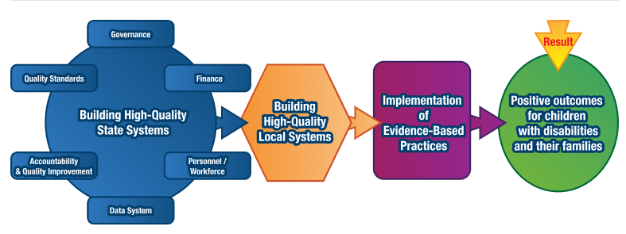
Early Childhood Technical Assistance (ECTA) Center
https://ectacenter.org/
Notes:
The ECTA Center supports state IDEA Part C and Part B, Section 619 programs in developing high-quality, effective, and sustainable state and local systems, to implement equitable access, equitable services, and supports for children with disabilities and their families that result in positive outcomes.

Slide 15

Family and Infant Preschool Program (FIPP)
https://fipp.ncdhhs.gov/
North Carolina early intervention program headed by Dathan Rush (and formerly M’Lisa Shelden)

Slide 16

Family Guided Routines Based Intervention (FGRBI)
https://fgrbi.com/
Evidence-base for family coaching as best practice within early intervention.

Slide 17

Head Start
https://headstart.gov/children-disabilities
The above link directs to the Head Start page on supporting children with disabilities

Slide 18

Iris Center at Vanderbilt Peabody College
https://iris.peabody.vanderbilt.edu/
The Iris Center is a national center dedicated to improving education outcomes for all children, especially those with disabilities birth through age 21, through the use of effective evidence-based practices and interventions.

Slide 19

Pathways
https://pathways.org/
Provides free evidence-based resources for families to support developmental milestone acquisition.

Slide 20
TEIS Community Resource Website
https://www.tn.gov/disability-and-aging/disability-aging-programs/teis/teis-community-resources.html
Resources for both families and service providers in early intervention in Tennessee.

Slide 21

Treatment and Research Institute for Autism Spectrum Disorders (TRIAD) at Vanderbilt
https://vkc.vumc.org/vkc/triad/home/
Improving assessment and treatment services for children with autism spectrum disorder and their families while advancing knowledge and training.

Slide 22

Virginia Early Intervention Professional Development Center (VEIPD)
https://www.veipd.org/main/index.html
Virginia Early Intervention Program
Notes:
Dana Childress was here

Slide 23
Professional Organizations

Slide 24

American Occupational Therapy Association (AOTA)
https://www.aota.org/
The professional organization for occupational therapy practitioners nationwide.

Slide 25
American Physical Therapy Association (APTA)
https://www.apta.org/
The professional organization for physical therapists, physical therapy assistants, and students of PT.

Slide 26
American Speech-Language-Hearing Association (ASHA)
www.asha.org
The national professional, scientific, and credentialing association for audiologists, SLPs, speech language and hearing scientists, assistants, and students.

Slide 27

Council for Exceptional Children (CEC)
https://exceptionalchildren.org/
Council for Exceptional Children (CEC) is the largest international professional organization dedicated to improving the success of children and youth with disabilities and/or gifts and talents.

Slide 28

Division for Early Childhood (DEC)
https://www.dec-sped.org/
To cultivate a society where inclusion and belonging is a lived reality for young children and their families across a diverse diaspora that embraces, celebrates, and empowers them to be actively engaged in their communities.

Slide 29
Other Ways to Access EBP

Slide 30
Google Scholar
https://scholar.google.com/
Access free online articles across a variety of research- based journals and institutions.

Slide 31
University Libraries
Most universities now have online access to their library systems for current students and may offer free or paid alumni access.
Reach out to the library at the university you attended and ask if they provide alumni access.
If you are local, ask about access to the physical libraries as well!

Slide 32
Contact Authors of Studies
If you come across an article that you want to read and it is behind a paywall, this is typically the journal itself wanting payment to access the article.
Sometimes, if you email the author(s) directly, they will send you the article directly.
Notes:
Researchers WANT to get their research into more people’s hands, so will often send if you just ask.

Slide 33
Wrap-Up/Questions

Slide 34
Resources
American Occupational Therapy Association (AOTA): https://www.aota.org/
American Physical Therapy Association (APTA): https://www.apta.org/
American Speech-Language-Hearing Association (ASHA): www.asha.org
Autism Focused Intervention Resources and Modules (AFIRM): https://affirm.fpg.unc.edu/

Slide 35
Resources
Center on the Social and Emotional Foundations for Early Learning (CSEFEL): https://csefel.vanderbilt.edu/
Council for Exceptional Children (CEC): https://exceptionalchildren.org/
Division for Early Childhood (DEC): https://www.dec-sped.org/
Early Childhood Technical Assistance Center (ECTA) Center: https://ectacenter.org/

Slide 36
Resources
Family and Infant Preschool Program (FIPP): https://fipp.ncdhhs.gov/
Family Guided Routines Based Intervention (FGRBI): https://fgrbi.com/
Google Scholar: https://scholar.google.com
Head Start Children with Disabilities: https://headstart.gov/children-disabilities
Iris Center at Vanderbilt Peabody College: https://iris.peabody.vanderbilt.edu/

Slide 37
Resources
National Center for Systemic Improvement: https://ncsi.wested.org/
Pathways: https://pathways.org/
TEIS Community Resource Website: https://www.tn.gov/disability-and-aging/disability-aging-programs/teis/teis-community-resources.html
Virginia Early Intervention Professional Development Center (VEIPD): https://www.veipd.org/main/index.html

Slide 38
Upcoming Events
May 2, 2025: Monthly Directors Teaming Meeting
  12:30 Central/1:30 Eastern: Center Based
  1:00 Central/2:00 Eastern: All Directors

Slide 39
Upcoming Events
Early Interventionist Q&A Summer Series with Jo-Ann Hinkle
  May 16, 2025: Communication with children under 1 year old
  June 13, 2025: Communication with children from 1-3 years old
  July 11, 2025: Communication with children from 3-5 years old.
  All at 11:30 A.M. Central/12:30 Eastern
  Please email any pre-submitted questions to LeeAnn.Finnegan@tn.gov

Slide 40
Upcoming Events
May 22, 2025, at 11:30 A.M. Central/12:30 P.M. Eastern: Coffee Break-FGRBI in Childcare Sessions.
  There will not be Coffee Breaks held in June or July, and we will resume on August 28.
  We are working on making all of these trainings more easily accessible and useful to you and your staff, and we hope to complete all of these in the summer.
May 28, 2025, at 11:30 A.M. Central/12:30 P.M. Eastern: Lunch and Learn

Slide 41
Contact Information
Charmaine Woods
Charmaine.Woods2@tn.gov
615-686-8410
LeeAnn Finnegan
LeeAnn.Finnegan@tn.gov
629-259-3711

