Slide 1
Evidence-Based Practice Part 1:
Media Literacy and Awareness
LeeAnn Finnegan, Provider Support Specialist, March 27, 2025

Slide 2
Agenda
Welcome/Check-in
Defining Concepts
Media Literacy
Logical Fallacies
Wrap-Up/Questions
Upcoming Events

Slide 3
Welcome!

Slide 4
Updates since last Coffee Break
How have you used the EI Competencies within your agency?
How has this impacted what you have seen in observations/your own practice?

Slide 5
Defining Concepts

Slide 6
What is/are?
Research
Evidence-Based Practice
Best Available Practice
Evidence-Based Instructional Practices

Slide 7
Research
A systematic process of collecting, analyzing, and interpreting information (data) in order to increase our understanding of the phenomenon about which we are interested or concerned.
Research is vital to our field, to help us know what we are doing is most effective and applicable to our population.

Slide 8
Research is NOT:
*Solely* information gathering
Rummaging for information that is difficult to locate
Transportation of facts from one location to another
Looking for facts that only support a preconceived hypothesis (Confirmation bias/Echo chambers)

Slide 9
Evidence-Based Practice
Shown to have a positive effect on child outcomes.
Research design leads us to infer that the practice led to child improvement.
Multiple, high-quality studies have been conducted.
Reviewed by a reputable organization.
Notes:
Multiple high-quality studies-one is not enough, if it cannot be replicated, it is not reliable

Slide 10
Example:
You read a new study that claims eating spaghetti helps children with a speech delay learn how to talk.
How many studies have already been done that show different teaching and coaching strategies that are proven to help children learn to talk?
Do we believe that eating spaghetti can really help a child learn to speak? OR when a child first starts eating spaghetti is around the typical age range for when children start using their first words?
Notes:
Correlation/causation argument

Slide 11
Best Available Practice
Using research from other fields and/or other age groups when true evidence-based practice is not available.
Early intervention is still a very young field in the world of scientific research, so we are still building our evidence base for practice.
In instances where true evidence-based practice does not yet exist, we can use what other research has told us, alongside wisdom and knowledge from within the field.
Notes:
1975 what became IDEA was first passed, and Congress first established early intervention in 1986-how many of you were not born yet?
Most of us are older than our field, so we get to be on the front end of a lot of research and new knowledge, and as such have to be adaptable and flexible as new research comes about.

Slide 12
Evidence Based Instructional Practices (EBIP)
Teaching methods backed by research demonstrating their effectiveness in improving student learning and outcomes.
In simpler terms, translating results of research into practice with children and families.

Slide 13
Scientific Evidence: What to Look For
Discovers evidence and uses it to inform belief, relies on entire body of evidence.
Conservative claims are tentative and based on evidence, changes in conjunction with evidence.
Precise and measurable terminology conducive to understanding and replication.
Knows, understands, and applies logic with body of evidence to defend position.
Views critics as colleagues, seeks criticism and refutation.
Lang et al., 2016, Early Intervention for Young Children with Autism Spectrum Disorder​

Slide 14
Media Literacy

Slide 15
Media Literacy
The ability to access and critically analyze media messages, as well as create, reflect, and take action.
Knowing what is true and what is not by examining information at deeper than a surface level

Slide 16
4 Types of Misinformation in Online Media
1. False or regularly misleading websites that are shared on social media-often uses distorted headlines and decontextualized information to generate likes, shares, and profits.
2. Websites that may circulate misleading and/or potentially unreliable information.
3. Websites that sometimes use clickbait headlines and social media descriptions.
4. Satire/comedy sites, which may offer important critical commentary, but have the potential to be shared as literal.

Slide 17
How to find “the truth”: Four Moves and A Habit
1. Check for previous work
  Chances are someone has already dug into the claim and done some fact-checking.
  Look around and see what other resources you can find, such as news coverage, reputable online sites, or a fact checking site.
2. Go upstream to the source
  Most content found online is not original, so you can go “upstream” to the original source to determine if it is trustworthy or not.

Slide 18
How to find “the truth”: Four Moves and A Habit
3. Read laterally
  Read across other trustworthy sites to see what others have said about the author or publisher.
4. Circle back
  Circle back to the original source and start again. You may find that you already know more to assess the original claim.

Slide 19
How to find “the truth”: Four Moves and A Habit
The Habit: Check your emotions
  False information is meant to trigger your emotions, so if you find yourself becoming angry or frustrated, take a step back and think about why that is.
  Becoming emotional can diminish our critical thinking and ability to fact check.
  Take a step away and come back when you are able.

Slide 20
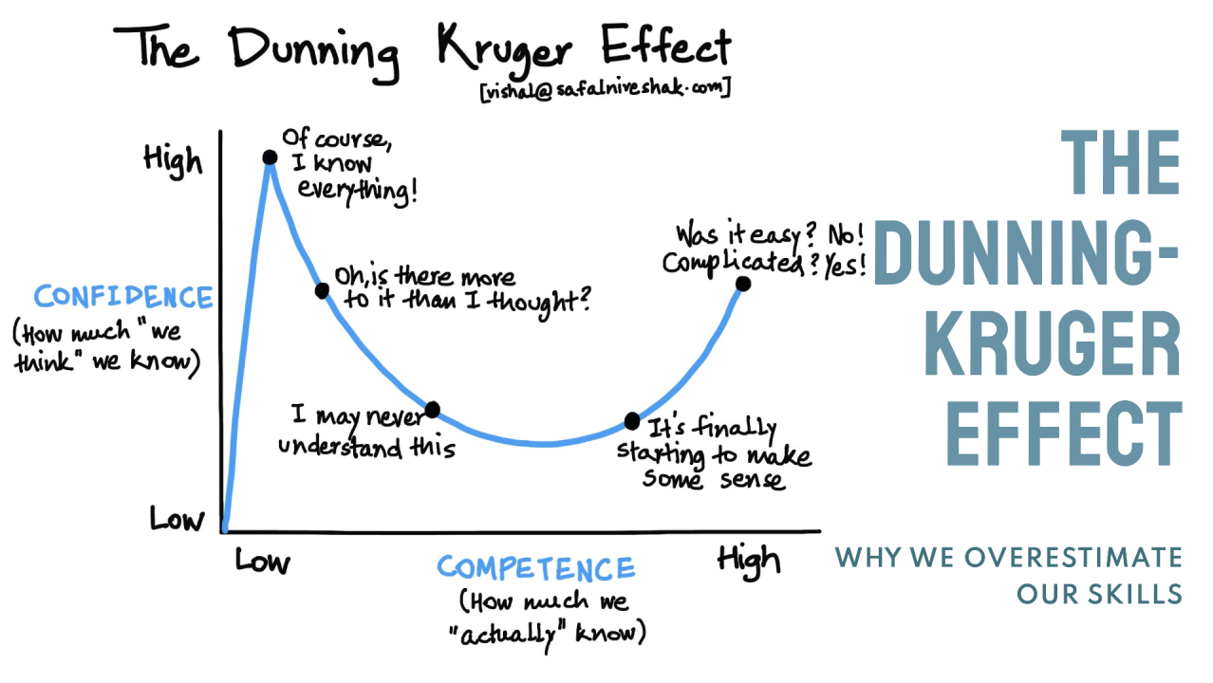
The Dunning Kruger Effect

Slide 21
How to Improve Your Media Literacy
Know what you’re up against.
Think carefully about how you frame a search.
Think critically about keywords.
Never stop learning.
https://www.unc.edu/discover/how-to-improve-your-media-literacy-skills/

Slide 22
Logical Fallacies

Slide 23
Logical Fallacies
Common errors in reasoning that undermine the logic of your argument.
It is important that we are aware of:
  How others use these to influence the information we receive AND
  If there are any that we use that may influence how we portray information to others.

Slide 24
Commonly Used Logical Fallacies
Ad Hominem: Attacking someone’s character, rather than the issue.
  Example: When discussing policy and someone disagrees, they mention prior bad acts by the person.
Appeal to False Authority: Using a source quote by someone who is not truly an expert in their field.
  Example: If I claim that I am an expert in modeling and high fashion.

Slide 25
Commonly Used Logical Fallacies
Bandwagon: When the “evidence” is that everyone else is doing it.
  Example: Everyone is getting the new iPhone this weekend, so you should too!
Begging the Question/Circular Reasoning: If the claim is only affirmed by itself.
  Example: Blueberries are good for you because they are full of antioxidants.
Notes:
Begging the question-relies on the underlying belief that antioxidants are good for you, but what are the benefits?

Slide 26
Commonly Used Logical Fallacies
Either/Or: Reducing complex arguments to simple right and wrong arguments when there are many more possible answers.
  Example: We can either only wear pants or wear no pants at all.
Faulty Analogy: Comparing things that are similar in some ways, but not where it matters the most.
  Example: Both dogs and trees have bark, so they are the same thing.

Slide 27
Commonly Used Logical Fallacies
Faulty Causality: Drawing the conclusion that when two events happen close together, one caused the other.
  Example: I ate a cheeseburger, then fell and broke my leg, so it had to have been because of the cheeseburger.
Hasty Generalization: Making a claim based on one or two examples that are not relevant to the claims or subject.
  Example: I met two people from Tennessee who were both so nice to me, so all Tennesseans must be nice!

Slide 28
Commonly Used Logical Fallacies
Slippery Slope: If A happens, then B will happen, and C, all the way to Z.
  Example: If we can't keep a lion as a pet, then eventually we can't keep cats as pets!
Straw Man: Oversimplifying an opponent’s viewpoint and then attacking that simplified point.
  Example: People who don't like cats must hate all animals.
Vagueness, Evasions, Misstatements: Intentionally not stating all the information known or taking something out of context.

Slide 29
Resources
Evidence Based Instructional Practices: https://ebip.vkcsites.org/
Four Moves & A Habit: https://content.bridgepointeducation.com/curriculum/file/b73d8413-f392-4ddd-914a-7399c878f007/1/FOUR%20MOVES%20%26%20A%20HABIT.pdf
Lang, R., Hancock, T. B., & Singh, N. N. (2016). Early Intervention for Young Children with Autism Spectrum Disorder. Springer.

Slide 30
Resources
Purdue OWL Logical Fallacies: https://owl.purdue.edu/owl/general_writing/academic_writing/logic_in_argumentative_writing/fallacies.html
University of Nevada Reno Logical Fallacies: https://www.unr.edu/writing-speaking-center/writing-speaking-resources/logical-fallacies

Slide 31
Wrap-Up/Questions

Slide 32
Upcoming Events
April 14, 2025, from 1:00-4:00 p.m. Central: EIRA Directors Quarterly Meeting in Nashville at MTRO (275 Stewarts Ferry Pike, Nashville)
April 15, 2025, from 9:00 a.m-12:00 p.m. Central: SICC at MTRO
April 16, 2025, from 9:00 a.m.-2:00 p.m. Central: Coaching Mentor Workshop at MTRO

Slide 33
Upcoming Events
April 18, 2025: State offices closed for Good Friday
April 23, 2025, at 11:30 Central/12:30 Eastern: Lunch and Learn
April 24, 2025, at 11:30 Central/12:30 Eastern: Coffee Break
May 2, 2025: Monthly Directors Teaming Meeting
  12:30 Central/1:30 Eastern: Center-Based Directors Discussion
  1:00 Central/2:00 Eastern: All Directors Discussion
May 16, 2025, at 11:30 Central: EI Q&A

Slide 34
Contact Info
Charmaine Woods
Charmaine.Woods2@tn.gov
615-686-8410
LeeAnn Finnegan
LeeAnn.Finnegan@tn.gov
629-259-3711

