Slide 1
Signing Documents in Adobe Sign Using a Phone or Tablet
Click anywhere to advance to the next slide

Slide 2
Instructions
Following are the step-by step instructions for signing a document sent to you by your TEIS service coordinator through Adobe Sign. These instructions are specific to your phone or tablet. You may also refer to the written instructions provided by the accompanying downloadable document.
Click anywhere to advance to the next slide when ready.

Slide 3
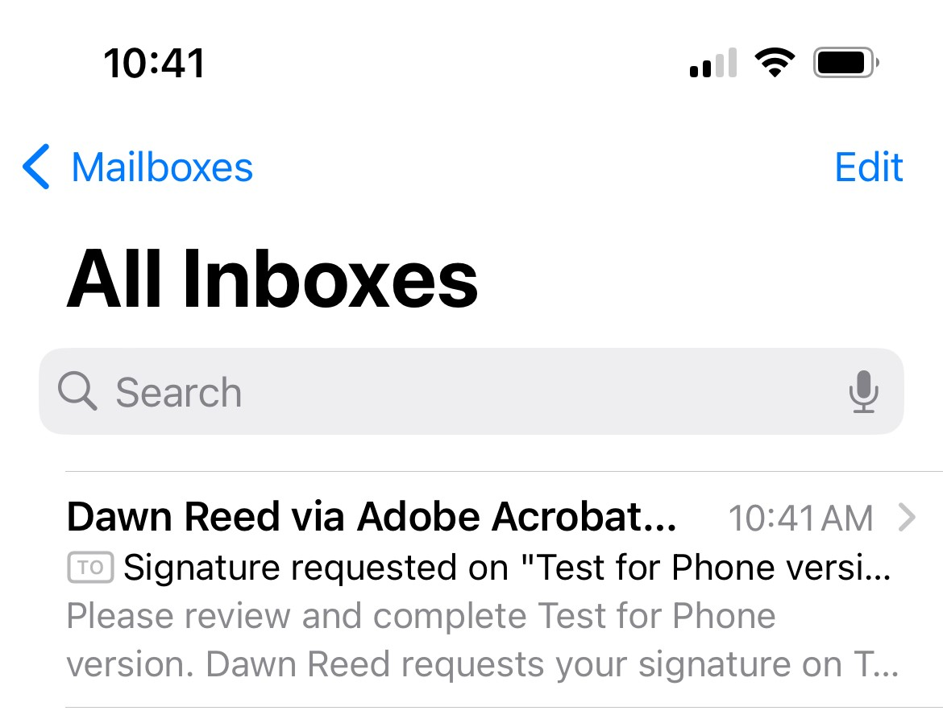
Receiving the Email
Open the email that is titled with your service coordinator's name (example, "Jane Doe via Adobe Acrobat Sign")

Slide 4
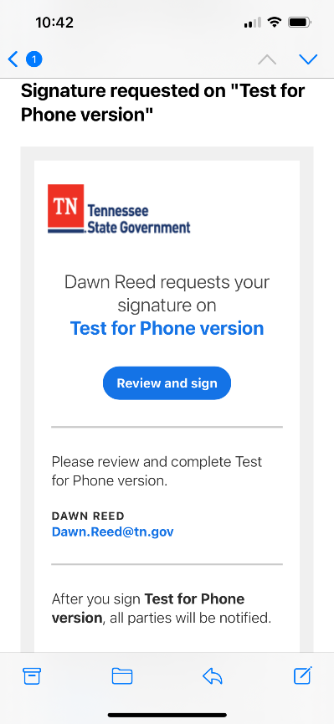
Signature Request
Tap or click the blue oval that says "Review and Sign".

Slide 5
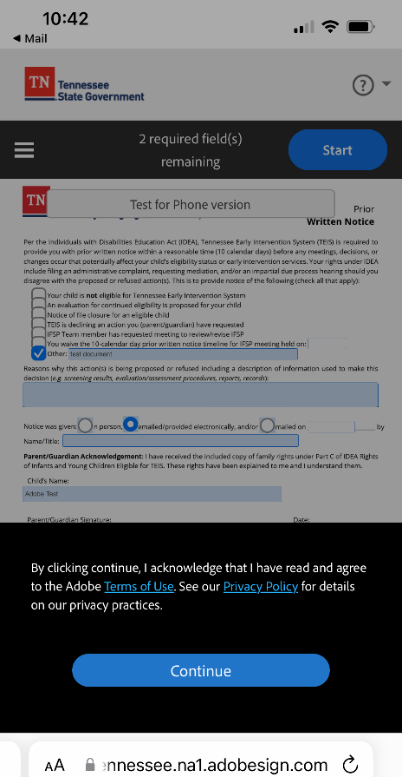
Adobe Terms of Use and Privacy Policy
Adobe Acrobat Sign will be opened in your phone web browser. If you'd like to read the privacy policies, tap or click on the links highlighted in blue within the black box. When ready, tap or click the blue oval that says "Continue".

Slide 6
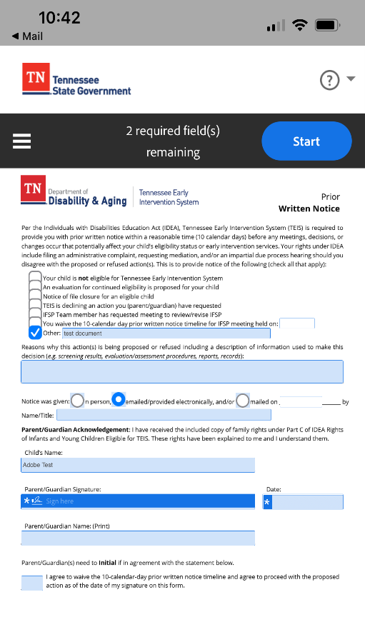
Required Fields and Start
Across the top you will now see the number of required fields to complete within the document(s) you have been sent. As you complete each field, this number will decrease down to zero. Click on the blue oval to the right that says, “Start” to begin signing.

Slide 7
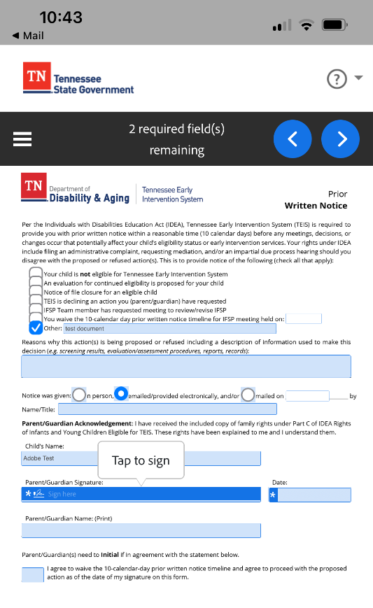
Tap to Sign
Click or tap the blue signature field, under the words "Tap to sign".

Slide 8
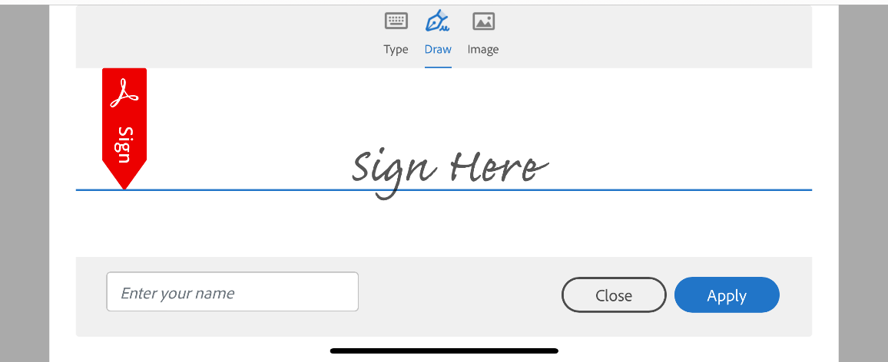
Signature Options
Choose your preferred method of signature:
Type will allow you to type in your name and it will display your name in a cursive font.
Draw will allow you to use your finger or a stylus to write your name on your phone screen.
Image will allow you to insert a
photo from your phone. This feature
enables you to sign your name on a
piece of paper, take a picture of your
signature, and then upload it here.

Slide 9
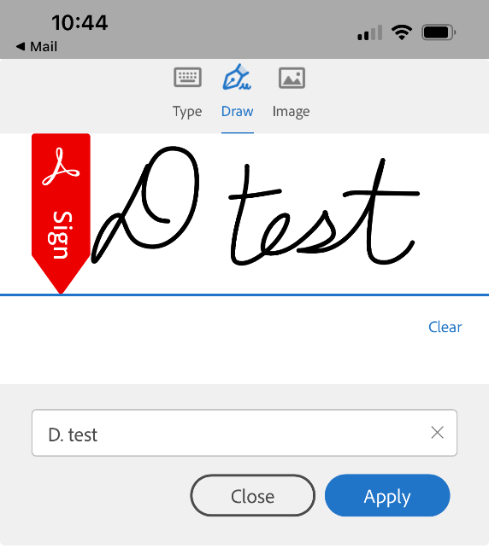
Enter Your Name and Apply
Once the signature is complete, you will be prompted to enter your name. Type your name in the box, then click "Apply".

Slide 10
Signature and Time Stamp
If you make a mistake after tapping “Apply”, tap the box that says “Tap to change” to go back to the signature screen.
Your signature with a time stamp will now appear on the line where the blue highlighted field previously was and will appear in all following fields requiring your signature.

Slide 11
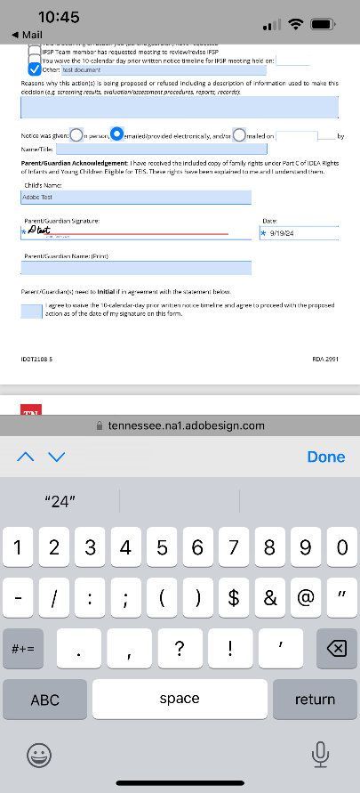
Other Required Fields-Date
Look for the next field highlighted in blue. Tap or click on the date box and type in the date MM/DD/YY.

Slide 12
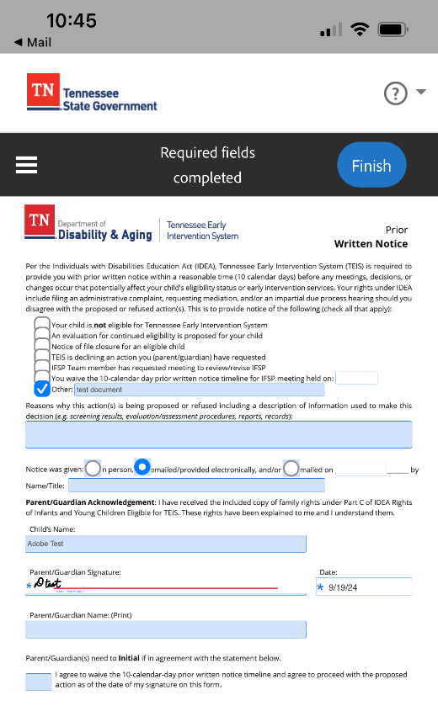
Finish
Once you've completed all required fields, tap or click the blue oval that says "Finish".

Slide 13
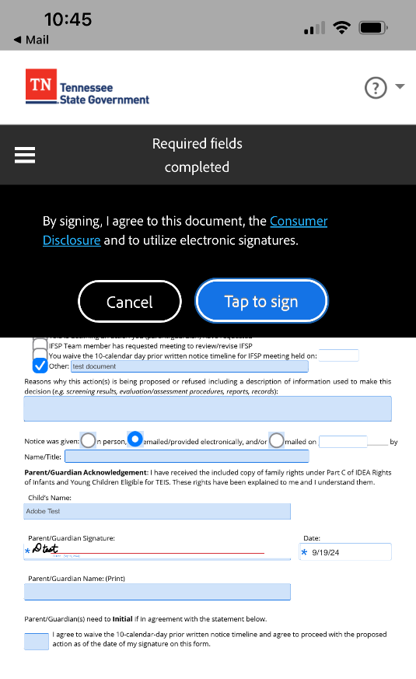
Consumer Disclosure and Tap to Sign
Click “Tap to sign” in the blue oval to finish signing the document.

Slide 14
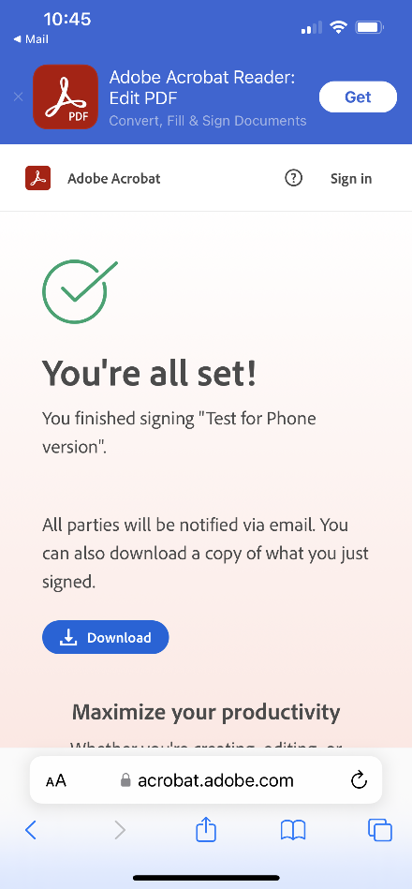
You’re Done Signing
If you'd like to save the document to your phone, click the blue oval that says “Download”.

Slide 15
Conclusion
You may now close the tab on your phone. An email will be sent to your service coordinator that the documents have been signed. If you were unable to download the signed forms for your records, you can request that your service coordinator send you a copy.

Slide 16
Thank You!
This course was developed by the Learning and Development Team and released in December 2024. Please reach out to your service coordinator if you need additional assistance signing forms using Adobe Sign.

