Slide 1
Signing Documents in Adobe Sign Using a Computer
Click to advance to the next slide

Slide 2
Instructions
Below are the step-by-step instructions for signing a document sent to you by your service coordinator for TEIS through Adobe Sign. These instructions are specific to your desktop or laptop computer. You may also refer to the written instructions provided by the accompanying downloadable document.
Click anywhere to advance to the next slide when ready.

Slide 3
Receiving the Email
Open the email that is titled with your service coordinator’s name (example, “Jane Doe via Adobe Acrobat Sign”)

Slide 4
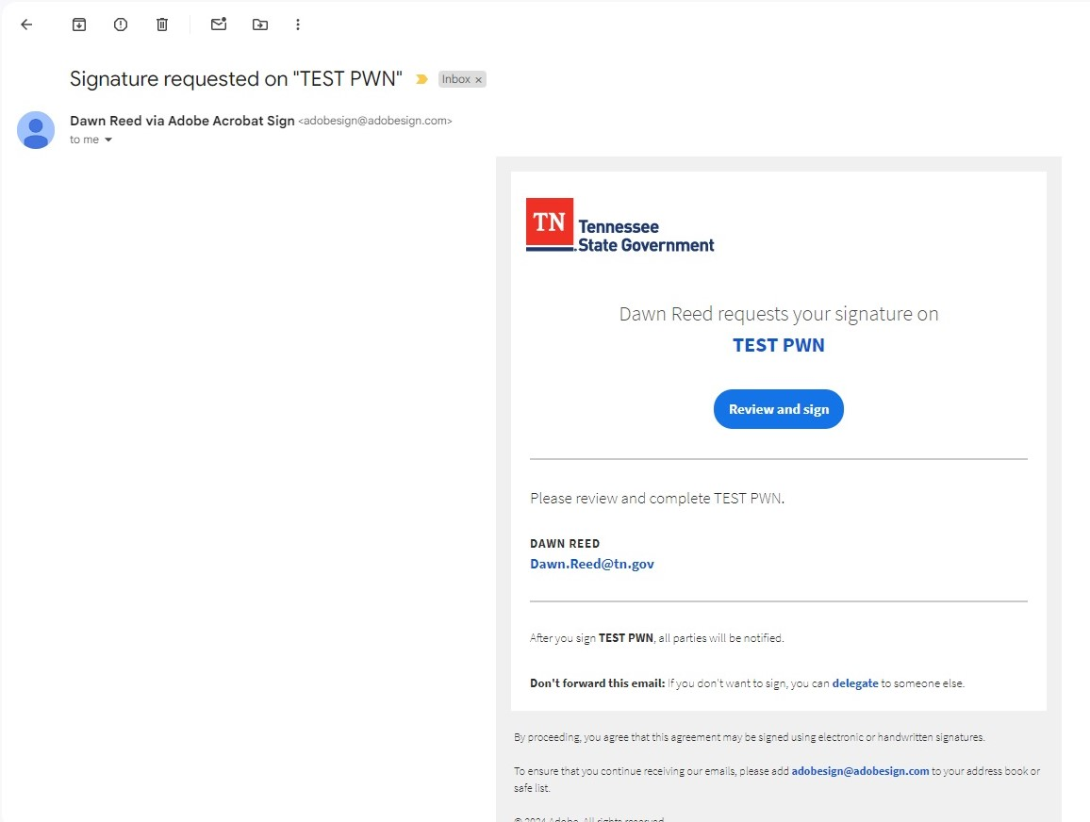
Signature Request
Click the blue oval that says “Review and sign.”

Slide 5
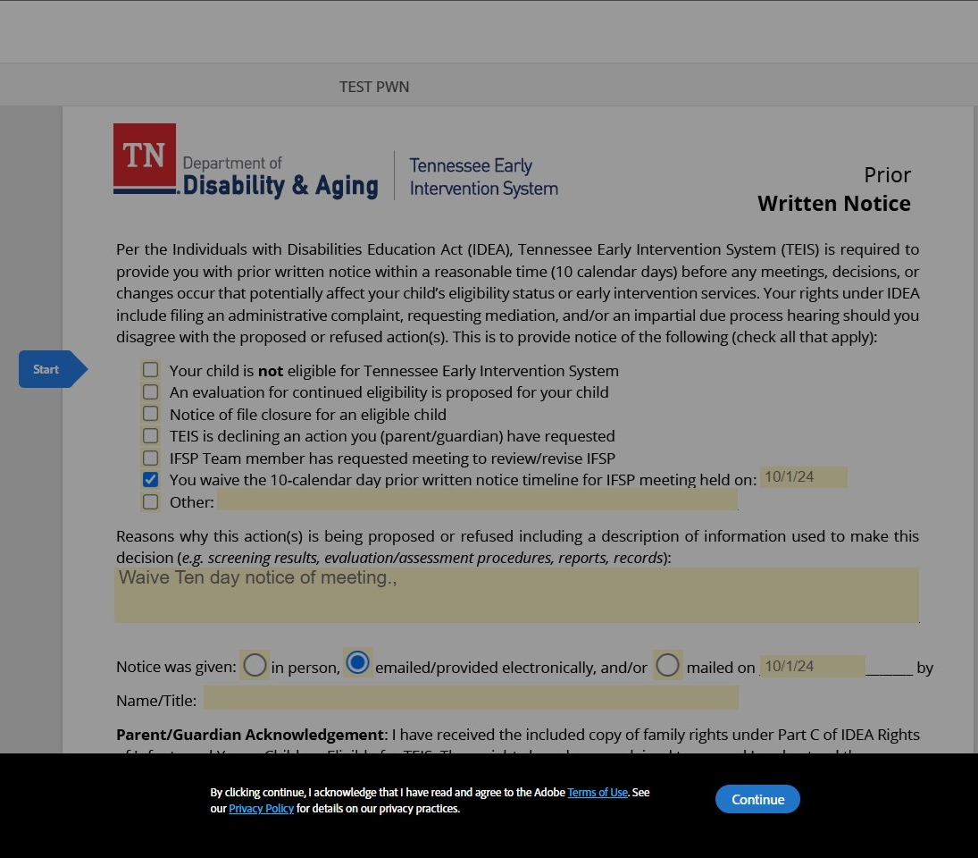
Adobe Terms of Use and Privacy Policy
Adobe Acrobat Sign will be opened in your computer browser. If you’d like to read the privacy policies, click on the links highlighted in blue within the black box. When ready, click the blue oval that says “Continue”.

Slide 6
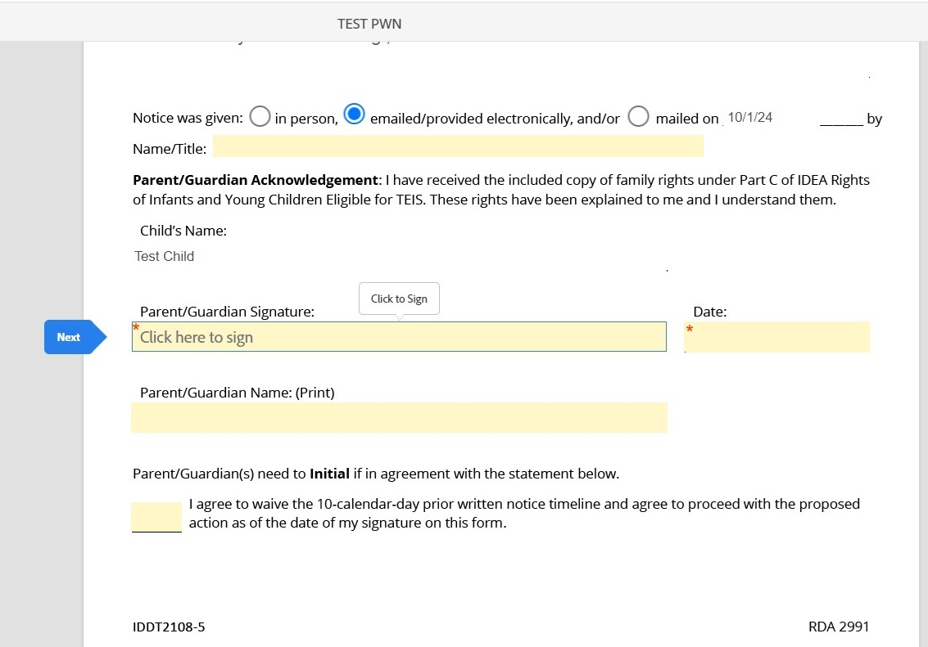
Tap to Sign
Click the signature field, under the words “Click to sign”.

Slide 7
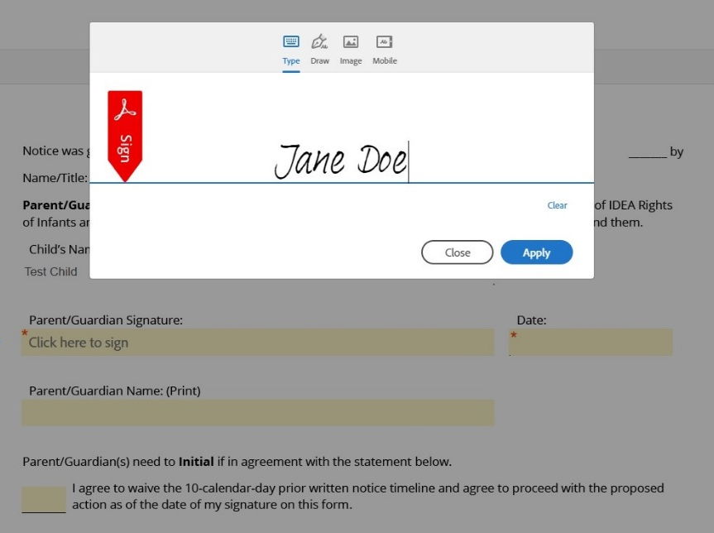
Signature Options
Choose your preferred method of signature:
Type will allow you to type in your name and it will display your name in a cursive font.
Draw will allow you to use your finger or a stylus to write your name on your touch screen computer, if applicable.
Image will allow you to insert a
photo from your computer. This feature
enables you to sign your name on a
piece of paper, take a picture of your
signature, and then upload it here.
When you are done signing, click “Apply” in the blue oval.

Slide 8
Signature and Time Stamp
If you make a mistake after tapping “Apply”, click the box that says “Click to change” to go back to the signature screen.
Your signature with a time stamp should now appear on the line where the *red asterisk field previously was and will appear in all following fields requiring your signature, if applicable.

Slide 9
Other Required Fields-Date
Look for the next required field with the * red asterisk. Click on the date box and type in the date MM/DD/YY.

Slide 10
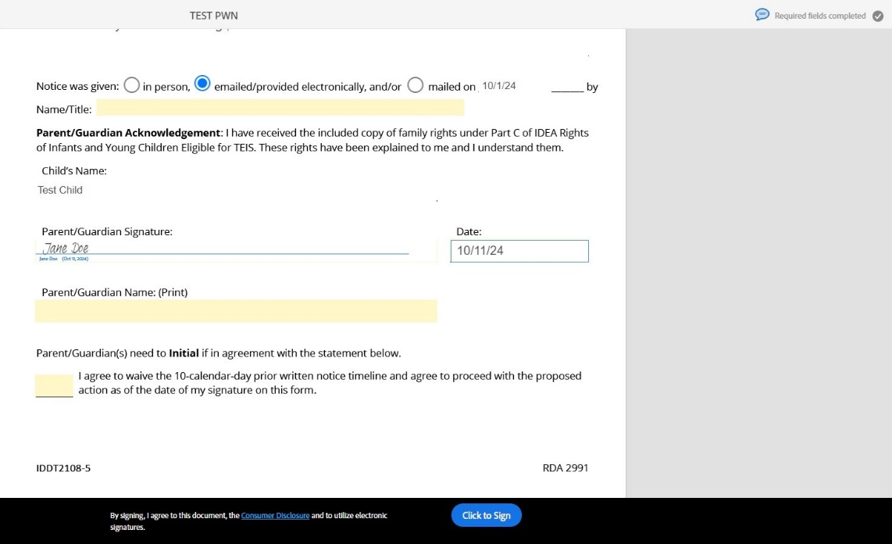
Consumer Disclosure and Tap to Sign
Click, “Click to sign” in the blue oval to finish signing the document.
“Required fields completed appears in the top right corner.

Slide 11
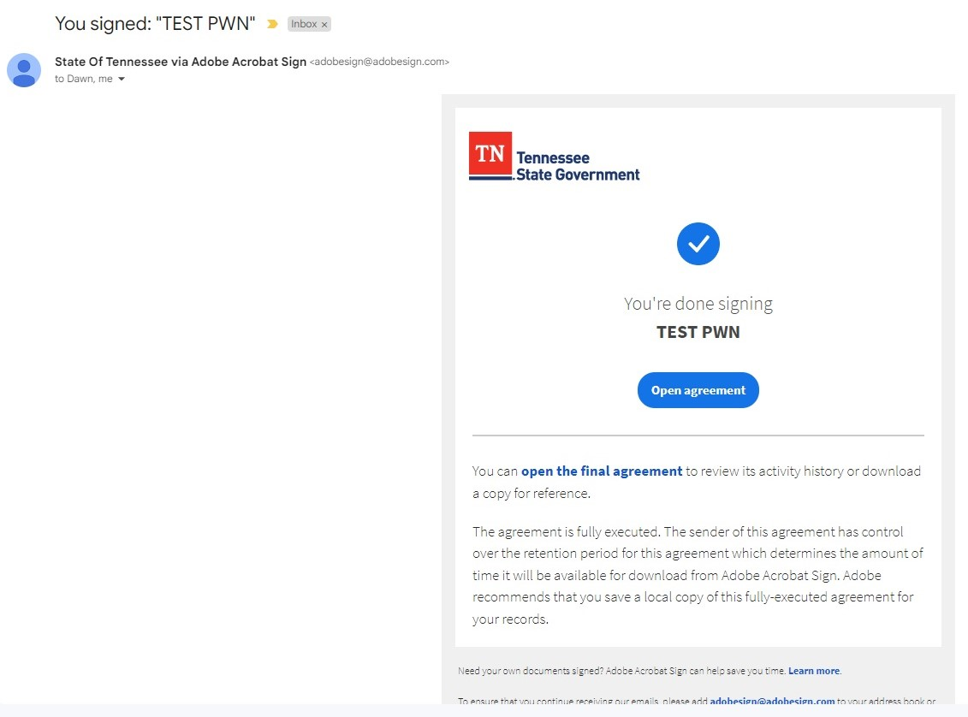
You’re Done Signing
If you’d like to save the document to your computer, click the blue oval that says “Open agreement”.

Slide 12
Conclusion
You may now close the tab on your browser. An email will be sent to your service coordinator that the documents have been signed. If you were unable to download the signed forms for your records, you can request that your service coordinator send you a copy.

Slide 13
Thank You!
This course was developed by the Learning and Development Team and released in December 2024. Please reach out to your service coordinator if you need additional assistance signing forms using Adobe Sign.

