Slide 1
Reflection
Coffee Break September 2024
LeeAnn Finnegan, Provider Support Specialist

Slide 2
Agenda
Reflection defined
Reflection Key Indicators-10, 11, and 12
Using FGBRI reflection principles within supervision

Slide 3
What is Reflection?

Slide 4
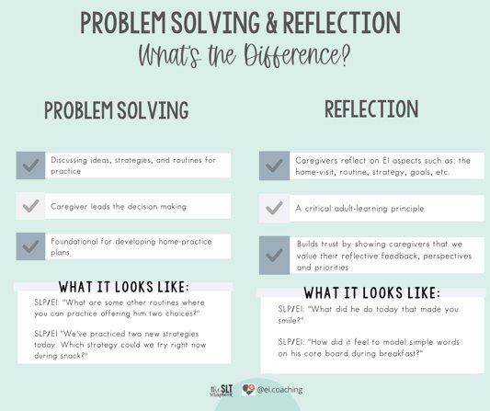
What's the difference?

Slide 5
Difference in Problem Solving and Reflection
Problem solving-an exchange of ideas about right now or in the future
Example: What is a strategy we can try right now in mealtime, or that you want to try over the next week?
Example: What are other routines in which you can offer choices to your child?
Reflection-an evaluation of something that has already happened
Example: What did you think about offering choices during bathtime?
Example: How was offering choices in bathtime different than when you offer choices at mealtime?

Slide 6
Shared Definition-Reflection
Questions or comments that are backward facing: How was that?
What did you think about that response or that strategy?

Slide 7
Reflection
EI supports the caregiver to analyze or evaluate a routine, strategy, or part of the session.​
Reflection encourages the caregiver to generate ideas to enhance strategy use and ways to generalize strategies to new routines.

Slide 8
Indicator 10

Slide 9
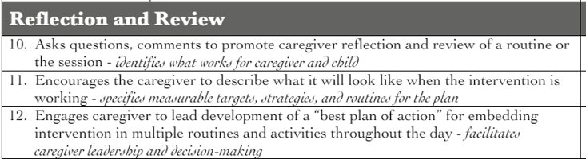
Indicator 10

Slide 10
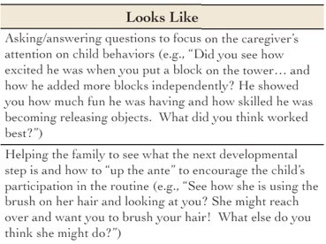
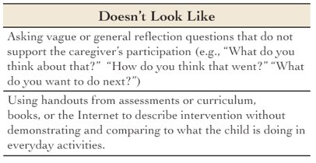
Indicator 10

Slide 11
Reflection Questions in Coaching Are:
Open-ended
Come from a sincere desire to learn or inquire
Supportive and empathetic in tone
Encourage engagement and ownership
Can be used to tap inner wisdom
Comments or skillful use of "wh" questions
Followed by silence to "hold the space"
Brown, J. (2020) Collaborative Coaching

Slide 12
Reflection
Could be the missing link to caregiver buy-in and implementation.
Related to both understanding of and belief in the practice-more than knowing how, it is belief that it matters.
Supports motivation and generalization.
Engages the learner in self assessment and self efficacy.
Should occur throughout the coaching cycle.
Is integral to effective problem solving with solutions the caregiver will enact.
Brown, J. (2020) Collaborative Coaching

Slide 13
Indicator 11

Slide 14
Indicator 11

Slide 15
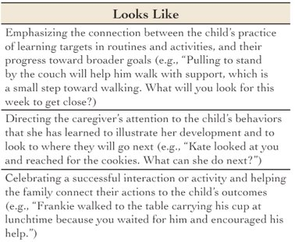
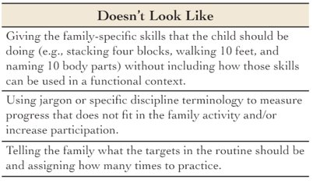
Indicator 11

Slide 16
Indicator 11 is:
For the parent to define what mastery or next steps look like for their child.
As early interventionists, we know what "mastery" of a developmental skill looks like, but...
Within the context of a family and home, the parent is the expert on knowing what mastery or realistic next steps to be mastered look like.

Slide 17
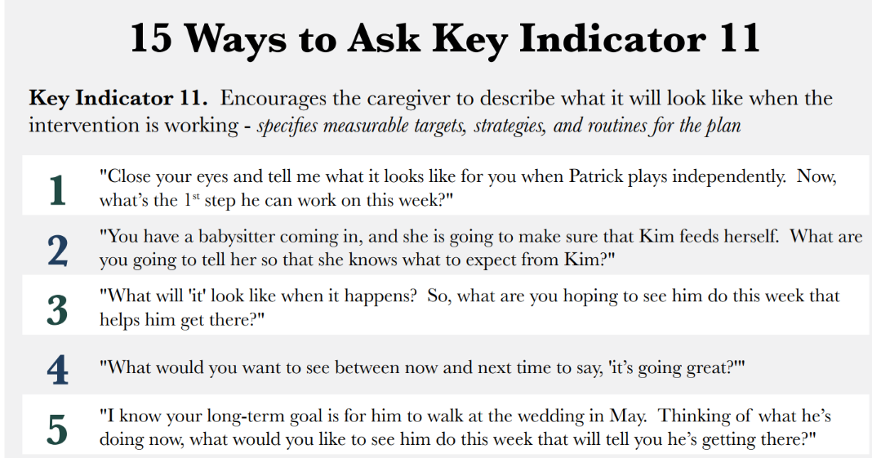
Indicator 11 Handout

Slide 18
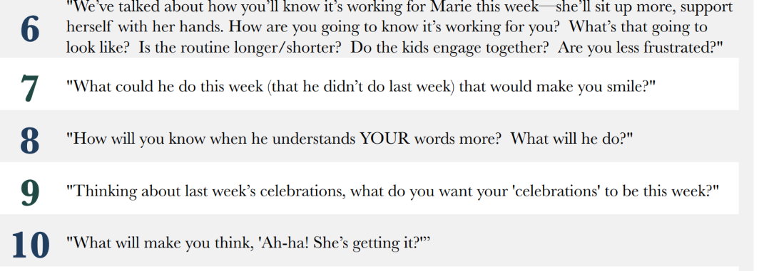
Indicator 11 Handout

Slide 19
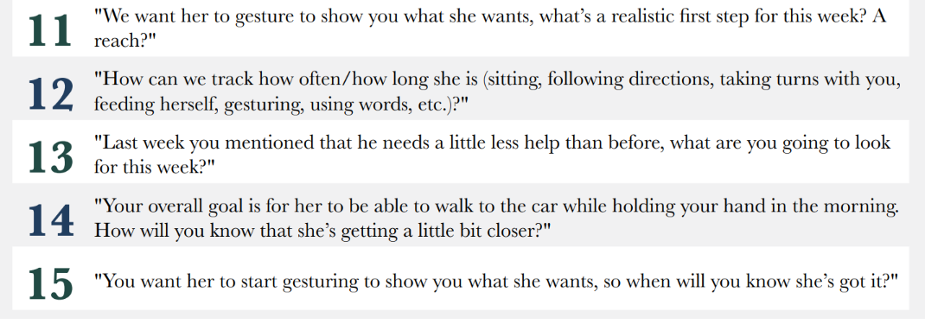
Indicator 11 Handout

Slide 20
Indicator 12

Slide 21
Indicator 12

Slide 22
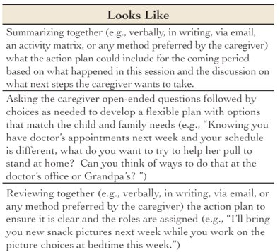
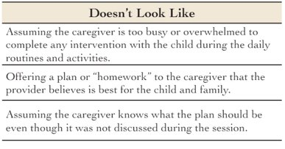
Indicator 12

Slide 23
Components of Indicator 12
Caregiver takes the lead to identify:
  Strategies (How)
  Specific routines, embedding throughout the day (where/who/when)
  Targets (what)
Same components as indicator 4-can tie indicator 12 in one session into indicator 4 in the next session

Slide 24
Reflective Supervision

Slide 25
Three Components
Reflection
Collaboration
Regularity
https://www.zerotothree.org/resource/three-building-blocks-of-reflective-supervision/
Notes:
Promotes and supports the development of a relationship-based organization

Slide 26
Reflection
Stepping back from the immediate, intense experience of hands-on work to take the time to wonder what the experience really means.
Requires a foundation of honesty and trust.
Encourages staff to assess their own performance and scaffold current knowledge to build new knowledge and skills.
Notes:
Be curious, wonder, ask questions to learn about the other person’s experiences and thoughts
Just like with families, requires honesty and trust-if staff doesn’t trust you they won’t be as open and forthcoming
Just like families as well, some are better at self reflection than others-if you and staff have a different opinion or recollection about something that happened, this can open the door for more conversation and questions

Slide 27
Collaboration
Sharing responsibility and control of power.
Allows for dialogue on issues affecting staff and the program as a whole.
Additionally, allows for staff to express interest in taking on new tasks, and allow everyone to learn from each other.

Slide 28
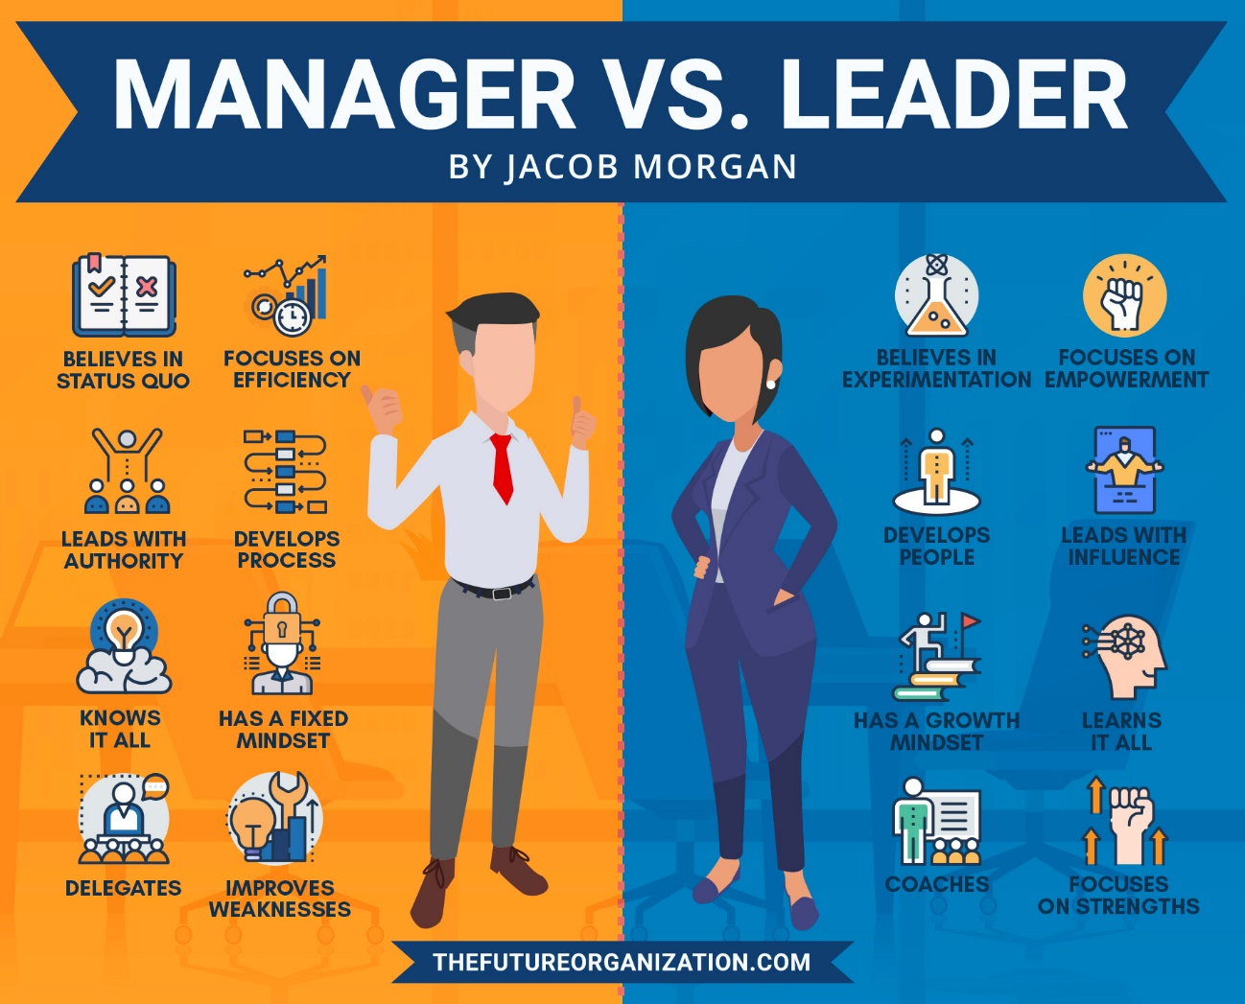
Notes:
We are encouraging EIs to be leaders and coaches, and we can model that for them in our supervision and leadership alongside them

Slide 29
Regularity
Should take place on a reliable schedule with enough time in between to practice.
Reflection and feedback are most effective as immediately as possible after a session.
https://www.zerotothree.org/resource/three-building-blocks-of-reflective-supervision/

Slide 30
Resources
15 Ways to Ask Key Indicator 11: https://fgrbi.com/wp-content/uploads/2020/07/15-Ways-KI-11_2020.pdf
Brown, J. (2020). Collaborative Coaching in Family-Guided Routines-Based Intervention [Powerpoint slides].
FGRBI Key Indicators Manual: https://fgrbi.com/wp-content/uploads/2021/09/KIManual2021-1.pdf ​

Slide 31
Resources
The SLT Scrapbook http://thesltscrapbook.com ​
Three Building Blocks of Reflective Supervision: https://www.zerotothree.org/resource/three-building-blocks-of-reflective-supervision/

Slide 32
Next Coffee Break: October 24 at 11:30 Central/12:30 Eastern
Our next three Coffee Breaks will be a deep dive into the FGRBI EI Competencies (handout available on the Community Resource Website)
Please send your questions, comments, and feedback!
LeeAnn Finnegan
LeeAnn.Finnegan@TN.gov
(629) 259-3711

