Slide 1
EI Competencies
LeeAnn Finnegan, Provider Support Specialist

Slide 2
Agenda
Check-In
FGRBI Knowledge Competencies
Questions/Wrap Up

Slide 3
Check-In

Slide 4
Please share:
What successes have you had with your team/within your own practice since our last Coffee Break?
What is your favorite holiday tradition in the winter holidays?

Slide 5
EI Competencies

Slide 6
EI Competencies
Two segments:
  Knowledge Competencies
  Application Competencies
  Adults learn through the 3 A’s:
    1. Acquiring knowledge
    2. Assimilating knowledge
    3. Applying knowledge

Slide 7
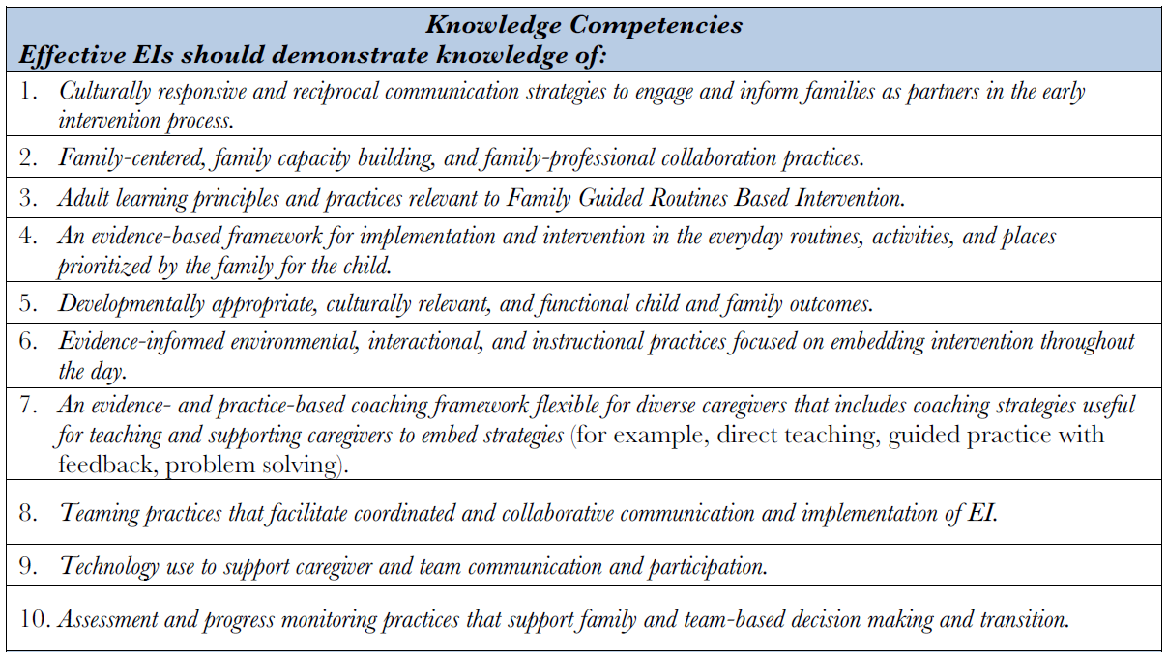
Knowledge Competencies

Slide 8
General Training Resources
Relias: Search “TEIS” in the search box to pull up all TEIS focused training modules.
  If your agency does not utilize Relias, many of the trainings can be accessed through the TEIS Community Resource Website
Council for Exceptional Children (CEC): https://exceptionalchildren.org/
Division of Early Childhood (DEC): https://www.dec-sped.org/
DEC Recommended Practices: https://www.dec-sped.org/dec-recommended-practices

Slide 9
General Training Resources
Early Childhood Investigations Webinars: https://www.earlychildhoodwebinars.com/
Early Intervention Technical Assistance Portal: https://www.eita-pa.org/
FGRBI: www.fgrbi.com
National Association for the Education of Young Children (NAEYC): https://www.naeyc.org/
Virginia Early Intervention Professional Development Center https://www.veipd.org/main/

Slide 10

Knowledge Competency 1
Culturally responsive and reciprocal communication strategies to engage and inform families as partners in the early intervention process.

Slide 11
Resources
Developing Cross-Cultural Competence (4th Edition) by Eleanor W. Lynch and Marci J. Hanson
VEIPD: https://www.veipd.org/main/sub_cult_comp.html
Informal Resources
  Ask questions! Be curious!
  Be open and willing to learn about the families we serve, the countries they came from, and the cultures that they thrive within.

Slide 12
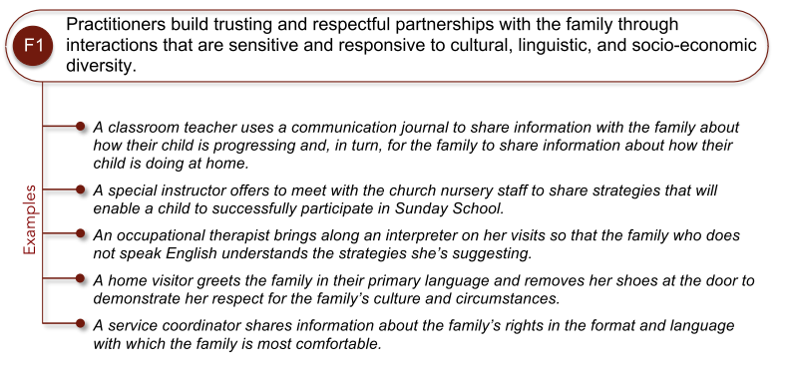
DEC-RP Family 1

Slide 13
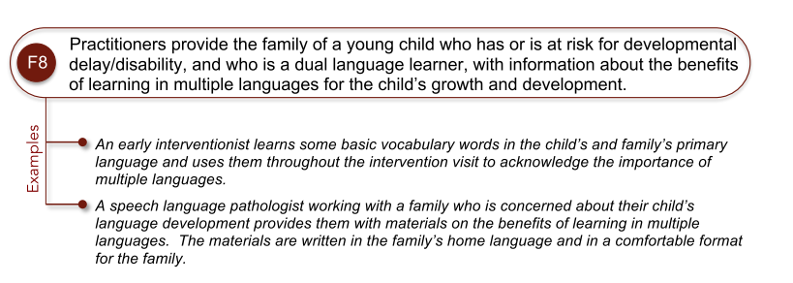
DEC-RP Family 8

Slide 14

Knowledge Competency 2
Family-centered, family capacity building, and family-professional collaboration practices

Slide 15
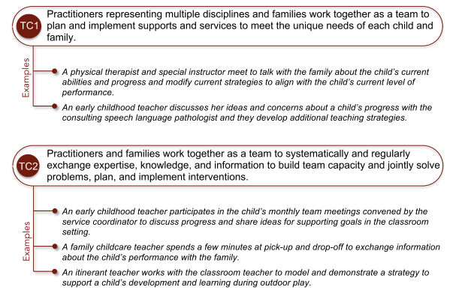
DEC-RP Teaming and Collaboration

Slide 16
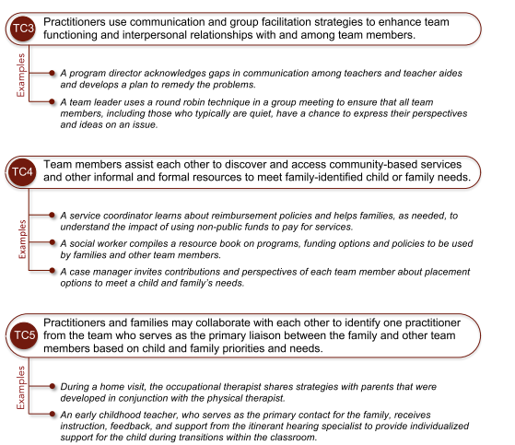
DEC-RP Teaming and Collaboration

Slide 17

Knowledge Competency 3
Adult learning principles and practices relevant to FGRBI.

Slide 18
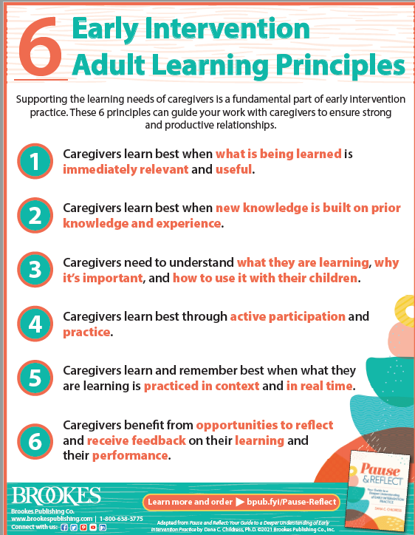

Adult Learning Principles

Slide 19

Knowledge Competency 4
An evidence-based framework for implementation and intervention in the everyday routines, activities, and places prioritized by the family for the child.

Slide 20



FGRBI
https://fgrbi.com/research/

Slide 21

Knowledge Competency 5
Developmentally appropriate, culturally relevant, and functional child and family outcomes.

Slide 22

Knowledge Competency 6
Evidence-informed environmental, interactional, and instructional practices focused on embedding intervention throughout the day.

Slide 23
Evidence Based Practices are:
Shown to have a positive effect on child and family outcomes.
The research design allows one to infer that the practice led to child or student improvement.
Multiple high-quality studies have been conducted.
Reviewed by a reputable organization (e.g., What Works Clearinghouse).
Consider your source and look for citations.
More to come!

Slide 24
Evidence Based Resources
AFIRM (Autism Focused Intervention Resources and Modules): https://afirm.fpg.unc.edu/
Center for the Developing Child at Harvard: https://developingchild.harvard.edu/
Early Childhood Learning and Knowledge Center: https://eclkc.ohs.acf.hhs.gov/
ECTA Center: https://ectacenter.org/topics/evbased/evbased.asp

Slide 25
Evidence Based Resources
Iris Center: https://iris.peabody.vanderbilt.edu/
National Center for the Pyramid Model: https://challengingbehavior.org/
Reach out to your academic institutions to ask for alumni access to university libraries.
If your agency receives any early childhood journals, ask for copies of articles you would like to read to learn more!

Slide 26

Knowledge Competency 7
An evidence- and practice-based coaching framework flexible for diverse caregivers that includes coaching strategies useful for teaching and supporting caregivers to embed strategies (for example, direct teaching, guided practice with feedback, problem solving).

Slide 27
FGRBI
www.fgrbi.com
Many other coaching frameworks have principles that are useful and compatible with FGRBI as well, and we can pull resources from these to complement our practice.
Family and Infant Preschool Program (FIPP): https://fipp.ncdhhs.gov/
Parents Interacting With Children (PIWI): https://eiclearinghouse.org/piwi/model/

Slide 28

Knowledge Competency 8
Teaming practices that facilitate coordinated and collaborative communication and implementation of EI.

Slide 29
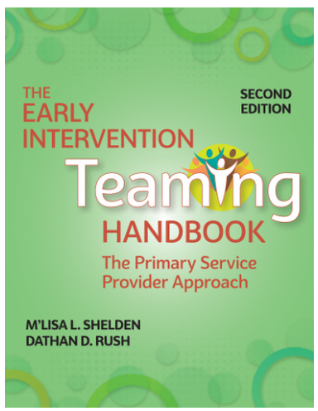
Teaming
Teaming amongst professionals can and should be both formal and informal.
  Formal: IFSP meetings, TCMs, transition meetings, etc.
  Informal: Teaming events, lunch, time to build relationships with team members outside of our official roles

Slide 30
Teaming
Teaming includes the family as well!
  An EI’s role should be to coach the family on how to advocate for themselves, not to advocate for them.
  Help families problem solve through barriers to advocating so they are empowered to continue doing it themselves.
  We are temporary, so we must pour the needed information and education into our families.

Slide 31

Knowledge Competency 9
Technology use to support caregiver and team communication and participation.

Slide 32
Technology Use
This should:
  Match the caregiver’s comfort and ability level while also
  Helping them to learn to use new technology is necessary.
  For example: Family wants to have a telehealth meeting because everyone is sick, but they have never used Zoom or Teams before.
  We should not FORCE families to use technology when they do not want to but assist with access and use as appropriate and desired.
Using Technology to Engage Families: https://www.naeyc.org/resources/pubs/tyc/aug2016/10x-using-technology-engage-families

Slide 33

Knowledge Competency 10
Assessment and progress monitoring practices that support family and team-based decision making and transition.

Slide 34
Progress to Goals form
Progress to Goals is the required progress monitoring within TEIS but…
You are free to use an additional assessment/progress monitoring tool within your agency.

Slide 35
References
8 Concepts from Adult Learning You Can Use to Support Caregivers: http://box5495.temp.domains/~fgrbicom/wp-content/uploads/2020/03/8Concepts.pdf
AFIRM (Autism Focused Intervention Resources and Modules): https://afirm.fpg.unc.edu/
Center for the Developing Child at Harvard: https://developingchild.harvard.edu/
Council for Exceptional Children (CEC): https://exceptionalchildren.org/

Slide 36
References
Division of Early Childhood (DEC): https://www.dec-sped.org/
DEC Recommended Practices: https://www.dec-sped.org/dec-recommended-practices
Early Childhood Investigations Webinars: https://www.earlychildhoodwebinars.com/
Early Childhood Learning and Knowledge Center: https://eclkc.ohs.acf.hhs.gov/

Slide 37
References
Early Intervention Technical Assistance Portal: https://www.eita-pa.org/
ECTA Center: https://ectacenter.org/topics/evbased/evbased.asp
Family and Infant Preschool Program (FIPP): https://fipp.ncdhhs.gov/
FGRBI: www.fgrbi.com

Slide 38
References
FGRBI Early Intervention (EI) Competencies: http://box5495.temp.domains/~fgrbicom/wp-content/uploads/2020/03/EICompetencies.pdf
Iris Center: https://iris.peabody.vanderbilt.edu/
National Association for the Education of Young Children (NAEYC): https://www.naeyc.org/
National Center for the Pyramid Model: https://challengingbehavior.org/

Slide 39
References
Parents Interacting With Children (PIWI): https://eiclearinghouse.org/piwi/model/
Using Technology to Engage Families: https://www.naeyc.org/resources/pubs/tyc/aug2016/10x-using-technology-engage-families
Virginia Early Intervention Professional Development Center https://www.veipd.org/main/

Slide 40
Recommended Texts
Crawford, M. J., & Weber, B. (2014). Early Intervention Every Day! Embedding Activities in Daily Routines for Young Children and Their Families. Brookes Publishing.
Lynch, E. W., & Hanson, M. J. (2011). Developing Cross-Cultural Competence: A Guide for Working with Children and Their Families. (4th ed.). Brookes Publishing.
McWilliam, R. A. (2010). Routines-Based Early Intervention: Supporting Young Children and Their Families. Brookes Publishing.

Slide 41
Recommended Texts
Prath, S. (2014). Routines-Based Early Intervention Guidebook: A Program for Improving Communication Skills with Activities in English and Spanish. CreateSpace Independent Publishing.
Shelden, M. L., & Rush, D. D. (2011). The Early Childhood Coaching Handbook. Brookes Publishing.
Shelden, M. L., & Rush, D. D. (2021). The Early Intervention Teaming Handbook: The Primary Service Provider Approach. (2nd ed.). Brookes Publishing.

Slide 42
Upcoming Meetings
November 22, 2024: EI Q&A at 11:30 Central/12:30 Eastern
December 5, 2024: EIRA Provider Office Hours at 10:00 Central/11:00 Eastern
No Lunch and Learn or Coffee Break in December (Happy Holidays!)

Slide 43
Upcoming Meetings
January 17, 2025: New Directors Meeting (Now open to all!) at 10:30 Central/11:30 Eastern
January 22, 2025: Lunch and Learn at 11:30 Central/12:30 Eastern
January 23, 2025: Coffee Break at 11:30 Central/12:30 Eastern
January 27, 2025: EIRA Quarterly Meeting from 1:00-4:00 Central Time at MTRO, 275 Stewarts Ferry Pike, Nashville

Slide 44
Contact Information
LeeAnn Finnegan
Provider Support Specialist
LeeAnn.Finnegan@tn.gov
629-259-3711

