Slide 1
Medicaid Alternative Pathways to Independence (MAPS)

Slide 2
Today’s Presenter
Jason “Jay” Camperlino
Youth Transition Director, DDA
Jason.Camperlino@tn.gov
Ph. 629-250-9367

Slide 3
Today’s Presentation
What is MAPs?
Who is MAPs for?
How can MAPs help me?
Virtual Community Resource Map
MAPs at Home
MAPs at Work
MAPs in the Community
How to Apply
Where is MAPs today?

Slide 4
what is maPS?

Slide 5
WHAT IS MAPS?
MAPs is a new program that supports people with intellectual and developmental disabilities who want to increase their independence at home, at work, and in their community.
MAPs is a 3-year program we a person works on Milestones that promote greater levels of Independence.

Slide 6
Who is maps for?

Slide 7
Who is MAPs for?
MAPs is for people with intellectual or developmental disabilities who want to:
Learn skills to help them work
Live independently
Learn about their neighborhoods
Find hobbies that interest them

Slide 8
Intellectual Disability
A person with an intellectual disability might have trouble learning at their expected level or doing daily activities without assistance such as:
Letting others know their wants and needs
Taking care of themselves or their home
Talking with other people
Staying healthy and safe
Intellectual disabilities are usually known before a person turns 18.

Slide 9
Who is MAPs for?
MAPs is for people with intellectual and developmental disabilities who:
Will leave high school in the next 3 years or have already left high school.
Are in inclusive higher education programs like Next Steps, IDEAL, or FUTURE.
Are on the waiting list for other long-term services and support programs like Employment and Community First CHOICES (ECF).

Slide 10
Who is MAPs for?
MAPs is not for people already enrolled in Home and Community Based Services or Long Term Services and Supports (ECF).
MAPs is for people already in Vocational Rehabilitation, Family Support or other state funded programs.

Slide 11
Who is MAPs for?

Slide 12
How can maps help me?

Slide 13
How Can MAPs Help Me?
MAPs can help you set up a path to independence.
The program will give you the tools, technology, and support you need to meet the goals you set for yourself at home, at work, and in your community through:
Enabling Technology
Peer Mentoring
Direct and In-Direct Support

Slide 14
Virtual community resource map (VCRM)

Slide 15
Virtual Community Resource Map (VCRM)
A MAPs team will help you find places and activities in your community that interest you.
Your team will include:
An Innovation Coordinator
A person from a MAPs provider agency
Anyone else you want to be there
Your provider will help you create your Virtual Community Resource Map (VCRM).

Slide 16
Virtual Community Resource Map (VCRM)
The VCRM will identify the people, places, and activities that are important to you.
It will include your independence goals at home, at work, and in your community, and your plan to reach these goals.

Slide 17
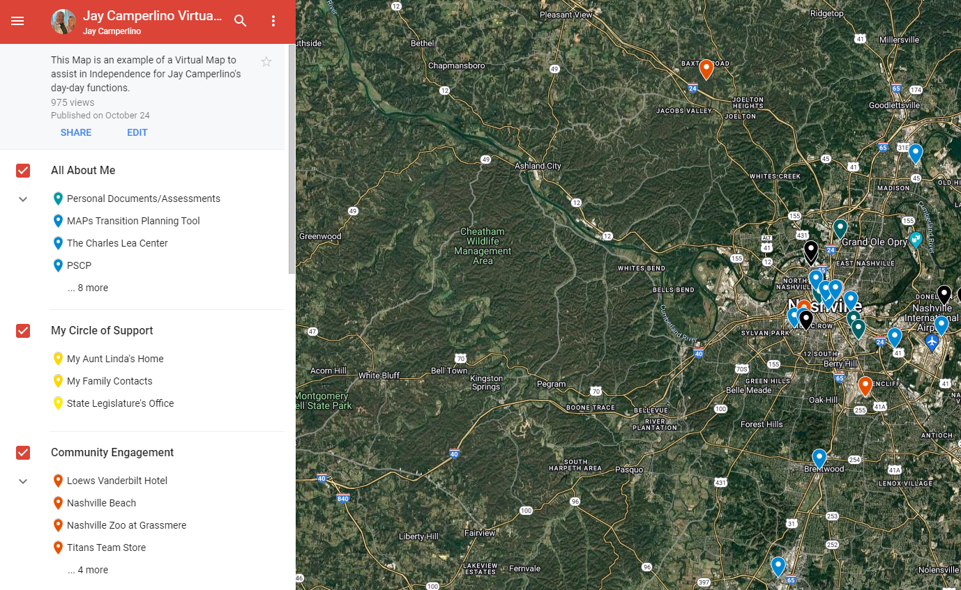

Slide 18
Virtual Community Resource Map (VCRM)
With your VCRM, you can
Get to know where things are in your community
Build a daily schedule so you can get to school and/or work
Learn how to travel in your community
Find opportunities in the community so you can meet new people
Find resources so you can explore new interests and goals

Slide 19
VCRM
You will be able to access your map on your own cell phone, tablet, or computer, or a cell phone provided through the program.

Slide 20
Maps supports

Slide 21
Enabling Technology
Enabling Technology is the use of devices and technology to support a person with disabilities to live as independently as possible.
These types of technologies include sensors, mobile applications, remote support systems, and other smart devices.

Slide 22
Enabling Technology
Enabling Technology can support you in your job and communities, help you gain more control of your environment, and provide remote support and reminders to assist you in independent living.
Endeavor
WayFinder

Slide 23
Peer Mentoring
Peer Mentoring can help you connect to peers who share similar interests, goals, and have a shared life experience of having an intellectual or developmental disability.
Both you and your Peer Mentor can learn from and support each other to achieve your goals.

Slide 24
Direct Supports
A MAPs provider can provide you with direct support to help you learn the skills you need to be more independent.
You can receive direct support from a person who is trained to support you gain skills that help you be more independent.

Slide 25
Direct and In-Direct Supports
They can support you in person or remotely.
Direct and In-Direct support will decrease as you become more independent and comfortable in your new skills.
Remember: MAPs is a 3-year program, we are trying to avoid learned dependence on the supports.

Slide 26
Maps At home

Slide 27
MAPs At Home
MAPs can help you gain independence at home.
You can learn skills that will help you
Stay safe at home
Prepare healthy meals
Maintain personal hygiene and take care of yourself
Manage your health by scheduling appointments with your doctor and asking for medical help when needed
Manage your money including paying bills, budgeting money for groceries and other expenses, and saving money

Slide 28
MAPs At Home
A person called an Independence Coach can help you learn these skills and provide support until you no longer need it.
Enabling Technology can also provide you with additional support and safety while you’re at home.

Slide 29
Enabling Technology at Home
There are many different ways you can use Enabling Technology at home.
A few examples of Enabling Technology you could use at home are:
Motion Sensors to help your supports know when you might need help
Ring doorbell to help you know when you have visitors
Live or on-demand audio and/or video calling so you can reach support
Automated medication dispensers to help you take your medication correctly

Slide 30
Maps At work

Slide 31
MAPs At Work
MAPs services can help you find a job and advance your career.
You can choose to receive supports so you can:
Find a job based on your strengths, skills, and interests
Figure out what support you will need at your job to be successful
Learn how to travel to and from work
Get a promotion

Slide 32
MAPs At Work
A person called a Job Coach or Job Developer can support you at work until you no longer need it.
Enabling Technology can also help you reach your goals at work.

Slide 33
Enabling Technology at Work
There are many different ways you can use Enabling Technology at work.
A few examples of Enabling Technology you can use at work are:
A phone or tablet that can teach you or remind you of your job responsibilities using video, audio, or pictures.
A phone or tablet that has GPS to help you navigate to work.
Online assessments to help you learn your skills, strengths, and interests.
Virtual reality to help you learn about different career paths and learn your job.

Slide 34
Maps in the community

Slide 35
MAPs In The Community
Your VCRM and other MAPs services can support you in your community to
Become aware of where your job, school, and other favorite places are within your community.
Develop routines to make scheduled and unscheduled community outings easier.
Find interests and create goals that are unique to you.
Meet new people and make connections with others in your community who share your same interests.
Learn to become more confident in situations or places that might seem overwhelming.
Complete a fully customized Travel Training Curriculum to help you navigate your community.

Slide 36
How to apply

Slide 37
How To Apply
To enrollment into the program, you will need to complete the application on the DDA website.
The application will ask you for basic information such as your
Name
Address
Email
Social security number
Parent/guardian information

Slide 38
How To Apply
Documentation will not be required when completing the application but will be needed later on in the process.
Examples of documents you might need are:
Medical records that show a diagnosis of intellectual or developmental disability
An IQ evaluation with diagnosis of intellectual disability
School records identifying the diagnosis (e.g., IEP or other assessments)
Therapy notes/assessments completed by a clinician identifying intellectual or developmental disability
Social Security Administration documents that list a diagnosis of intellectual or developmental disability
Conservatorship Documentation (if applicable)
Photo/Media Consent, Releases of Information (To be signed)

Slide 39
MAPs: Where Are We Today?
- MAPs Enrollment: 520+ (working up to 1250)
Delivering Services throughout entire State
20+ Provider Agency Partners
Peer Mentoring Request for Applications ACTIVE
217 Virtual Community Resource MAPs validated
300 Individual Milestones Achieved
Learning, Growing and Improving!

Slide 40
Where Can I find Information?
We have a MAPs webpage where you can find the latest updates on the program.
Find the webpage here: Medicaid Alternative Pathways (MAPs)
Follow us on social media:
Facebook
Instagram
YouTube
Twitter

Slide 41
Questions and Answers

