Slide 1
CUSTOMER-FOCUSED SERVICES
ADVOCACY SERVICES & COMPLAINT RESOLUTION

Slide 2
ADVOCACY SERVICES
The Division of Advocacy Services was established to ensure that DIDD listens to and responds to the needs and concerns of people we support and their families so that we are their best advocate.

Slide 3
CUSTOMER FOCUSED SERVICES
Upon Request – Customer Focused Services staff:
Attend COS meetings on behalf of persons supported [i.e., our customers], acting as their voice, listening empathetically, and providing consultation and guidance
Conduct Complaint & Conflict Resolution Interventions on behalf of customers, family representatives and/or their legal reps
Provide Self-Advocacy opportunities thru Focus Groups
Provide Conflict Management Training
Provide Mediation via CFS ADR: Rule 31 Mediators

Slide 4
COMPLAINT RESOLUTION
A formal process created—for DIDD recipients, their families, representatives, People Talking to People, etc.—whereby concerns can be addressed and entered into COSMOS.
CFS Coordinators assist by listening, advising, guiding, networking on consumer’s behalf, etc.
Issues resolved include: Communication, Health, Environmental, Training, Decision Making, Treatment, Financial, Human Rights, etc.
Services include: Residential, Day, PA, etc.

Slide 5
CONFLICT RESOLUTION
CFS Coordinators provide Conflict Intervention services for DIDD stakeholders
Conflict Intervention is typically employed when barriers to services are identified
Barriers include disputes in decision-making authority, communication breakdown, misunderstanding DIDD requirements, etc.
Conflict can be between customers, parents/families, legal reps, providers, etc.

Slide 6
FOCUS GROUPS
CFS Coordinators facilitate and/or attend meetings for customers. The direction these meetings take is largely driven by participant interest. Topics range from employment, education, relationships, etc.
CFS Coordinators can also attend parent, Provider, ISC and other DIDD stakeholder meetings in effort to advocate on DIDD customer’s behalf

Slide 7
CONFLICT MANAGEMENT TRAINING
CFS Coordinator/Mediator trains Provider staff and DIDD stakeholders in Conflict Management. Training includes:
Conflict sources and early identification,
Effective Listening & Communication,
Conflict management styles,
Conflict diffusion and resolution,
Stress Management and self-care

Slide 8
CFS MEDIATION
Mediation can be requested by disputants or regional staff after attempts to resolve conflict via Complaint Resolution has been engaged.
Mediation is an option intended for use in extreme cases of dispute only.
Dr. Coleman & Dr. Mailahn can be contacted for mediation services. The Regional Office Directors can also be contacted for requesting Mediation Services.

Slide 9
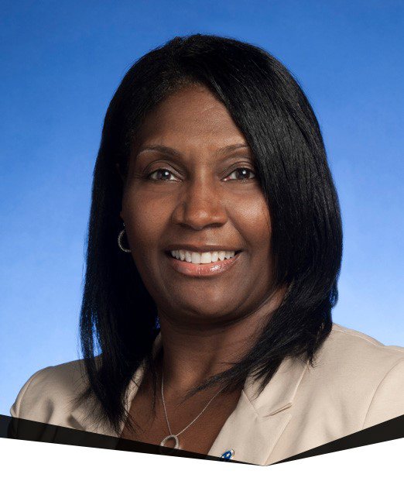
CFS CONTACTS: WEST
Dr. Vickey Coleman, CFS Director & Rule 31 Mediator
901-356-6324 (cell)
901-745-7880 (fax)
P.O. Box 949
11437 Milton Wilson Rd.
Arlington, TN.38002

Slide 10
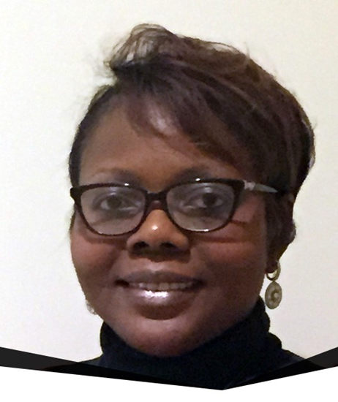
CFS CONTACTS: WEST
Yolanda Beason, CFS Coordinator Yolanda.Beason@tn.gov
901-745-7523 (office)
901-237-1780 (cell)
901-745-7880 (fax)
P.O. Box 949
11437 Milton Wilson Rd.
Arlington, TN.38002

Slide 11
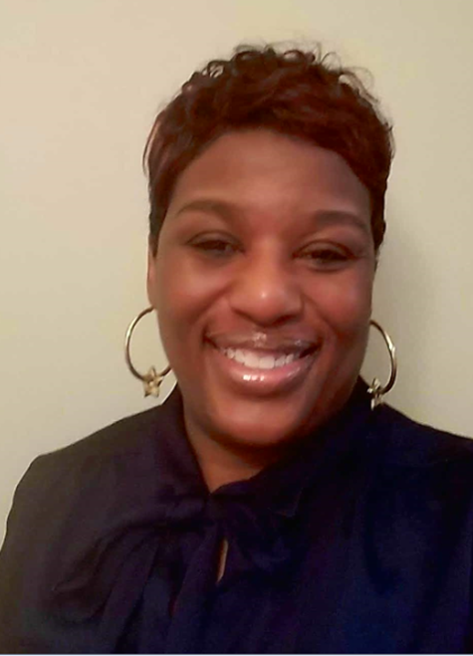
CFS CONTACTS: WEST
Rhonda Alston, CFS Coordinator Rhonda.Alston@tn.gov
901-745-7556 (office)
901-484-8743 (cell)
901-745-7880 (fax)
P.O. Box 949
11437 Milton Wilson Rd.
Arlington, TN.38002

Slide 12
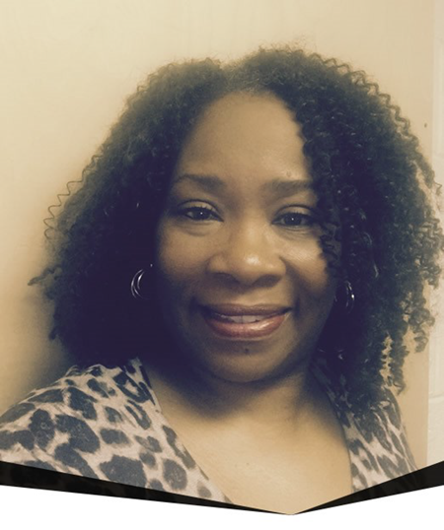
CFS CONTACTS: MIDDLE
Sherry Baskerville, CFS Coordinator Sherry.Baskerville@tn.gov
615-231-5362 (office)
615-651-0155 (cell)
615-231-5122 (fax)
309-A Stewarts Ferry Pike
Fir Cottage
Nashville, TN 37214

Slide 13
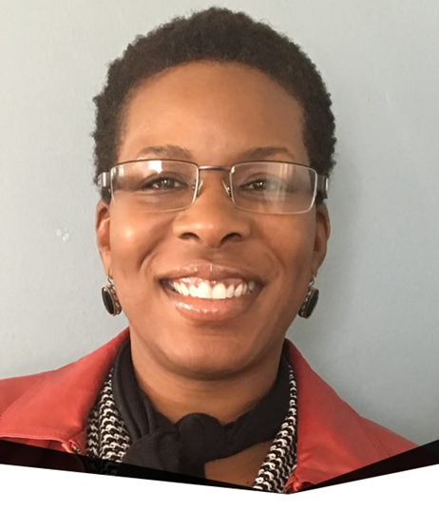
CFS CONTACTS: MIDDLE
Schavonne Hallmon, CFS Coordinator Schavonne.Hallmon@tn.gov
615-837-5531 (office)
615-840-3068 (cell)
615-231-5122 (fax)
309-A Stewarts Ferry Pike
Fir Cottage
Nashville, TN 37214

Slide 14
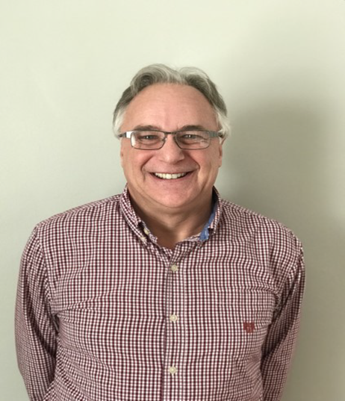
CFS CONTACTS: EAST
Jerry Winters, CFS Coordinator Jerry.Winters@tn.gov
423-787-6526 (office)
423-435-1710 (cell)
865-558-8269 (fax)
4850 E. Andrew Johnson Hwy
Greeneville, TN 37745

Slide 15
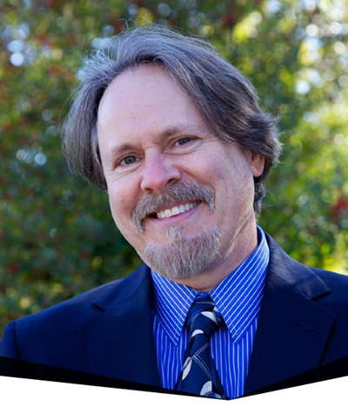
CFS CONTACTS: EAST
Dr. Michael Mailahn, CFS Coordinator & Rule 31 Mediator
865-320-2196 (cell)
865-558-8269 (fax)
520 West Summit Hill Dr.
Suite 201
Knoxville, TN 37902

Slide 16
QUESTIONS & ANSWERS
Q: Who is to provide a Complaint Resolution System?
A: Per the DIDD Provider Manual [Chapter 2.6] …Providers are required to establish a complaint resolution system:
Examples of “Providers” include –
Providers of Day, Residential and Supported Employment Services, Providers of Clinical (Nursing, Behavioral and Therapy) Services, Providers of Support Coordination [ISC] Services

Slide 17
QUESTIONS & ANSWERS
Q: How Formal is this process to be?
A: Upon admission and periodically, providers should notify each person supported (family, guardian and/or legal rep) of their Complaint Resolution System, its purpose, and the steps involved to access it.
Providers are to contact CFS whenever their designated complaint person changes.
In the event that persons supported (et. al) do not agree with the provider’s proposed solution to a complaint, they may contact the DIDD Regional Customer Focused Services Coordinator for assistance.

Slide 18
QUESTIONS & ANSWERS
CFS involvement could include formal mediation or intervention meetings.
The provider’s Complaint Resolution System will be reviewed for appropriateness during the provider’s DIDD Quality Assurance survey.
Retaliation against anyone reporting a complaint to the Provider or DIDD is Strictly Prohibited

