Slide 1
Tennessee Real Estate Commission
Broker Release Request

Slide 2
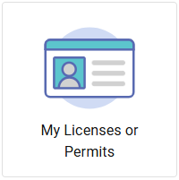
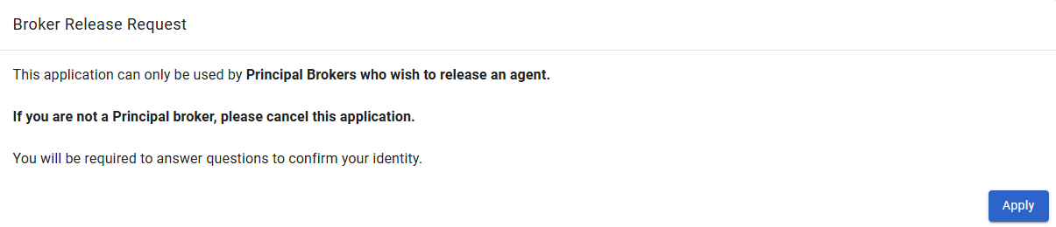
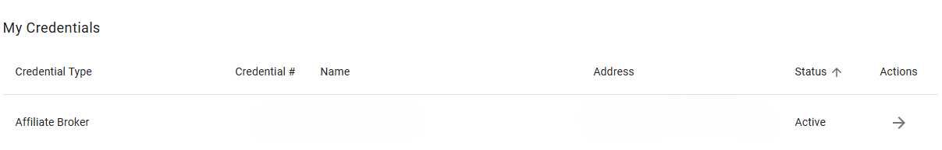
Sign In & Select Broker Release
Sign in to account at core.tn.gov.
Click My Licenses or Permits.
Click the arrow next to your license.
Scroll down until you see the Broker Release Request.
Click Apply.

Slide 3
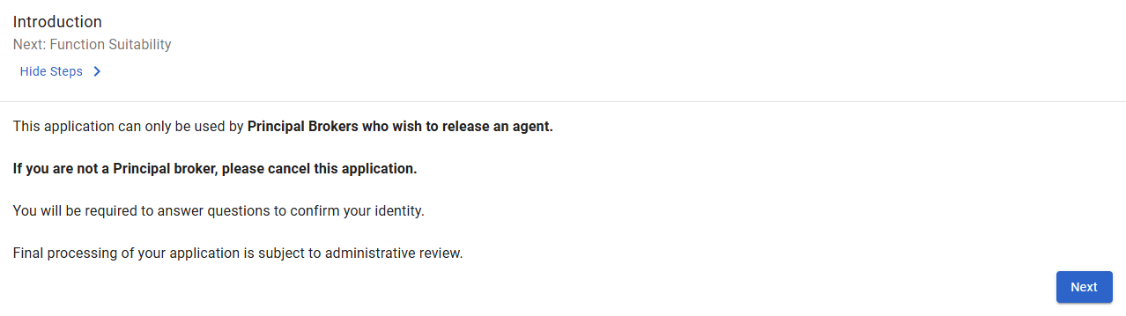
Introduction
Reminder that this application is only for Principal Brokers seeking to release an agent.
Applications are subject to review for approval.
Click Next to continue.

Slide 4
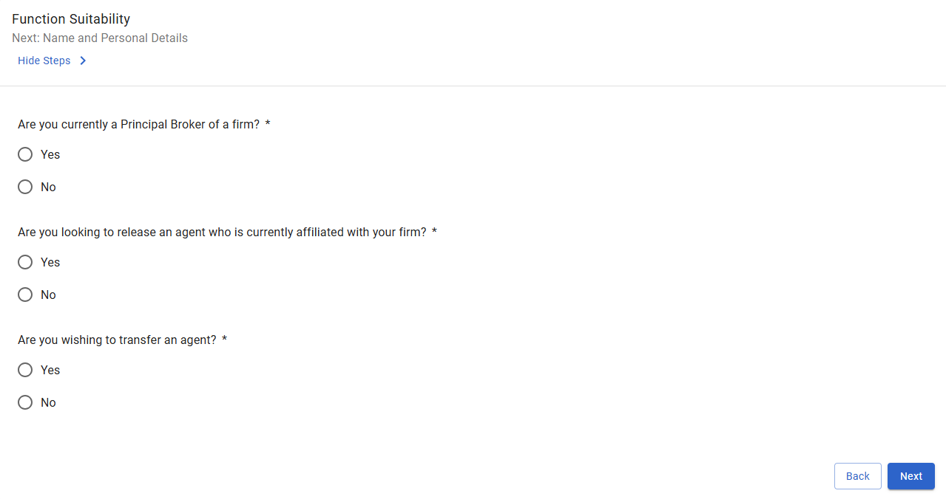
Function Suitability
Answer all questions to confirm you meet requirements to submit the application.
Submitting incorrect applications can cause processing delays.

Slide 5
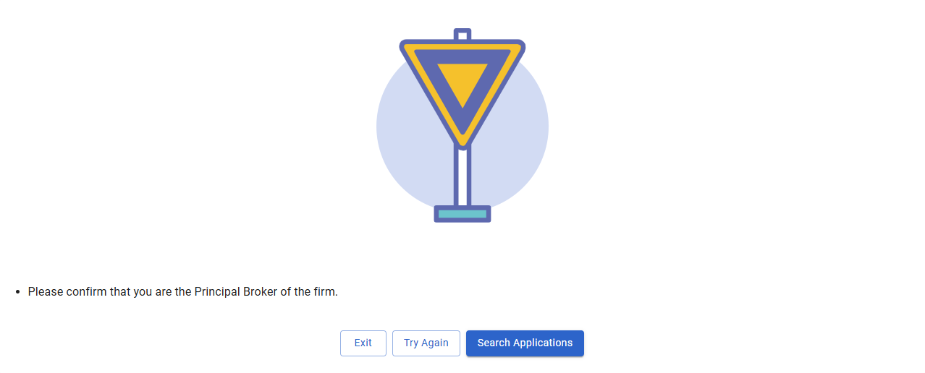
Function Suitability Error Message
If you receive an error message, you can Try Again or Exit the application to resume later.
If you have questions about an error message, you can contact our customer service line.

Slide 6
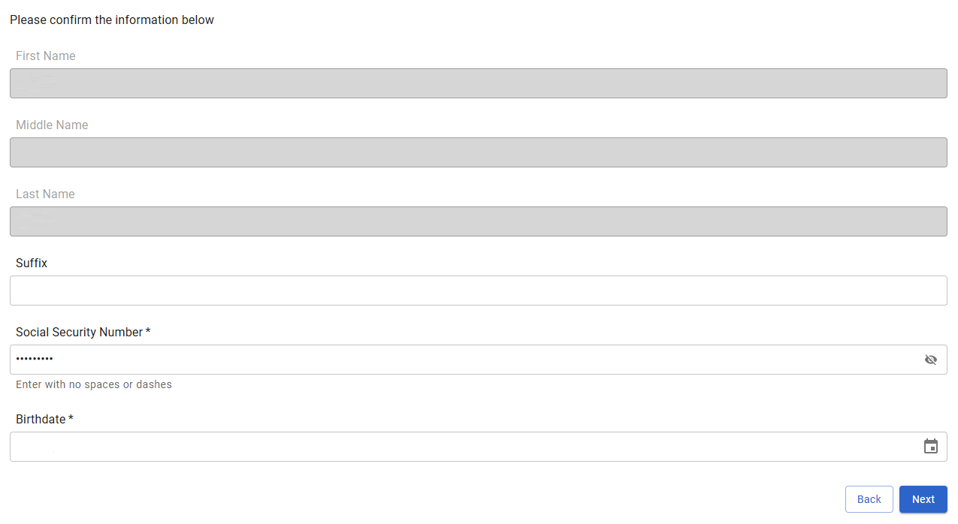
Review Name & Details
Review principal broker name and personal information as it currently appears.
Click Next to continue.
Please note: Information on this page is only for review and cannot be changed.

Slide 7
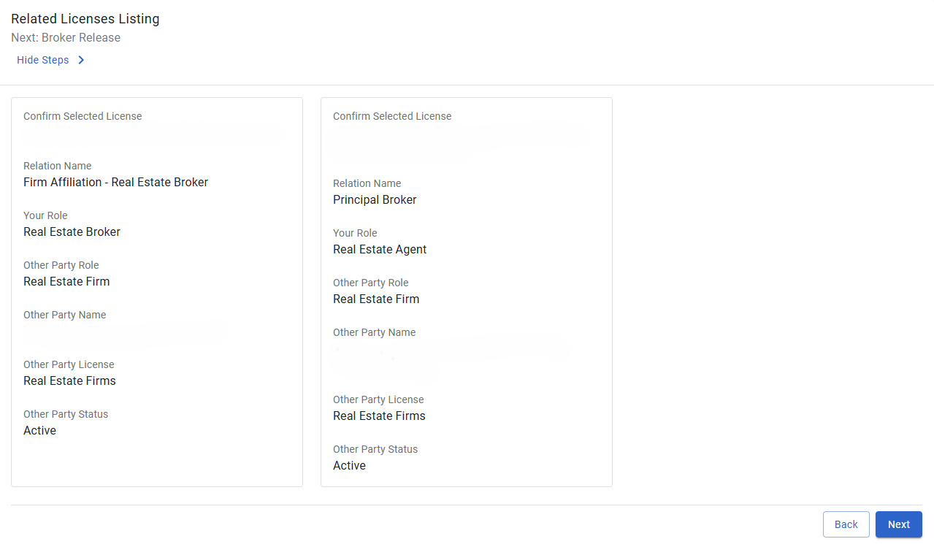
Review Related Licenses
Review your current firm affiliation.
Click Next to continue.
Please note: Information on this page is only for review and cannot be changed.

Slide 8
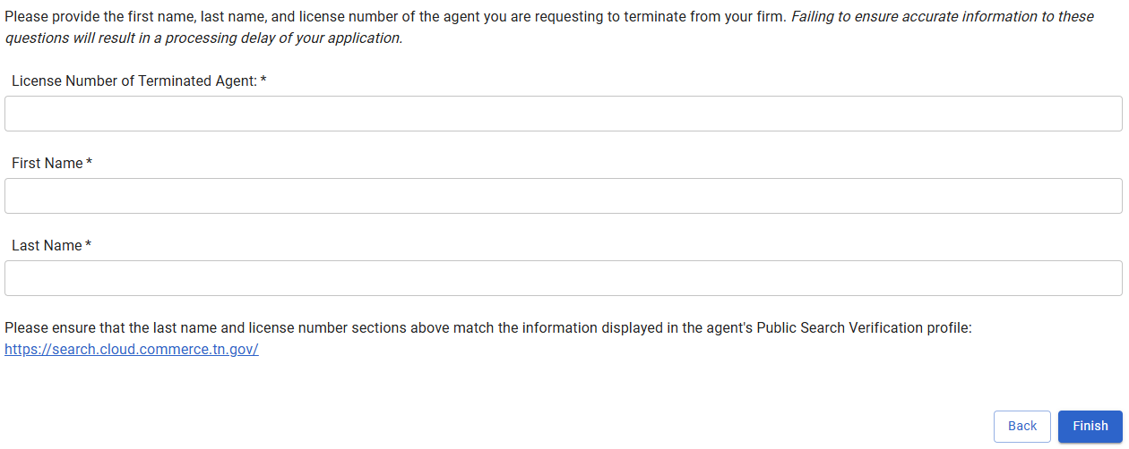
Enter Released Agent Information
Enter the name and license number of the agent you are releasing.
Inaccurate and/or incomplete information can cause processing delays.
Click Finish to continue.

Slide 9
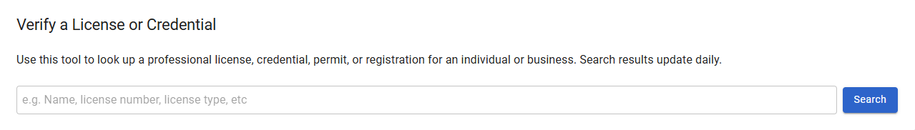
Verify License
You can confirm the name and/or license number of an agent to be released on our public Verify site.
Enter the name or license number you are trying to confirm, then click Search.

Slide 10
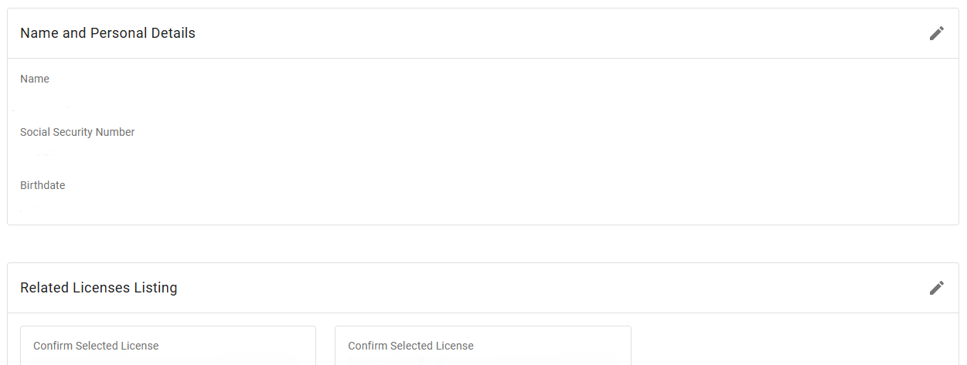
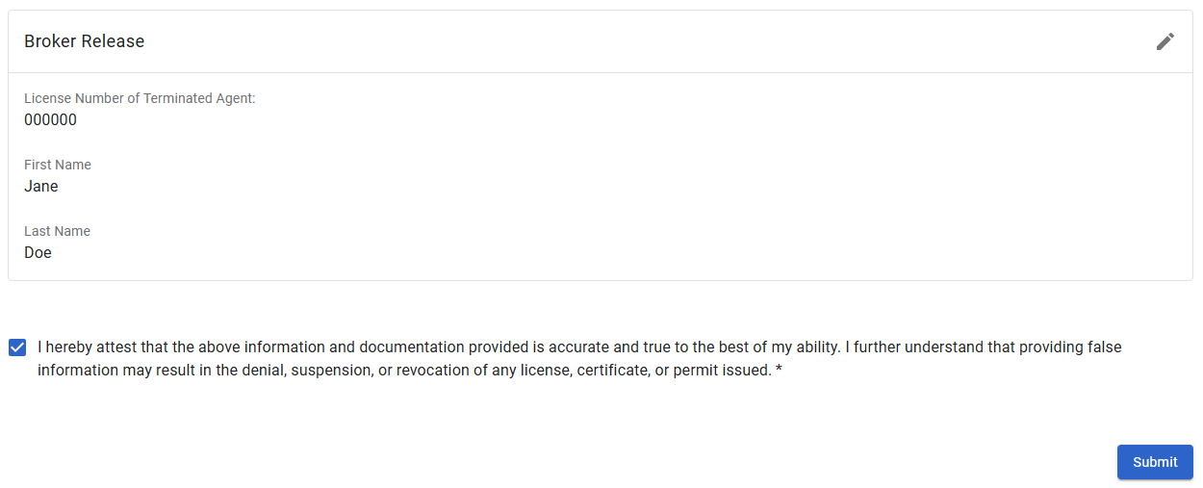
Review & Certify
Review all information.
Check box to certify accuracy of information and potential consequences of providing false information.
Click Submit to submit the application.

Slide 11
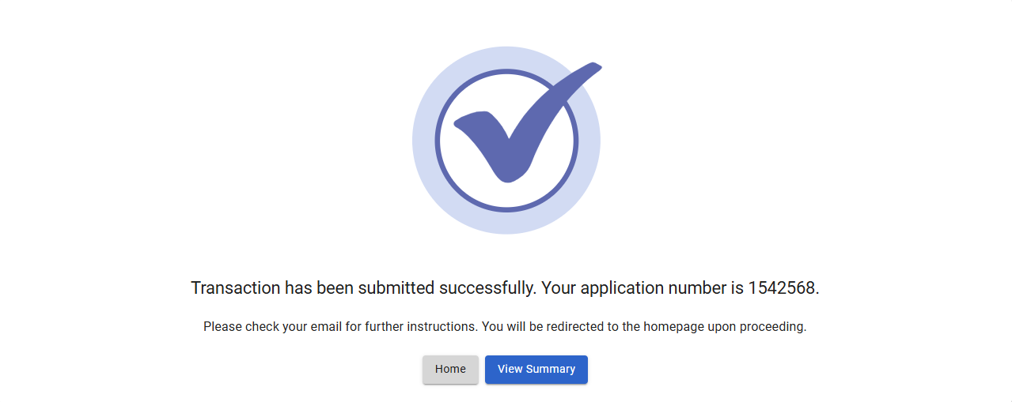
Transaction Submitted
Once submitted, an application summary will be sent to the email address on file. You can also download a copy of the application summary by clicking View Summary.
There is no fee for this application.

Slide 12

Contact TREC
Website: Tennessee Real Estate Commission
Email: TREC.info@tn.gov
Phone: 615-741-2273
Tennessee Real Estate Commission
Regulatory Boards Division
Tennessee Department of Commerce and Insurance
Davy Crockett Tower
500 James Robertson Parkway
Nashville, TN 37243

