Slide 1
Appraiser Temporary Practice Permit
Tennessee Real Estate Appraiser Commission

Slide 2
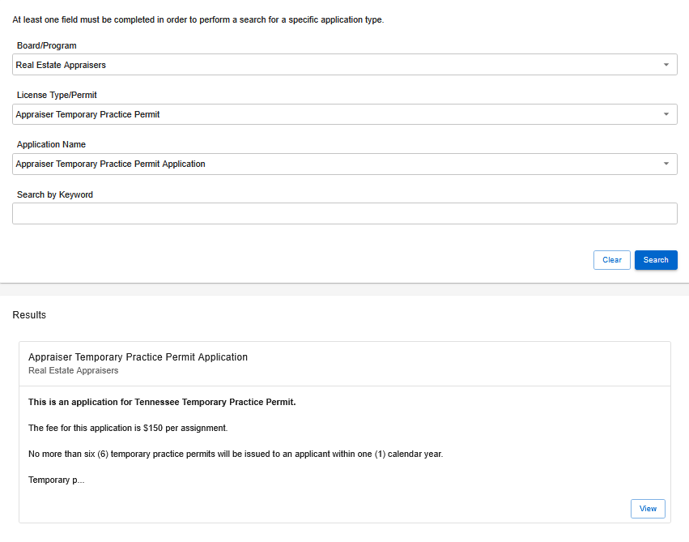
Step 1: Application Search
Search for the application.
Board/Program: Real Estate Appraisers
License Type/Permit: Appraiser Temporary Practice Permit
Application Name: Appraiser Temporary Practice Permit Application
Select View once the results appear.

Slide 3
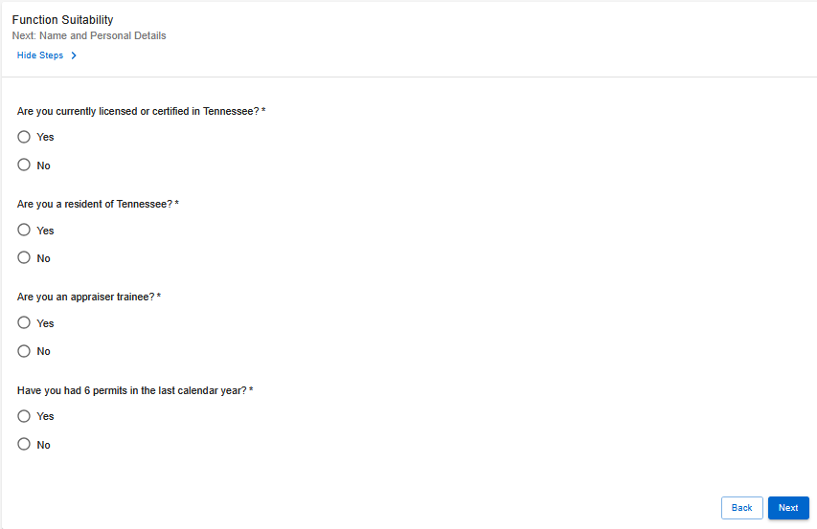
Step 2: Function Suitability
This section confirms whether you meet the requirements to continue the application.
Answer all questions based on your current status.
If you receive an error message you believe is incorrect, please contact the Board office.

Slide 4
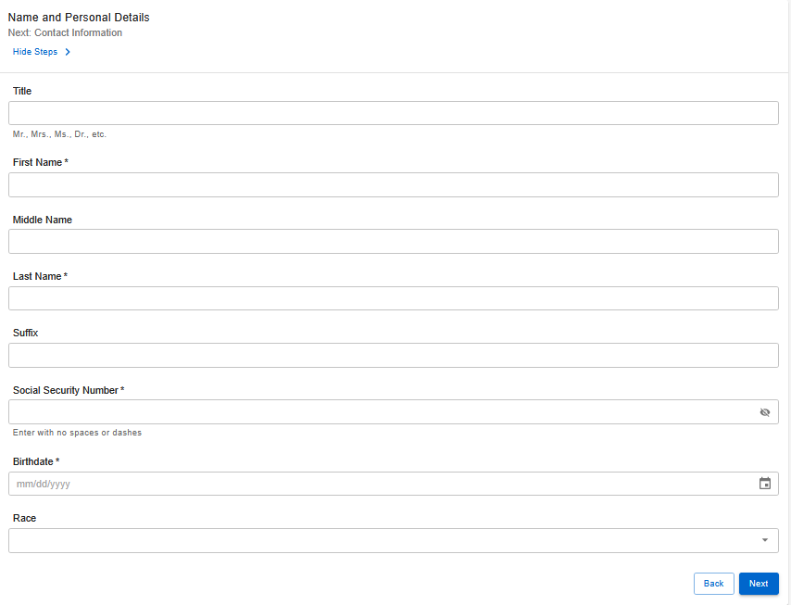
Step 3: Name & Personal Details
Complete all required fields.
Your social security number is required to proceed.
Note: If you do not have a social security number, contact the Board office for assistance.

Slide 5
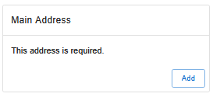
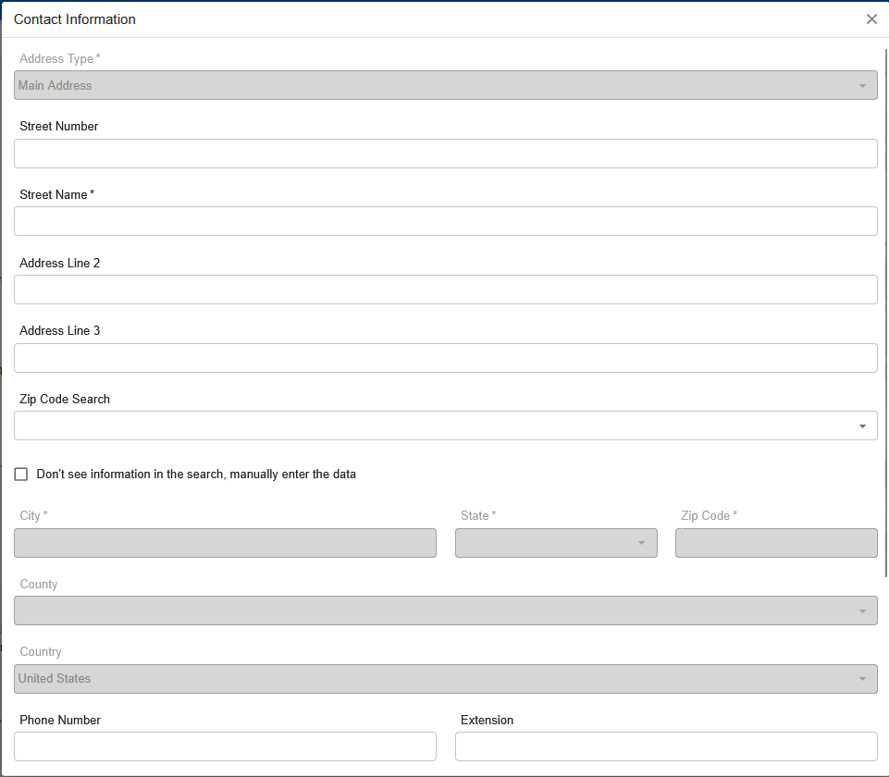
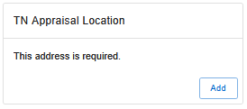
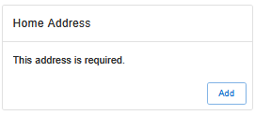
Step 4: Contact Information
Enter your main and home address, as well as your TN Appraisal Location.
You may also provide any additional appraisal locations you wish to include.

Slide 6
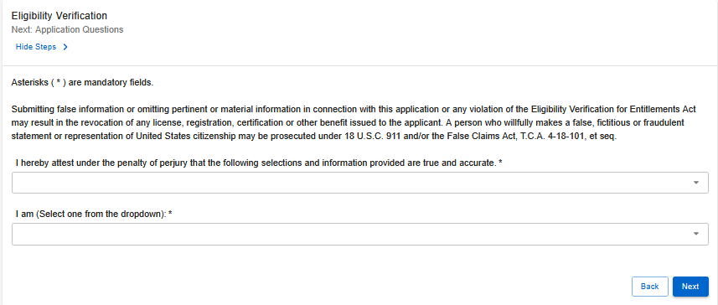
Step 5: Eligibility Verification
Select the appropriate option from the drop-down menu and complete all required fields.
You must provide supporting documents to verify your eligibility.
A list of acceptable documents can be found here.

Slide 7
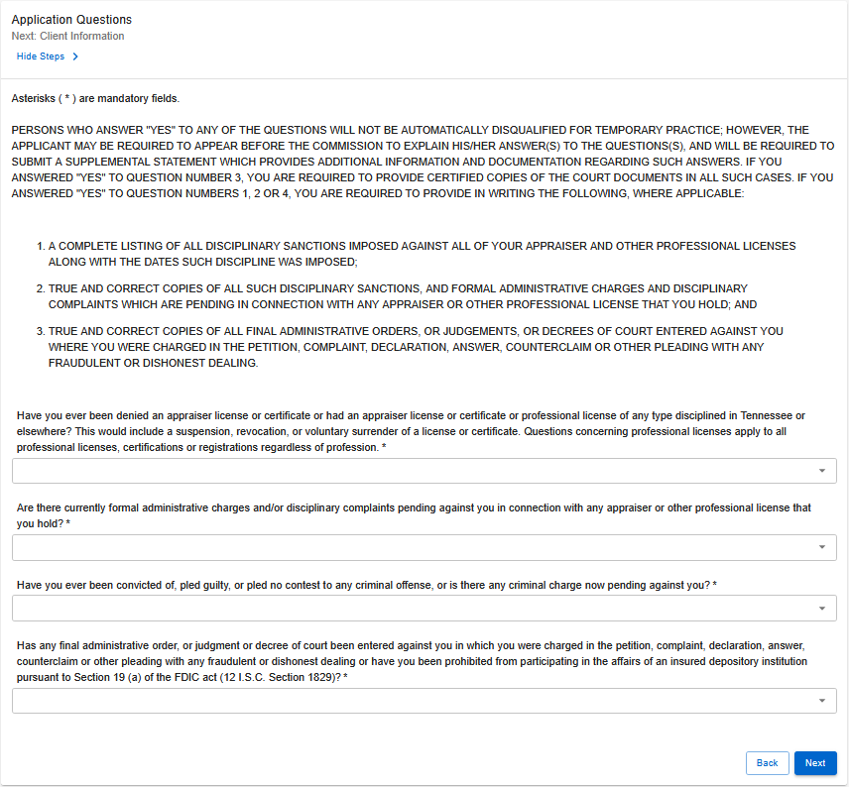
Step 6: Application Questions
Answer all questions based on your current status.
If you select “Yes” to any question, additional documentation will be required, such as court documents or details of disciplinary actions.
Note: Review the instructions on the Application Questions page for details on required documentation.

Slide 8
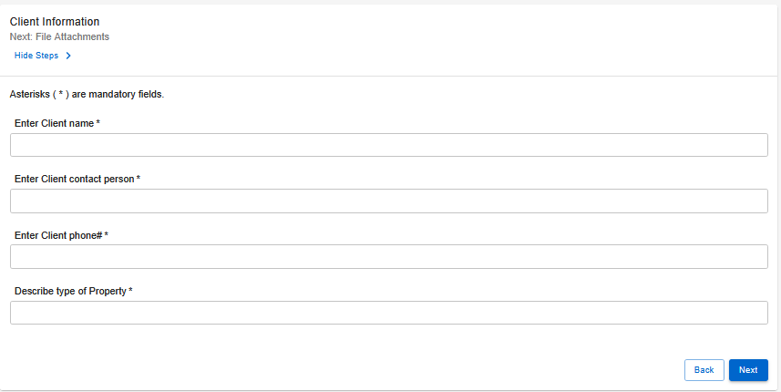
Step 7: Client Information
Fill out the required fields:
Client Name
Point of Contact
Phone Number
Property Description

Slide 9
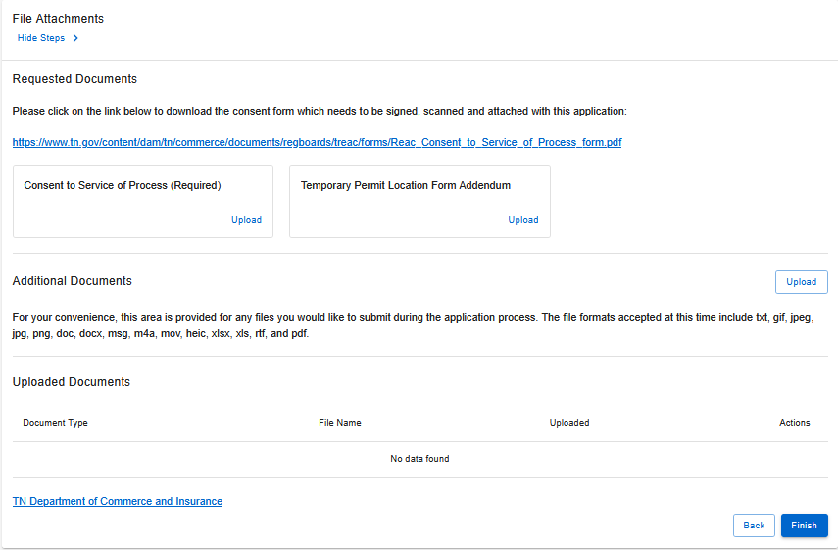
Step 8: File Attachments
Upload the requested documents:
Consent to Service of Process (required)
Temporary Permit Location Form Addendum
Use the Additional Documents section to upload other files if needed.
Note: Instructions for uploading your documents as a PDF can be found here.

Slide 10

Step 9: Summary
Review all information to ensure accuracy.
Submitting incorrect or incomplete information may delay processing.

Slide 11
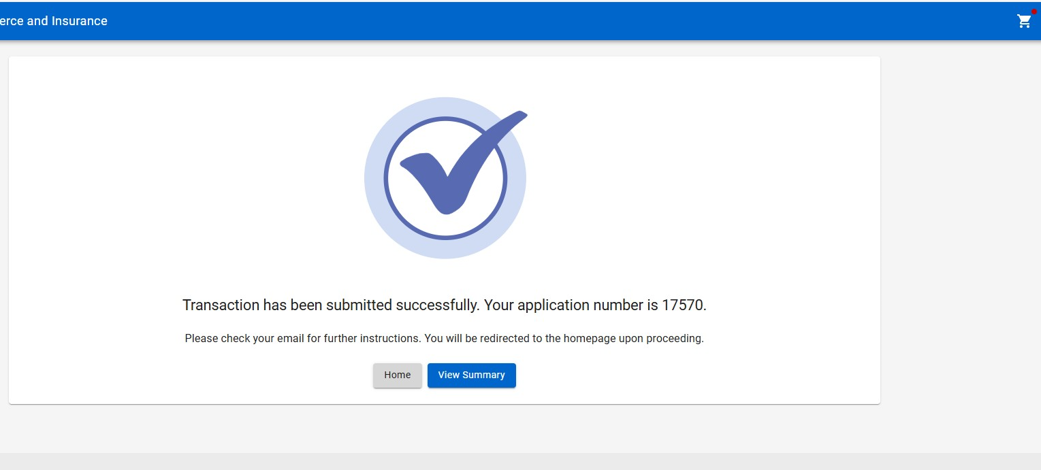
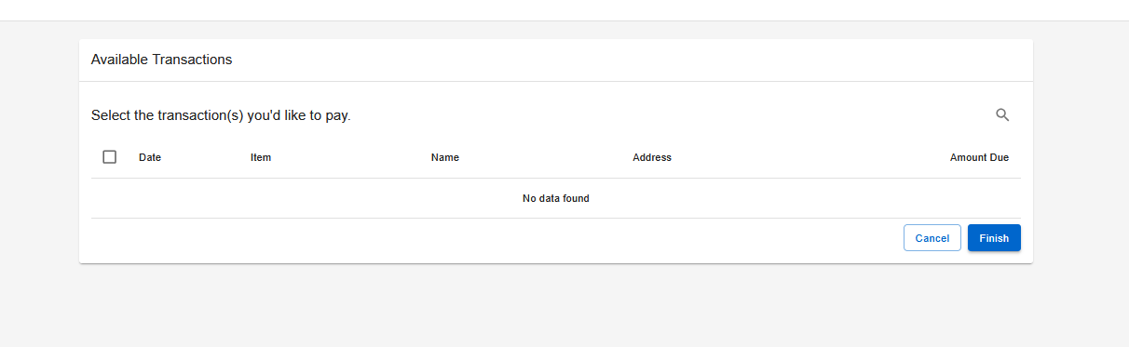
Step 10: Paying for the Application
After submitting your application:
Select the shopping cart icon in the top-right corner of the screen.
Select your application and follow the on-screen prompts to pay the amount due.
Note: Your application will NOT be processed until the application fee is received.

Slide 12

Step 11: Wait for Further Correspondence
If additional information is needed, you will receive an emailed letter outlining the steps required to complete your application.
If a letter is not received, you can assume your application is progressing in the licensing process.
Reminder: Monitor the email address associated with your account, including spam or junk folders.

Slide 13
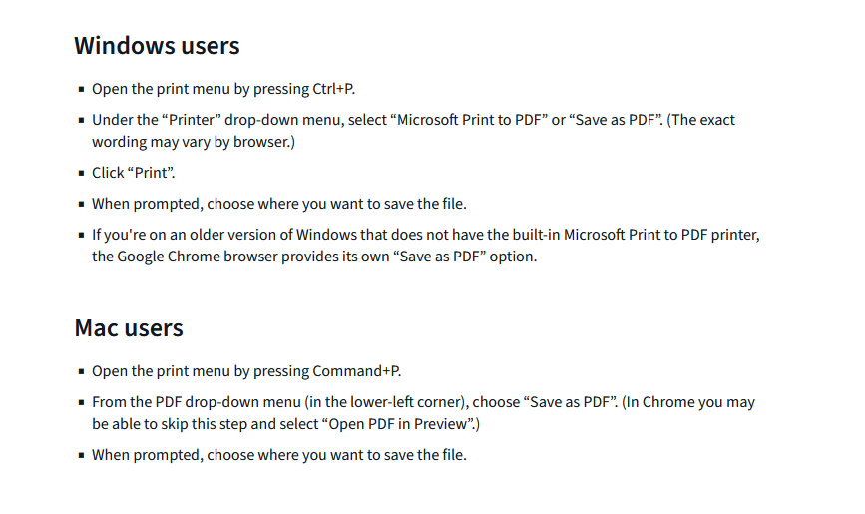
How To: Upload Your File Attachments (as a PDF)
Step 1: Identify the document you wish to save.
Step 2: Follow this guide to saving your document as a PDF.
Step 3: Locate the saved document and upload it to your application.
Note: For an easy way to turn physical documents into a PDF for upload, you can use your phone. You can find instructions for the specific model of your phone here.
For applicants applying on their phones, please follow one of the below guides:
Android
iPhone

Slide 14

Board Contact Information
Email: realestate.appraisers@tn.gov
Customer Service Phone: 615-741-2241
Address:
Tennessee Department of Commerce and Insurance
Tennessee Real Estate Appraiser Commission
Davy Crockett Tower, 10th Floor
500 James Robertson Parkway
Nashville, TN 37243
For more information or assistance, please visit the Board website by clicking the image above.

