Slide 1
Renewal Application: Home Inspector
Home Inspector Licensing Program

Slide 2
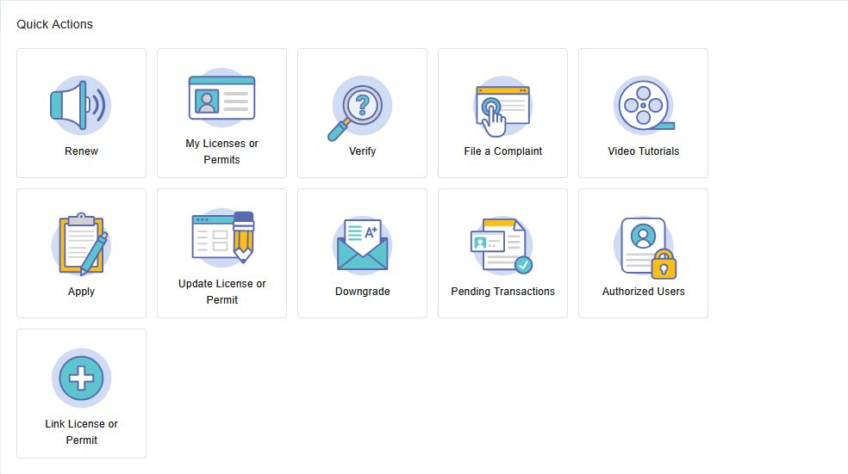
Step 1: Home Page
Click the Renew tile.
Note: If the renewal tile does not appear, please contact the Board to have your license linked.

Slide 3
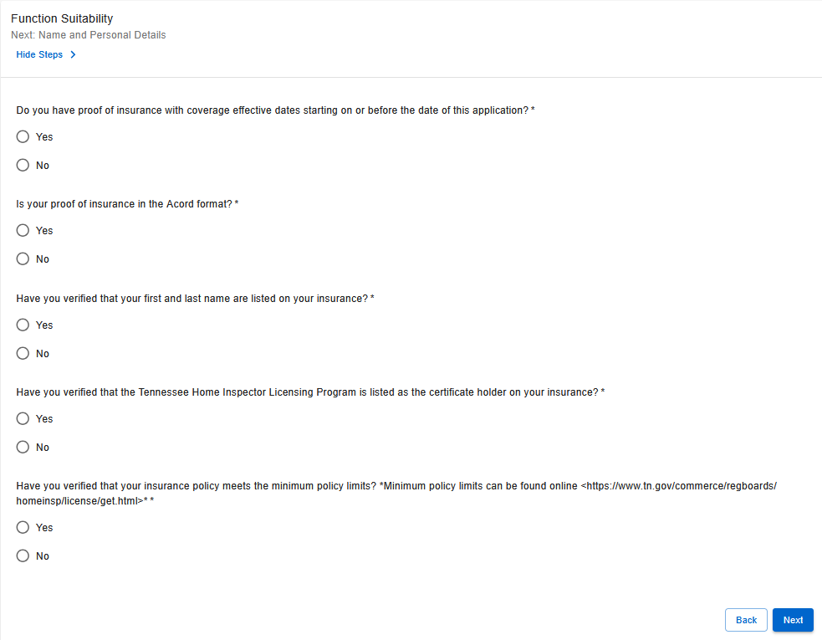
Step 2: Function Suitability
This section confirms whether you meet the requirements to continue the application.
Answer all questions based on your current status.
If you receive an error message that you believe is incorrect, please contact the Board office.

Slide 4
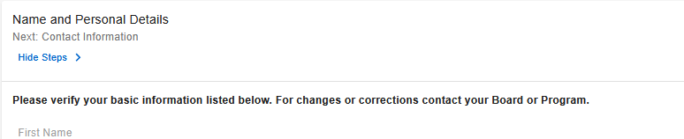
Step 3: Name & Personal Details
Verify your information.
Note: For assistance updating your name or personal details, please contact the Board office.

Slide 5
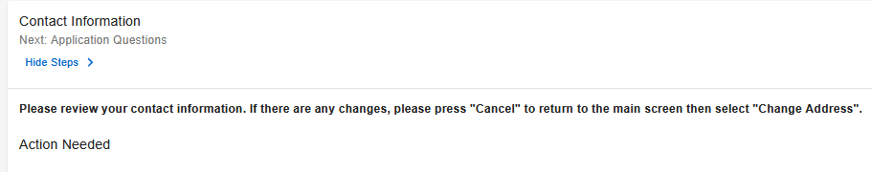
Step 4: Contact Information
Ensure your home, business and main addresses are correct.
Note: If you are having difficulty updating your contact information, please contact the Board office.

Slide 6
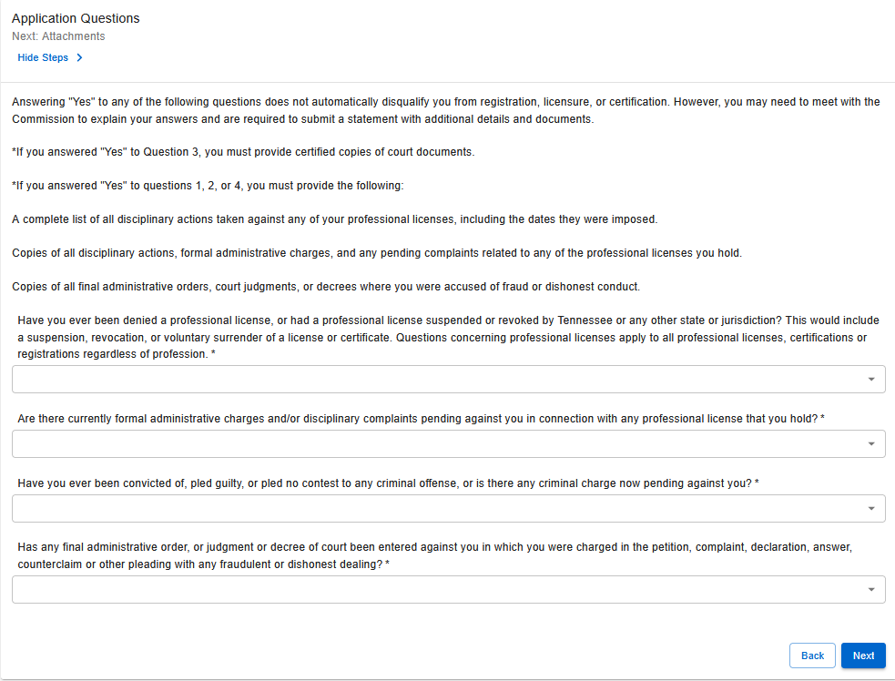
Step 5: Application Questions
Answer all questions based on your current status.
If you select “Yes” to any question, additional documentation will be required, such as court documents or details of disciplinary actions.
Note: Review the instructions on the Application Questions page for details on required documentation.

Slide 7
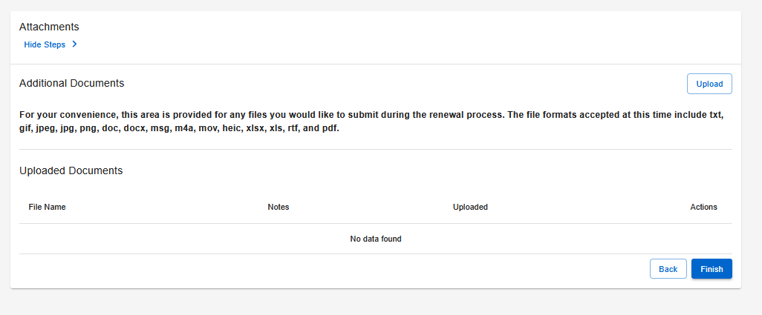
Step 6: File Attachments
Upload any file attachments you wish to provide with your renewal application.
Note: Instructions for uploading your documents as a PDF can be found here.

Slide 8
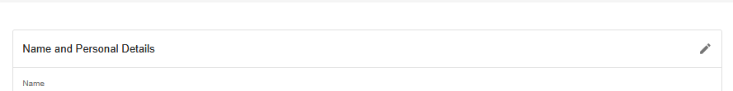
Step 7: Summary
Review all information to ensure accuracy.
Submitting incorrect or incomplete information may delay processing.

Slide 9
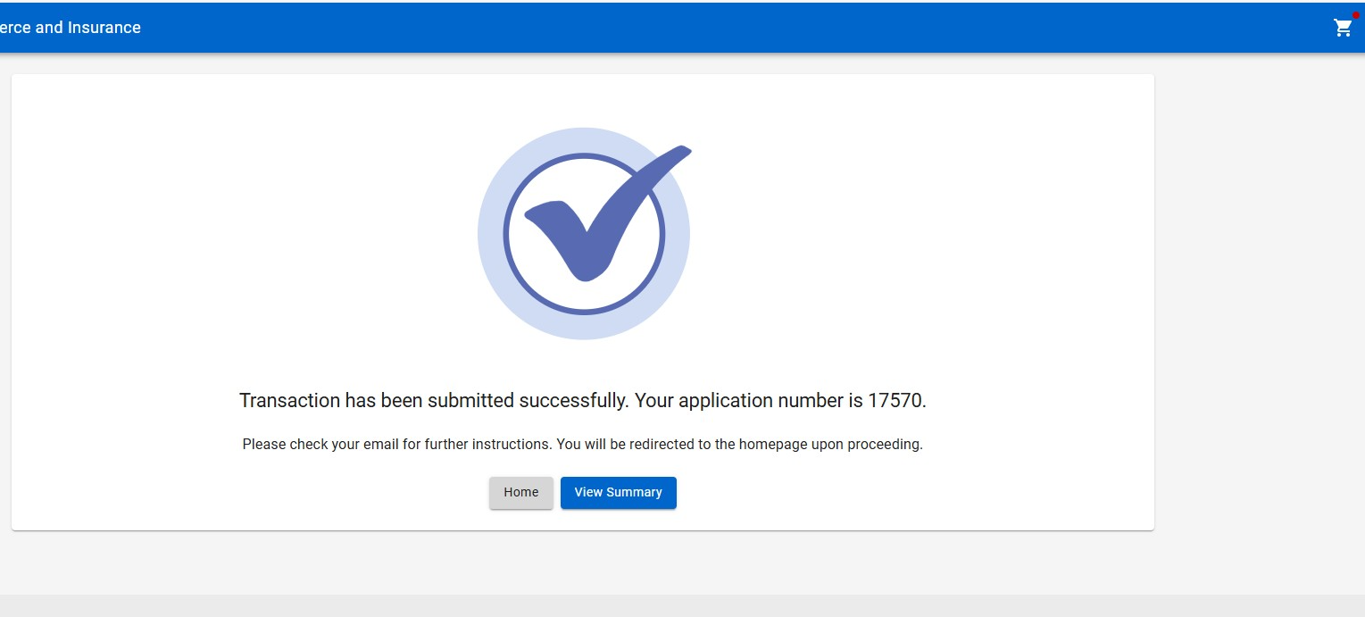
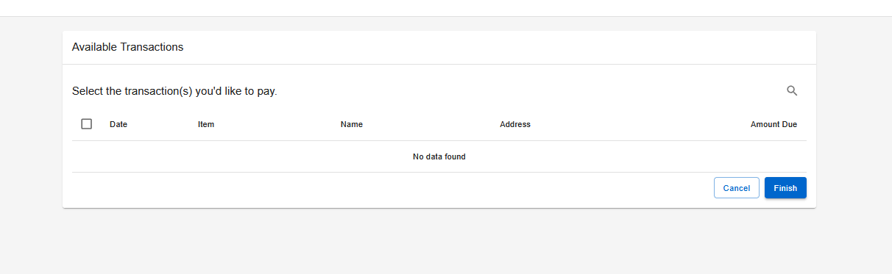
Step 8: Paying for the Application
After submitting your application:
Select the shopping cart icon in the top-right corner of the screen.
Select your application and follow the on-screen prompts to pay the amount due.
Note: Your application will NOT be processed until the application fee is received.

Slide 10
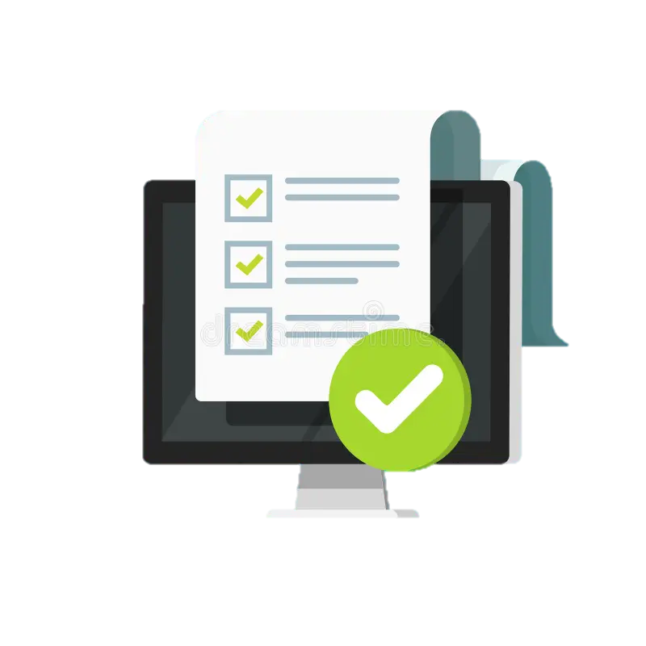
Step 9: Wait for Further Correspondence
If additional information is needed, you will receive an emailed letter outlining the steps required to complete your application.
If a letter is not received, you can assume your application is progressing in the licensing process.
Reminder: Monitor the email address associated with your account, including spam or junk folders.

Slide 11
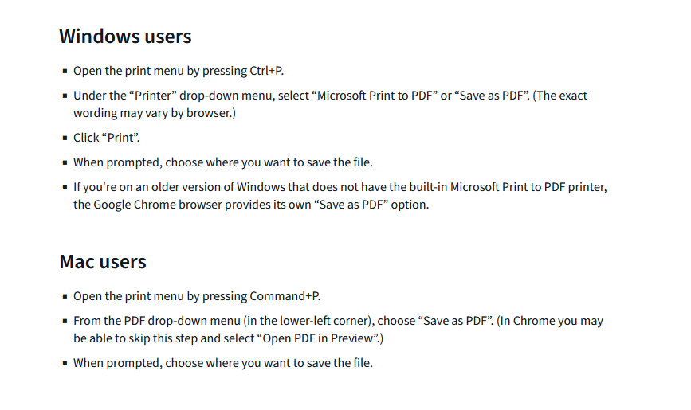
How To: Upload Your File Attachments (as a PDF)
Step 1: Identify the document you wish to save.
Step 2: Follow this guide to save your document as a PDF.
Step 3: Locate the saved document and upload it to your application.
Note: For an easy way to turn physical documents into a PDF for upload, you can use your phone. You can find instructions for the specific model of your phone here.
For applicants applying on their phones, please follow one of the below guides:
Android
iPhone

Slide 12

Board Contact Information
Email: home.inspector.licensing@tn.gov
Customer Service Phone: 615-741-3449
Address:
Tennessee Department of Commerce and Insurance
Home Inspector Licensing Program
Davy Crockett Tower, 10th Floor
500 James Robertson Parkway
Nashville, TN 37243
For more information or assistance, please visit the Board website by clicking the image above.

