Slide 1
Initial Application: Home Inspector Course
Home Inspector Licensing Program

Slide 2
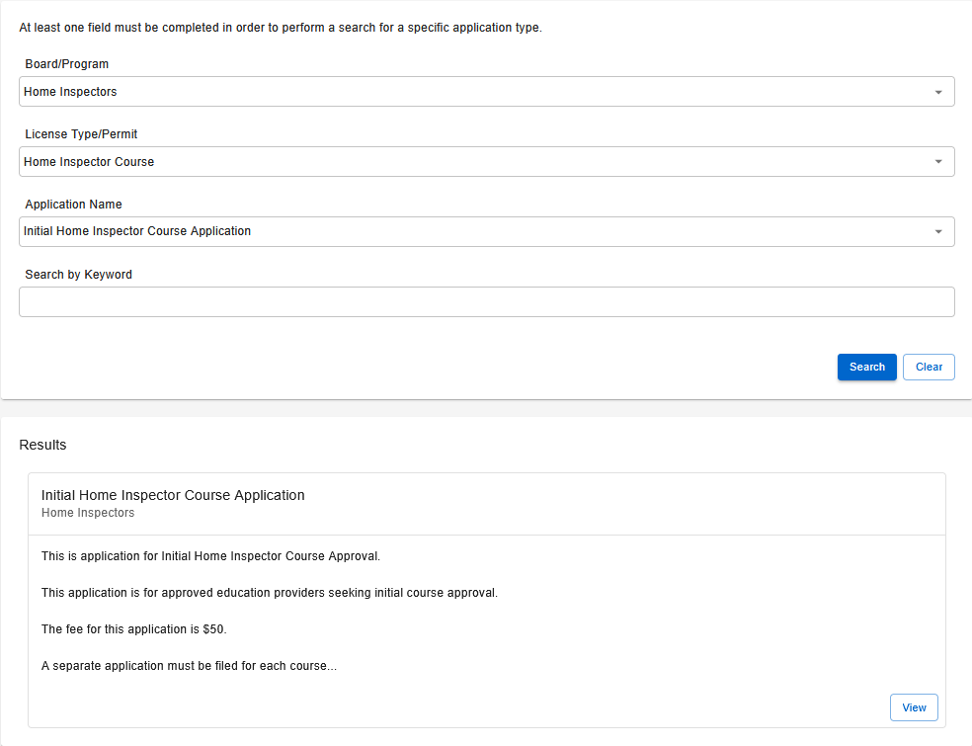
Step 1: Application Search
Search for the application.
Board/Program: Home Inspectors
License Type/Permit: Home Inspector Course
Application Name: Initial Home Inspector Course Application
Select View once the results appear.

Slide 3
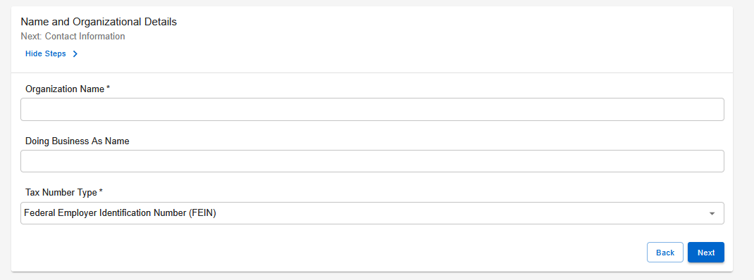
Step 2: Name and Organizational Details
Complete all required fields.

Slide 4
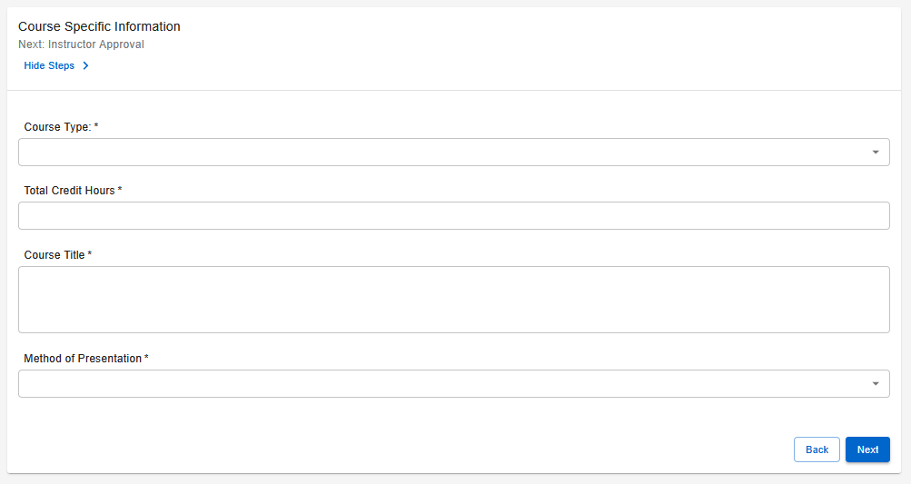
Step 3: Course Specific Information
Complete the required fields.
Qualifying Courses: ≥90 hrs
Continuing Education Courses: <90 hrs
Enter the total number of credit hours participants will receive for this class.

Slide 5
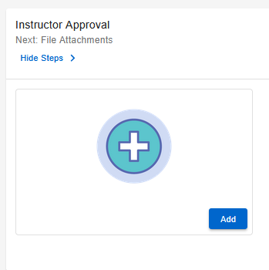
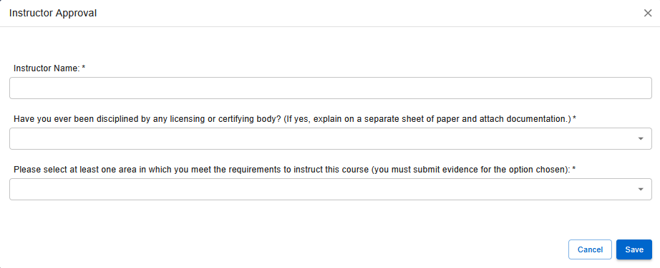
Step 4: Instructor Approval
Complete all required fields.

Slide 6
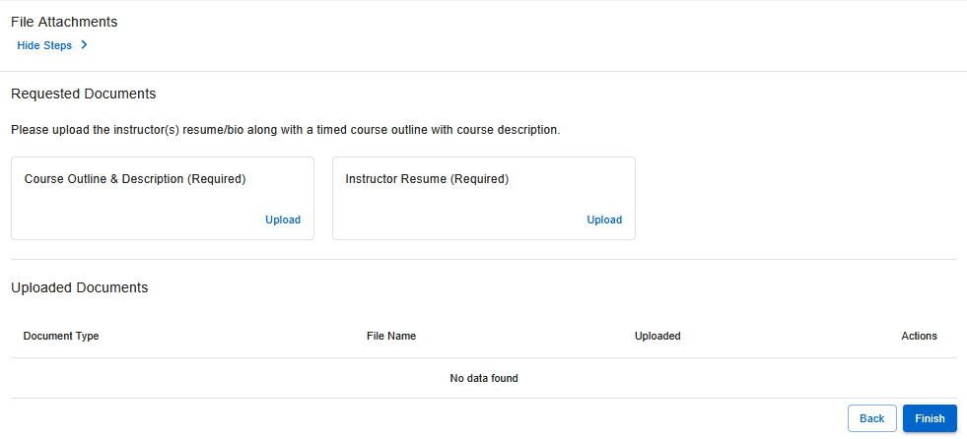
Step 5: File Attachments
Upload the required documents:
Course Outline & Description
Instructor Resume
Note: Instructions for uploading your documents as a PDF can be found here.

Slide 7
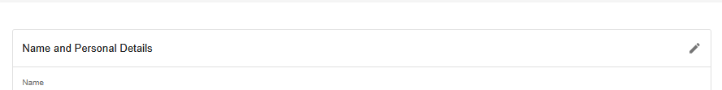
Step 6: Summary
Review all information to ensure accuracy.
Submitting incorrect or incomplete information may delay processing.

Slide 8
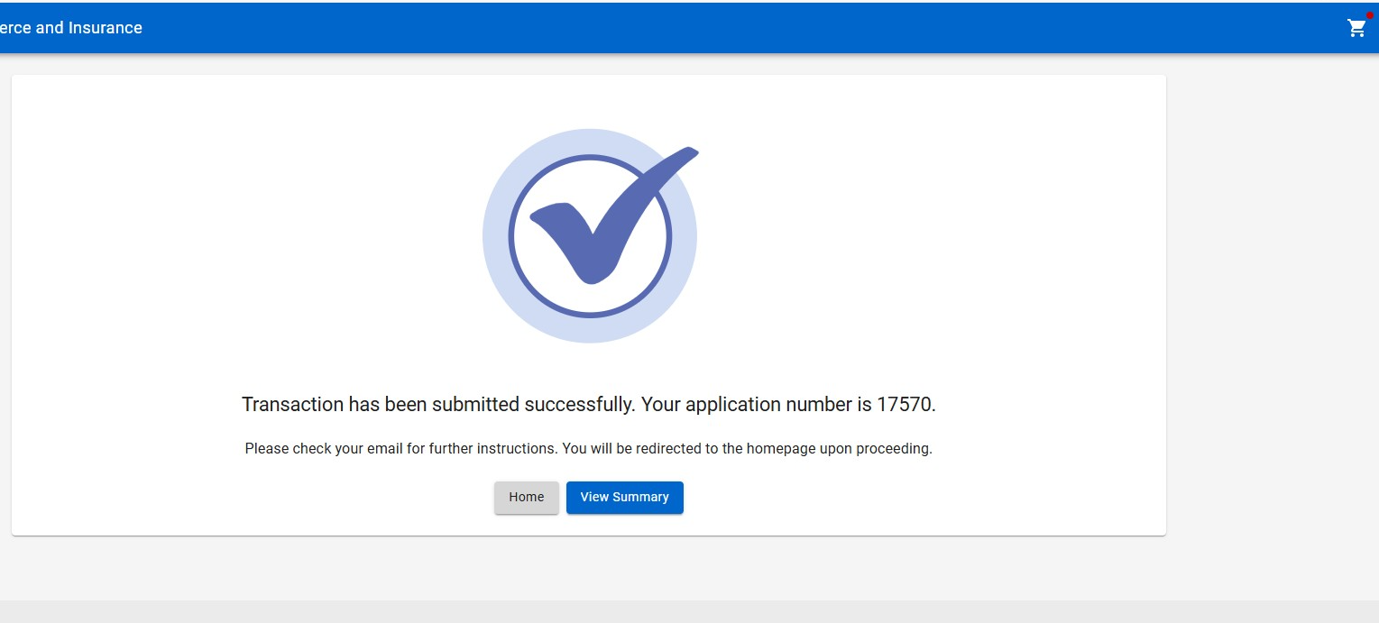
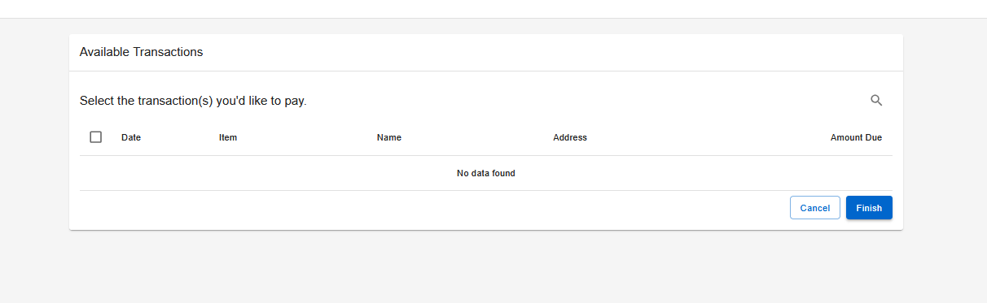
Step 7: Paying for the Application
After submitting your application:
Select the shopping cart icon in the top-right corner of the screen.
Select your application and follow the on-screen prompts to pay the amount due.
Note: Your application will NOT be processed until the application fee is received.

Slide 9
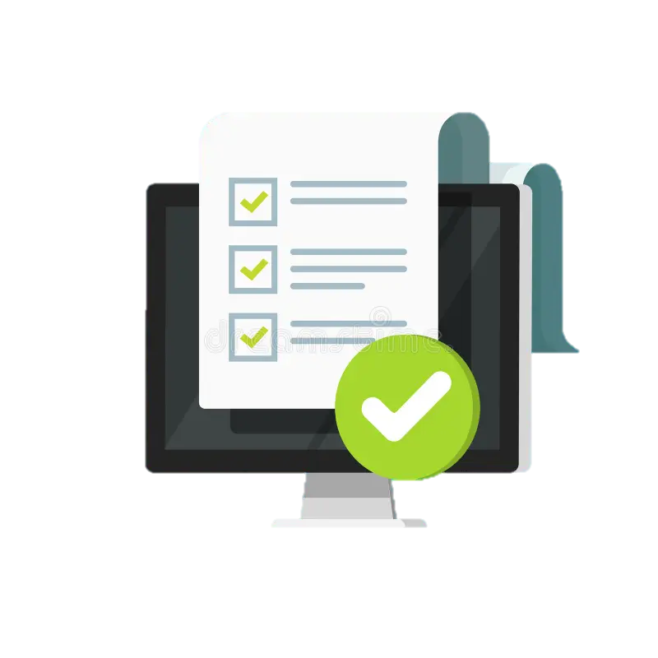
Step 8: Wait for Further Correspondence
If additional information is needed, you will receive an emailed letter outlining the steps required to complete your application.
If a letter is not received, you can assume your application is progressing in the licensing process.
Reminder: Monitor the email address associated with your account, including spam or junk folders.

Slide 10
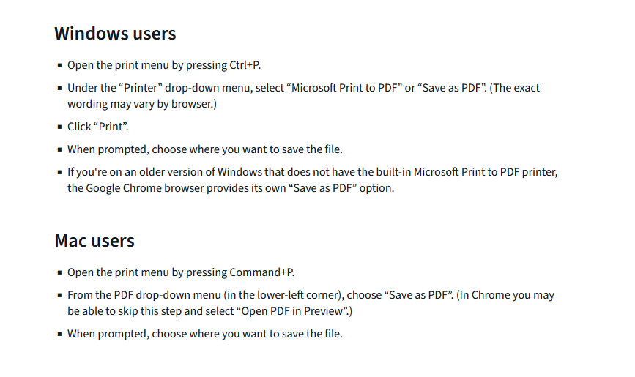
How To: Upload Your File Attachments (as a PDF)
Step 1: Identify the document you wish to save.
Step 2: Follow this guide to save your document as a PDF.
Step 3: Locate the saved document and upload it to your application.
Note: For an easy way to turn physical documents into a PDF for upload, you can use your phone. You can find instructions for the specific model of your phone here.
For applicants applying on their phones, please follow one of the below guides:
Android
iPhone

Slide 11

Board Contact Information
Email: home.inspector.licensing@tn.gov
Customer Service Phone: 615-741-3449
Address:
Tennessee Department of Commerce and Insurance
Home Inspector Licensing Program
Davy Crockett Tower, 10th Floor
500 James Robertson Parkway
Nashville, TN 37243
For more information or assistance, please visit the Board website by clicking the image above.

