Slide 1
Initial Application: Land Surveyor in Training
Board of Examiners for Architects, Engineers, and Land Surveyors

Slide 2
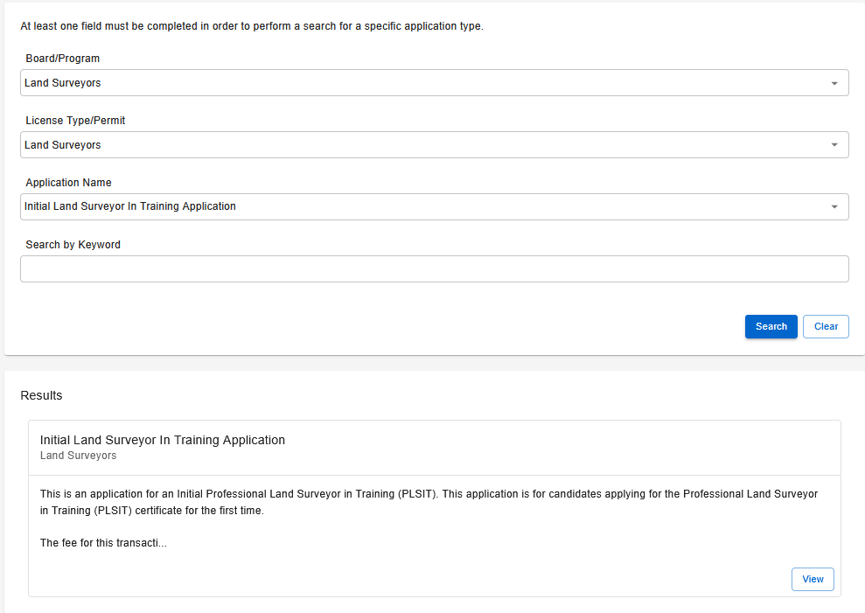
Step 1: Application Search
Search for the application.
Board/Program: Land Surveyors
License Type/Permit: Land Surveyors
Application Name: Initial Land Surveyor in Training Application
Select View once the results appear.

Slide 3
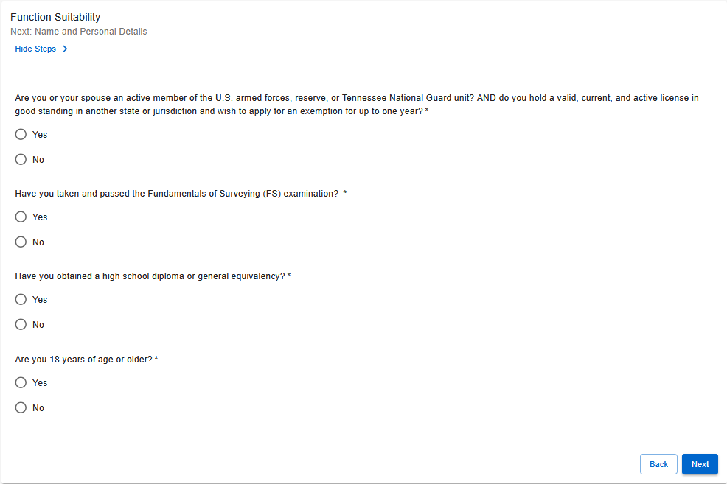
Step 2: Functional Suitability
This section confirms whether you meet the requirements to continue the application.
Answer all questions based on your current status.
If you receive an error message you believe is incorrect, please contact the Board office.

Slide 4
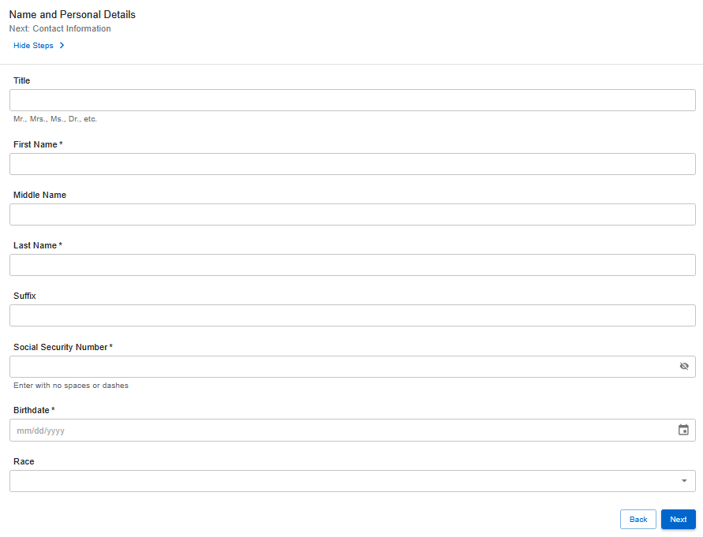
Step 3: Name and Personal Details
Complete all required fields.
Your social security number is required to proceed.
Note: If you do not have a social security number, contact the Board office for assistance.

Slide 5
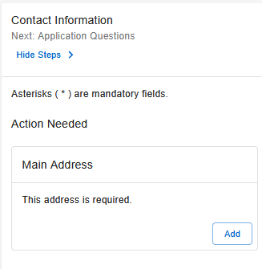
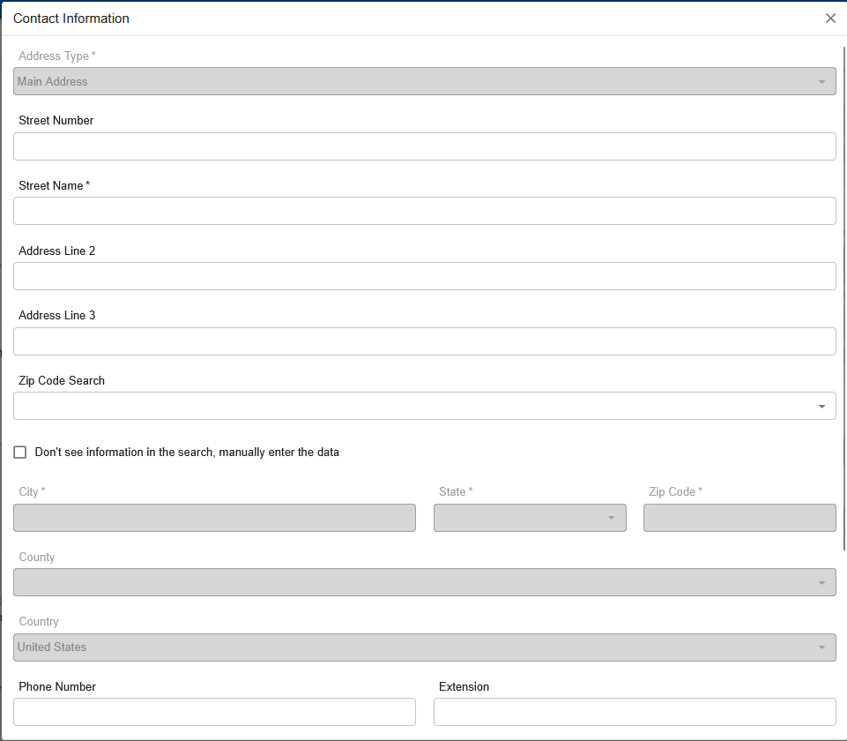
Step 4: Contact Information
Enter your mailing and email address.
You may also provide any additional contact information you would like to include.
Note: You can add multiple addresses, such as your place of employment; however, you must select one as a main address.

Slide 6
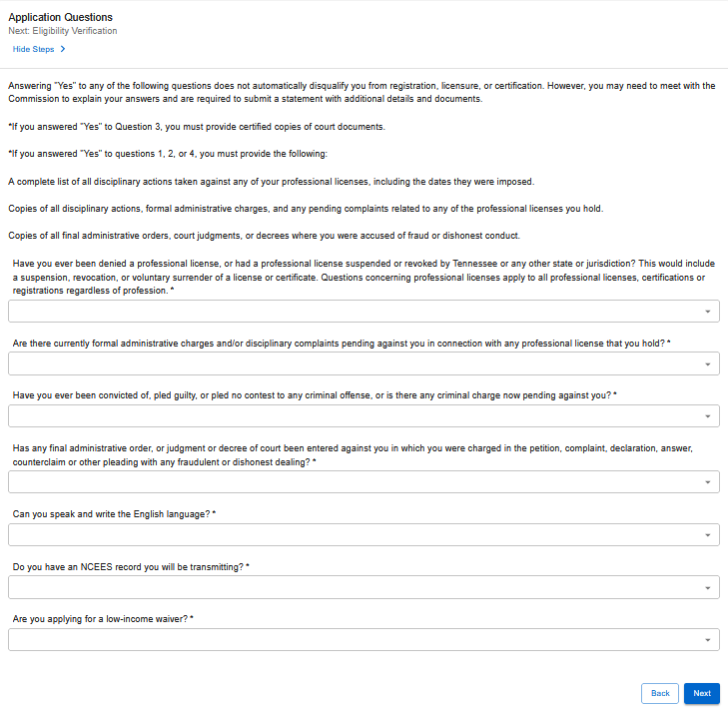
Step 5: Application Questions
Answer all questions based on your current status.
If you answer “Yes” to the questions regarding a felony, name change, loss of license, or low-income waiver, you must upload the required supporting documents.
For felonies or loss of license, include a statement of explanation addressed to the Board.

Slide 7
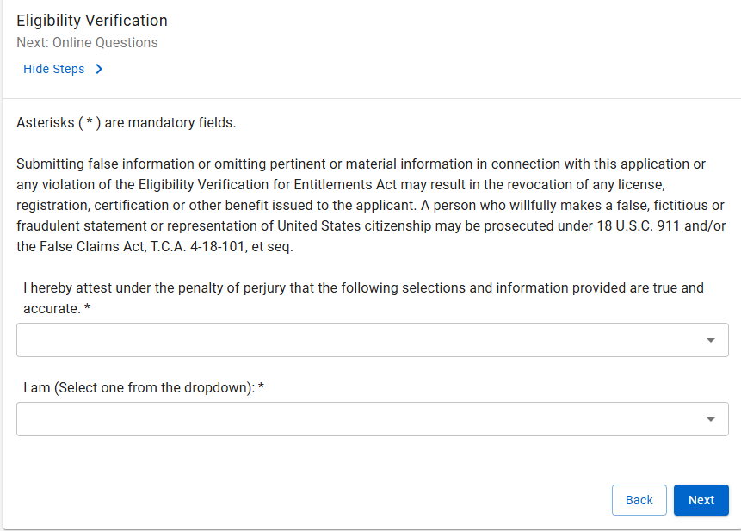
Step 6: Eligibility Verification
Select the appropriate option from the drop-down menu and complete all required fields.
You must provide supporting documents to verify your eligibility.
A list of acceptable documents can be found here.
Note: If you are a foreign national located outside of the United States, please contact the Board office to determine next steps.

Slide 8
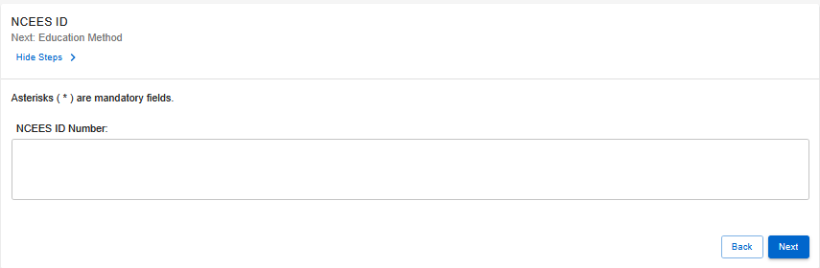
Step 7: NCEES ID
Enter your NCEES Council Record ID Number, if applicable.

Slide 9
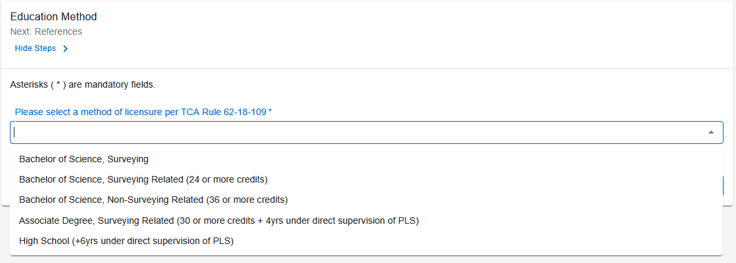
Step 8: Education Method
Select the applicable option from the drop-down menu:
BS, Surveying
BS, Surveying Related (24+ credits)
BS, Non-Surveying Related (36+ credits)
AS, Surveying Related (30+ credits & 4 yrs under PLS)
High School (6yrs under PLS)
You may review accepted education pathways here.
Note: You are responsible for confirming your degree and experience meet one of the listed pathways exactly as written.

Slide 10
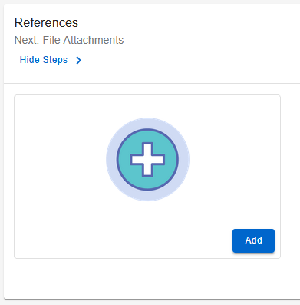
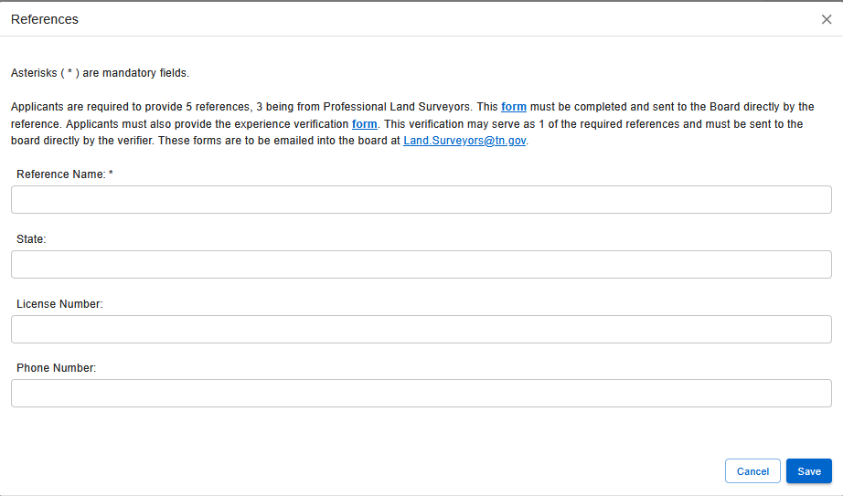
Step 9: References
Please provide your reference’s information. Repeat this process for all 5 references.
No more than 3 references from the same company or firm will be accepted.

Slide 11
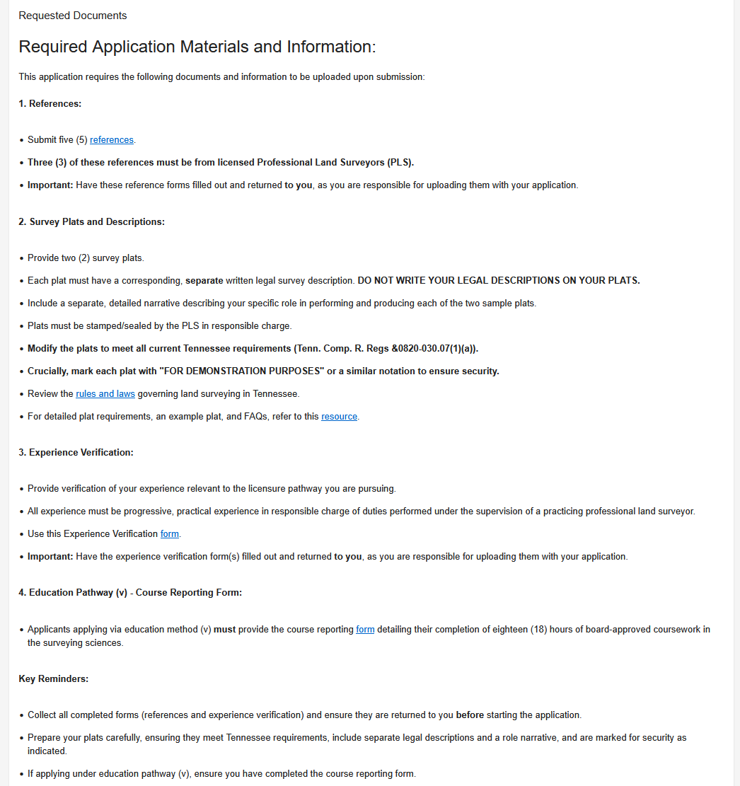
Step 10: File Attachments – Overview
Review the list of required documents.
Use the provided links to access forms and resources.
Choose one of the following steps to provide your documents:
Step 10A: NCEES Record Applicants
Step 10B: Non-NCEES Applicants

Slide 12
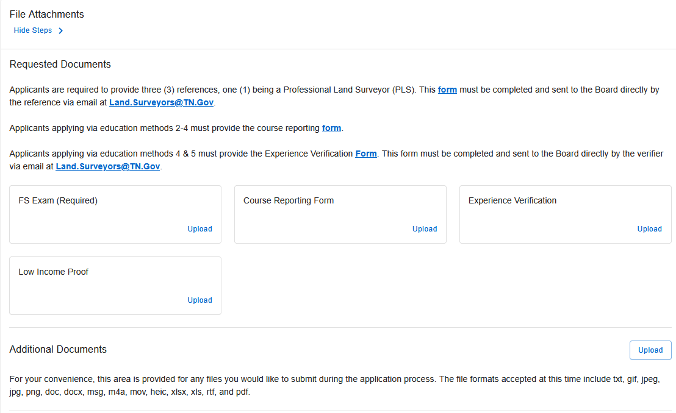
Step 10A: NCEES File Attachments
Upload the required documents:
FS Exam
Course Reporting Form
Experience Verification
Low-Income Proof (if applicable)
Use the Additional Documents section to upload other files if needed.

Slide 13
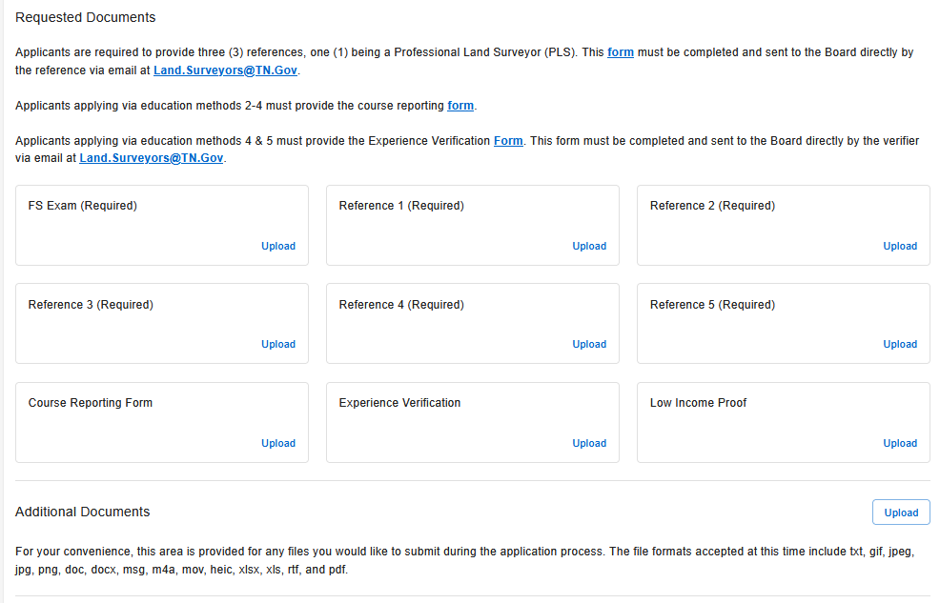
Step 10B: Non-NCEES File Attachments
Upload the required documents:
FS Exam
References 1-5
Course Reporting Form
Experience Verification
Low-Income Proof (if applicable)
Use the Additional Documents section to upload other files if needed.

Slide 14
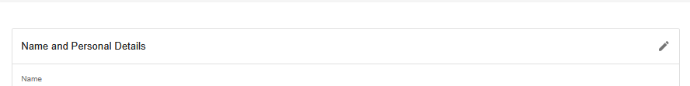
Step 11: Summary
Review all information to ensure accuracy.
Submitting incorrect or incomplete information may delay processing.

Slide 15
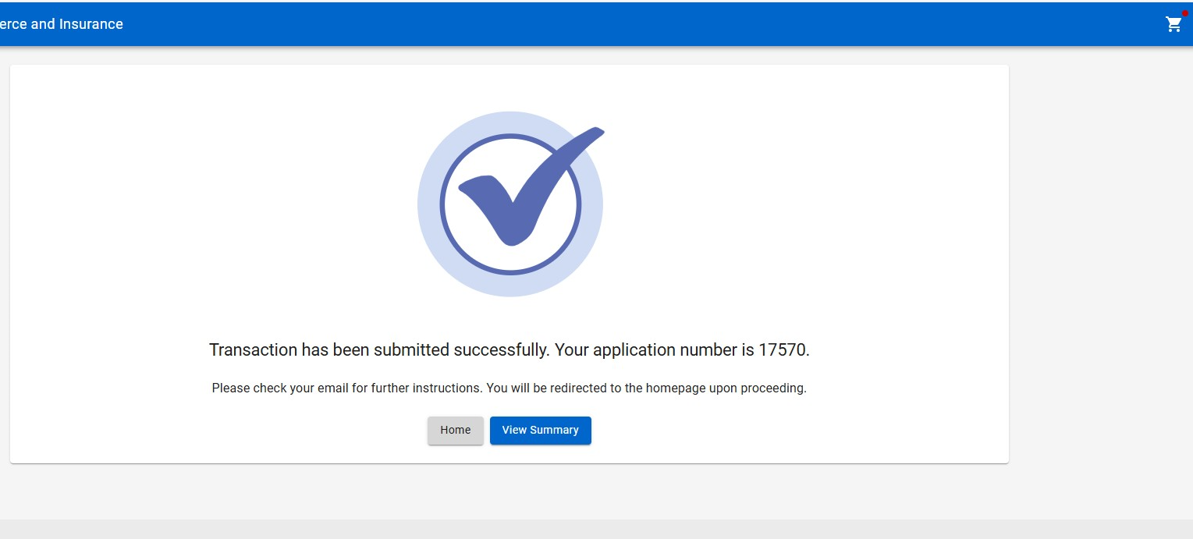
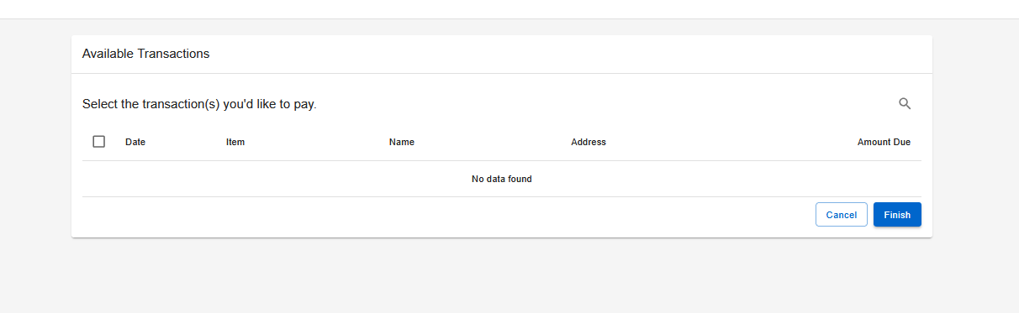
Step 12: Paying for the Application
After submitting your application:
Select the shopping cart icon in the top-right corner of the screen.
Select your application and follow the on-screen prompts to pay the amount due.
Note: Your application will NOT be processed until the application fee is received.

Slide 16

Step 13: Wait for Further Correspondence
If additional information is needed, you will receive an emailed letter outlining the steps required to complete your application.
If a letter is not received, you can assume your application is progressing in the licensing process.
Reminder: Monitor the email address associated with your account, including spam or junk folders.

Slide 17

Board Contact Information
Email: ce.aeboard@tn.gov
Customer Service Phone: 615-741-3221
Address:
Tennessee Department of Commerce and Insurance
Board of Examiners for Architects, Engineers, and Land Surveyors
Davy Crockett Tower, 10th Floor
500 James Robertson Parkway
Nashville, TN 37243
For more information or assistance, please visit the Board website by clicking the image above.

