Slide 1

Motor Vehicle Application Assistance
Salesperson Transfer
2026

Slide 2
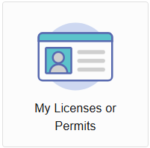
Getting Started
Salesperson Transfers are for individuals who currently hold or have ever held a Motor Vehicle Salesperson license in Tennessee.
The purpose of the transfer is to allow an individual to transfer their license to another dealership.
Before you can transfer your license, the license you are transferring must be “terminated” from your previous employer’s account.
To begin, access your account by visiting: https://access.cloud.commerce.tn.gov/portal/public
Click on the “My Licenses or Permits” tile:
Select the license you will transfer.

Slide 3
Transfer Your License
Scroll until you find the Salesman Transfer Application and click “Apply”.
As you are completing your Transfer Application, it is a good idea to ensure your personal information is correct. You cannot change your name from this application. For name changes, please reach out to the Commission office.
In order to process your license, please remember to pay all fees required at the conclusion of your application. When you click “submit”, you will be taken to a screen with your application number and a “Pay Now” button. Click the “Pay Now” button and follow all prompts to complete your submission. Failure to pay all required fees or submit required information will result in delayed licensure.
You will receive a NEW license when your transfer is complete.

