Slide 1

Motor Vehicle Application Assistance
Salesperson Termination
2026

Slide 2
Things to Remember
By law, it is the responsibility of the licensed dealer to terminate the license of a salesperson within thirty (30) days of termination of employment, for any reason.
Terminating a license is an important safeguard for dealers to ensure an individual who held a salesperson license at the dealer’s established place of business is unable to use the invalid license for purposes for which the dealer could be held responsible.

Slide 3
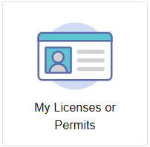
Getting Started
Log into your account and click on the “My Licenses or Permits” Tile.

Slide 4
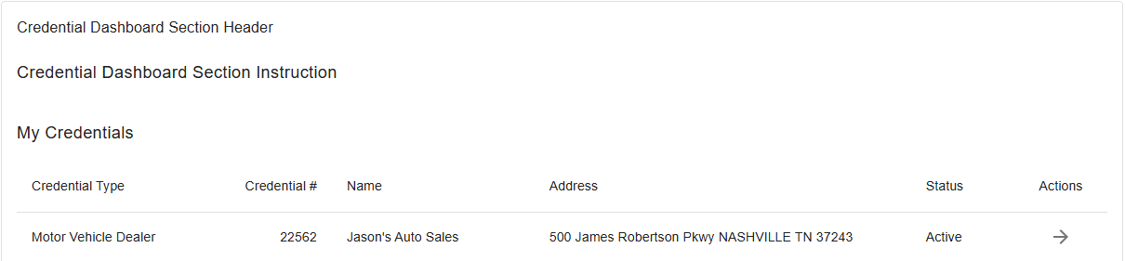
Select License
At the credential screen, select the license to which the salesperson is associated, and click the arrow under “actions”.

Slide 5
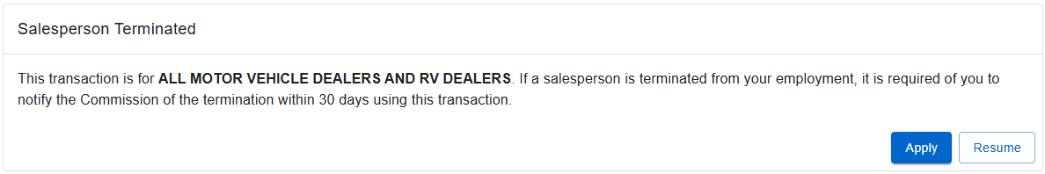
Salesperson Termination Application
Select “Apply” on the “Salesperson Terminated” application.

Slide 6
Name and Organizational Details
This page identifies the organization’s name, tax number and entity type (LLC, LLP, Corp., etc.).
Review this section to ensure the appropriate licensee is selected. Information cannot be changed on this page. Should changes be needed, please contact the Commission office.

Slide 7
Salesperson Termination
Click “Add” on the “Salesperson Termination” tile.
Answer all questions for each required field and review all information to ensure accuracy. Click “Save”.
Continue through the application and submit the termination.

Slide 8
Final Things to Remember After Termination
After terminating a salesperson license with the Commission, destroy both the wallet card and wall license of the salesperson. There is no need to send these licenses back to the Commission office.
Ensure the termination was processed by visiting Verify Public Search.
Contact the Commission office at 615-741-2711 with any questions you may have.

