Slide 1
Salesperson Renewal
Filing Your Salesperson Renewal Online
Motor Vehicle Commission 2026

Slide 2

Salesperson Renewal Assistance
Submitting a Renewal Application for your Salesperson License
2026

Slide 3
Important Things to Know About Your Motor Vehicle Salesperson Renewal
Your Motor Vehicle Salesperson license is a two-year license which allows you to sell vehicles for ONLY the dealership for which you are employed.
During your renewal period, your employer will receive a renewal notice approximately 45 days prior to your expiration date.
Once your license enters an “expired-grace” status, you may not conduct sales or participate in selling a vehicle until your license has been renewed.
Salesperson license renewals are fifty dollars ($50).
Late fees for renewals are half of your licensing fee, twenty-five dollars ($25), for a total renewal fee of seventy-five dollars ($75).

Slide 4
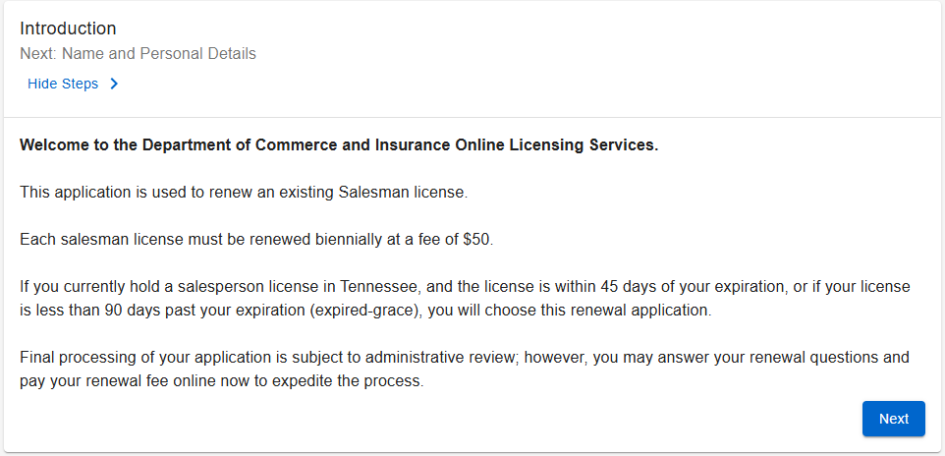
Getting Started with Your Renewal
Read the Introduction to your application, thoroughly. Click “Next” when you are ready to start your application.

Slide 5
Name and Personal Details
Review your personal information on this page. You may not make changes to any of this pre-populated information. Should you need to make changes to this information, contact the Commission office.
Click “Next” to move to the next page.

Slide 6
Contact Information
Review your contact information on this page. For mailing address changes, you may submit an address change by navigating to your account and submitting the address change.
Click “Next” to move to the next page.

Slide 7
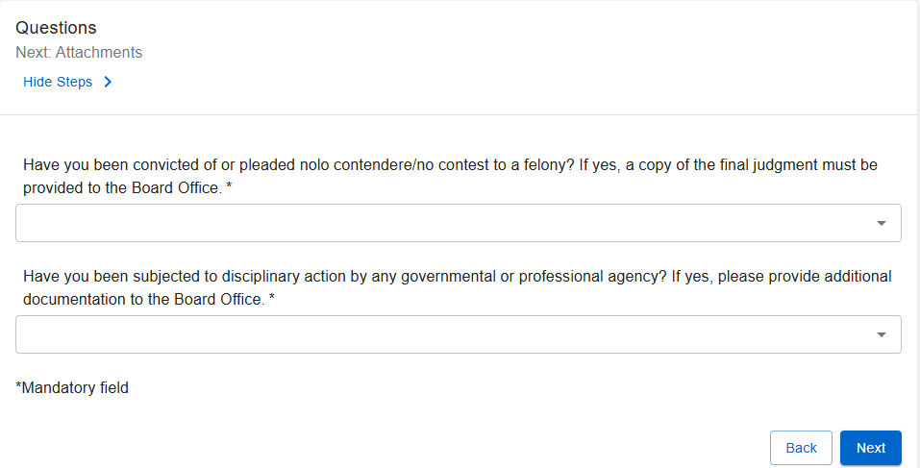
Required Questions
You must answer these questions before moving on with your submission.

Slide 8
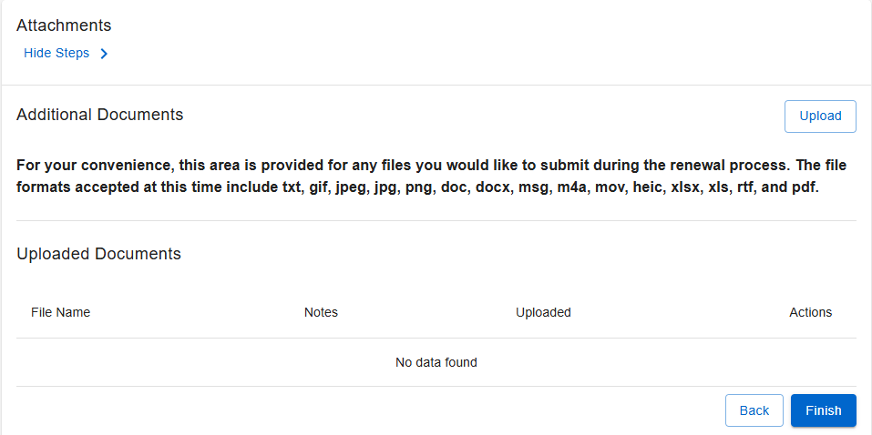
Attachments
From this screen, you may attach any documents needed to complete your renewal. No documents are generally needed for standard salesperson renewals except if a final judgment is needed.

Slide 9
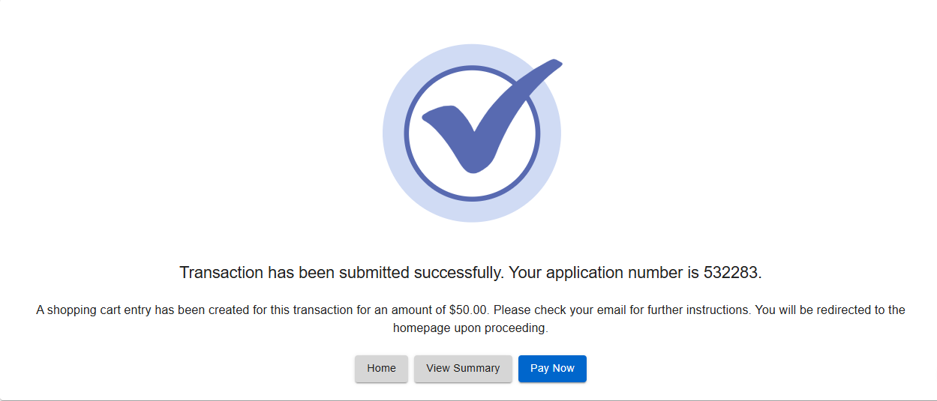
Summary Review
Review your summary and click the “Submit” button. Once submitted, you will receive notification of your successful submission.

Slide 10
Payments
You must pay for your renewal before your renewal can be processed. Failure to pay will result in your delayed renewal.
Click on the “Pay Now” button and follow the prompts. You will receive a payment summary/receipt when completed.

