Slide 1
Motor Vehicle Dealer License Renewal
Submitting Your Renewal Online
Tennessee Motor Vehicle Commission 2026

Slide 2

Motor Vehicle Application Assistance
Dealership Renewal
Tennessee Motor Vehicle Commission 2026

Slide 3
Things to Remember About Your Renewal
Renewal applications open approximately 45 days prior to the expiration of your license. The application is not available in your account to complete until then.
Renewals are for a two (2) year license.
You may not conduct business past the expiration date of your license.
A new two-year surety bond must be submitted at the time of renewal.
Check your comprehensive garage liability insurance to ensure your policy is still active. Both policies (insurance and bond) must be active for the renewal to be accepted.

Slide 4
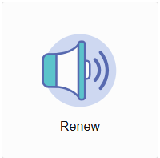
Where to Renew
Visit https://access.cloud.commerce.tn.gov/portal/public
Select the “Renewal” Tile.

Slide 5
Introduction to Your Renewal
If you currently hold a motor vehicle dealer license in Tennessee, and the license is within 45 days of your expiration, or if your license is less than 90 days past your expiration (expired-grace), you will choose the renewal application. In order to complete the renewal, you must provide a 2-year surety bond/continuation certificate, and an updated certificate of liability insurance policy on an ACORD form.
The following renewal must be completed in its entirety, all pertinent/accurate information must be received and all fees paid before renewal can be determined.
The fee for Dealer renewal is $600. Additionally, each franchise dealer must pay $600 per line make.
You will be able to attach supporting documentation during this application process.
Final processing of your application is subject to administrative review.

Slide 6
Name and Organizational Details
Review your organizational name and details to ensure accuracy. If the information is incorrect, please contact the Commission office.
If franchised, you must attach a copy of the letter of acknowledgment from the manufacturer or distributor awarding the franchise agreement(s). The dealer name must be the same as the entity to whom the franchise is granted. The relevant market area (RMA) must be defined, or it must include a statement clarifying that "no relevant market area (RMA) is awarded or geographic boundary defined." You will be given the opportunity to attach all documents required for licensure prior to electronic submission of your application.

Slide 7
Contact Information - Addresses
If you wish to change your mailing address, you must submit a change of address application through the online portal.
If the physical location of your dealership is changing, you must submit a relocation application. Licenses are non-transferable and are location specific.

Slide 8
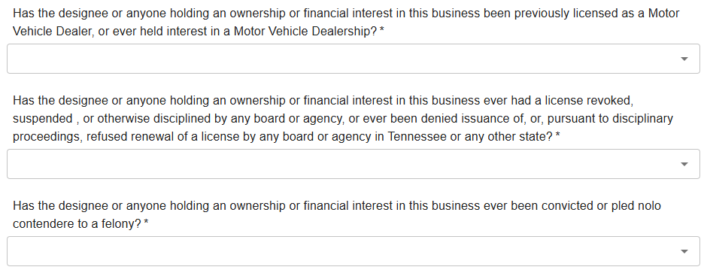
Questions
All questions must be answered by the person authorized as designee for the business, or in the case of a sole-proprietorship, the owner must complete the questions.

Slide 9
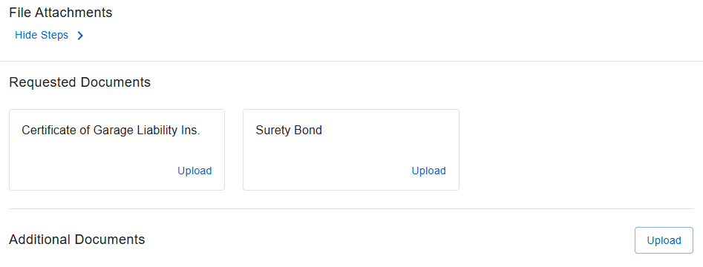
Attachments
You will attach your updated surety continuation certificate or a new bond.
If a new bond is used, it must be signed by the principal and notarized.
If needed, you will upload your comprehensive garage liability insurance documents during this step. Please be advised the Commission will only accept garage liability policies on an ACORD form.

Slide 10
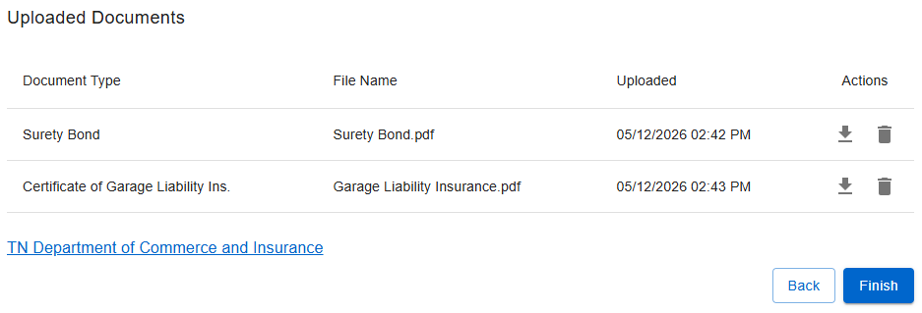
Completion of Your Renewal
Once you have uploaded your attachments, you can click “Finish”.

Slide 11
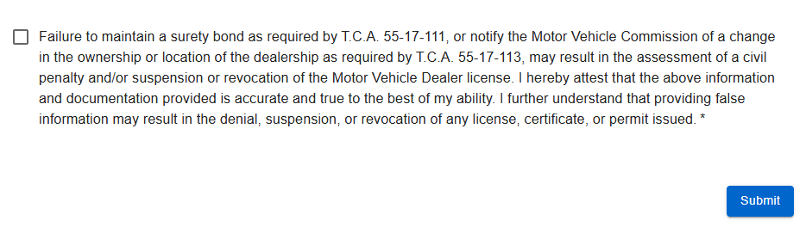
Submitting Your Renewal
Once you select “FINISH”, the summary of your renewal will appear. Please review all information for accuracy. When you are comfortable with your renewal, scroll to the bottom of your summary and click the attestation box certifying the renewal is accurate. Click submit. You will receive a confirmation of your submission.

Slide 12
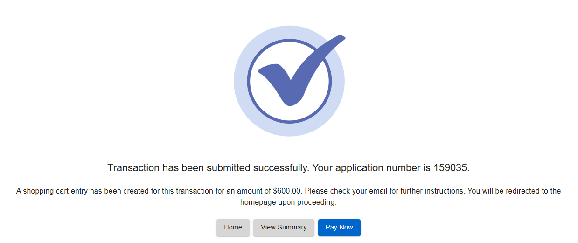
Renewal Payment
Once you have submitted your renewal, the following screen will appear. Click “Pay Now”.

Slide 13
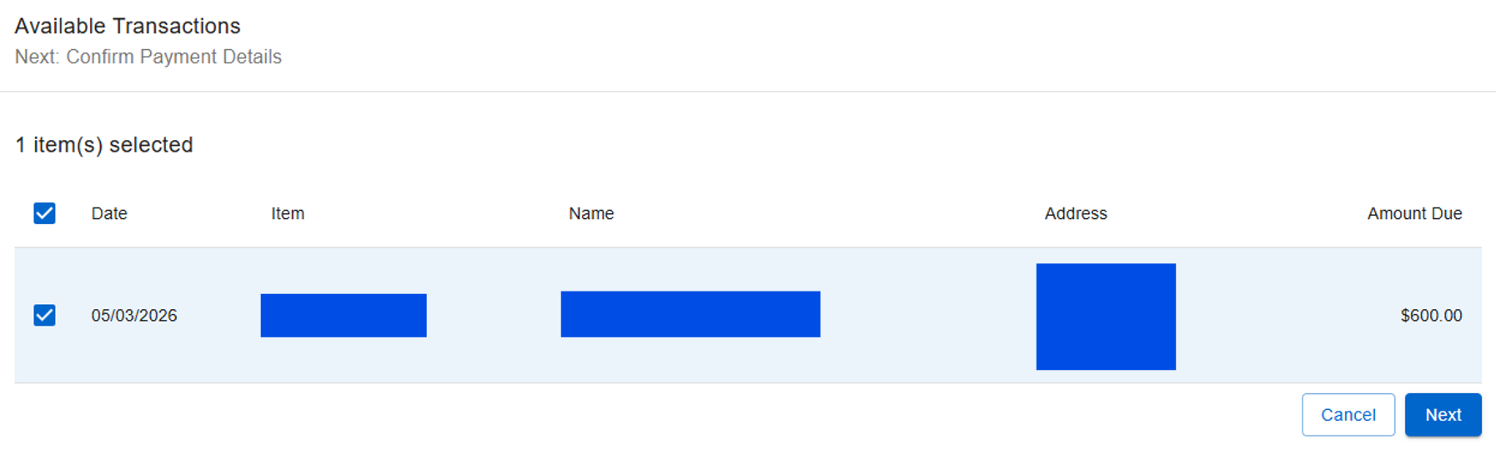
Transactions and Confirming Payment Details
After you click “Pay Now”, you will be taken to the payment screen. Please select the box of the license for which you are paying. The appropriate fee is auto-populated for you. Then click “Next”.

Slide 14
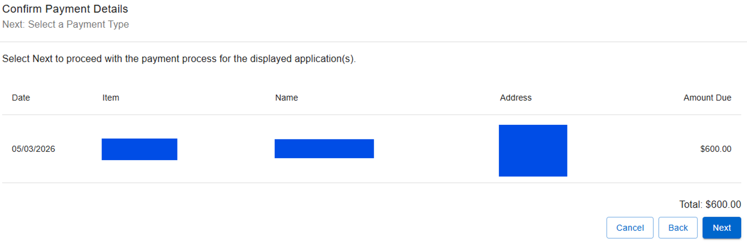
Confirmation of Payment Details
Next, the system will ask you to confirm the payment details. Confirm the details and select “Next”.

Slide 15
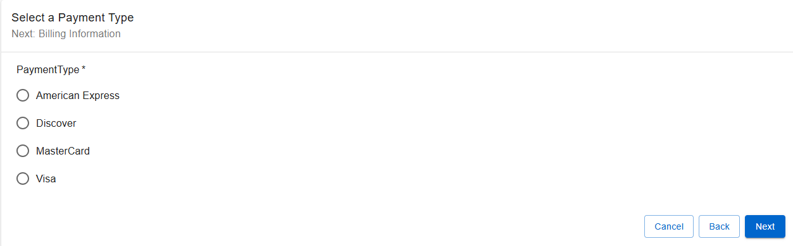
Selecting Your Payment Type
Select your payment type and then select “Next”.

Slide 16
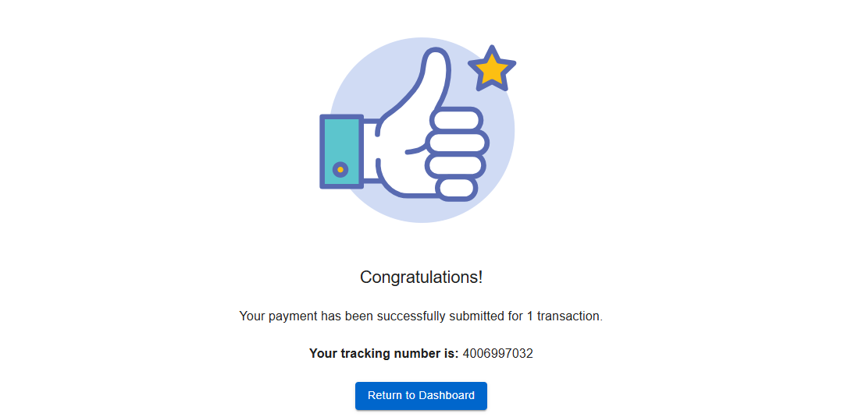
Payment Confirmation
Verify your billing information and click “Finish”. Once finished, you will receive a notification with a tracking number for your records.

