Slide 1
Annual Sales Reporting
Filing Your Annual Sales Report Online
Tennessee Motor Vehicle Commission 2026

Slide 2
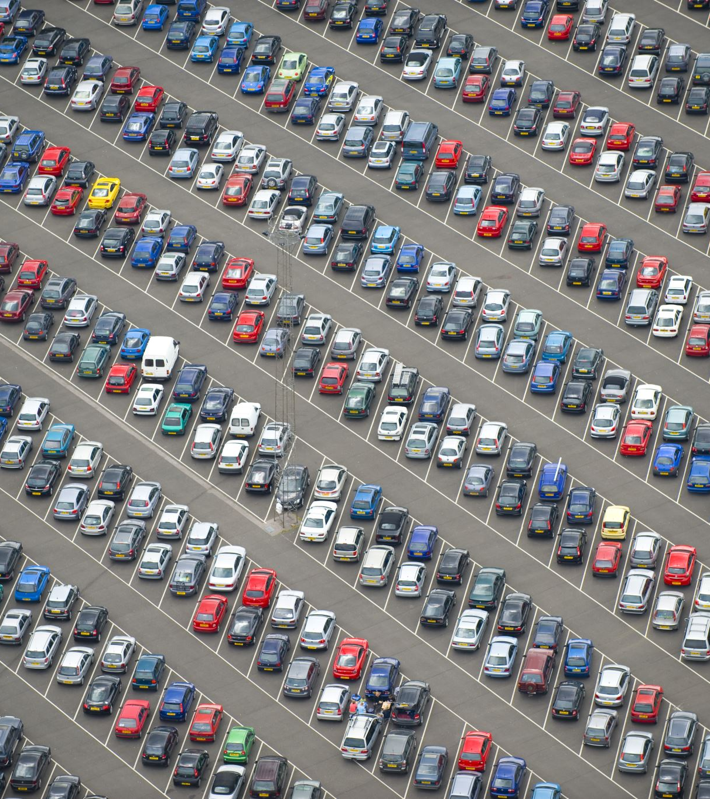
Annual Sales Reporting Assistance
Reporting Annual Sales for Your Dealership
2026

Slide 3
Things to Remember
Annual Sales Reports are due on or before February 15 each year.
Late reports are assessed a One Hundred Dollars ($100) late fee which must be paid before you will be allowed to obtain dealer plates.
Selling fewer than 24 vehicles allows the purchase of three (3) dealer plates. Selling 24 vehicles or more will allow the purchase of up to (225) dealer plates.
Dealer plates must be renewed annually.
Dealer plates are processed through your local County Clerk’s office.

Slide 4
Accessing the Annual Sales Report Application

Slide 5
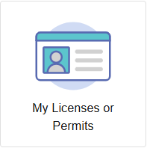
Where to File Your Annual Sales Report
Visit https://access.cloud.commerce.tn.gov/portal/public
Select the “My Licenses and Permits” Tile.
Select the license you are submitting the report for by clicking on the arrow beside the license.

Slide 6
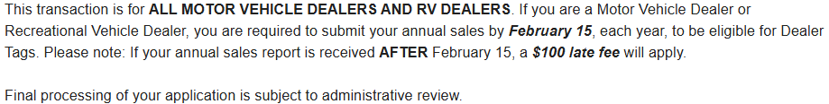
Application Introduction
You will be asked to:
- Identify the number of units sold in the reporting year.
- New Sales
- Used Sales
- Total Sales

Slide 7

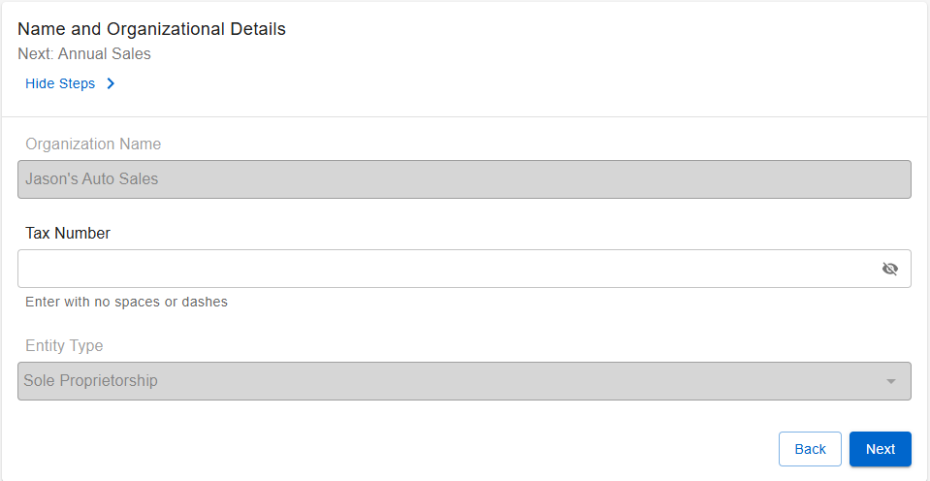
Name and Organizational Details
Review your organizational name and details to ensure accuracy. If the information is incorrect, please contact the Commission office.

Slide 8
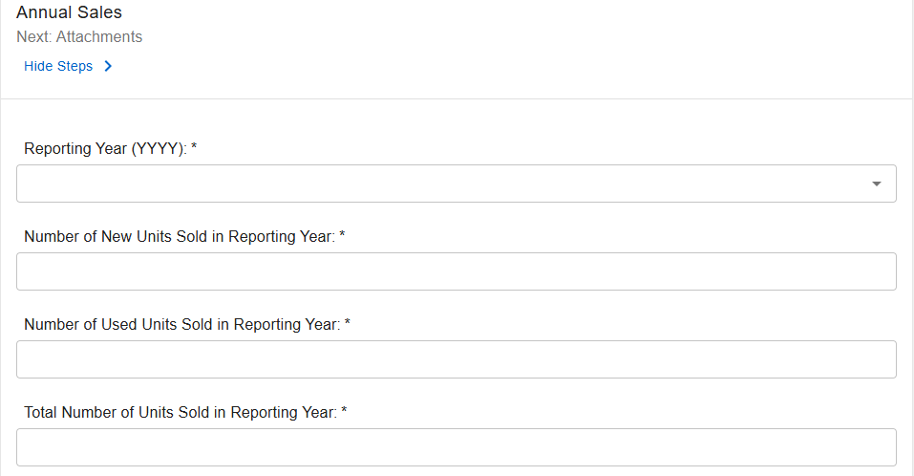
Annual Sales Report Questions
Complete each question regarding your annual sales for the reporting year. You MUST answer every question, or you will be unable to submit your report.

Slide 9
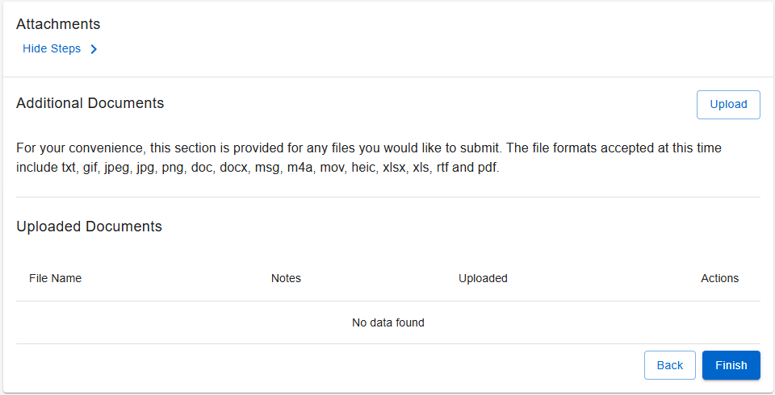
Complete Your Annual Sales Report
There are no attachments you need to submit for your annual sales report submission. If you file your sales report after February 15, you must pay a One Hundred Dollar ($100) late fee, which can be paid through the online portal before your submission will be accepted.

Slide 10
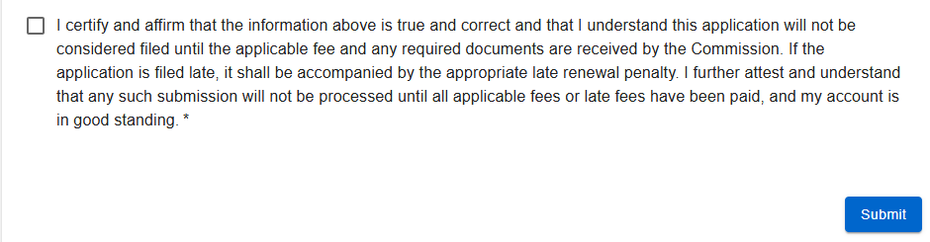
Submitting Your Annual Sales Report
Once you select “FINISH”, the summary of your submission will appear. Please review all information for accuracy. When you are comfortable with your report, scroll to the bottom of your summary and click the attestation box certifying the report is accurate. Click submit. You will receive a confirmation of your submission.

