Slide 1
TN Burial Services
Preneed Seller Renewal
July 2026

Slide 2
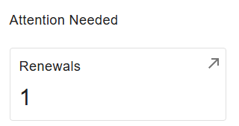
Where To Complete Preneed Seller Renewal
Visit https://access.cloud.commerce.tn.gov/portal/public.
Select Sign In, located in the top right-hand corner.
Under Attention Needed select Renewals.

Slide 3
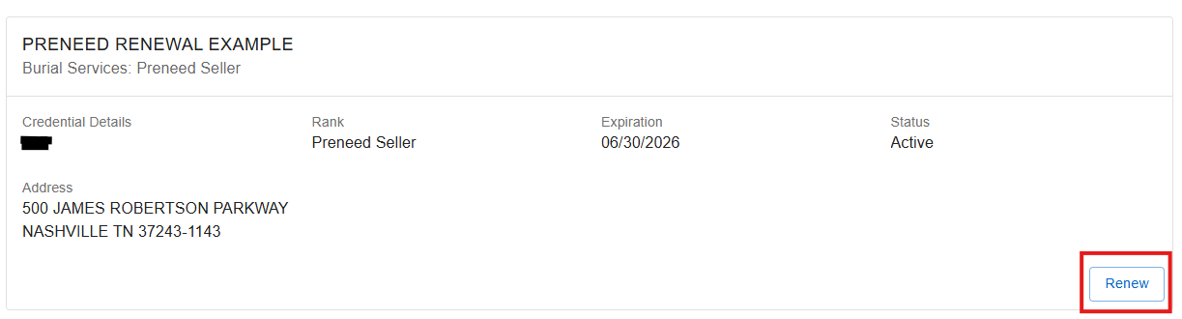
STEP 1: Renewals
Confirm this is the license you wish to renew and select Renew.

Slide 4
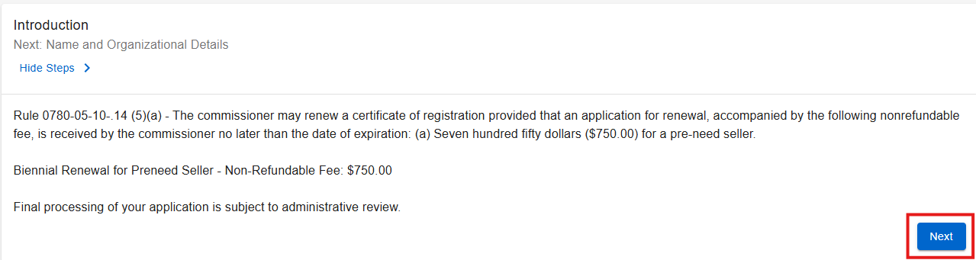
STEP 2: Introduction
Introduction, verify this is the correct application you need, then select Next.

Slide 5
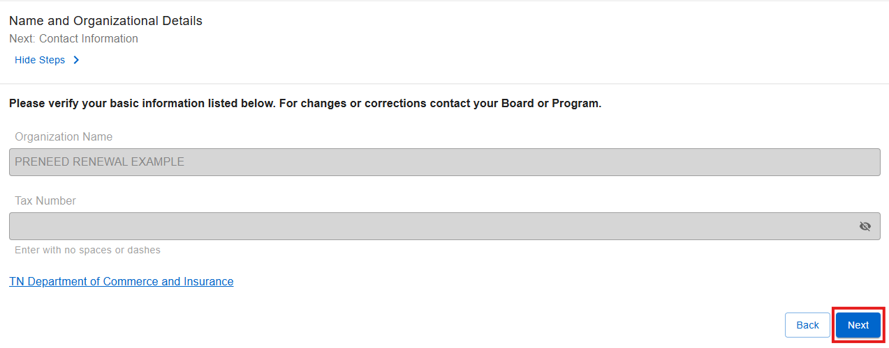
Step 3: Name and Organizational Details
This information can not be updated. If this information is incorrect, please email funeral.cemetery.board@tn.gov.
Select Next.

Slide 6
STEP 4: Contact Information
Under contact information, please review the contact information section, which includes the Main Address, Owner, Mailing Address, Site Location, and Trustee Address.
The main address, mailing address, and site location address must reflect the physical and operational details of the preneed seller and cannot be replaced with a corporate mailing address.

Slide 7
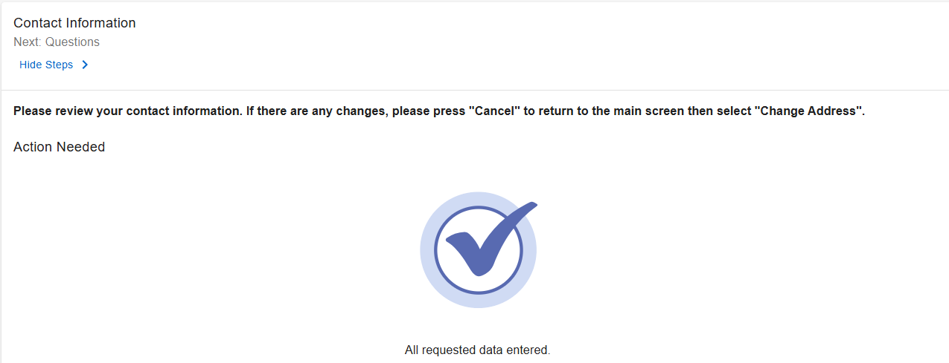

STEP 4: Contact Information Continued
Once you have reviewed all addresses on file, select Next.

Slide 8
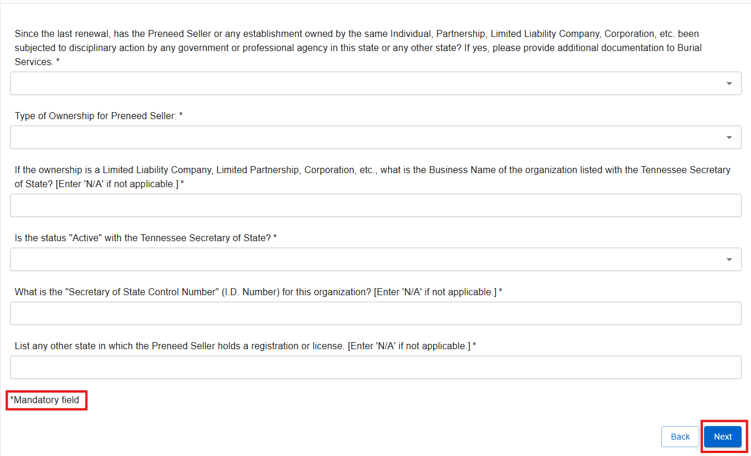
STEP 5: Questions
Please answer all questions, including those marked with an asterisk (*), as these items are mandatory. Once all required fields are completed, select Next to continue.

Slide 9
STEP 6: Preneed Contracts Sold
Enter the number of contracts sold for each of the previous two (2) calendar years. Each year is mandatory and must be completed before continuing. After entering the yearly totals, add the numbers together and place the combined amount under “Number of Preneed Contracts” for the two (2) previous calendar years.”

Slide 10
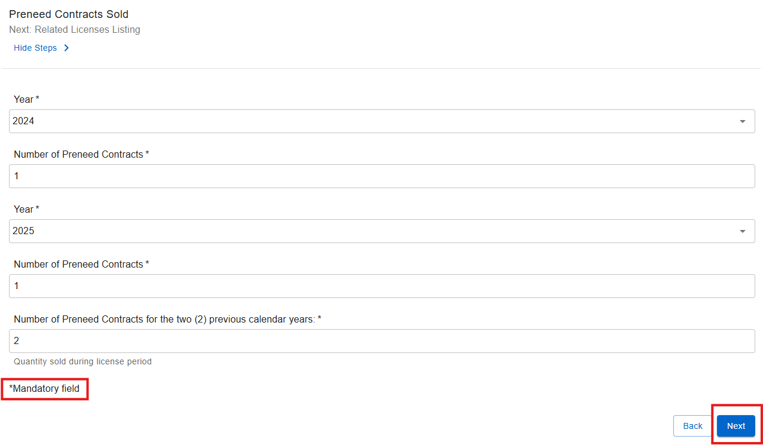
STEP 6a: Preneed Contracts Sold Continued
Once you have entered in your information, select Next.

Slide 11
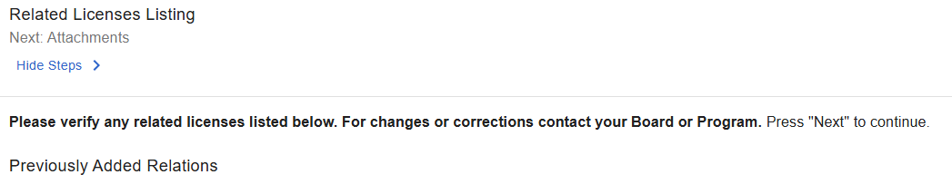

STEP 7: Related Licenses Listing
Please review the related licenses. If any information is incorrect, contact Burial Services via email at funeral.cemetery.board@tn.gov. Once you have verified the information, select Next to continue.

Slide 12
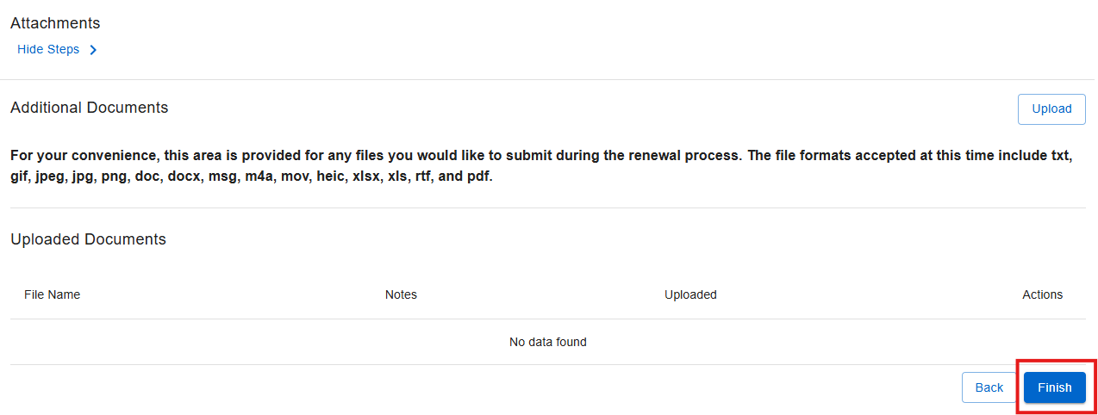
STEP 8: Attachments
Upload any additional renewal‑related documents here. Do not include the Establishment’s Preneed Seller Funeral Funds Report with the renewal application. When finished, select Finish to proceed.

Slide 13
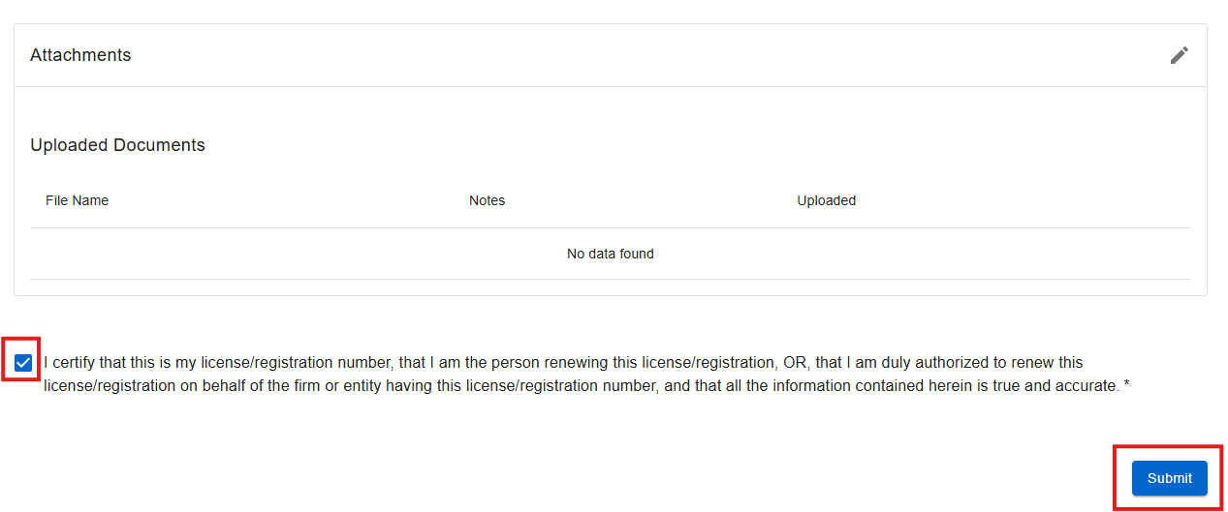
STEP 9: Summary/Attestation
Click the attestation checkbox to confirm the accuracy of all provided information and documentation, then select Submit.

Slide 14
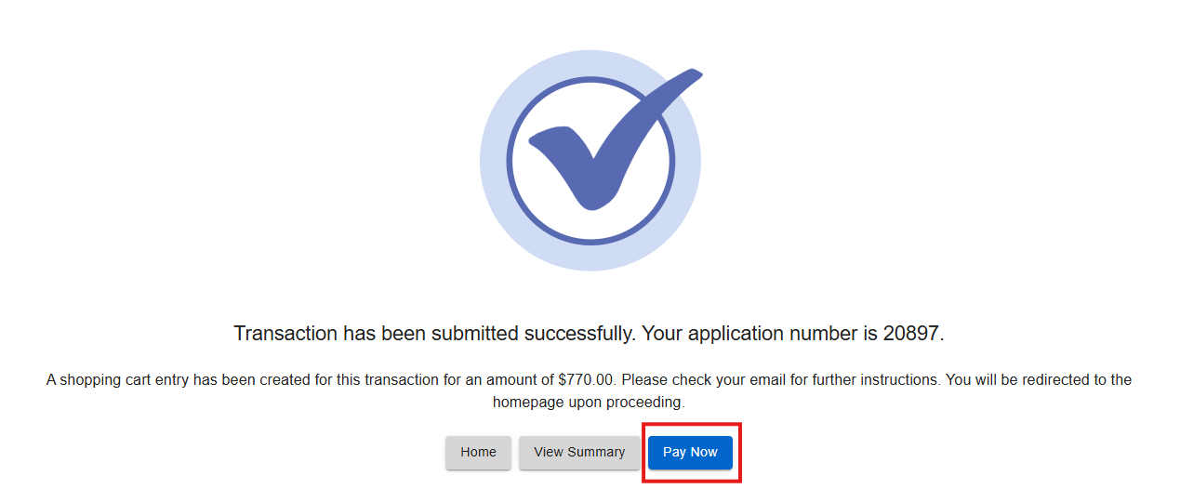
Step 10: Transaction Successful – Pay Now
After your submission is successful, a confirmation message will appear displaying your application number. You will then be prompted to proceed with payment. The total amount will include both the renewal fee and the consumer protection fee. When prompted, select Pay Now to continue.

Slide 15
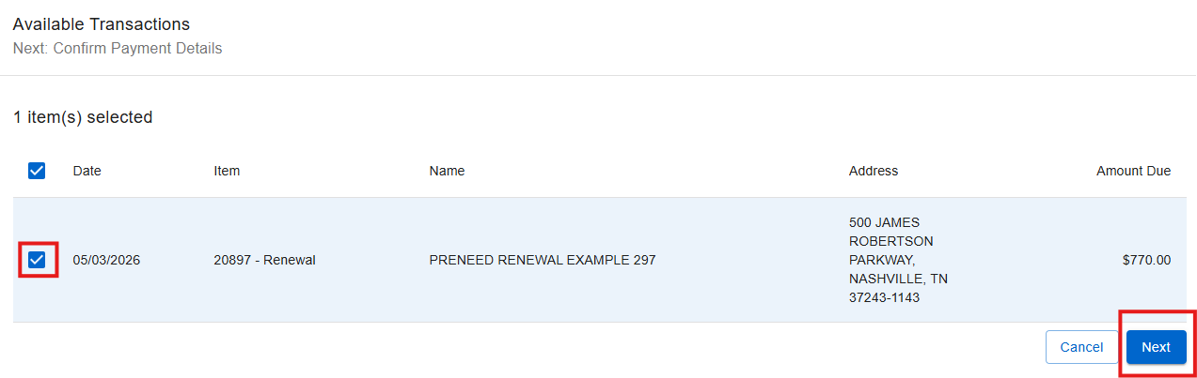
Step 11: Available Transactions
Select the specific transaction you intend to pay from the list provided, and then select Next.

Slide 16
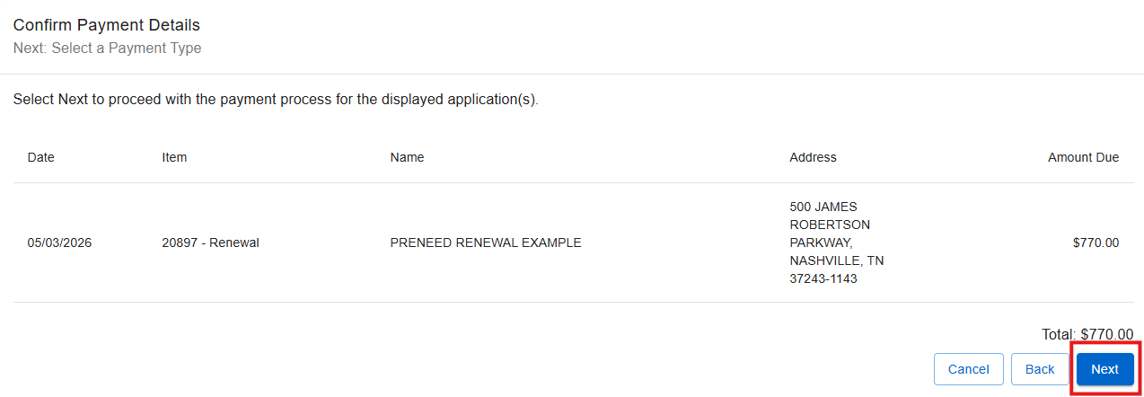
Step 12: Confirm Payment Details
Confirm the selected application is correct and click Next.

Slide 17
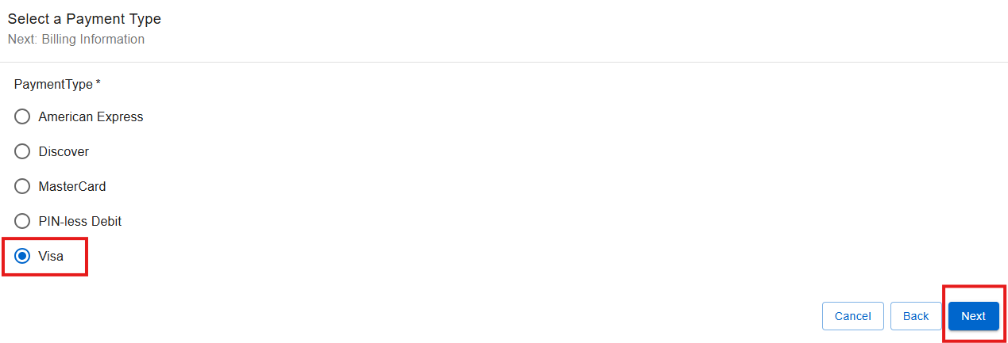
Step 13: Select a Payment Type
Choose the appropriate payment type from the available options, then proceed by selecting Next.

Slide 18
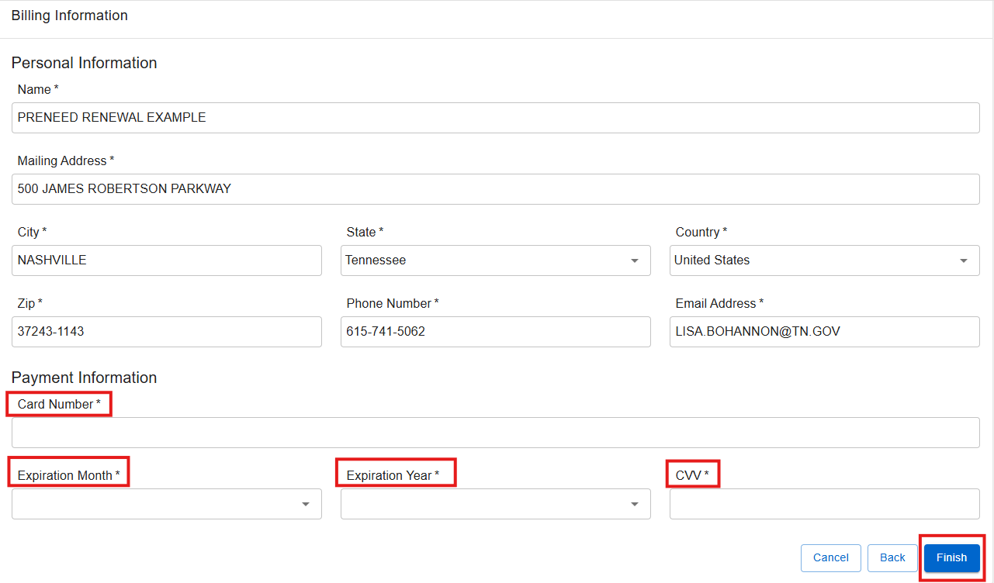
Step 14: Billing Information
Provide all required billing information to complete the payment process.

Slide 19
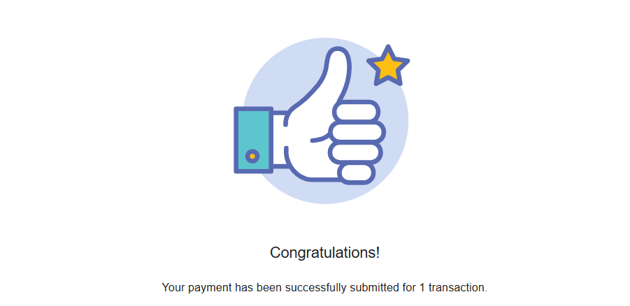
FINAL STEP
Upon successful completion of the transaction, a confirmation message will be shown. The applicant will subsequently receive an email that includes the application summary as well as the online payment summary.

