Slide 1
TN Board of Funeral Directors and Embalmers
Funeral Director and Embalmer Renewals
July 2026

Slide 2
Rule 0660-10-.03 - Continuing Education Requirements
(1) As a prerequisite to license renewal, each licensee shall submit with the license renewal application satisfactory proof of having completed a minimum of ten (10) hours of continuing education coursework during the licensing period. Of the ten (10) hours of continuing education coursework, five (5) hours must be attended in person, which means it shall be completed in the physical presence of the provider of the coursework or is completed by the licensee through an interactive virtual program that requires participants to confirm their presence during the program through a two-way transfer of information between the licensee and provider’s point of origin. All coursework must be approved by the Board for credit to be awarded. A licensee may receive one (1) hour of continuing education credit per renewal period for in-person attendance of a regularly scheduled meeting of the Board.
(2) Continuing education credit may be obtained by licensees through attendance at only those continuing education courses which have been approved by the Board. A licensee may not repeat the same continuing education course within consecutive renewal periods.
(3) Licensees may not carry over continuing education hours from one licensing period to the next.
(4) Except as provided in subsection (5), the requirements of this chapter do not apply to new licensees during the first licensing period.
(5) A person required to reapply as for initial licensure by T.C.A. § 62-5-316(b), shall as a prerequisite to issuance of a new license, submit with the application satisfactory proof of having completed a minimum of ten (10) hours of continuing education coursework within ninety (90) days of the date of application. Of the ten (10) hours of continuing education coursework, five (5) hours must be attended in person, which means it shall be completed in the physical presence of the provider of the coursework or through an interactive virtual program that requires participants to confirm their presence during the program.

Slide 3
To Check Continuing Education Credits
Visit verify.tn.gov.
Enter the licensee information and select Search. Next, select View. Under Continuing Education, all your completed continuing education hours will be listed.

Slide 4
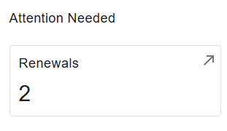
Where To Complete The Renewal
Visit https://access.cloud.commerce.tn.gov/portal/public.
Select Sign In, located in the top right-hand corner.
After logging in, locate the Attention Needed section; beneath it, select Renewals.

Slide 5
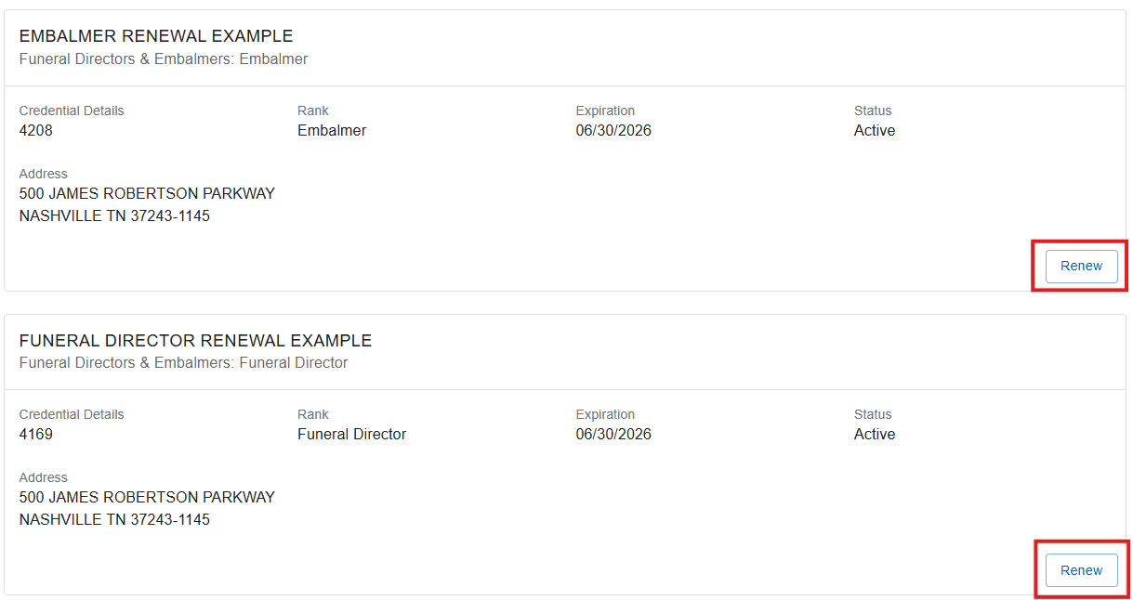
Step 1: Renewals
Select Renew to initiate the renewal process and proceed through the guided prompts.
When renewing multiple licenses, process each license individually, one (1) at a time.

Slide 6
Step 2: Introduction
These applications are for the renewal of a funeral director and embalmer license.
Renewal Fee: $375.00. Late Fee: $250.00.
Final processing of your application is subject to administrative review. Select Next.

Slide 7
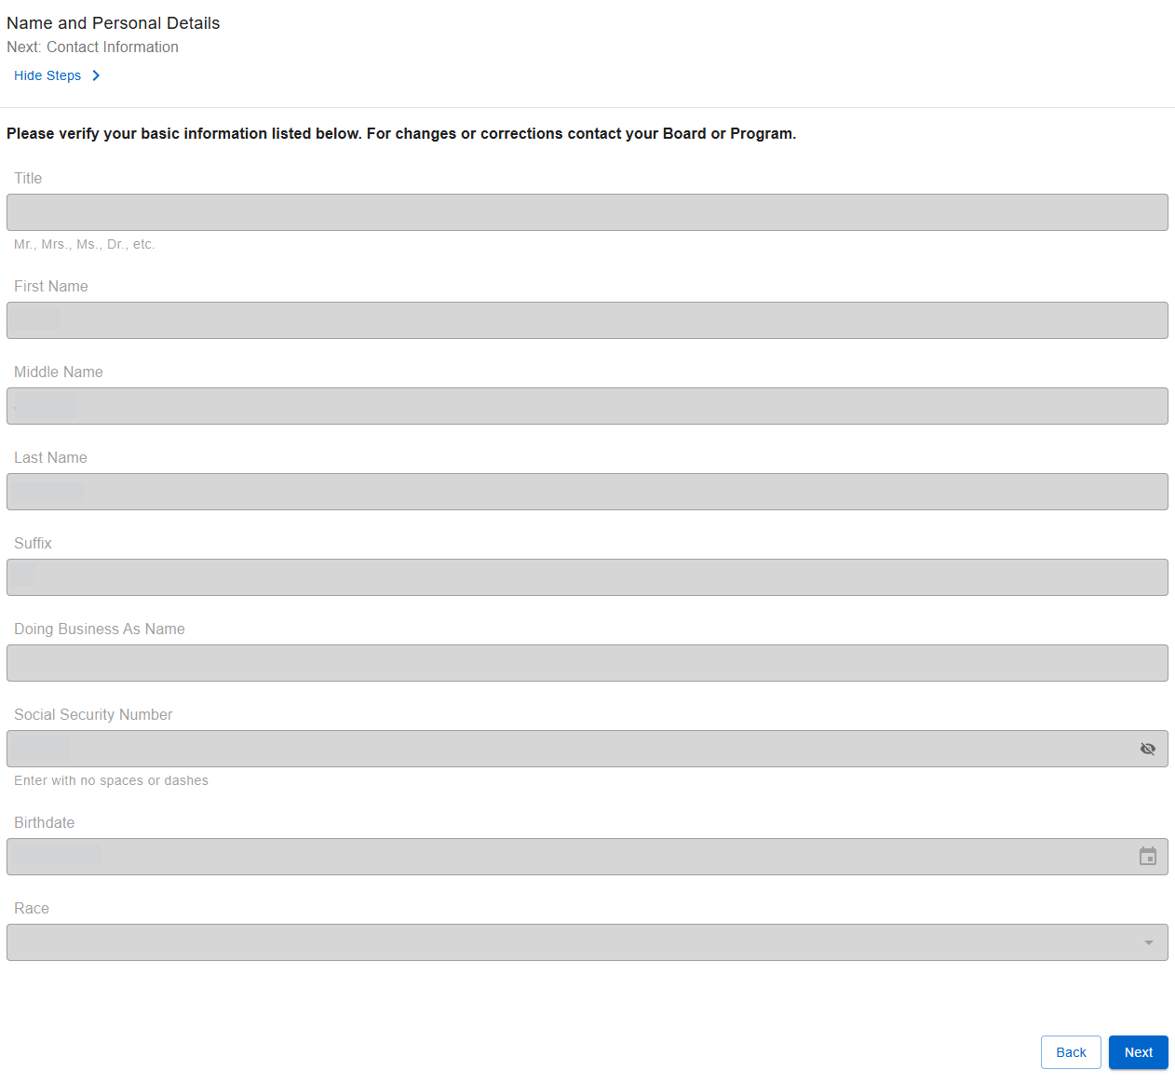
Step 3: Name and Personal Details
The information on this screen is fixed and cannot be changed. Continue by selecting Next.

Slide 8
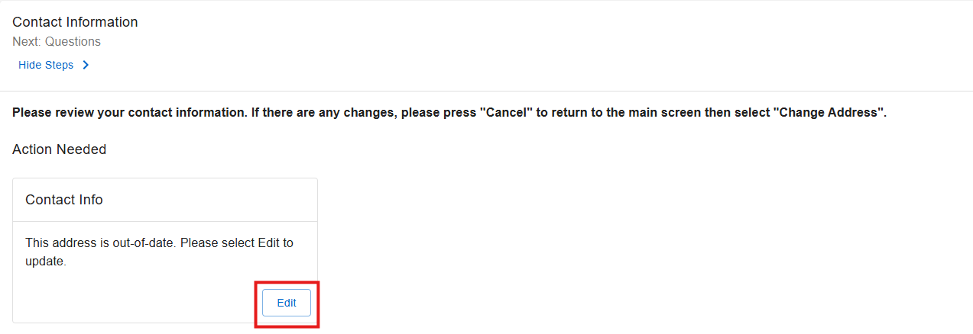
Step 4: Contact Information
In the Contact Info section, locate Action Needed and select Edit to continue.

Slide 9
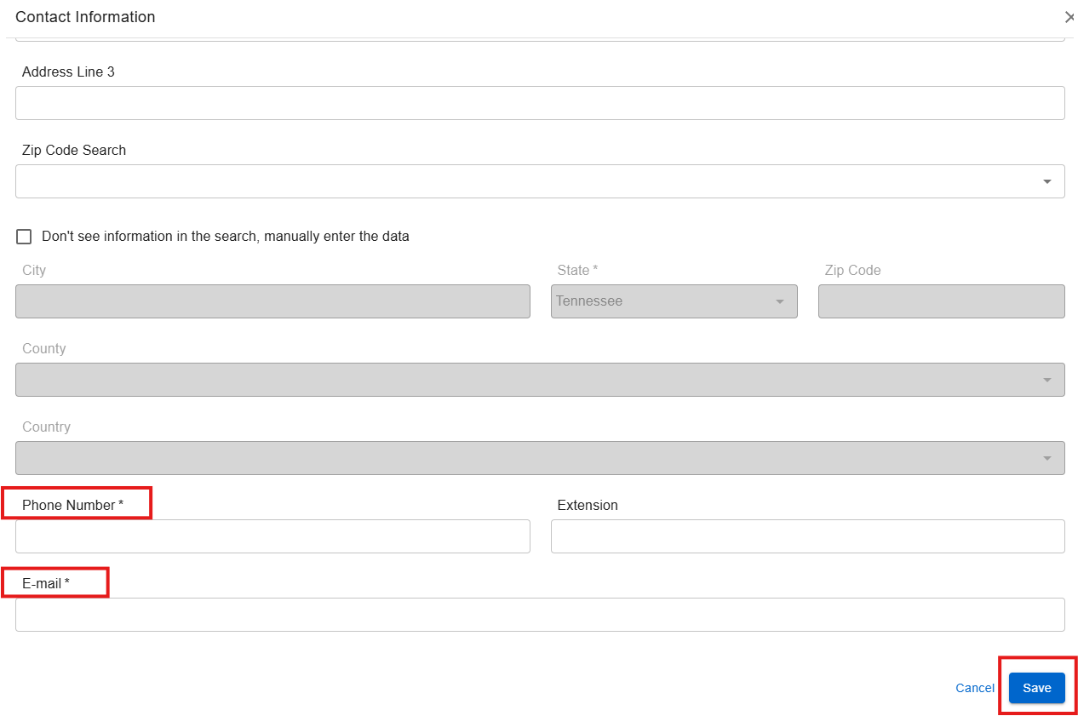
Step 4.1: Contact Information Continued
After choosing Edit in the Contact Information box, complete all applicable fields. Enter your personal cell number and personal email address, then select Save to finalize your updates.

Slide 10
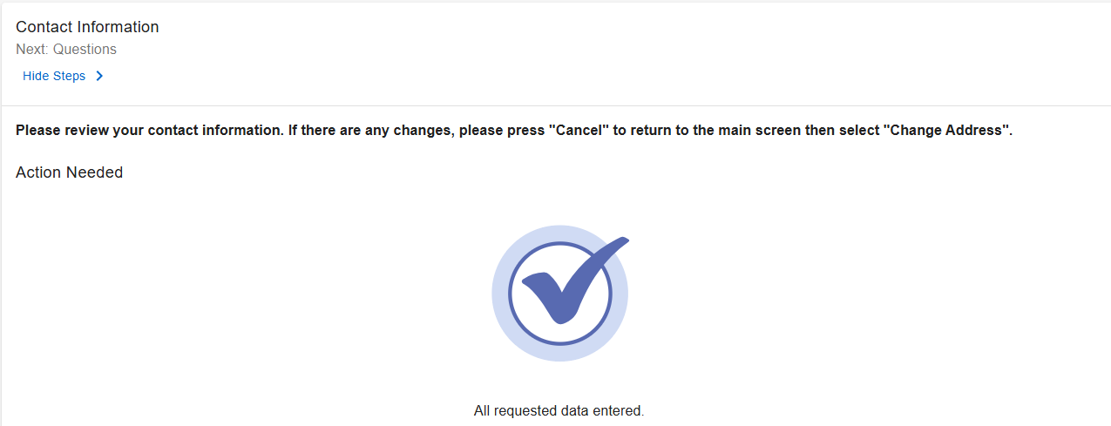

Step 4.2: Contact Information Continued
Once all addresses are up to date, select Next.

Slide 11
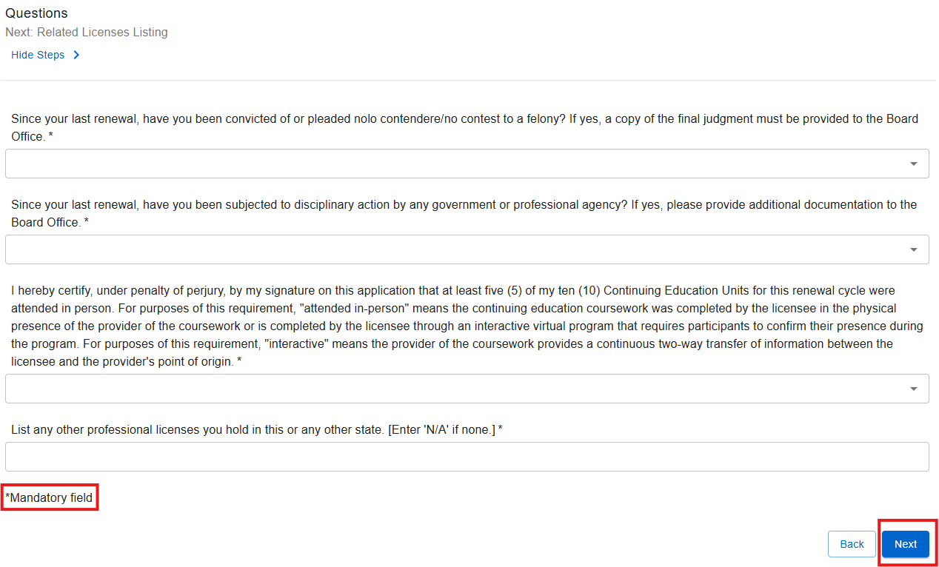
Step 5: Questions
Please answer all questions, including those marked with an asterisk (*), as these items are mandatory. Once all required fields are completed, select Next to continue.

Slide 12
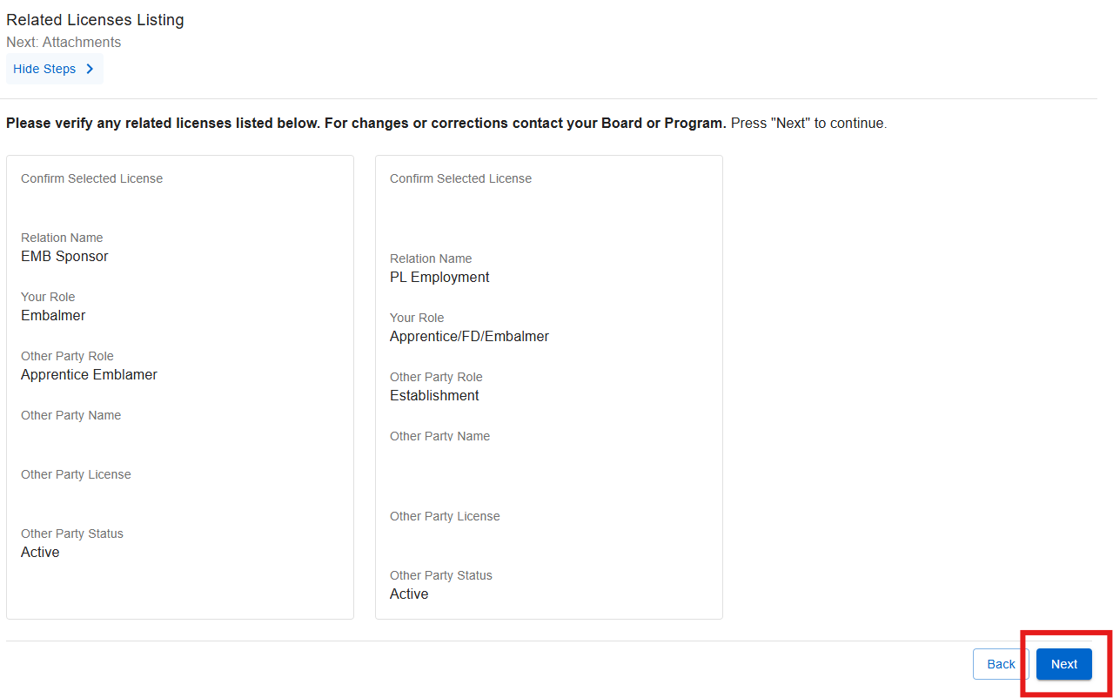
Step 6: Related Licenses Listing
Please review the related licenses. If any information is incorrect, contact the Funeral Board via email at funeral.cemetery.board@tn.gov. Once you have verified the information, select Next to continue.

Slide 13
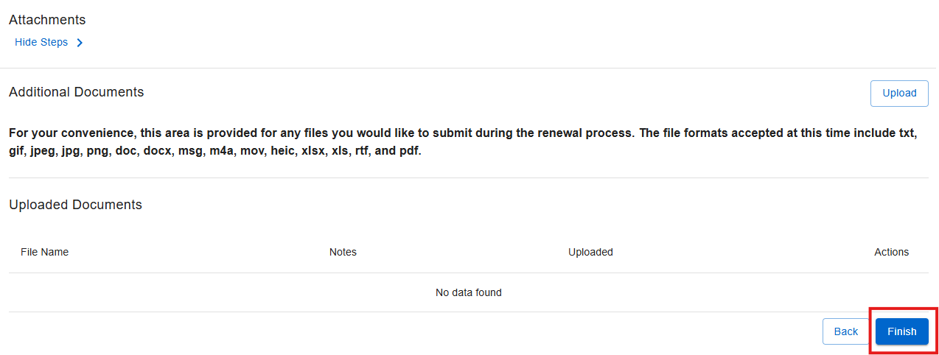
Step 7: Attachments
If there are any additional documents related to the renewal, please upload them here, then select Finish to continue.

Slide 14
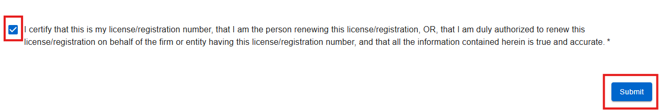
Step 8: Summary/Attestation
Click the attestation checkbox to confirm the accuracy of all provided information and documentation, then select Submit.

Slide 15

Step 9: Transaction Successful – Pay Now
After your submission is successful, a confirmation message will appear displaying your application number. You will then be prompted to proceed with payment. When prompted, select Pay Now to continue.

Slide 16
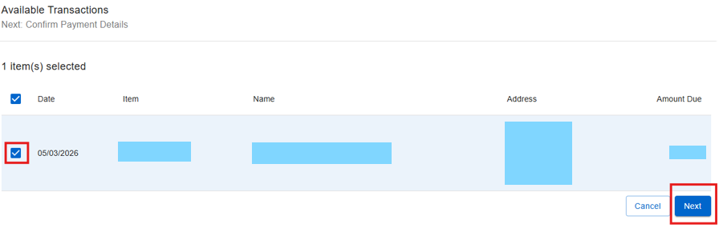
Step 10: Available Transactions
Select the specific transaction you intend to pay from the list provided, and then select Next.

Slide 17
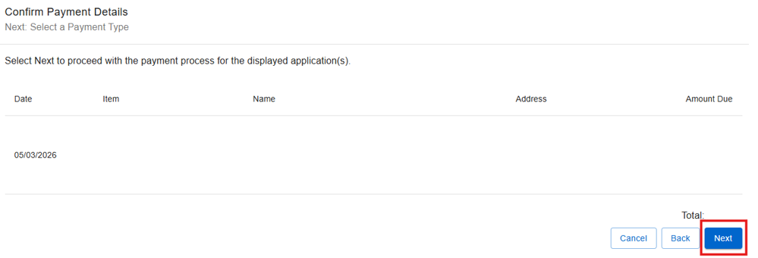
Step 11: Confirm Payment Details
Confirm the selected application is correct and click Next.

Slide 18
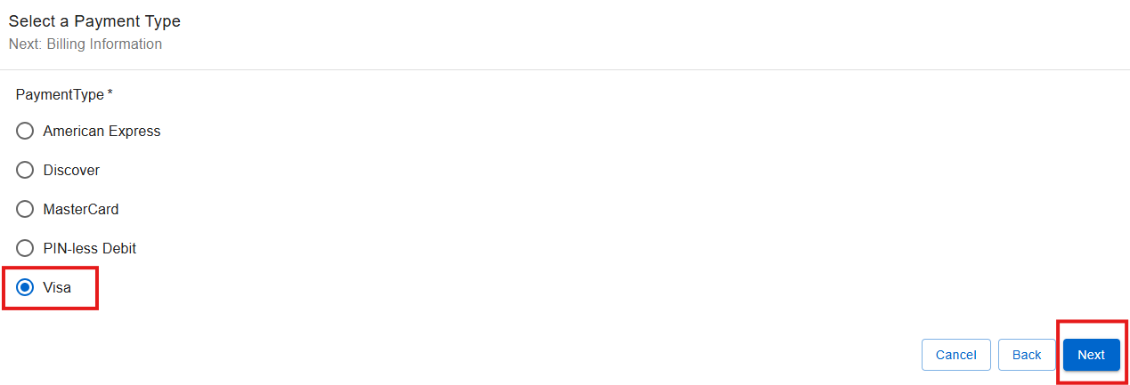
Step 12: Select a Payment Type
Choose the appropriate payment type from the available options, then proceed by selecting Next.

Slide 19
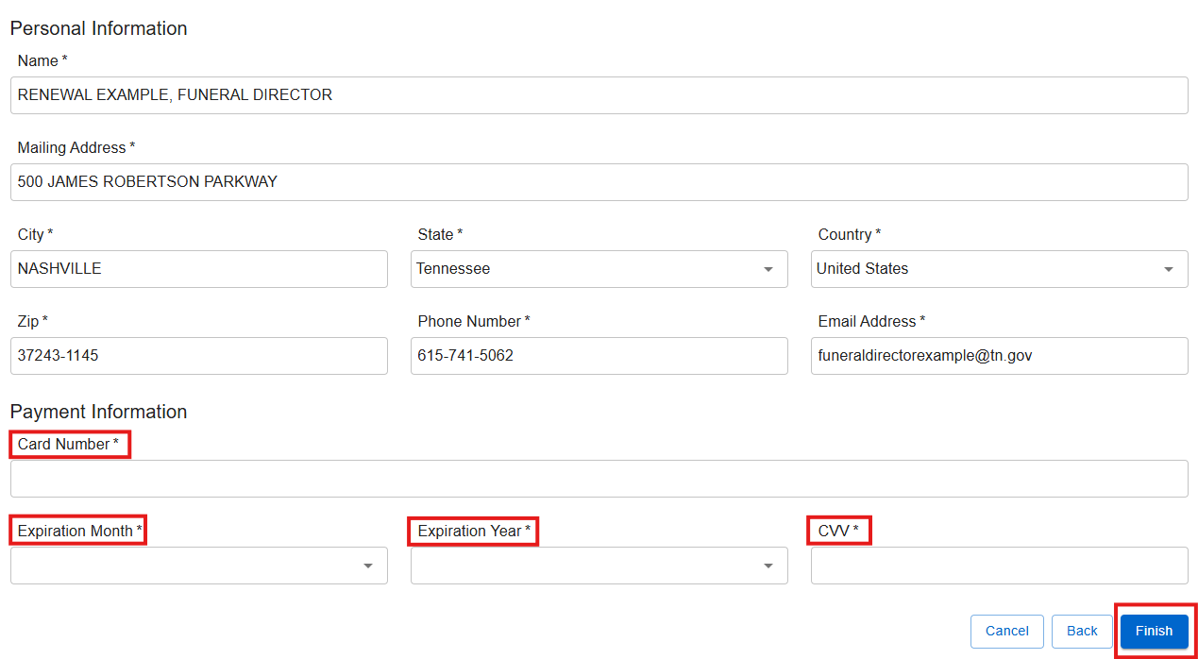
Step 13: Billing Information
Provide all required billing information to complete the payment process.

Slide 20
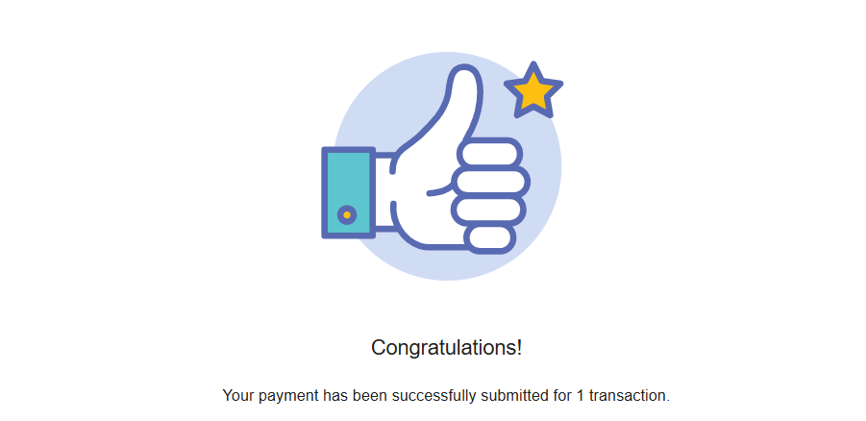
Final Step
Upon successful completion of the transaction, a confirmation message will be shown. The applicant will subsequently receive an email that includes the application summary as well as the online payment summary.

