Slide 1
TN Board of Funeral Directors and Embalmers
Establishment Renewal
July 2026

Slide 2

Tennessee Board of Funeral Directors and Embalmers Application Assistance
Establishment Renewal

Slide 3
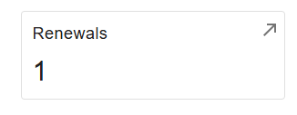
Where To Complete The Renewal
Visit https://access.cloud.commerce.tn.gov/portal/public.
Select Sign In, located in the top right-hand corner.
After logging in, locate the Attention Needed section; beneath it, select Renewals.

Slide 4
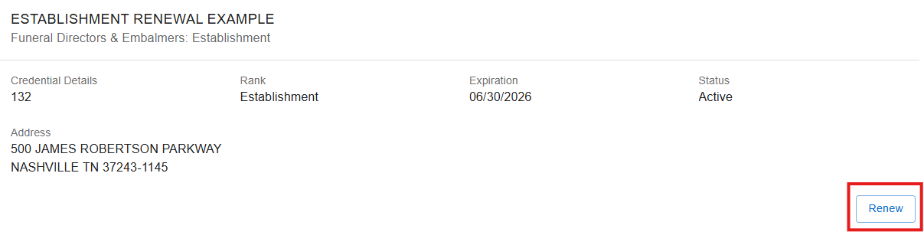
Step 1: Renewals
Start the renewal by selecting Renew and follow the prompts to proceed.

Slide 5
Step 2: Introduction
This application is for the renewal of an establishment license.
Renewal Fee: $1,150.00. Late Fee: $250.00.
Final processing of your application is subject to administrative review. Select Next.

Slide 6
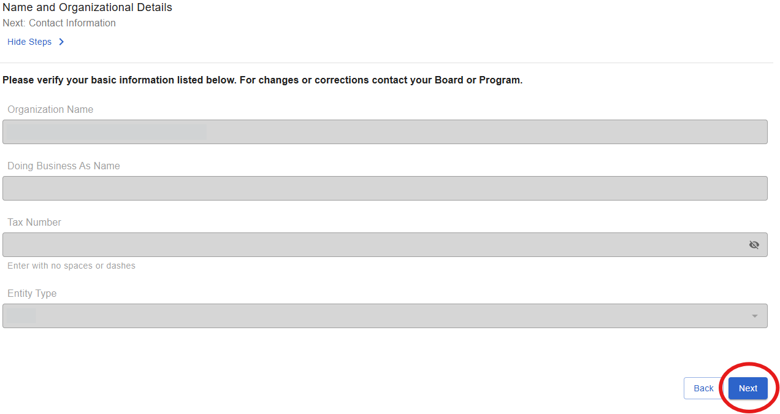
Step 3: Name and Organizational Details
The information on this screen is fixed and cannot be changed. Continue by selecting Next.

Slide 7
Step 4: Contact Information
Under contact information, please review the contact information section, which includes the Main Address, Owner Address, Mailing Address, and Business Address.
The main address, mailing address, and business address must reflect the physical and operational details of the establishment and cannot be replaced with a corporate mailing address.

Slide 8
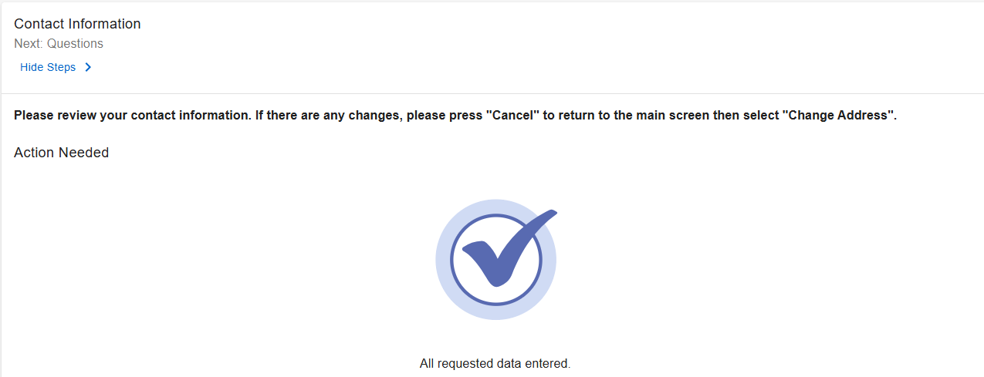

Step 5: Contact Information Continued
Once you have reviewed all addresses on file, select Next.

Slide 9
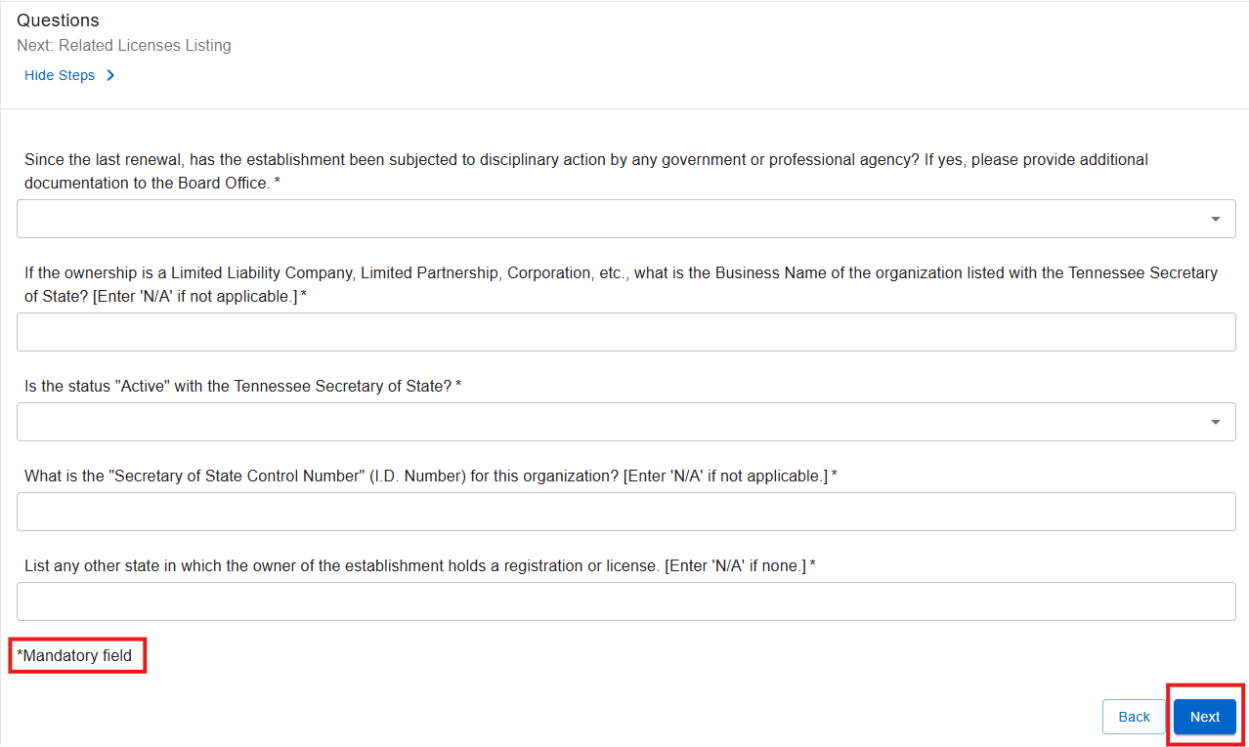
Step 6: Questions
Please answer all questions, including those marked with an asterisk (*), as these items are mandatory. Once all required fields are completed, select Next to continue.

Slide 10
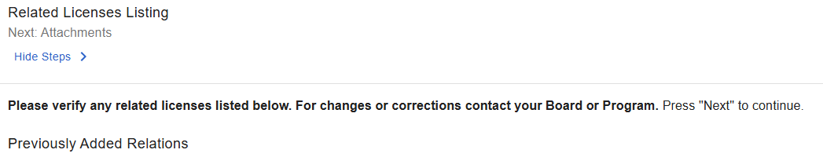

Step 7: Related Licenses Listing
Please review the related licenses. If any information is incorrect, contact the Funeral Board via email at funeral.cemetery.board@tn.gov. Once you have verified the information, select Next to continue.

Slide 11
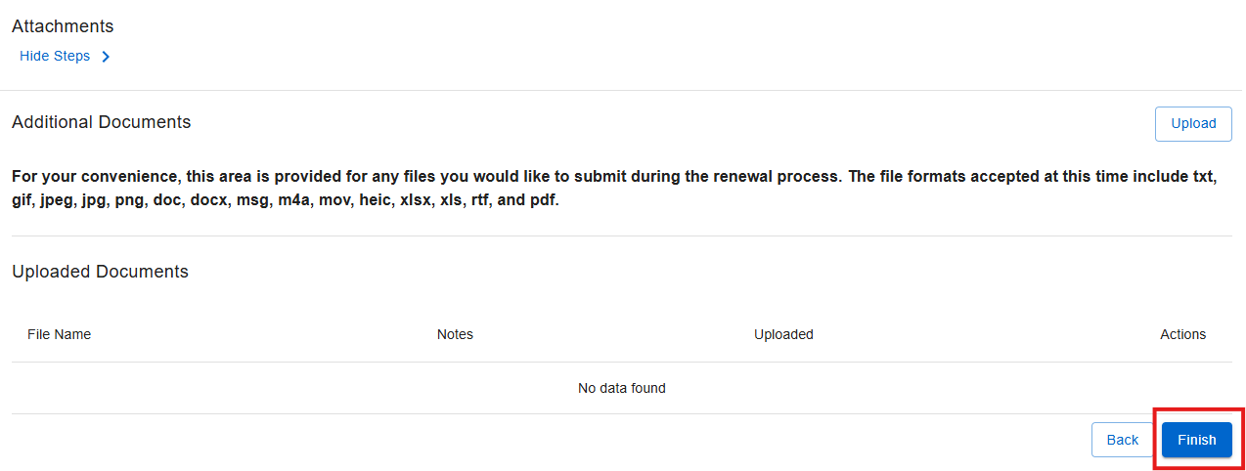
Step 8: Attachments
If there are any additional documents related to the renewal, please upload them here, then select Finish to continue.

Slide 12
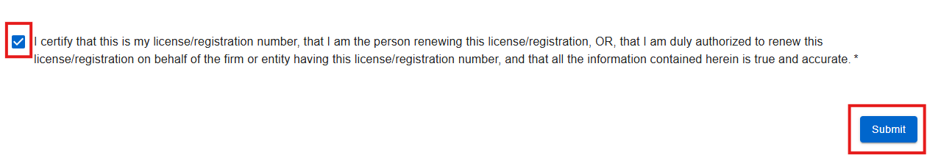
Step 9: Summary/Attestation
Click the attestation check mark to confirm the accuracy of all provided information and documentation, then select Submit.

Slide 13

Step 10: Transaction Successful – Pay Now
After your submission is successful, a confirmation message will appear displaying your application number. You will then be prompted to proceed with payment. When prompted, select Pay Now to continue.

Slide 14
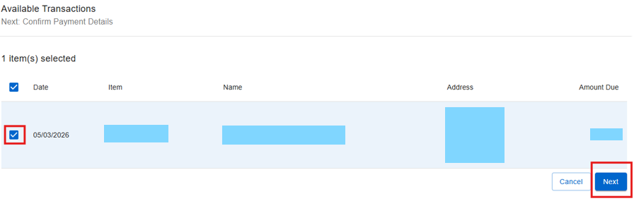
Step 11: Available Transactions
Select the specific transaction you intend to pay from the list provided, and then select Next.

Slide 15
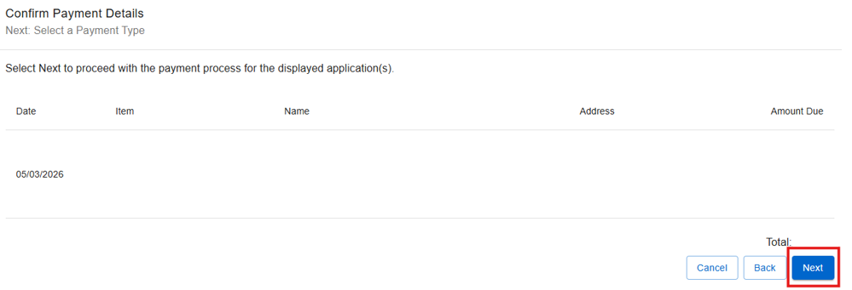
Step 12: Confirm Payment Details
Confirm the selected application is correct and click Next.

Slide 16
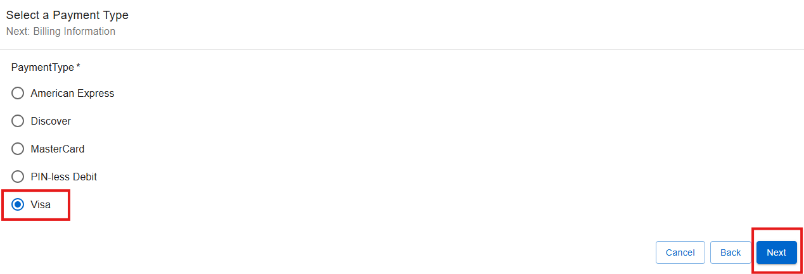
Step 13: Select a Payment Type
Choose the appropriate payment type from the available options, then proceed by selecting Next.

Slide 17
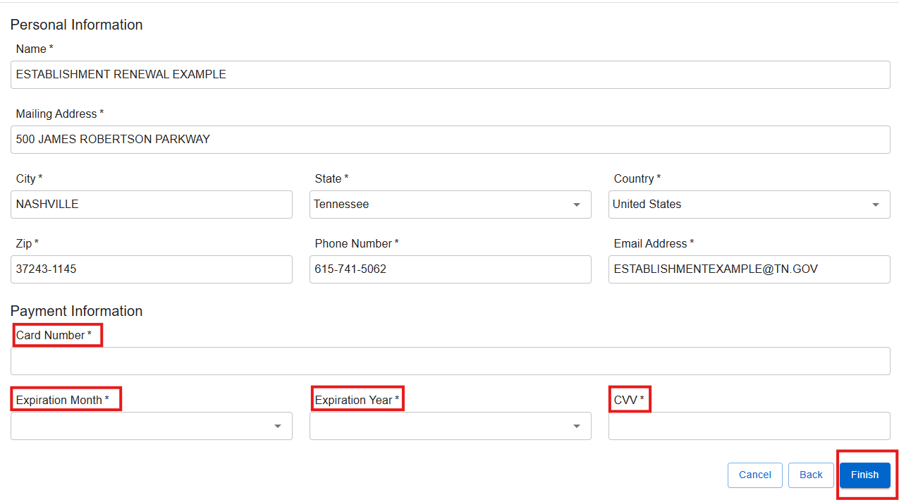
Step 14: Billing Information
Provide all required billing information to complete the payment process.

Slide 18
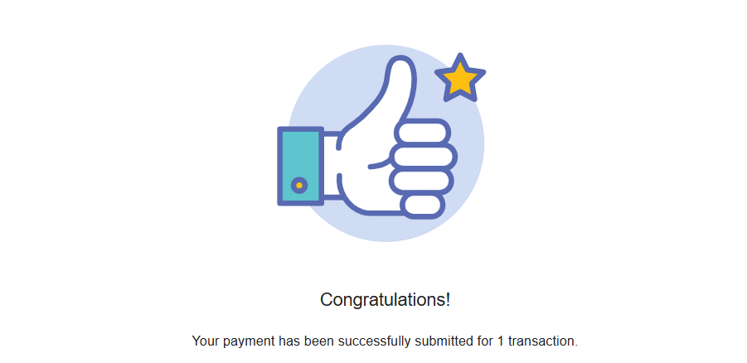
Final Step
Upon successful completion of the transaction, a confirmation message will be shown. The applicant will subsequently receive an email that includes the application summary as well as the online payment summary.

