Slide 1

Credit Service Business
Application Assistance
Initial License and Renewal Applications

Slide 2
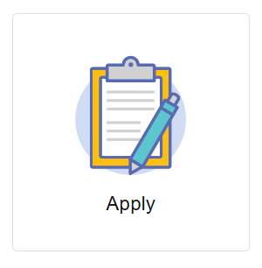
Where to Apply – Initial Licensure
Visit https://access.cloud.commerce.tn.gov/portal/public
Select the Apply tile and search for the Initial Credit Service Business Application.

Slide 3
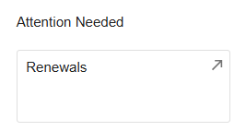
Where to Apply – Renewal
Visit https://access.cloud.commerce.tn.gov/portal/public
Click the Renewals tile to see all renewal applications associated with your account.

Slide 4
Application Introduction
Application Fee – Initial License Application: $50.00
Renewal Application – No Fee
Required Attachments:
A surety bond in the amount of one hundred thousand dollars ($100,000)
If the business is a corporation, limited liability company, or other entity, attach proof that the entity is duly registered in the State of Tennessee
If the business is a sole-proprietorship or general partnership, attach the full name, title, address, phone number, email and Social Security number of each proprietor or general partner, and identify verification by a government issued photo ID such as a driver’s license or passport.
A current copy of your client contract, cancellation notice and fee schedule
TIP!
The most common reason for delay in processing applications is due to missing information that is required to be in a customer contract and cancellation notice. Specific information that is required to be included in a credit services business’s customer contract and cancellation notice can be found in T.C.A. § 47-18-1005 and § 47-18-1006.

Slide 5
Function Suitability
You will be asked to:
Confirm that you have a $100,000 surety bond.

Slide 6
Name and Organizational Details/Contact Information
On these two pages, list your company’s name and details, and enter contact information. The Board keeps three address types on file:
- Main Address (preferred mailing address)
- Business Address
- Physical Address(es)

Slide 7
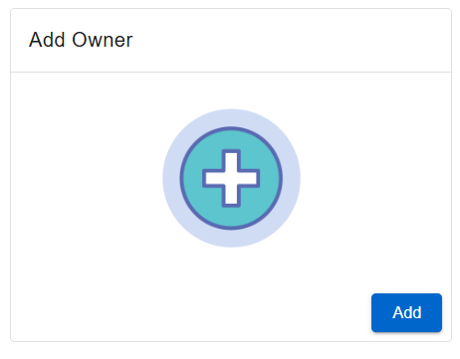
Ownership Information
Enter the name, address and ownership percentage for each owner. You may supply updated information at renewal if there have been changes to this information.

Slide 8
Low Income Waiver
Pursuant to T.C.A. 62-76-105, you may identify whether or not you are applying for a waiver of initial licensure fees. If you select “Yes”, you will be required to provide proof of public assistance in the attachments screen.
Please note that this waiver does not apply to federal fees, if applicable. If you qualify for this waiver, you are still required to pay the federal fees.
Indicate if you a recipient of a state or federal public assistance program such as temporary assistance for needy families (TANF), Medicaid, supplemental nutrition assistance program (SNAP), or any other state or public assistance program.

Slide 9
File Attachments
Required Attachments:
A surety bond in the amount of one hundred thousand dollars ($100,000)
If the business is a corporation, limited liability company, or other entity, attach proof that the entity is duly registered in the State of Tennessee
If the business is a sole-proprietorship or general partnership, attach the full name, title, address, phone number, email and Social Security number of each proprietor or general partner, and identify verification by a government issued photo ID such as a driver’s license or passport
A current copy of your client contract, cancellation notice and fee schedule
Additional documentation or explanation may be required,
depending on your answers to the application questions.

Slide 10
Summary
View a summary of the information you provided. Click the pencil icon to make necessary changes. Click Submit when complete.
You must agree to a statement that the information and documentation provided is accurate and true to the best of your ability, and that you understand that providing false information may result in the denial, suspension, or revocation of any license, certificate, or permit issued.
You will see a notification that your application has been submitted successfully and that a shopping cart entry has been created for this transaction.

Slide 11
Payment – Initial Applications Only
Your initial application is not complete until payment is submitted.
Click Pay Now to proceed.
Navigate the payment screens to enter your payment details:
- Select transactions to pay.
- Confirm Payment Details
- Select Payment Type
- Enter Billing Details

Slide 12
Check your Email
Your application submission is complete.
Check your email for summaries of your application and payment.

