Slide 1

Collections Application Assistance
Surety Bond Attachment

Slide 2
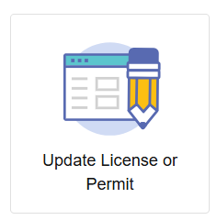
Where to Apply
Visit https://access.cloud.commerce.tn.gov/portal/public
Select Update License or Permit and select the Surety Bond Attachment Application.

Slide 3
Application Introduction
This application is for a collection agency that has an expired or soon to expire surety bond.
There is no fee associated with this request.
Required Attachments:
Proof of the renewed or extended bond

Slide 4
Surety Details
Enter the following information:
- Bond Type
- Bond Number
- Bond Amount
- Bond Effective Date
- Bond Expiration Date

Slide 5
File Attachments
Required Documents:
Surety Bond

Slide 6
Summary
View a summary of the information you provided. Click the pencil icon to make necessary changes. Click Submit when complete.
You must agree to a statement that the information and documentation provided is accurate and true to the best of your ability, and that you understand that providing false information may result in the denial, suspension, or revocation of any license, certificate, or permit issued.
You will see a notification that your application has been submitted successfully.

Slide 7
Check your Email
Your application submission is complete.
Check your email for summaries of your application.

