Slide 1

Collections Application Assistance
License Renewal

Slide 2
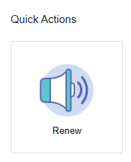
Where to Renew
Visit https://access.cloud.commerce.tn.gov/portal/public
Select the Renew tile to begin the application.

Slide 3
Application Introduction
This application is used to renew an existing Collections Agency license. If your license is expired for 60 days or longer, you must complete a Reapply Application.
The renewal fee is $350 if paid before the expiration date.
A late fee of $100 applies after the expiration date.
Required Attachments:
Surety Bond
Financial Statement prepared and signed by a CPA

Slide 4
Function Suitability
T.C.A. 62-20-103 provides exemptions to the requirement to hold a Collection license.
View the statute online here:
https://www.tn.gov/commerce/regboards/collections/rules-laws/laws.html
You will be asked to:
Confirm that you have read the TN Collection Exemption law to determine if you need a collection license.
Confirm that you have a financial statement prepared and signed by an Active CPA or licensed Public Accountant.

Slide 5
Contact Information
Review the contact information on file and make changes as necessary:
- Main Address (preferred mailing address)
- Business Address
- Physical Address(es)

Slide 6
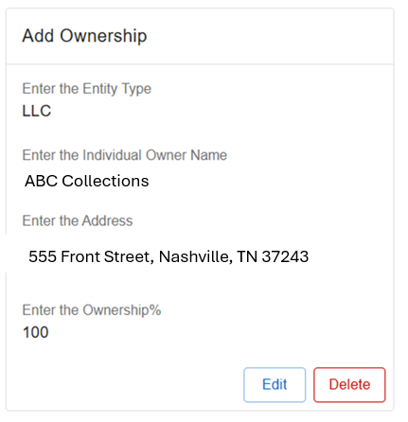
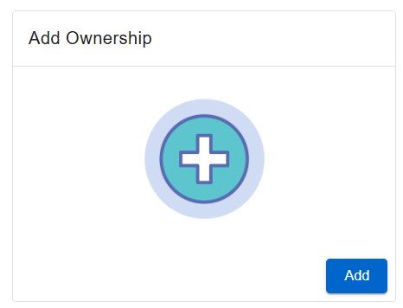
Ownership
Add, change, or delete ownership information as needed.
If an ownership change results in a different person(s) or entity acquiring an aggregate of fifty (50) percent or more of the shares, ownership, or other member interest, STOP and return to the main menu to submit an Ownership Change application.
Edit or delete an existing owner.
Add a new owner.

Slide 7
Questions
You must attach supporting documentation and/or an explanation if any of these are true:
You have ever been denied a collection agency license in Tennessee or elsewhere
In the last two years any owner(s), officer(s), member(s) or partner(s) have
  Been convicted of fraud in any court
  Been convicted of any felony
  Had a judgement entered in any court for failure to account to a client for money or property collected
  Been convicted of or have pending felony, misdemeanor, or civil actions relating to a financial transaction, honesty or trust
  Had a license suspended or revoked
  Filed a petition or been declared bankrupt
- Enter the number of employees
-Indicate if the agency has a location in Tennessee

Slide 8
Financial Information
You will be asked to affirm the following statements. If the answer is No, attach an explanation on the File Attachments Screen.
Do you affirm that the agency maintains a separate fiduciary or trust account with sufficient funds at all times to disburse such accounts as due to all clients?
Do you affirm that you remit to your clients monies collected for them within thirty (30) days after the close of each month, unless specific arrangements have been made with clients?
- List financial institution(s) where you deposit client money
- Enter the statement date of your company’s financial statement
- Current Balance of Fiduciary/Trust account
- Trust/Fiduciary Account Funds Owed to Clients

Slide 9
File Attachments
Required Documents:
Financial Statement
Surety Bond
City or County Business Tax Receipt (if agency has a physical location in TN)
Additional documentation or explanation may be required,
depending on your answers to the renewal questions.

Slide 10
Summary
View a summary of the information you provided. Click the pencil icon to make necessary changes. Click Submit when complete.
You must agree to a statement that the information and documentation provided is accurate and true to the best of your ability, and that you understand that providing false information may result in the denial, suspension, or revocation of any license, certificate, or permit issued.
You will see a notification that your application has been submitted successfully and that a shopping cart entry has been created for this transaction.

Slide 11
Payment
Your application is not complete until payment is submitted.
Click Pay Now to proceed.
Navigate the payment screens to enter your payment details:
- Select transactions to pay.
- Confirm Payment Details
- Select Payment Type
- Enter Billing Details

Slide 12
Check your Email
Your application submission is complete.
Check your email for summaries of your application and payment.

