Slide 1
TN Detection Services Licensing Program
Private Investigation Company License Renewal Application

Slide 2
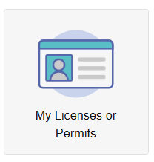
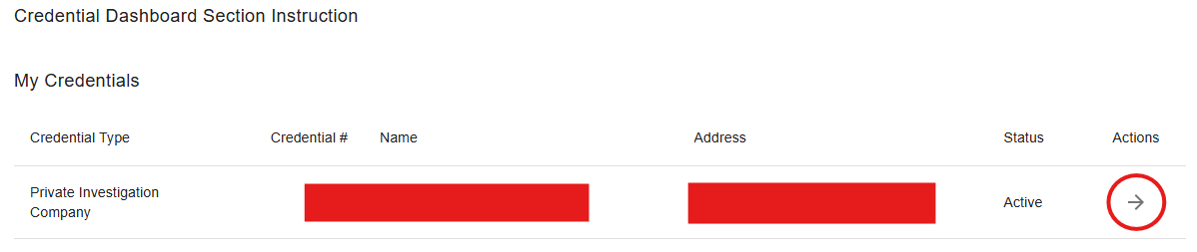
Step 1: Application Search
Log in to Your Core account through: https://core.tn.gov
Select the My Licenses or Permits button in the Quick Actions menu.
Click the arrow under “Actions” next to your Private Investigation Company.
Select the renewal application on the following page.

Slide 3
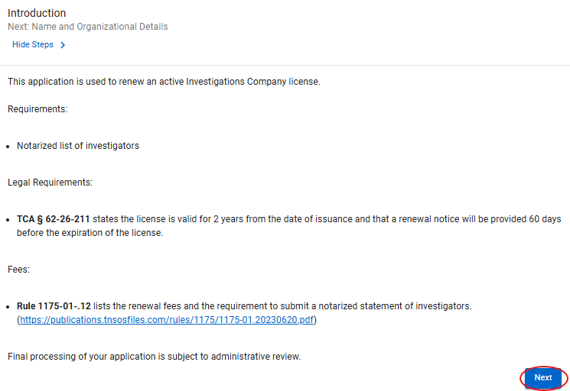
Step 2: Introduction
This section explains the requirements to continue the application.
Notarized list of investigators
Renewal Fee
The required notarized statement of affiliates form can be found at the following link: https://www.tn.gov/commerce/regboards/pi/license/forms.html

Slide 4
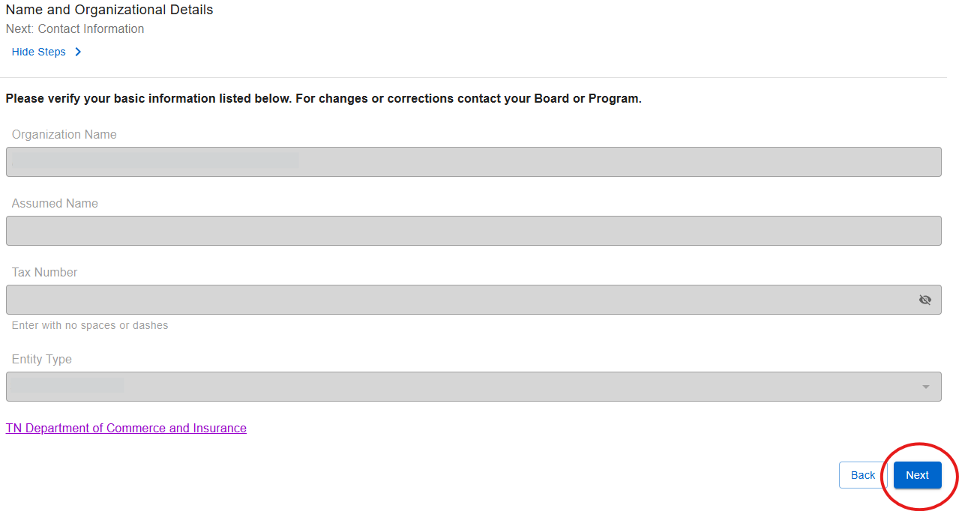
Step 3: Name & Organizational Details
Verify that all information listed is correct.
Your company name, contact information, and related license cannot be updated through this process.
To make changes to your information, send written notice with the exact company name, new address, and any license relation updates to the Board at: Private.Investigation@tn.gov

Slide 5
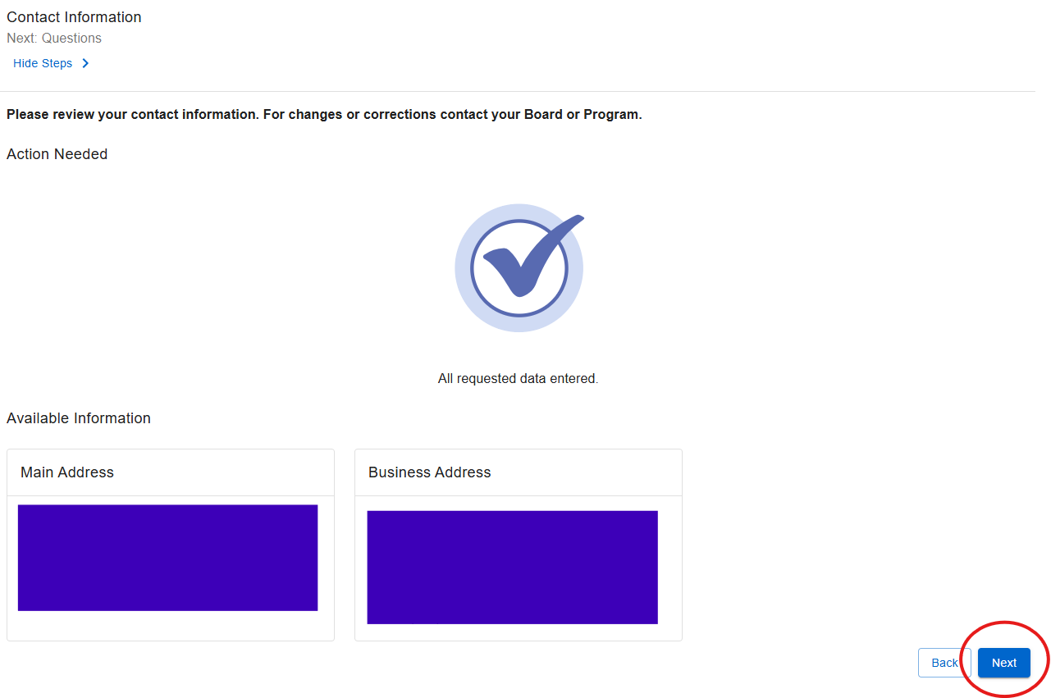
Step 4: Contact Information
Verify your contact information is correct.
*You will need to contact the Board if your addresses need to be updated.

Slide 6
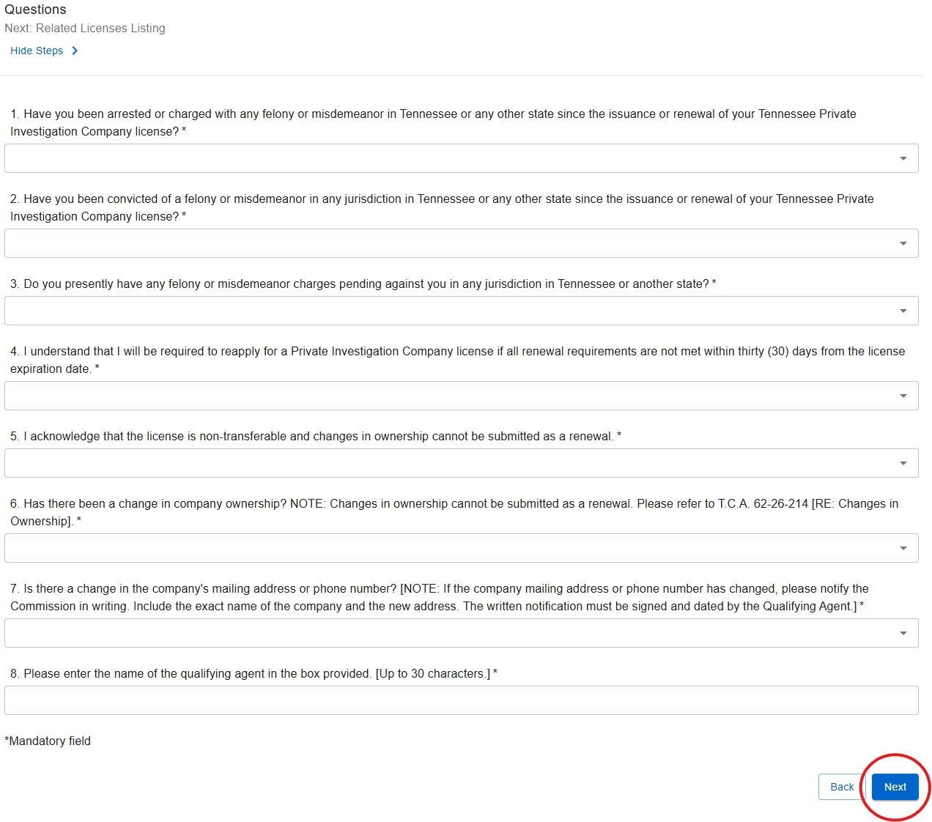
Step 5: Questions
Answer all questions based on your current status.
If the company ownership, mailing address, or phone number has changed, please notify the Board in writing. Include the exact name of the company and the new address.

Slide 7
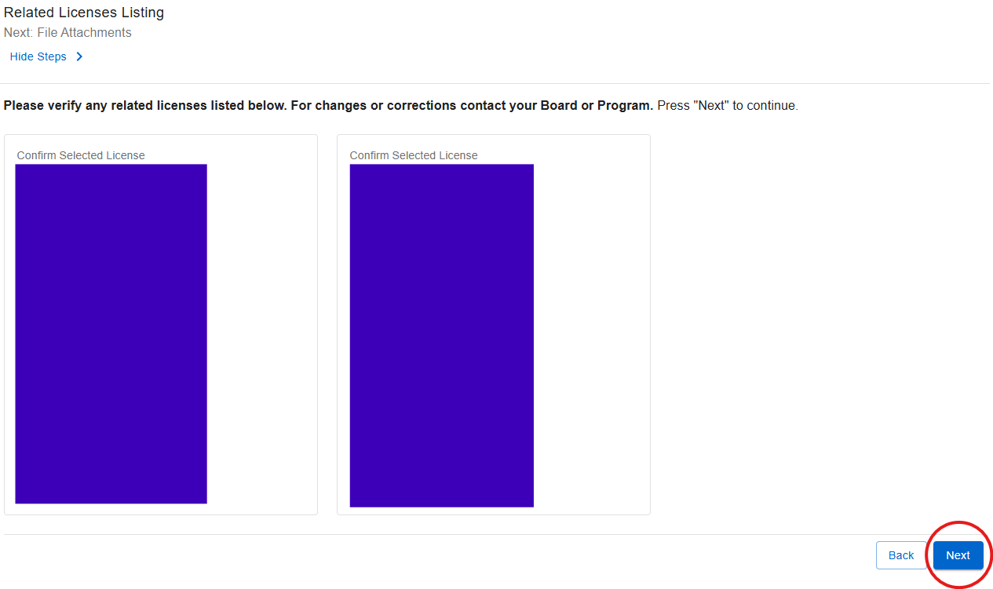
Step 6: Related Licenses Listing
Verify the related license information is correct.
*You will need to contact the Board if this information needs to be updated.

Slide 8
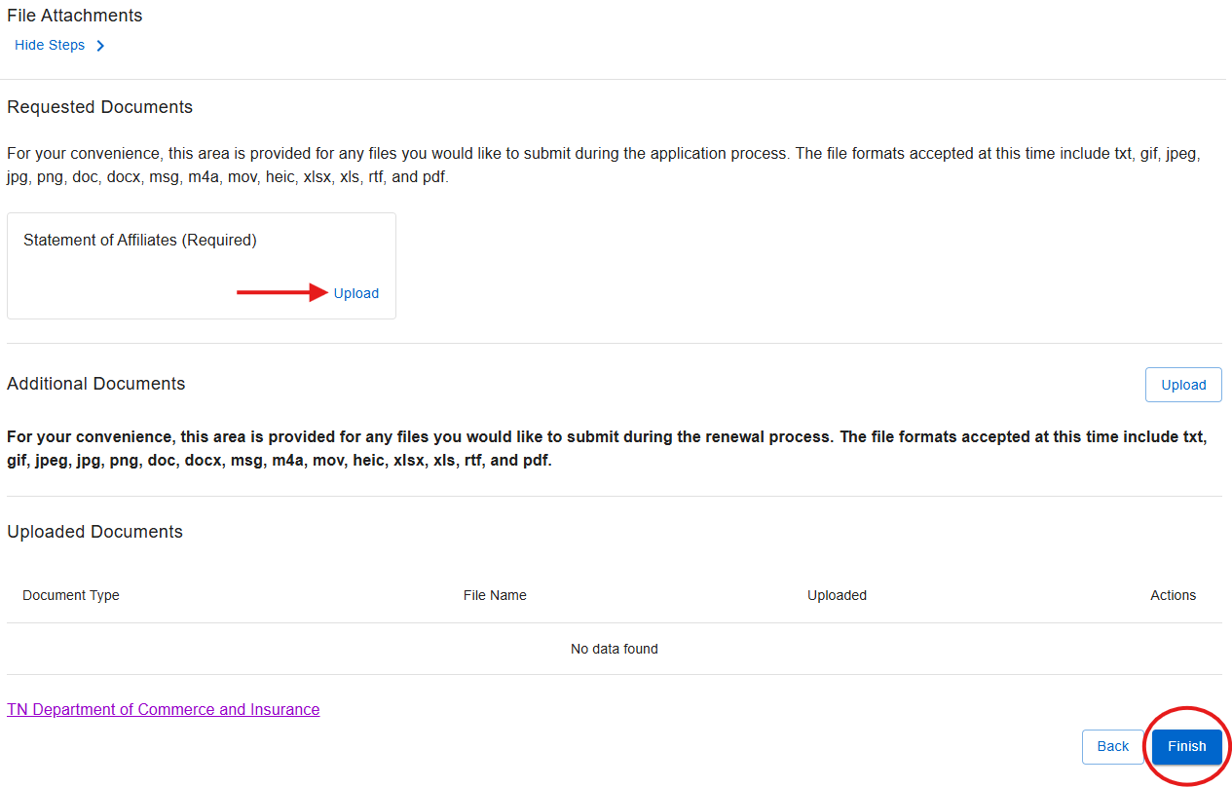
Step 7: File Attachments
Upload the required Statement of Affiliates* documentation.
If you have additional documents you would like to upload, you may do so on this page too.
*Note: Statement of Affiliates form can be found here: https://www.tn.gov/commerce/regboards/pi/license/forms.html.

Slide 9
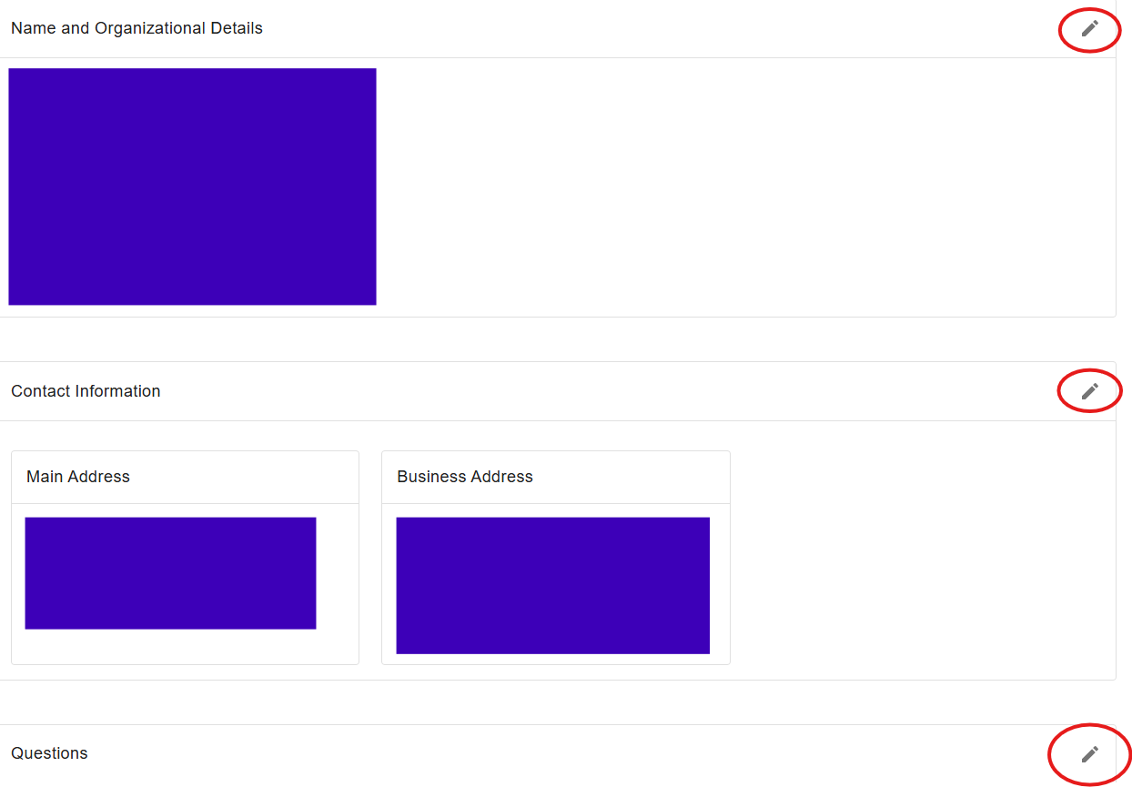
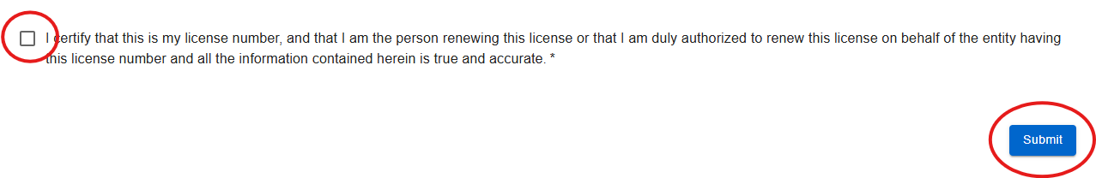
Step 8: Review
Review the application summary and acknowledge that all information is correct, then submit.
*If you need to edit any of the information you have entered before submitting your renewal application, you can click on the pencil icon located to the right of each section.

Slide 10
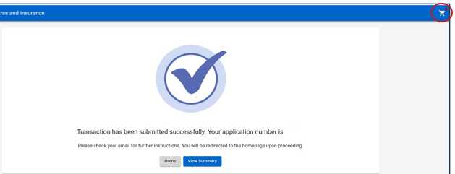
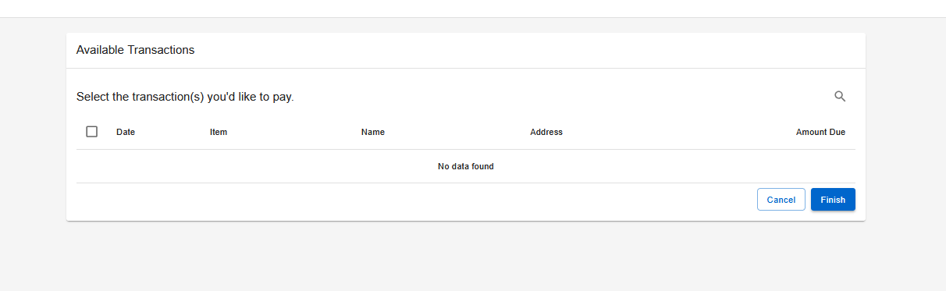
Step 9: Paying for the Application
After submitting your application:
Select the shopping cart icon in the top-right corner of the screen.
Select your application and follow the on-screen prompts to pay the amount due.
Note: Your application will NOT be processed until the application fee is received.

Slide 11

Step 10: Wait for Further Correspondence
If additional information is needed, you will receive an emailed letter outlining the steps required to complete your application.
If an email or letter is not received, you can assume your application is progressing in the licensing process.
Reminder: Monitor your mail and email address associated with your account, including spam or junk folders.
Verify your license status through https://verify.tn.gov

Slide 12

Private Investigation Contact Information
Email: Private.Investigation@tn.gov
Customer Service Phone: 615-741-4827
Address:
Tennessee Department of Commerce and Insurance
Detection Services Licensing Program
Davy Crockett Tower
500 James Robertson Parkway
Nashville, TN 37243
For more information or assistance, please visit website by clicking the link above.

