Slide 1
Detection Services Licensing Program
Private Protective Services
Armed Security Guard Add Classification Application

Slide 2
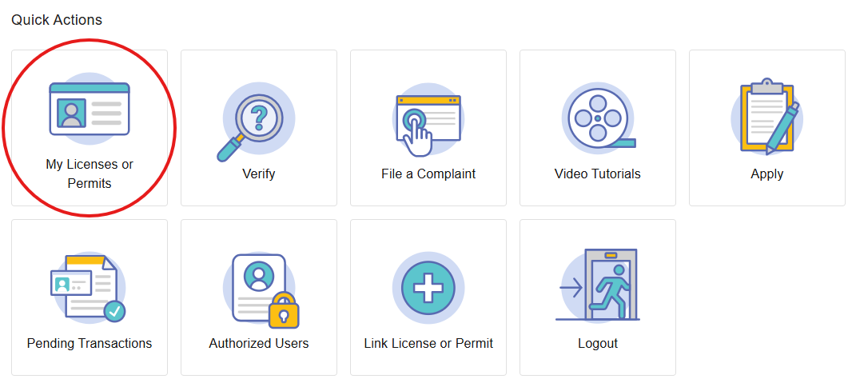
Step 1: My License or Permits
Log in to your Core account through: https://core.tn.gov
Click the “My Licenses or Permits” button in the Quick Actions Menu.

Slide 3
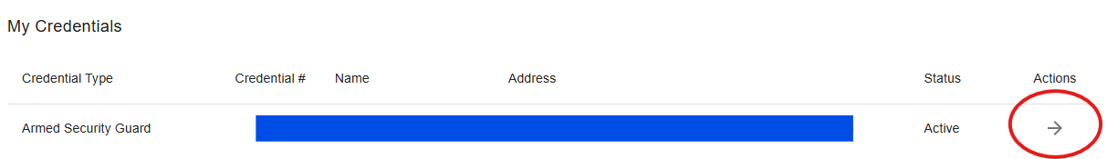
Step 2: Selecting the Correct License
Click the arrow under “Actions” opposite your Armed Security Guard License.

Slide 4
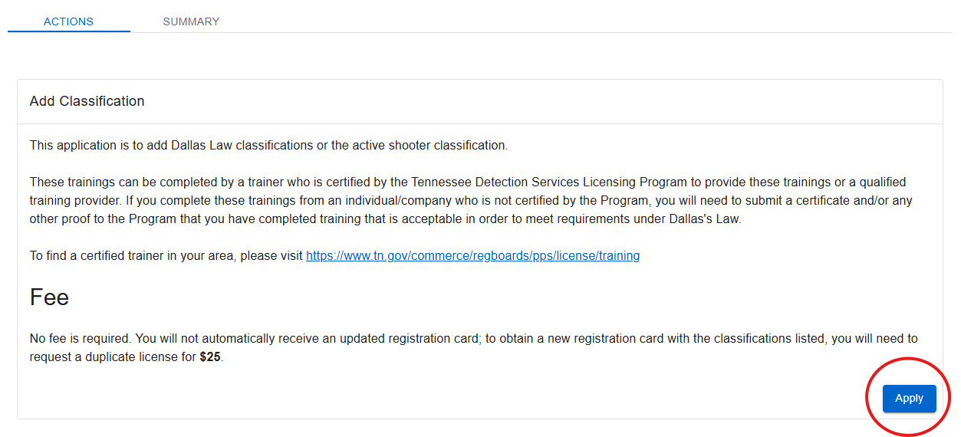
Step 3: Apply
Locate the Add Classification application and click “Apply”.

Slide 5
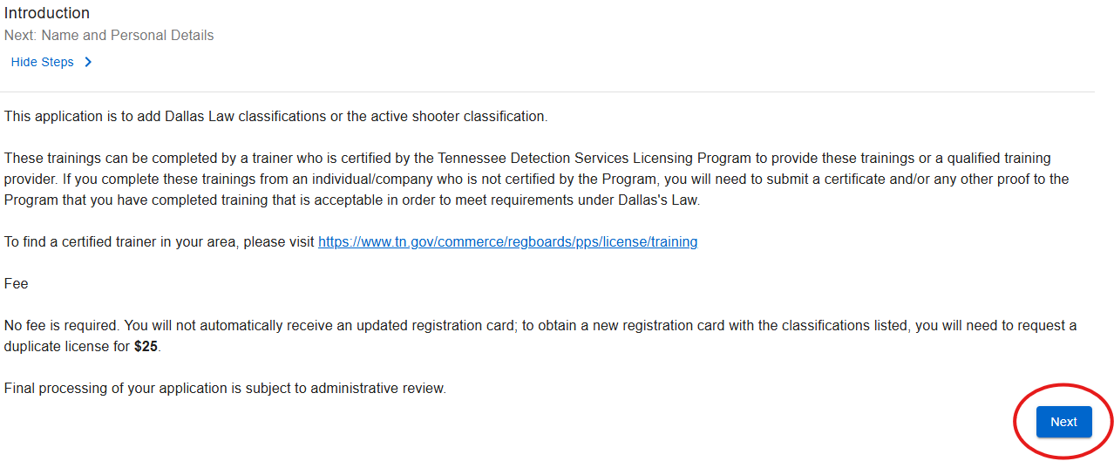
Step 4: Introduction
Confirm that you have all required documentation before continuing the application process. Select “Apply”.
You will need to have your training form available to upload.

Slide 6
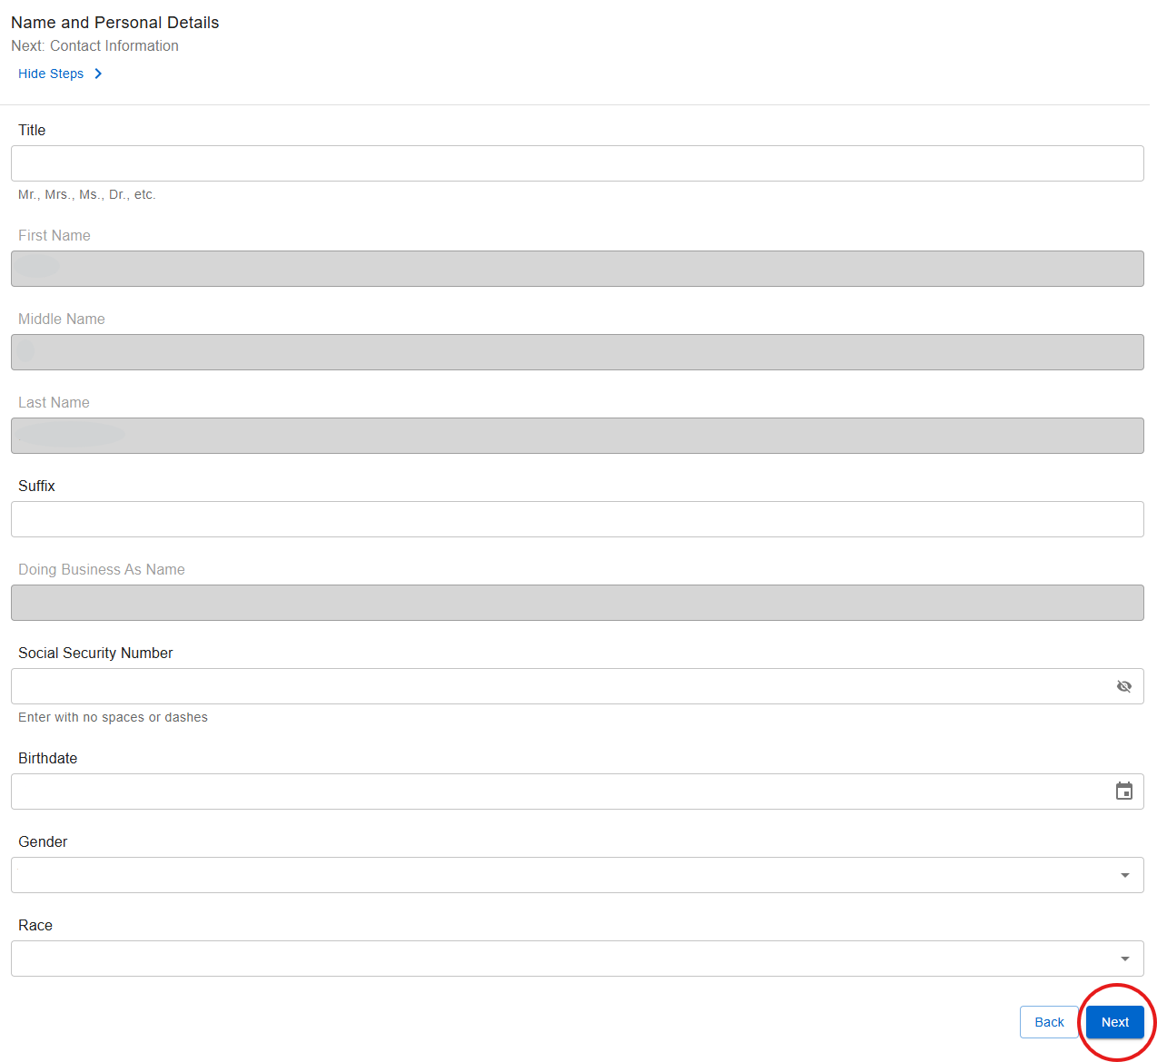
Step 5: Name and Personal Information
Verify your personal information is correct.
If your name or personal information needs updating, please contact us:
Email: Private.Protective@TN.Gov
Customer Service Phone: 615-741-6382
Select “Next”.

Slide 7
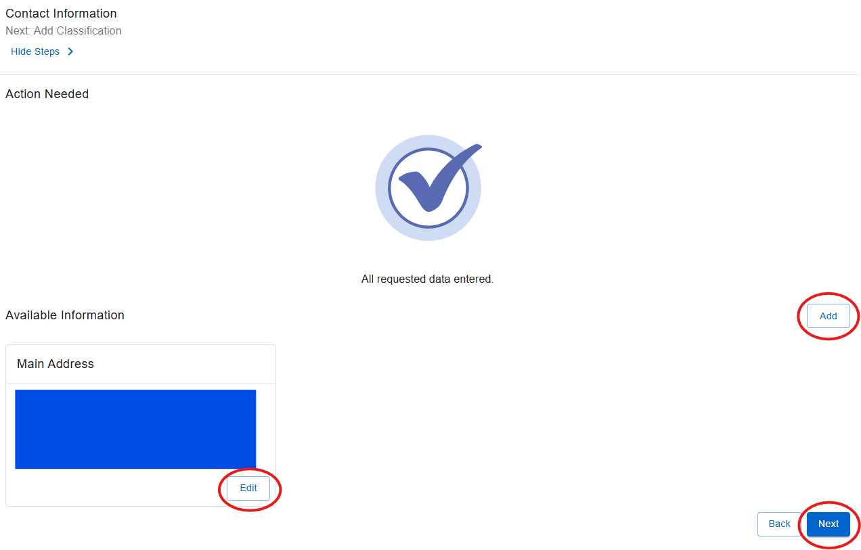
Step 6: Contact Information
Verify your address.
If your contact information needs to be updated:
Click edit.
Update the information as needed.
Click save once completed.
Note: If you would like to add another address, select “Add”, enter your information, then click save.

Slide 8
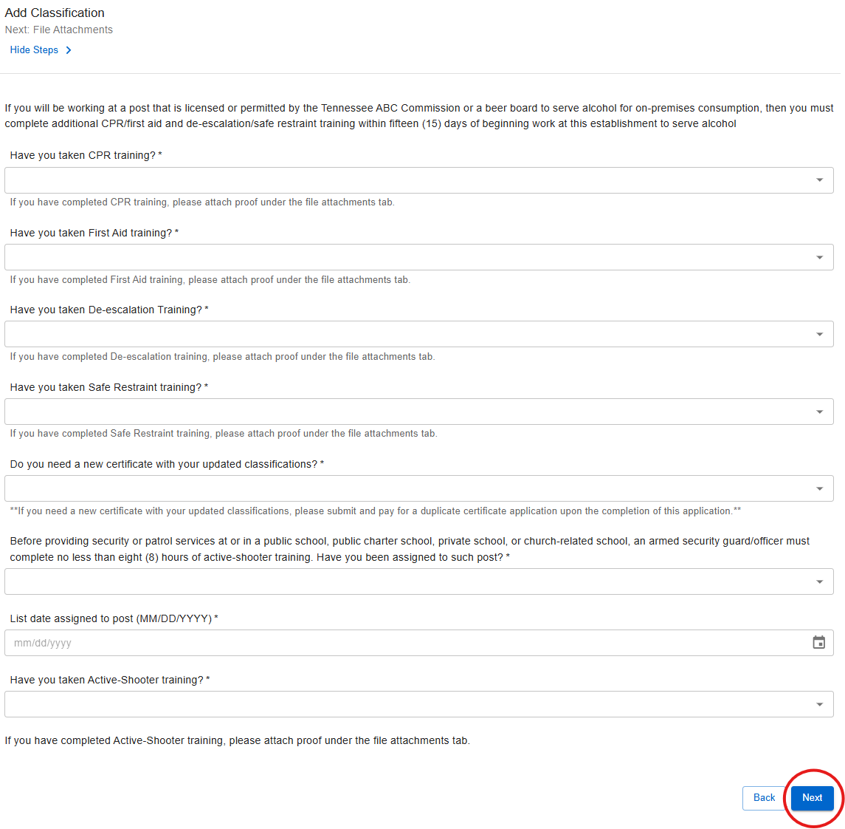
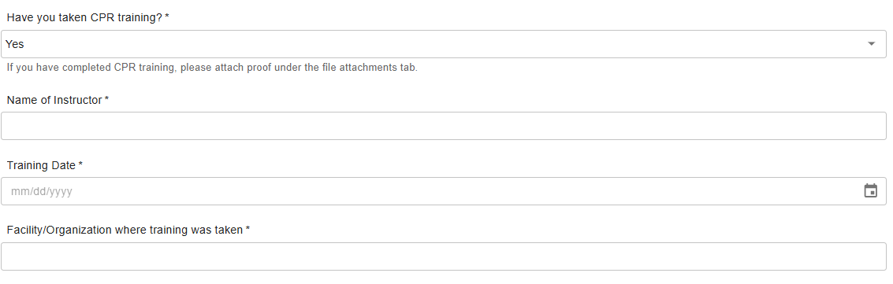
Step 7: Add Additional Training Information
Please click each drop-down arrow and answer “Yes” or “No” as they apply to your training.
Anything marked “Yes” will require you to provide the following:
Instructor's name.
The date course was taken.
The location where the course was taken.
Once everything is completed click “Next”.

Slide 9
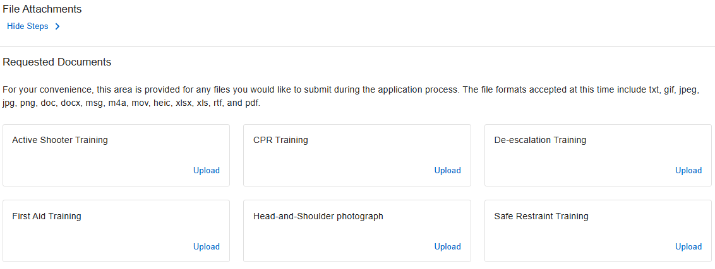
Step 8: Required Documents
Required documents:
Training for each classification you are adding.
  If the class was taken with a State Certified trainer, the State Training Form will be required.
  If the training form or certificate includes more than one discipline, you are only required to upload the document once under one of the appropriate fields.
A passport style photo.
Once you have finished uploading your documents, click “Finish”.

Slide 10
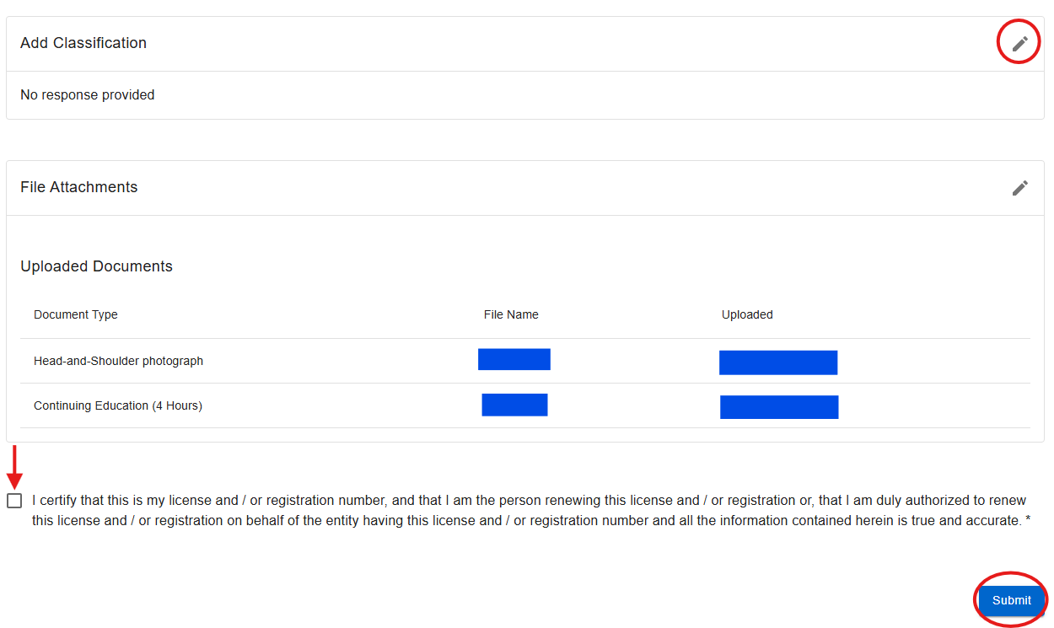
Step 9: Summary
Review all information to ensure accuracy.
Review the summary of the add classification application. If you need to edit any step, select the pencil icon located to the right of the step.
If everything is true and correct, please check the box to certify, then click “Submit”.
Submitting incorrect or incomplete information may delay processing.

Slide 11
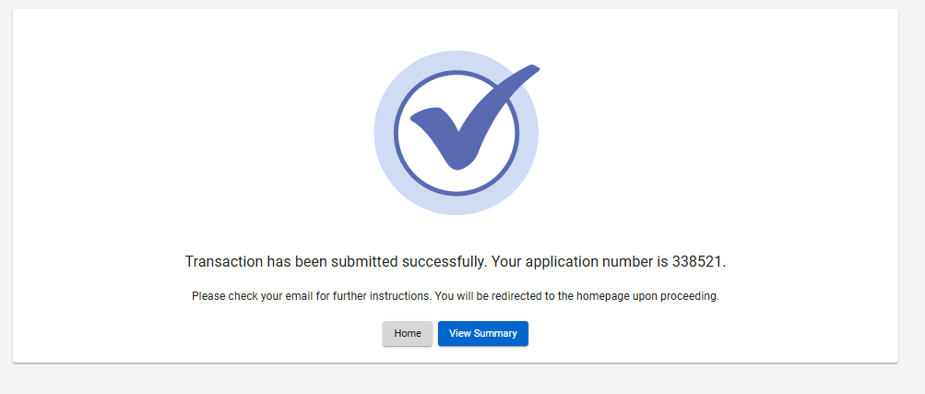
Step 10: Completed
Your transaction has successfully been submitted.
Note: If you want a duplicate license with your new classifications listed, you will need to request a duplicate license.

Slide 12

Step 11: Wait for Further Correspondence
If additional information is needed, you will receive an email or letter outlining the steps required to complete your application.
If a letter is not received, you can assume your application is progressing in the licensing process.
Reminder: Monitor the email address associated with your account, including spam or junk folders.

Slide 13

Email: Private.Protective@TN.Gov
Customer Service Phone: 615-741-6382
Address:
Tennessee Department of Commerce and Insurance Regulatory Boards
Detection Services Licensing Program
Private Protective Services
Davy Crockett Tower, 10th Floor
500 James Robertson Parkway
Nashville, TN 37243
Private Protective Services Contact Information
For more information or assistance, please visit our website by clicking the image above.

