Slide 1
DETECTION SERVICES LICENSING
Private Protective Services
Armed Security Guard Renewal Application

Slide 2
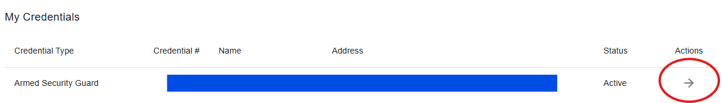
Step 1: Application Search
Sign In to your account via: https://core.tn.gov
Navigate to “My Licenses or Permits” on the Quick Actions Menu.
Beside the license you’d like to renew, click the arrow under “Actions”.

Slide 3
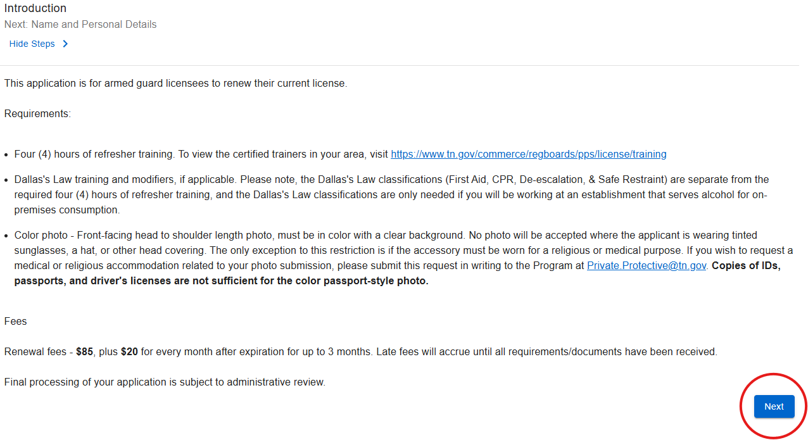
Step 2: Introduction
Confirm that you have all required documentation before continuing the application process.
Requirements:
Four (4) hours of refresher training.
Dallas’s Law training if applicable.
Color photo.
Select “Next”.

Slide 4
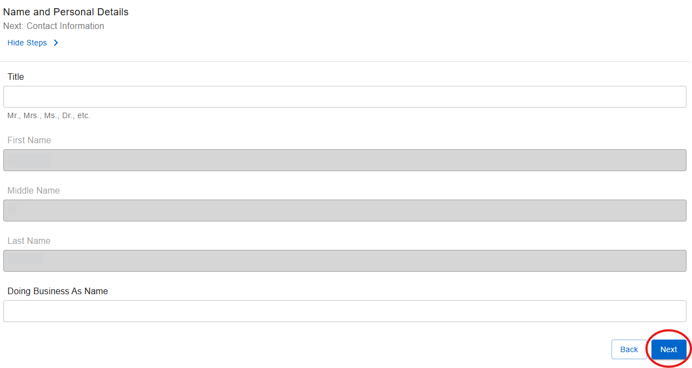
Step 3: Name & Personal Details
Review your personal information to ensure accuracy.
Click "Next" if there are no changes.

Slide 5
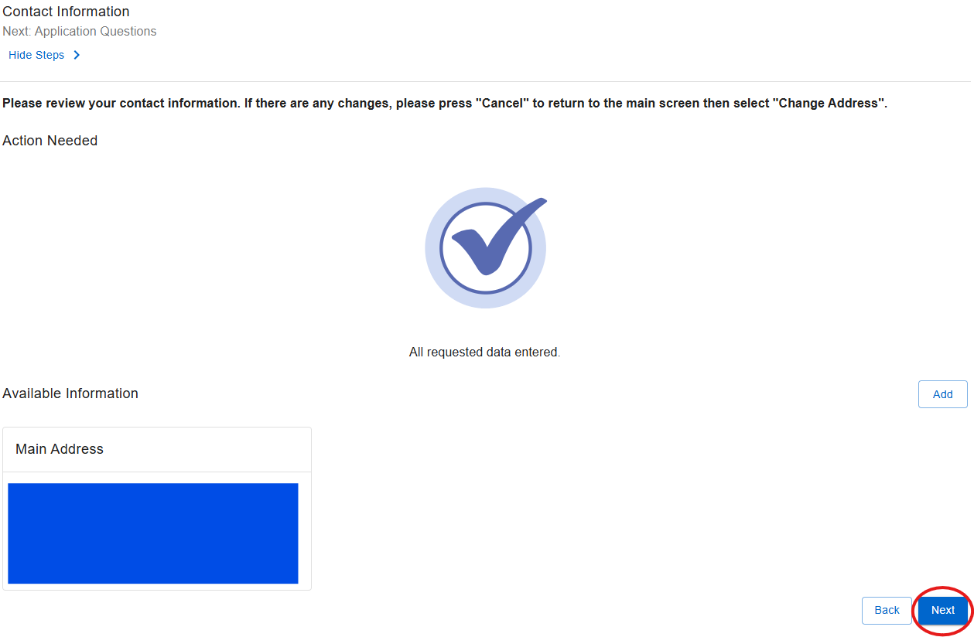
Step 4: Contact Information
Verify your Contact Information
Note: You WILL NOT be able to edit address information in this application.
Steps on how to change your address are below.
To update your address:
Return to your home page, click on “My Licenses or Permits”.
Click the arrow opposite your Armed Security Guard license under “Actions”.
Click “Apply” under Change of Address.

Slide 6
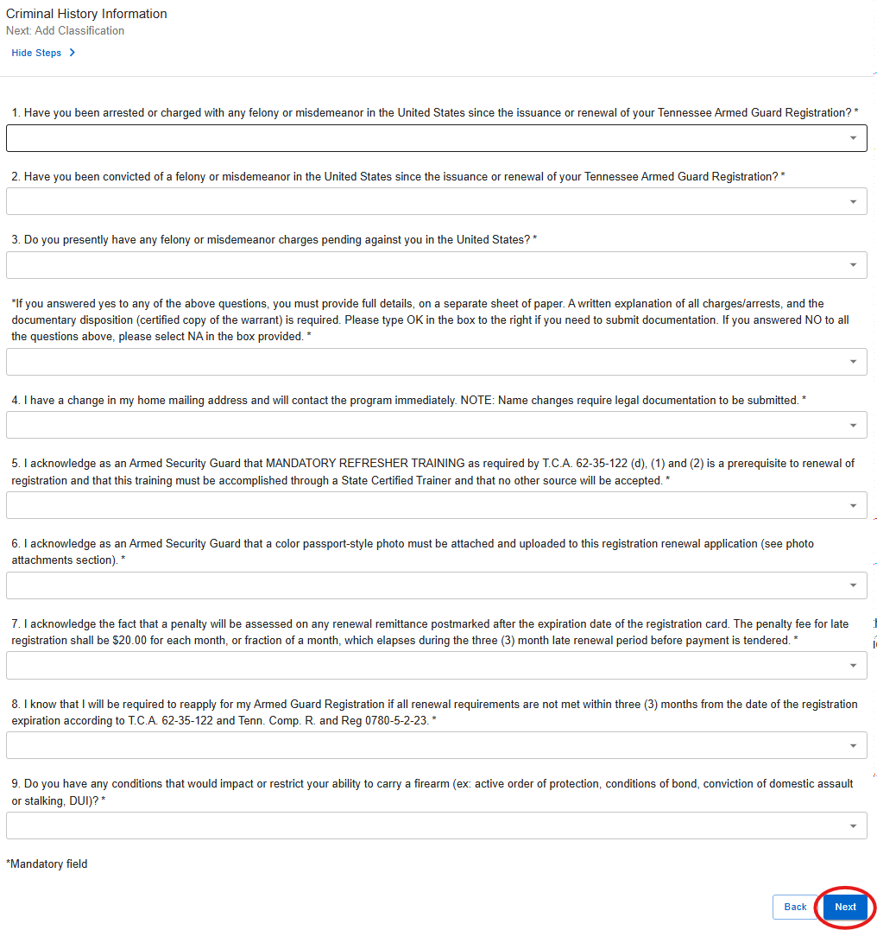
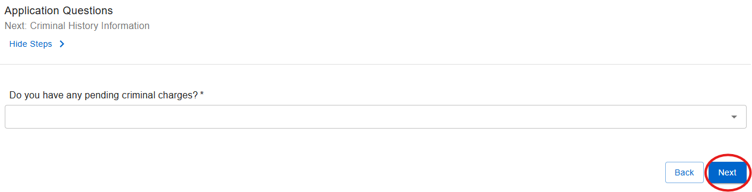
Step 5: Application Questions/Criminal History Information
Please answer “Yes” or “No” to the Application and Criminal History questions.
If “Yes”, you will be required to upload supporting documentation.

Slide 7
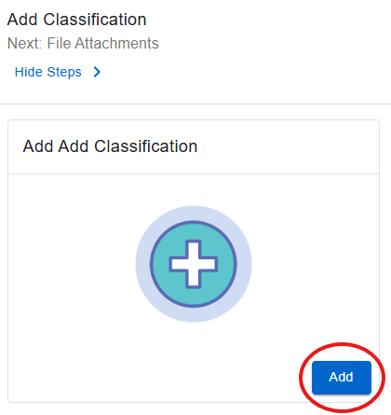
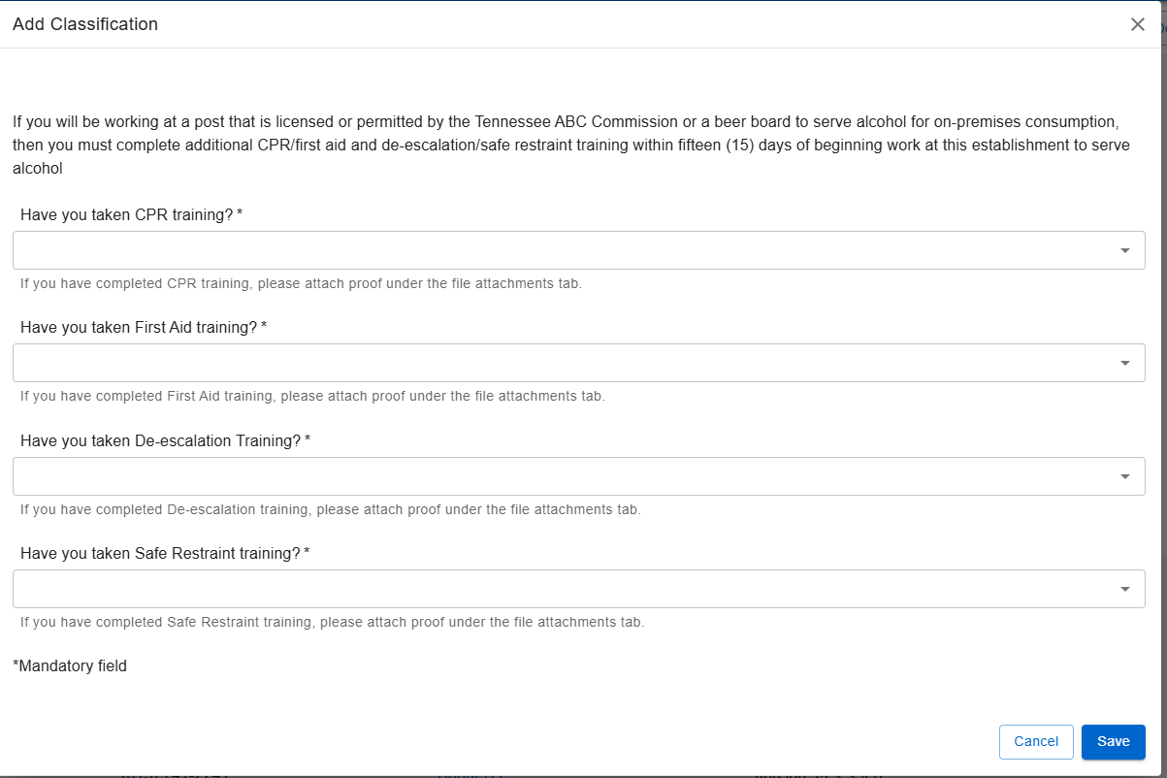
Step 6: Add Classification
If you will be working at a post that is licensed or permitted by the Tennessee ABC Commission or a beer board to serve alcohol for on‑premises consumption, you are required to complete additional CPR/First Aid training and de‑escalation/safe restraint training within fifteen (15) days of beginning work at that establishment.
If you have completed the Dallas Law Training, please answer the following questions and click “Save”.
If you have not completed the training, click “Next”.

Slide 8
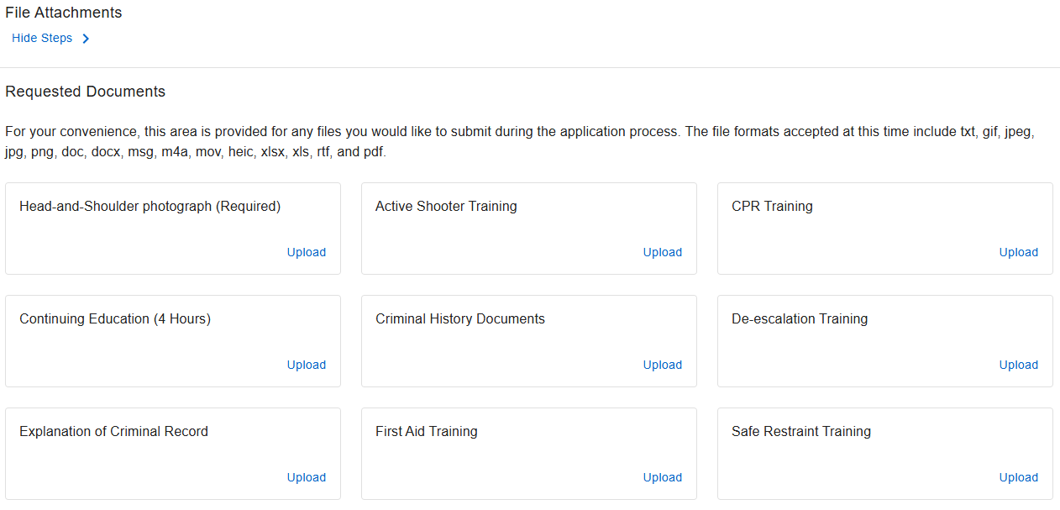
Step 7: File Attachments
Upload your required documents and any additional documentation you wish to add.
Common document uploads include:
4 Hours of Refresh Training
Color Passport Style Photo
Criminal History Documents
Please “Upload”, “Save", and then select “Finish” at the bottom of the page.

Slide 9
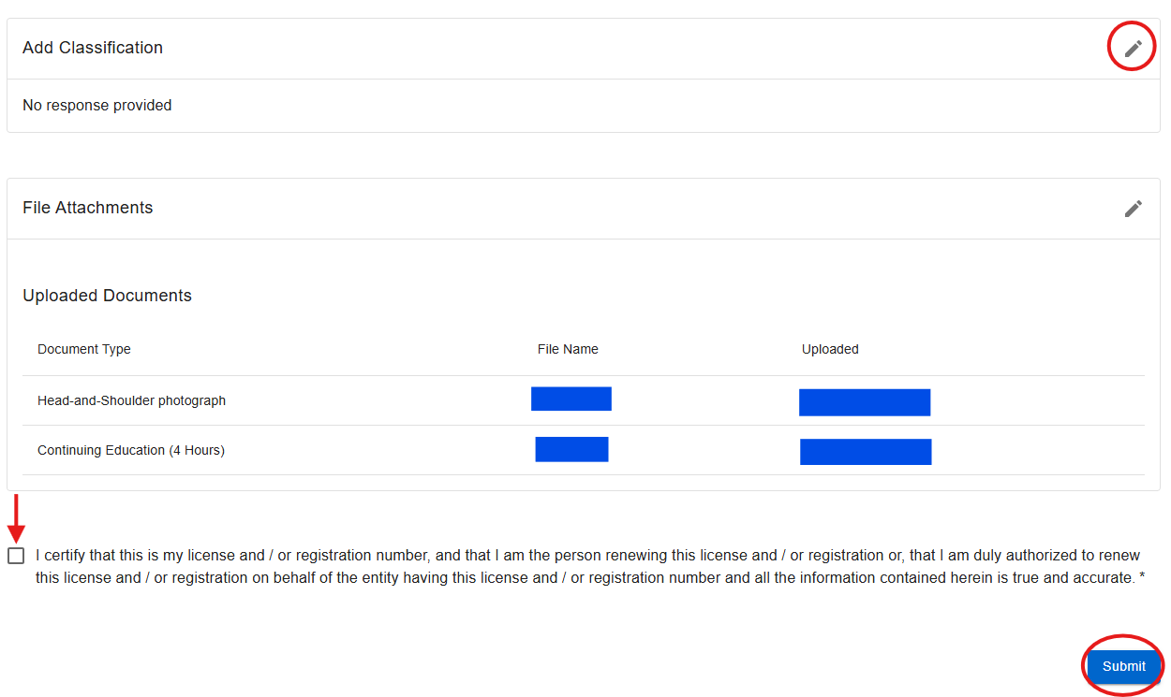
Step 8: Summary & Attestation
Review all information to ensure accuracy.
Review the summary of the Renewal application. If you need to edit any step, select the pencil icon located to the right of the step.
If everything is true and correct, please check the box to certify, then click “Submit”.
Submitting incorrect or incomplete information may delay processing.

Slide 10
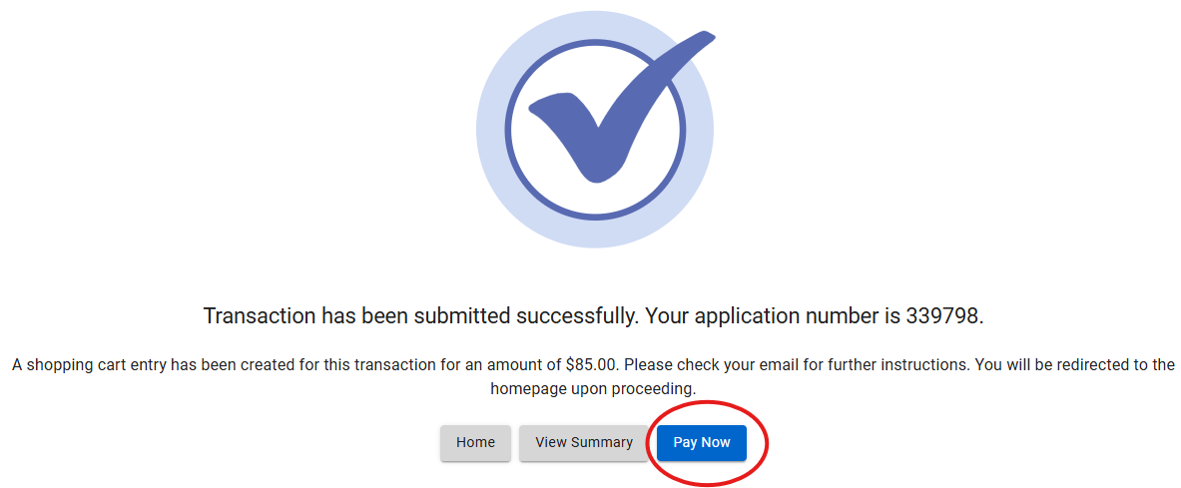
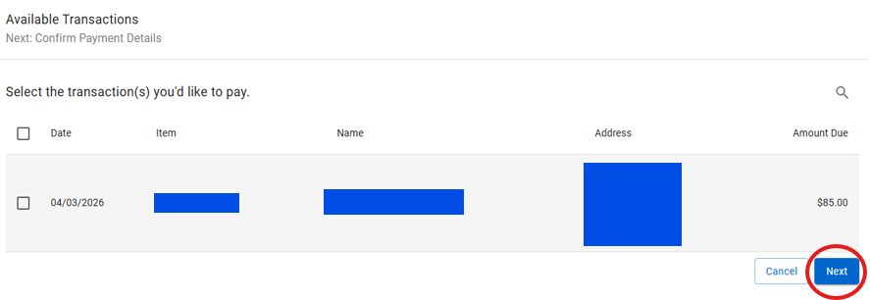
Step 9: Paying for the Application
After submitting your application:
Select the “Pay Now” button or the shopping cart icon in the top-right corner of the screen.
Select your application and follow the on-screen prompts to pay the amount due.
Note: Your application will NOT be processed until the application fee is received.

Slide 11

Step 10: Wait for Further Correspondence
If additional information is needed, you will receive an email or letter outlining the steps required to complete your application.
If an email or letter is not received, you can assume your application is progressing in the licensing process.
Reminder: Monitor the mail and email address associated with your account, including spam or junk folders.

Slide 12

Contact Information
Email: Private.Protective@tn.gov
Customer Service Phone: 615-741-6382
Address:
Tennessee Department of Commerce and Insurance
Detection Services Licensing Program
Davy Crockett Tower, 10th Floor
500 James Robertson Parkway
Nashville, TN 37243
For more information or assistance, please visit our website by clicking the image above.

