Slide 1
BOARD FOR LICENSING CONTRACTORS
Limited Licensed Electrician
License Application Requirements

Slide 2
LLE Applications & Renewals
What will be covered in this presentation
Limited Licensed Electrician license basics, scope, and threshold.
When the LLE license is required and when a contractor license may be required instead.
Local jurisdiction considerations and statutory exemptions.
Initial application, examination, and fee requirements.
Renewal timing, late renewal, and expired-license requirements.
Change of address and proper license use.
Online application resources and Board contact information.

Slide 3
Basics, Scope, and Thresholds
LLE work is limited to electrical work with a total cost of less than $25,000.
Electrical work of $25,000 or more requires a contractor license with the appropriate electrical classification and sufficient monetary limit, usually CE or an applicable CE subclassification.
The $25,000 threshold includes the total electrical scope, including materials and labor.
An LLE license does not authorize the licensee to advertise or hold out as a “contractor” unless the licensee also holds a valid contractor license.
The license is issued for a two-year period.

Slide 4
Local Rules and Exemptions
A state LLE license is not required in a municipality or county that issues its own licenses for persons performing electrical work in that jurisdiction.
Local licensing, permit, and inspection requirements may still apply; applicants should verify requirements with local code enforcement before performing work.
  Tennessee Electrical Permits Exempt Jurisdictions
  A list of Electrical Permitting Agents can also be found on page 12 of the LLE application: The Limited Licensed Electrician (LLE) initial application
A single-residence homeowner is exempt from LLE requirements when performing electrical work on the homeowner’s own residence.
Certain owner/church, qualifying nonprofit or religious organization, and supervised educational-institution exemptions may apply when statutory conditions are met.
Exemptions are fact-specific and should not be treated as blanket permission to perform electrical work without the proper state or local authorization.

Slide 5
How to Apply
Complete the Limited Licensed Electrician application through CORE or the Board’s application resources.
  https://access.cloud.commerce.tn.gov/portal/public
Submit the required application information and pay the applicable Board fees.
The application is not complete until all required fees are received.
Examination costs, when applicable, are paid directly to the Board’s designated examination administrator.
No bond, financial statement, or letter of reference is required to obtain an LLE license.

Slide 6
Initial Application and General Process
Completed LLE application
  Individual applicant information.
  LLE licensure is limited and does not authorize a business to hold itself out as a contractor unless it also holds a contractor license.
Application/license fee
  Verify the current fee in CORE/VERSA or the current Board form before processing.
Passing LLE exam result
  Proof the applicant passed the Limited Licensed Electrician exam, unless already transmitted/verified through the testing vendor.
Photo ID
  Unexpired driver’s license, passport, or other acceptable government-issued photo ID.
Eligibility Verification Attestation
  Required for a natural person applying for a state license/benefit.
  If an SSN is provided and verified, additional citizenship documentation may not be needed; foreign-passport/qualified-alien applicants need required immigration documentation.
Disclosure documentation, if applicable
  Felony conviction documents.
  Prior license discipline, denial, suspension, or revocation explanation.
  Complaint, judgment, litigation, or other disciplinary documentation if disclosed.

Slide 7
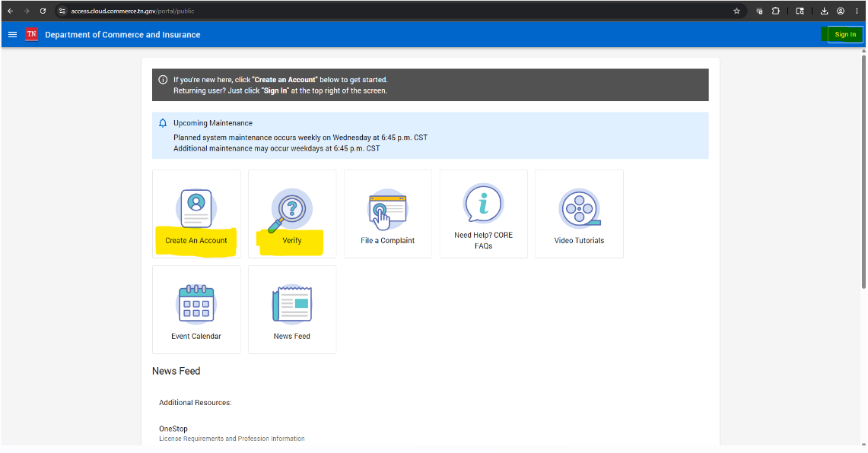
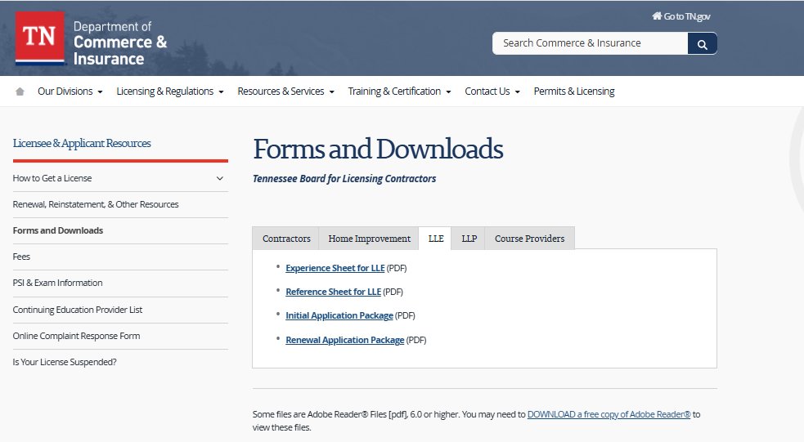
Apply Online and Find Forms
License Application Submission Portal (CORE):
  https://access.cloud.commerce.tn.gov/portal/public
Licensee / Applicant Forms and Resources:
  https://www.tn.gov/commerce/regboards/contractors/license/forms.html
Use the LLE tab or Limited Licensed Electrician resources when available.

Slide 8
LLE Fees
Initial license fee: $50.00.
License renewal fee: $50.00.
Late renewal fee per month for up to three (3) months: $10.00.
Reinstatement fee (after license is expired over three (3) months): $80.00.
Replacement license fee: $5.00.
Examination costs are paid directly to the designated examination administrator.
ProV is the Board’s new exam provider beginning July 1, 2026. Applicants already scheduled with PSI after July 1 may keep that PSI appointment through the transition period or schedule with ProV
  Schedule with PSI until June 30, 2026
    https://www.psiexams.com/
  Schedule with ProV beginning July 1, 2026
    https://provexam.com/

Slide 9
Renewal and Reinstatement Basics
Each LLE license expires on the 24th month on the last day of the month of issuance.
  Renewal Fee: $50
The renewal must be filed no later than the expiration date set by rule.
  An expired LLE license may be late-renewed for up to three (3) months after expiration by paying the renewal fee and applicable late fee of $10 per month.
  More than three (3) months after expiration, the applicant must submit a new initial application, pay applicable fees ($80), and complete the exam unless waived by the Board.
A renewal application is not considered filed until the required fee is received.
Renewal keeps the license active for the next licensing cycle when all requirements are satisfied.

Slide 10
Change of Address and Proper License Use
A licensee must notify the Board office in writing within 30 days of any change of address.
The licensee should keep contact information current, so renewal notices and Board communications are received.
The LLE license should be used only within its authorized scope and threshold.
The licensee may not use the appellation “contractor” or any designation suggesting contractor status unless the licensee also holds a valid contractor license.
License status should be verified before advertising, contracting, requesting inspections, or performing regulated work.

Slide 11
Contact Info & Resources
Email: Contractors.Home-Improvement@tn.gov
Website Resources: https://www.tn.gov/commerce/regboards/contractors.html
Licensee / Applicant Forms and Resources: https://www.tn.gov/commerce/regboards/contractors/license/forms.html
CORE Portal: https://access.cloud.commerce.tn.gov/portal/public
License Verification Search: https://search.cloud.commerce.tn.gov/

