Slide 1
BOARD FOR LICENSING CONTRACTORS
Home Improvement Initial, Renewal, and Reinstatement Applications

Slide 2
Home Improvement Initial Applications
What will be covered in this presentation:
Home improvement license basics, scope, thresholds, and adopted counties
Board review and approval process
Online application, website resources, fee, and required documents
Ownership, name, business location, experience, and disclosure information
Bond or irrevocable letter of credit requirement
General liability insurance and workers' compensation or exemption documentation
After issuance, renewals, changes, prohibited practices, and resources

Slide 3
Home Improvement License Basics
A Home Improvement license is required before transacting, representing, or offering to transact home improvement business where the law applies.
A Home Improvement license applies to residential remodeling/improvement work over $3,000 and less than $25,000 in counties that have adopted the law.
Current adopted counties: Bradley, Davidson, Hamilton, Haywood, Knox, Marion, Robertson, Rutherford, and Shelby.
Projects of $25,000 or more require the appropriate contractor license, not a Home Improvement license.
The license is issued for a two-year period and is tied to the licensed name and business location.

Slide 4
What Counts as Home Improvement
Home improvement includes repair, replacement, remodeling, alteration, conversion, modernization, improvement, or addition to residential land or buildings for one to four dwelling units.
Examples include driveways, swimming pools, porches, garages, landscaping, fences, roofing, painting, and other adjacent improvements.
Central heating or air conditioning systems, storm windows, and awnings are included without regard to the extent of affixation.
Home improvement does not include new home construction or work with a contract price of $3,000 or less.
A Home Improvement license does not authorize work reserved to another state or local license, including plumbing, electrical, gas, mechanical, or other regulated work.

Slide 5
Application and General Process
Complete the Initial Home Improvement Contractor Application through CORE.
  https://access.cloud.commerce.tn.gov/portal/public
The application must be complete before it can be reviewed for approval and issuance
The Board may request information related to character, experience, financial stability, and other qualifications.
Do not operate, advertise, or contract as a licensed home improvement contractor until the license has been issued.
The initial application and license fee is $250.

Slide 6
Board Review and Approval Process
Home Improvement applications are generally processed as they are submitted and will be routed electronically for review and approval.
The Executive Director may approve Home Improvement applications before a regular Board meeting when there are no evident impediments and delay would cause imminent substantial business loss.
Home Improvement applications approved before a Board meeting are ratified at the next scheduled meeting.
A Board meeting may become important if there are questions about financial stability, experience, or other issues.
All meetings are open to the public, recorded, and may be viewed online.
  https://www.tn.gov/commerce/regboards/contractors/meetings.html

Slide 7
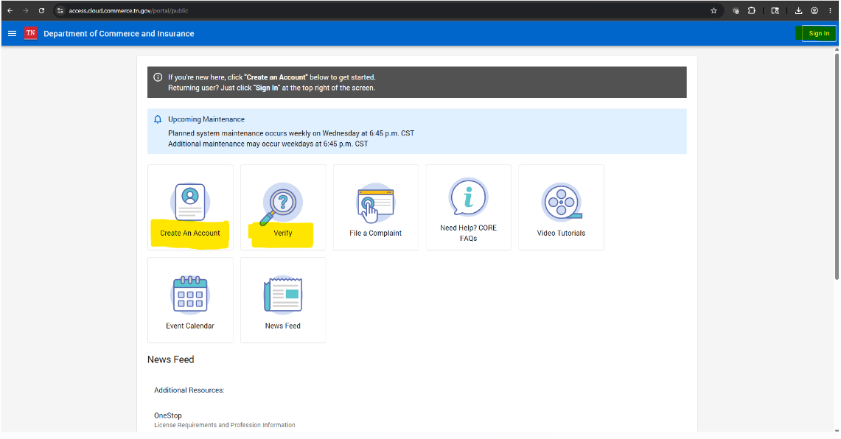
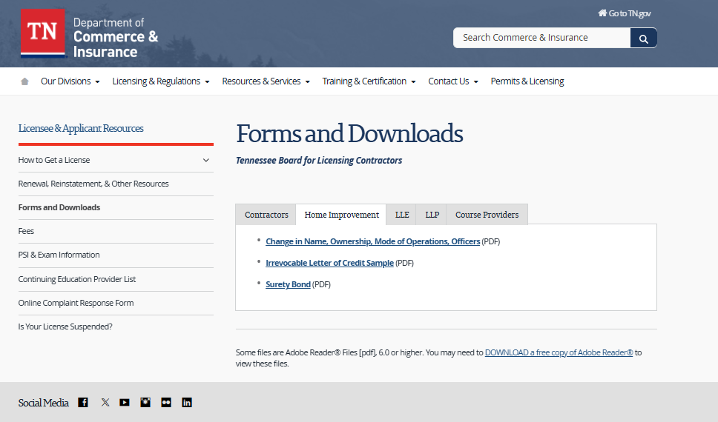
Apply, Renew, or Reinstate Online
License Application Submission Portal (CORE): https://access.cloud.commerce.tn.gov/portal/public
Online Licensing Packet Resource: https://www.tn.gov/commerce/regboards/contractors/license/forms.html

Slide 8
Ownership, Name, and Business Location
An applicant may apply as an individual/sole proprietor, partnership, corporation, LLC, or other legal entity.
The proposed licensed name may not be identical or confusingly similar to an existing licensee unless the applicant has exclusive trademark rights.
If the mailing address is a post office box, the application must also include a physical business location.
Corporations, general partnerships, and LLCs should ensure Tennessee Secretary of State registration matches the application, insurance, and bond or letter of credit.
After licensure, changes in ownership/control, management, address, or trade name must be reported to the Board in writing within 30 days.

Slide 9
Experience and Disclosure Information
The application should describe the general nature of the home improvement business or the applicant's duties.
Provide a record of previous experience in home improvements or other construction work.
Disclose judgments in the last five years, current outstanding judgments, and pending litigation arising from home improvement or construction work.
Disclose whether any professional or vocational license has been refused, suspended, or revoked in Tennessee or another state.
False, altered, forged, or misleading documentation may result in denial or discipline.

Slide 10
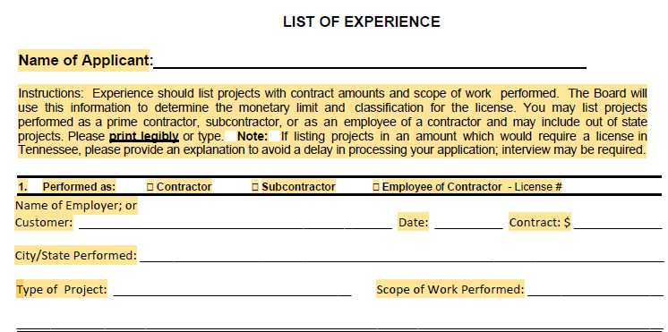
Experience and Disclosure Information
When completing the experience section of your application, you must fill out all required fields. Missing or incomplete information may delay the processing of your application and could result in a deficiency letter.
Clearly state the applicant’s role on each project: contractor, subcontractor, or employee.
If subcontractor or employee, include the prime contractor or employer and license number.
Provide complete project details: city/state, project date, contract amount, and scope of work.
Use specific scope descriptions, not vague terms like “construction.”
Older experience or long gaps may require an explanation or more current experience.

Slide 11
Security Requirement - Bond or Letter of Credit
A $10,000 surety bond or irrevocable letter of credit must be effective and filed with the Board before the license is issued.
The principal name on the bond or letter of credit must match the name on the license application.
The bond is for the benefit of a claimant damaged by breach of a home improvement contract.
If the bond ceases to be in effect, the home improvement contractor license becomes invalid.
The bond may not be released until one year after inactivation, expiration, or revocation, and after pending claims are resolved.
If the bond or letter of credit is cancelled, the licensee must notify the Board in writing within 10 days.

Slide 12
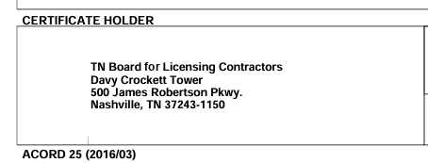
General Liability Insurance
A Certificate of Insurance is required with the initial application and at renewal as proof of general liability coverage.
All home improvement contractor applicants and licensees must maintain at least $100,000 in general liability insurance.
Insurance information should match the exact applicant or licensed business name.
The Board must be named as the certificate holder on the general liability insurance policy.

Slide 13
Workers' Compensation or Exemption Documentation
The application must include evidence of workers' compensation coverage unless the applicant qualifies for an exemption and provides proper documentation.
Failure to provide evidence of required coverage makes the applicant ineligible until the evidence is supplied.
Insurance information should match the business name on the application.
If the business has employees, confirm active coverage before submitting the application.
If using an exemption, confirm the exemption matches the correct owner, entity, and license structure.
A workers’ compensation exemption covers only the individual listed on the exemption. It does not cover the business or any employees.

Slide 14
Advertising, Permits, and Correct Name
Advertisements for home improvement business must include the contractor name and license number.
False, deceptive, or misleading advertising, including certain finance or credit representations, is prohibited.
A licensee must enter contracts and operate the related business in the name in which the license is issued.
Local permits must list each contractor's home improvement license number unless the work is performed by the owner of the property.
The license does not replace separate local requirements for plumbing, electrical, gas, or mechanical work.

Slide 15
Prohibited Practices and Discipline
The Board may refuse to issue or renew, or may suspend, or revoke a license for material omissions, misrepresentations, lack of competence, felony conviction, fraud, bad faith, or violations of the Home Improvement law.
Prohibited practices include abandonment, false promises, fraud in contract documents, failure to obtain required permits, and operating in a name other than the licensed name.
Unlicensed home improvement activity may result in citations, civil penalties, and Class A misdemeanor exposure.
Failure to cooperate with an investigation, failure to maintain required workers' compensation, or submitting false or misleading documentation may constitute misconduct.
Do not demand or receive payment before the home improvement contract is signed.
Deposits over one-third of the contract price are prohibited unless a statutory exception applies.

Slide 16
Renewal Information
A Home Improvement license expires on the last day of the twenty-fourth month from the date of issuance unless renewed.
Renewal requires the $200 renewal fee, evidence of required insurance, active security/bond or letter of credit, a statement of material changes, and any additional documentation requested by the Board.
Late renewal penalty is $10 per month, not to exceed three months.
No renewal application may be accepted more than 90 days after expiration.

Slide 17
Reinstatement Information
If the license has been expired more than ninety (90) days, the application is treated as a new license application.
The applicant must complete the same process as an initial Home Improvement application.
This includes submitting a new application, application/license fee, required insurance, bond or letter of credit, business information, and any additional documentation requested by the Board.
Do not contract, offer to contract, advertise, or operate as a licensed home improvement contractor until the new license is issued.

Slide 18
Contact Info & Resources
Email: Contractors.Home-Improvement@tn.gov
Website Resources:
  https://www.tn.gov/commerce/regboards/contractors.html
  https://www.tn.gov/commerce/regboards/contractors/license/forms.html
  https://access.cloud.commerce.tn.gov/portal/public
  https://search.cloud.commerce.tn.gov/

