Slide 1
BOARD FOR LICENSING CONTRACTORS
General Contractor License Renewals

Slide 2
General Contractor Renewals
What will be covered in this presentation:
General Contractor Renewal Basics
Board Review and Approval Process
Renewal timing and expiration dates
Online renewal, website resources, fee, and required documents
Financial statement requirements
General liability insurance
Workers’ compensation or exemption documentation
Residential Continuing Education, when applicable
Changes to license information and qualifying agent issues
Late renewal, expired licenses, and reinstatement

Slide 3
General Contractor Renewal Basics
A renewal keeps the existing license active for another two-year cycle when all requirements are satisfied.
Contractor licenses expire on the last day of the twenty-fourth month after issuance or renewal.
Renewal notices are sent ninety (90) days before expiration.
For the license to not expire before the renewal is approved, the renewal application needs to be received by the Board thirty (30) days before expiration.
A license becomes invalid on the expiration date unless renewed.
A renewal does not change classification, name, officers, qualifying agent, monetary limit, ownership, or mode of operation and cannot be used as a substitute for a change application.
  Changes to name, ownership, officers, qualifying agent, or mode of operation require a separate change application.
  Changes in address or corporate officers must be reported in writing within 30 days.
  A different classification or higher monetary limit must be requested separately and supported by the required documentation.

Slide 4
Board Review and Approval Process
Renewals are generally processed as they are submitted and will be routed electronically for review and approval.
The Executive Director may approve renewal applications before a regular Board meeting when there are no evident impediments and delay would cause imminent substantial business loss.
Renewals approved before a Board meeting are ratified at the next scheduled meeting.
A Board meeting may become important if there are questions about financial stability, classification, monetary limit, ownership, or other renewal issues.
All meetings are open to the public, recorded, and may be viewed online.
  https://www.tn.gov/commerce/regboards/contractors/meetings.html

Slide 5

Renewal Timing and Expiration Dates
Contractor licenses expire on the last day of the twenty-fourth month after initial issuance or renewal.
Renewal notices are sent ninety (90) days before expiration.
For the license to not expire before the renewal is approved, the renewal application needs to be received by the Board thirty (30) days before expiration.

Slide 6
Late Renewal, Expired Licenses, and Reinstatement
A license becomes invalid on the expiration date unless renewed.
  The license will go into an Expired-Grace period for up to 12 months following the expiration date.
  The license can be processed for renewal within these 12 months under the statutes, rules, and processes for renewals.
  Once the 12 month Expired-Grace renewal period ends, the license must go through the reinstatement process to become active again.
Expired one (1) to twelve (12) months — a ten percent (10%) penalty is assessed each month, up to twice the normal fee.
Expired more than one (1) year — follow new application requirements for reinstatement of license.
Do not bid, offer to contract, enter into new contracts, or perform contracting while the license is expired, invalid, or inactive.

Slide 7
How to Renew a Contractor License
Start the renewal early.
Use the renewal notice and your CORE account to begin the renewal as soon as possible.
  https://access.cloud.commerce.tn.gov/portal/public
Verify the license number, expiration date, classification, monetary limit, and licensed name before submitting.
Upload all required documents through the online renewal application.
Submit the renewal application and fee.
  A renewal is not complete until the required renewal documents and fee are received.
  Missing items may delay processing and may cause the license to expire before renewal is completed.
  The contractor renewal fee is $200.

Slide 8
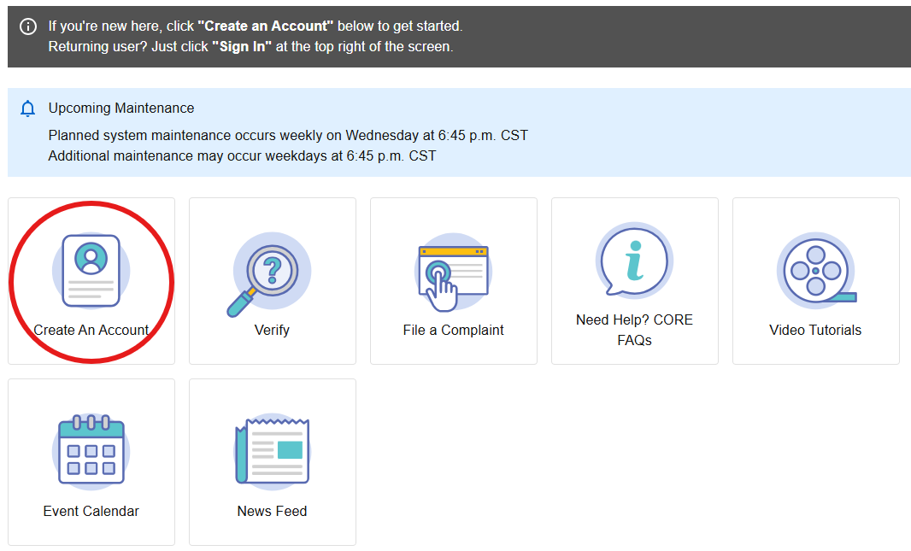
Renew Online
License Application Submission Portal (CORE): https://access.cloud.commerce.tn.gov/portal/public

Slide 9
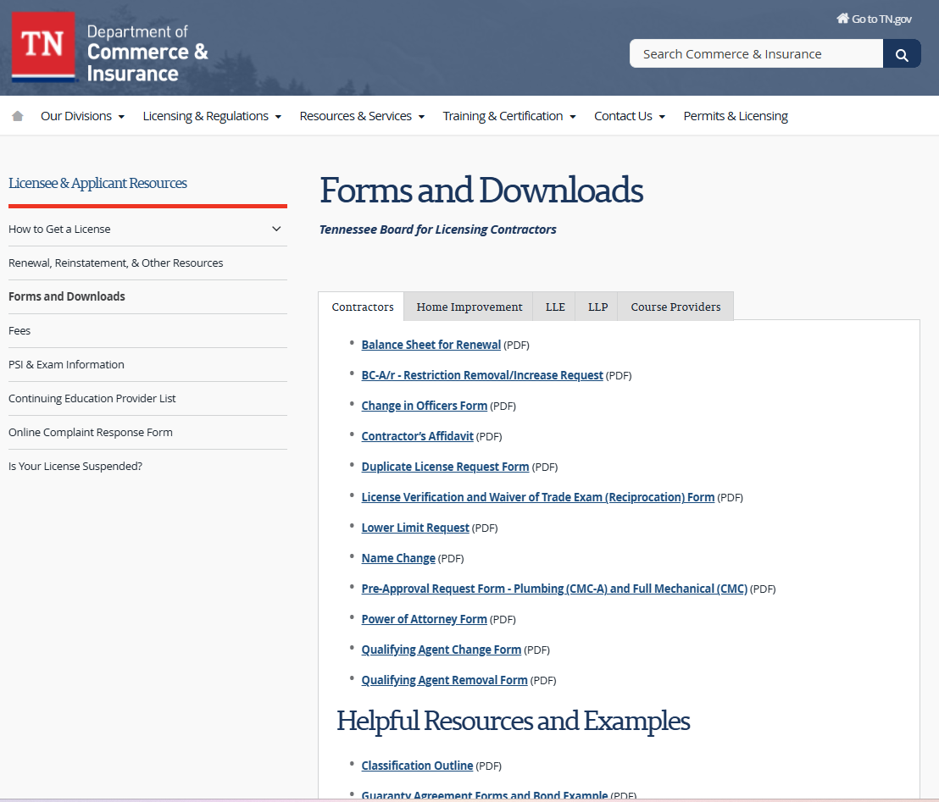
Renewal Forms and Resources
Licensee/Applicant Forms and Resources:
https://www.tn.gov/commerce/regboards/contractors/license/forms.html

Slide 10
Financial Documentation and Monetary Limit Review
Monetary limits of $1,500,000 or less - submit a notarized statement that the financial statement information is true and correct.
Monetary limits greater than $1,500,000 - submit a compilation prepared by a licensed public accountant or CPA.
Regardless of monetary limit, the Board may require a reviewed or audited financial statement when there is cause to do so.
Beginning July 1, 2026, a renewal applicant may submit proof of a qualifying surety bond in lieu of a financial statement. The bond must be at least 50% of the monetary limit, continuous, and maintained while the license is active.
Financial documentation must be dated within 12 months and prepared in the applicant/licensee’s name.

Slide 11
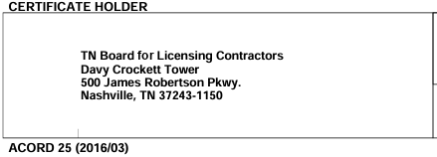
General Liability Insurance
Licensees must provide a Certificate of Insurance at renewal as proof that general liability insurance has been maintained.
The Board must be named as the certificate holder.
Minimum coverage depends on the monetary limit:
  Up to $500,000 - minimum coverage of $100,000.
  $500,001 to $1,500,000 - minimum coverage of $500,000.
  $1,500,001 or more - minimum coverage of $1,000,000.

Slide 12
Workers’ Compensation or Exemption Documentation
Renewal requires evidence of current workers’ compensation insurance coverage unless the licensee qualifies for an exemption and provides the required documentation.
Failure to provide evidence of coverage makes the applicant ineligible for renewal until evidence is provided.
Insurance information should match the business name on the contractor license.
If using an exemption, confirm that the exemption matches the correct owner, entity, and license structure.
If the company has employees, confirm active coverage before submitting the renewal.

Slide 13
Residential Continuing Education (If Applicable)
BC-A, BC-A/r, and BC-A,b(sm) residential contractors licensed on or after January 1, 2009, must obtain eight (8) hours of Board-approved RCE during the two-year period before expiration.
Residential contractors initially licensed before January 1, 2009, are not required to complete RCE.
RCE must be completed by one qualifying agent on the license.
Active membership in a Board-approved professional trade association may satisfy RCE: four (4) hours per year, or eight (8) hours for the two-year renewal period, with proof of active membership.
No carryover of RCE hours is permitted.

Slide 14
Changes to a License
Notify the Board in writing within thirty (30) days of any change of address or, for a corporation, officers.
Changes in mode of operation, merger, ownership, or similar changes may require a separate application or new license.
When a new or revised license is required, the entity may not bid on or enter into new contracts until the license has been issued.
Contracting in a name different from the licensed name may result in disciplinary action.

Slide 15
Qualifying Agent Issues
The Board must be notified within ten (10) days of the death, resignation, termination, or incapacity of a qualifying agent.
If the qualifying agent leaves, a new qualifying agent must be appointed within three (3) months or the license becomes inactive.
A qualifying agent may not be listed on more than one license unless they have majority ownership.
The contractor license belongs to the licensed business entity; it does not belong to the QA unless the QA is also an owner.

Slide 16
Contact Info & Resources
Email: Contractors.Home-Improvement@tn.gov
Website Resources:
  Tennessee Board for Licensing Contractors
  Forms and Downloads for Tennessee Board for Licensing Contractors
  Tennessee Contractors Residential Continuing Education Provider List

