Slide 1
BOARD FOR LICENSING CONTRACTORS
Contractor Initial License & Reinstatement Requirements

Slide 2
Types of Licenses - Contractors
Who Is Required To Be Licensed: https://www.tn.gov/commerce/regboards/contractors.html
A Contractor's license is required prior to contracting (bidding, offering to engage, or negotiating a price) for projects $25,000 or more, when acting as one of the following:
  Prime (General) Contractor - Bidding or contracting directly with the “owner” of the project.
  Subcontractor – Contracting directly with any contractor (not to the owner) to perform projects when the total cost of that portion on the project is $25,000 or more, for the following (includes all materials, equipment, and labor).
  Electrical, Mechanical, Plumbing, HVAC, and **Roofing.
    **Roofing prime and subcontractors must be licensed when the amount is over $25,000.
  Construction Management/Consultant – When the value of the total project is $25,000 or more.

Slide 3
Types of Licenses – Contractors Continued 1
Subcontractors and Responsibility
A major point for both contractors and subcontractors is this: the prime contractor's license matters. If a subcontractor is working under a prime contractor, the subcontractor should verify that the prime contractor has the correct classification and enough monetary limit to cover the work.
If the prime does not have the correct classification or monetary limit, the subcontractor may not be protected under that license. Also, when the prime contractor hires subcontractors, the prime contractor remains responsible for the work being performed under the prime's license.
It is also important to understand that a homeowner is not a prime contractor simply because the work is being done for that homeowner. Working directly for a homeowner is different from working as a subcontractor under a licensed prime contractor.

Slide 4
Types of Licenses – Contractors Continued 2
The application we are discussing is for general contractor licenses, meaning licenses that allow work at or above the contractor threshold of $25,000. That license can allow the applicant to bid and contract for larger projects, subject to the classification and monetary limitation granted by the Board.
Before beginning a project, applicants should also check local jurisdiction requirements. Some counties or municipalities may have additional permitting or inspection requirements, and some local jurisdictions may require a particular license before work begins.

Slide 5
What Will Be Covered In This Presentation
Application and general process.
Contractors ( $25,000 and up )
Major categories
Classifications, examinations, and exam waiver if required
Experience requirements and experience sheet
Monetary limits and financial statement requirements
Contractors Affidavit page, signatures and notarizations
Professional reference documentation and power of attorney
General liability insurance
Workers' compensation insurance or proper exemption documentation
Secretary of State registration
Application fee of $250

Slide 6
Board Review and Meetings
Applications are generally processed as they come in and may be routed electronically for board review and approval.
All applications approved and issued will be ratified at the next scheduled board meeting.
A board meeting usually becomes important only when the Board has questions about experience, financials, classification, or when the applicant disagrees with the classification or monetary limit being recommended.
If applicable, the agent assisting you with the application will schedule an interview with the board, at the next available meeting.
All meetings are open to the public, recorded, and may be viewed live online at https://www.tn.gov/commerce/regboards/contractors/meetings.html

Slide 7
Reinstatement Information
If the license has been expired more than twelve (12) months, the application is treated as a new license application.
The applicant must complete the same process as an initial General Contractor application.
This includes submitting a new application, application/license fee, required insurance, bond or letter of credit, business information, and any additional documentation requested by the Board.
Do not contract, offer to contract, advertise, or operate as a licensed contractor until the new license is issued.

Slide 8
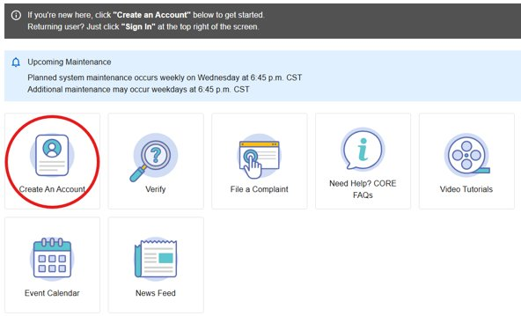
Check the License, Apply Online
License Verification Search: https://access.cloud.commerce.tn.gov/portal/public

Slide 9
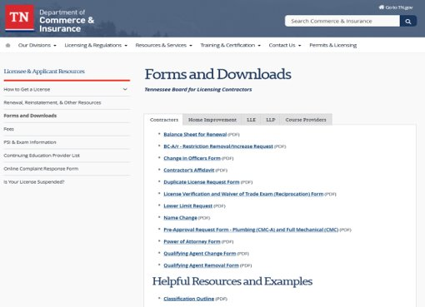
Application Forms and Resources
Online Licensing Packet resource: https://www.tn.gov/commerce/regboards/contractors/license/forms.html

Slide 10
Step 1: Classifications, Examinations, and Exam Waiver
The classification outline is one of the most important tools in the application process. Applicants should review it before applying so they request the correct classification and understand what exams or other approvals may be required.
ProV is our testing administrator for our trade exams. You may visit their website for information on how to schedule your exam: https://provexam.com/scheduler/.
We also accept NASCLA’s commercial and electrical exams.
If an applicant has taken and passed a trade exam in another state, the applicant should check whether Tennessee has a reciprocal arrangement for that trade exam. If so, the applicant may be able to submit a license verification form, from the other state and avoid retaking the trade exam. The out-of-state license must be active and in good standing.

Slide 11
Step 2: Experience Requirements
Experience should list projects with contract amounts and scope of work performed. The Board will use this information to determine the monetary limit and classification for the license. You may list projects performed as a prime contractor, subcontractor, or as an employee of a contractor and may include out of state projects. Please print legibly or type when filling out your application.
You must list a minimum of three projects related to each classification for which you are applying. For example, if you are applying for a full residential BC-A classification, you must demonstrate experience in ground-up residential construction.
If listing projects in an amount which would require a license in Tennessee, please provide an explanation to avoid a delay in processing your application; a board interview may be required.

Slide 12
Step 2.1: Experience Requirements
Experience Sheet – Key Completion Tips
Clearly state the applicant’s role on each project: contractor, subcontractor, or employee.
If subcontractor or employee, include the prime contractor or employer and license number.
Provide complete project details: city/state, project date, contract amount, and scope of work.
Use specific scope descriptions, not vague terms like “construction.”
Examples: ground-up residential construction, storm damage cleanup, grading, paving, plumbing, electrical, etc.
Recent experience matters, especially for mechanical, plumbing, and electrical classifications.
Older experience or long gaps may require an explanation or more current experience.

Slide 13
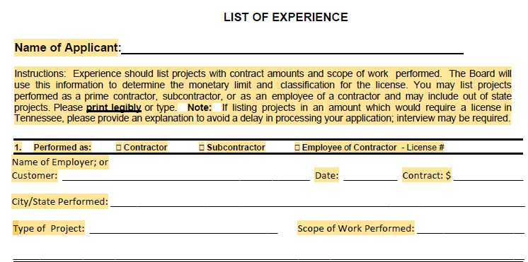
Step 2.2: Experience Requirements
When completing the experience section of your application, you must fill out all required fields. Missing or incomplete information may delay the processing of your application and could result in a deficiency letter.

Slide 14
Step 3: Monetary Limits & Financial Statement Requirements
Monetary Limit - All licenses are issued with a monetary limit. This limit is the maximum amount approved for contracting or bidding and is based on your experience and financial statements prepared by a Certified Public Accountant (CPA).
Financial Statement - A reviewed financial statement is required to obtain a monetary limit of $3,000,000 or less. An audited financial statement is required for monetary limits over $3,000,000 and may qualify the licensee for an unlimited monetary limit. Financial statements must be prepared by a properly licensed Certified Public Accountant (CPA). The contractor license will be issued in the exact name shown on the financial statement.
Surety Bonds - A continuous surety bond in the Board’s required format may be used instead of a CPA-reviewed or audited financial statement. The surety bond amount must equal one-half of the monetary limit requested. For example, if you request a monetary limit of $1,000,000, the required surety bond amount is $500,000. The bond must be submitted in the Board’s approved format to be accepted.
Indemnities - A guaranty agreement with a supplemental financial statement (personal or parent company), or a bond in the Board’s required format, is required when submitting a cash financial statement with little or no fixed assets. These indemnities may also be used to increase working capital and net worth for higher monetary limits. A line of credit may be used to supplement working capital. Required forms and Board policies are available on our website.

Slide 15
Step 4: Contractors Affidavit
Contractors Affidavit Page, Signatures and Notarizations
Affidavit - The affidavit must be signed and notarized by all applicable individuals, including the qualifying agent, owners, partners, members, principal officers, and major stockholders. For large corporations with multiple officers, list at least three individuals who have authority to act on behalf of the company.
Applicant Disclosure Requirements - The applicant must inform the Board of the following: felony convictions; judgments; disciplinary actions; and complaint history, including both open and closed cases. This includes court actions such as pending litigation, arbitration proceedings, bankruptcy, or violations of licensing laws in any state. A detailed explanation must be provided as outlined in the application instructions.

Slide 16
Felony Convictions Disclosure
If you have been convicted of a felony in Tennessee or any other jurisdiction, you must disclose the conviction(s) to the Board for review.
You must provide the following information:
A written statement explaining the conviction, including:
a. Your age at the time of the conviction.
b. A description of the offense.
c. The circumstances or actions that led to the conviction.
d. Any rehabilitation efforts, improvements, or evidence of a clear criminal record since the conviction.
Copies of official court documents, including:
a. The charging document or court order.
b. Proof of sentencing, including time served and/or probation period.
c. The final disposition of the case (final outcome).

Slide 17
Step 5: Professional Reference & Power of Attorney
Professional Reference Documentation and Power of Attorney
Letter of Reference - A letter of reference is required for all applicants, including those applying for a second license or reinstatement. The reference must be completed by a past client, employer, or a codes official who has inspected your work. The reference must be based on your construction work or experience and may not be completed by a relative. Only one letter of reference is required.
Power of Attorney - Employees designated as Qualifying Agents (QA) must provide a Power of Attorney, unless they hold majority ownership. A Qualifying Agent must have sufficient knowledge of the construction business to legally bind the company.
Qualifying Agent (QA) — Eligibility to Take the Exam - The following individuals may be designated as a Qualifying Agent (QA) to take the exam:
  • Individual/Sole Proprietor — The owner or a family member who is a full-time employee.
  • Partnership — One or more partners, or a full-time employee.
  • Corporation — A major stockholder or a full-time employee.
  • Limited Liability Company (LLC) — An owner or a full-time employee.

Slide 18
Step 5.1: Professional Reference & Power of Attorney Continued
Power of Attorney Continued
A Qualifying Agent may not be listed on more than one license unless they have majority ownership.
The Social Security Number must be provided; however, it will be redacted from any public records request and will not be released.
If a Qualifying Agent leaves the company, the Board must be notified within 10 days. The contractor may continue operating and has up to three (3) months to replace the Qualifying Agent.
The contractor license belongs to the business entity and the owner(s) listed on the financial statement and insurance. It does not belong to the Qualifying Agent unless they are also an owner.

Slide 19
Step 6: General Liability Insurance
Certificate of Insurance (COI) — A Certificate of Insurance (COI) is required when applying for a contractor license. The COI must include a minimum of 5 policy limits, the policy number(s), expiration date, and list the Board for Licensing Contractors as the certificate holder, including the Board’s address. Please submit the COI with your application. Do not have the insurance company send it separately.
General Liability Insurance — The Board has established minimum general liability insurance requirements based on the monetary limit requested for the license:
• Monetary limit up to $500,000 — Minimum coverage of $100,000
• Monetary limit from $501,001 to $1,500,000 — Minimum coverage of $500,000
• Monetary limit exceeding $1,500,000 — Minimum coverage of $1,000,000, including unlimited licenses

Slide 20
Step 7: Workers’ Compensation/Exemption
Workers’ Compensation Insurance or Proper Exemption Documentation
Workers’ Compensation Insurance — Workers’ compensation insurance is required for all contractors applying for a license unless both of the following apply:
  The contractor does not have any employees; and
  The license owner or employer qualifies for an exemption or provides proof of registration as a Construction Services Provider with the Department of Labor.
If you qualify for the exemption registration and have fewer than five employees, all owners, officers, and employees must register for the exemption.

Slide 21
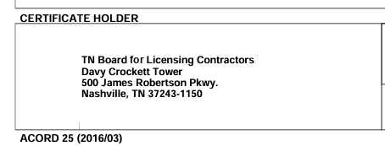
Certificate Holder Information
Both the general liability and workers’ compensation Certificates of Insurance (COI) must list the Board as the certificate holder. The certificate must list the Board for Licensing Contractors, including the Board’s address, as shown in the example below.

Slide 22
Step 8: Secretary of State Registration
Tennessee Secretary of State — The Tennessee Secretary of State is responsible for business filings. For more information, call (615) 741-2286 or visit the website at https://sos.tn.gov/
Tennessee corporations, out-of-state (foreign) corporations, limited liability company or a limited/general partnership must register with the Tennessee Secretary of State’s office and submit proof with their license application, such as a copy of their “Certificate of Authority” or “Articles of Organization”. This must be in the same name as listed on the application, insurance, and financial statement.

Slide 23
Step 9: Application Fee
Application Fee of $250
Once the application is complete, there is a non-refundable fee of $250. You may pay this online once the application has been submitted.
Failure to pay the application fee will result in your application being closed.

Slide 24
Contact Information & Website Resources
Email: Contractors.Home-Improvement@tn.gov
Types of Licenses: https://www.tn.gov/commerce/regboards/contractors/license/get.html
Licensee/Applicant Forms and Resources:
  https://www.tn.gov/commerce/regboards/contractors/license/forms.html

