Slide 1
Tennessee Private Probation Services Council
Assistance with Initial Officer Application

Slide 2

Apply: Important Information
Applications are done online at core.tn.gov.
If you have not already done so, create an account using an email address and password.
Enter your contact information. —Make sure address, phone number, email, and name are current
Answer all application questions, attach required documents, and a government-issued ID.

Slide 3
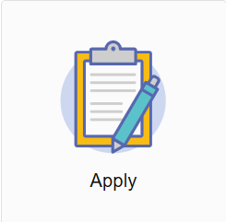
Where to Apply
Visit https://access.cloud.commerce.tn.gov/portal/public
Select the Apply tile to begin the application.

Slide 4
Online Application Introduction
This is an application for an Initial Private Probation Services Council Officer that works under a licensed company. This application must be accompanied by:
- Fingerprint Acknowledgement Form
- 40-hour orientation training reflecting the company you work for
- FBI report & TBI report
- Social security card
- Educational certificate or proof of four (4) years work experience in the industry
Final processing of your application is subject to administrative review.
You will be asked to:
Answer questions about your personal history, education and current contact information.
Attach all required documents.
There is no fee for this application. The officer must work for a licensed private probation misdemeanor company.

Slide 5
Summary
View the summary of the information you provided. Click the pencil icon to make necessary changes. Click Submit when complete.
You must agree to a statement that the information and documentation provided is accurate and true to the best of your ability, and that you understand that providing false information may result in the denial, suspension, or revocation of any license, certificate, or permit issued.
You will see a notification that your application has been submitted successfully.

Slide 6
Check your Email
Your application submission is complete.
Check your email for a summary of your application.

