Slide 1
Court Reporting Program
Assistance with Initial and Reciprocal Court Reporter Applications

Slide 2

Apply: Important Information
Applications are done online at core.tn.gov.
If you have not already done so, create an account using an email address and password.
Enter your contact information. — Make sure address, phone number, email, and name are current.
Answer all application questions, attach required documents, and a government-issued ID.

Slide 3
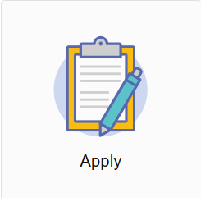
Where to Apply
Visit https://access.cloud.commerce.tn.gov/portal/public
Select the Apply tile to begin the application.

Slide 4
Online Application Introduction
This is an application for an Initial/Reciprocal Court Reporter. This application must be accompanied by:
- Proof of passing the NCRA, NVRA or AAERT (both CER & CET)
- Applicants licensed in another state need active license, proof of passing national exam and current continued education
- Proof of age document with photo
- Fee
Final processing of your application is subject to administrative review.
You will be asked to:
Answer questions about your personal history, prior discipline, and provide current contact information.
Attach all required documents.
Application fee is $250.00.

Slide 5
Summary
View the summary of the information you provided. Click the pencil icon to make necessary changes. Click Submit when complete.
You must agree to a statement that the information and documentation provided is accurate and true to the best of your ability, and that you understand that providing false information may result in the denial, suspension, or revocation of any license, certificate, or permit issued.
You will see a notification that your application has been submitted successfully and that a shopping cart entry has been created for this transaction.

Slide 6
Payment
Your application is not complete until payment is submitted.
Click Pay Now to proceed.
Navigate the payment screens to enter your payment details:
- Select transactions to pay.
- Confirm Payment Details
- Select Payment Type
- Enter Billing Details

Slide 7
Check Your Email
Your application submission is complete.
Check your email for summaries of your application and payment.

