Slide 1
Renewal Application- Landscape Architect
Board of Examiners for Architects, Engineers, and Land Surveyors

Slide 2
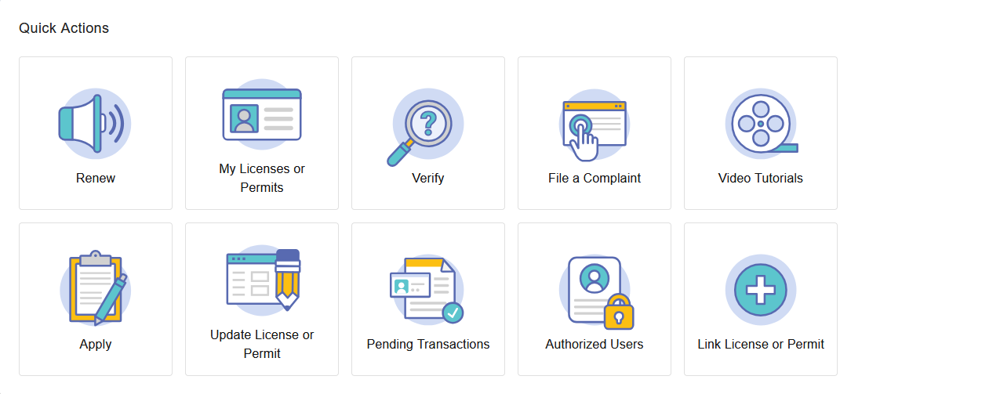
Step 1: Home Page
Click the Renew tile.
Note: If the renewal tile does not appear, please contact the Board to have your license linked.

Slide 3
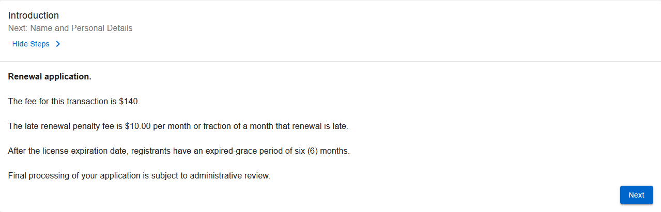
Step 2: Introduction
This section provides an overview of the application.
Verify this is the correct application.

Slide 4
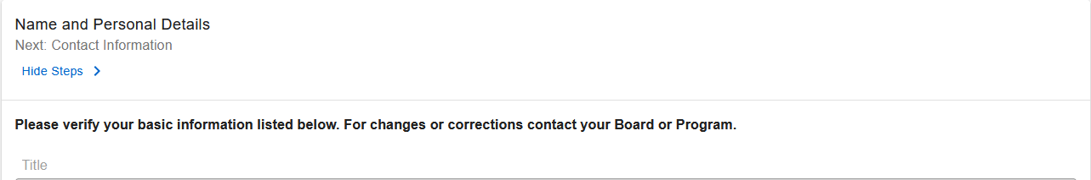
Step 3: Name & Personal Details
Verify your information.
Note: For assistance updating your contact information, please contact the Board office.

Slide 5
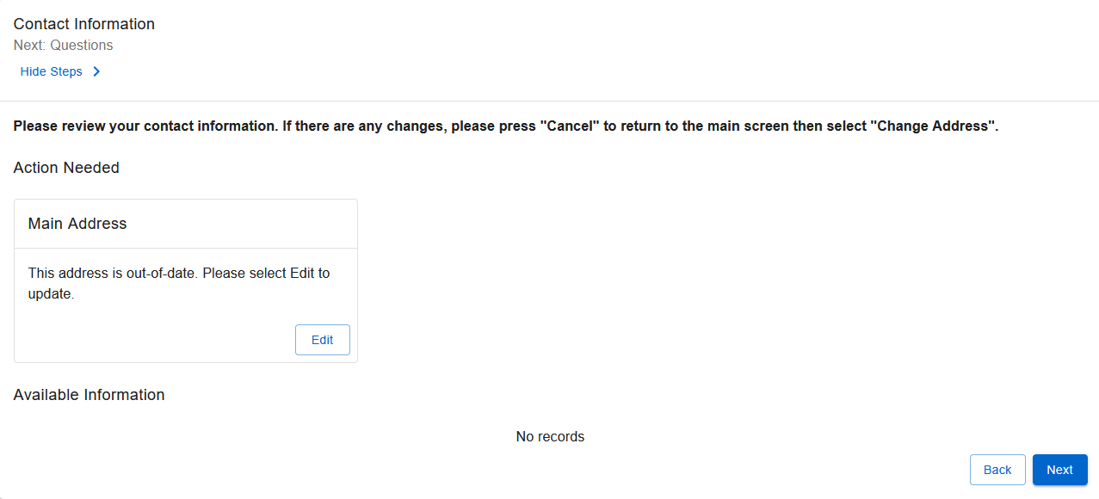
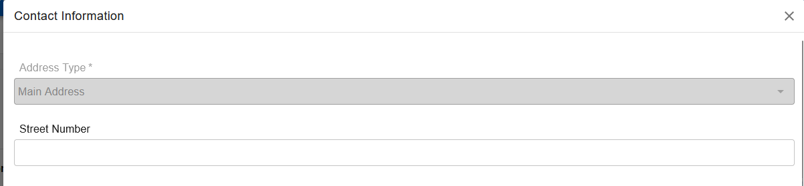
Step 4: Contact Information
Ensure both the mailing and email addresses are correct.
Note: If you are having difficulty updating your contact information, please contact the Board office.

Slide 6
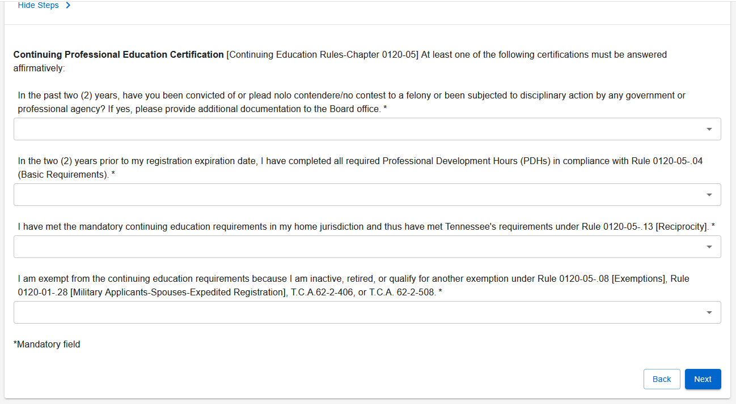
Step 5: Continuing Education
Answer all questions as they relate to your situation.
Note: The Board no longer accepts carry-over hours.

Slide 7
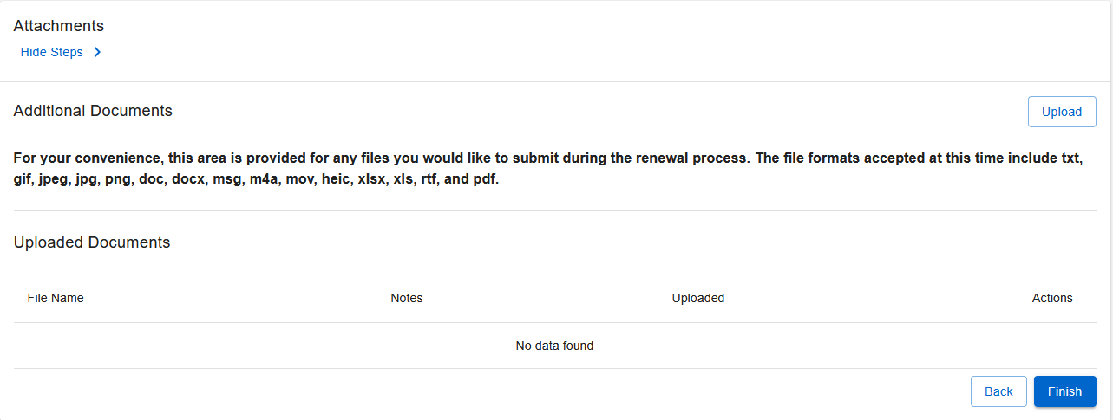
Step 6: File Attachments
Upload any additional or required documents.

Slide 8
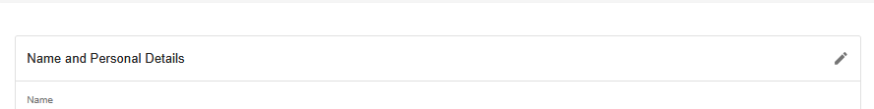
Step 7: Summary
Review all information to ensure accuracy.
Submitting incorrect or incomplete information may delay processing.

Slide 9
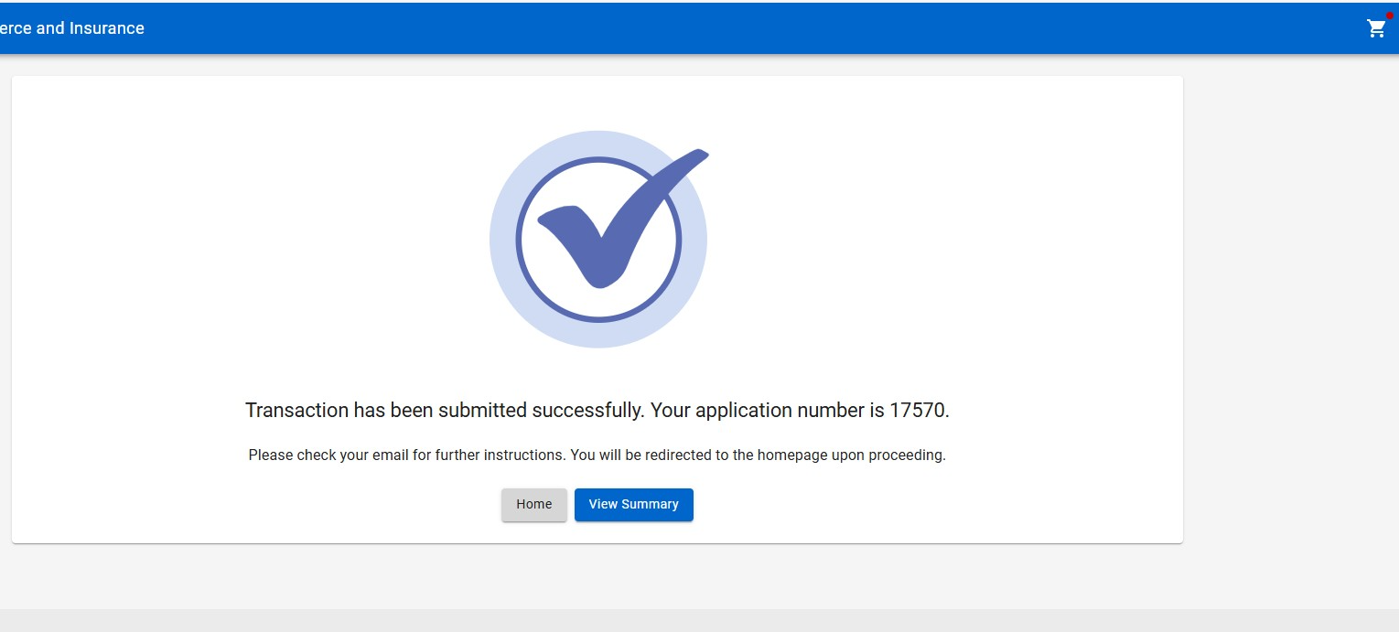
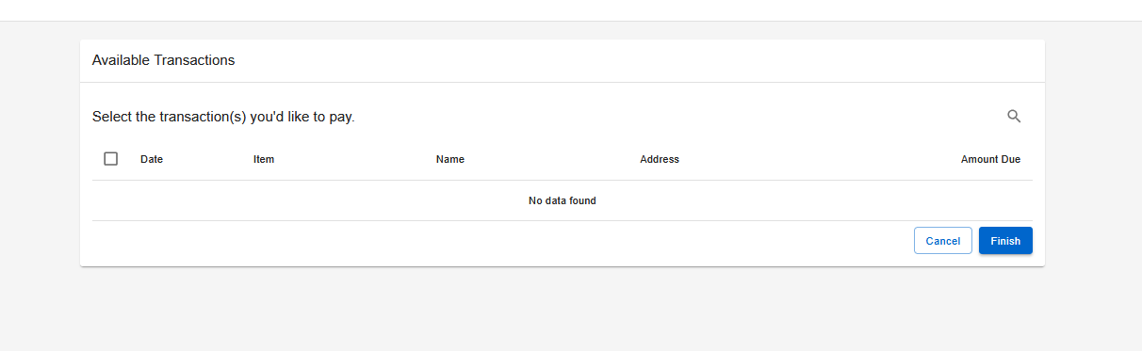
Step 8: Paying for the Application
After submitting your application:
Select the shopping cart icon in the top-right corner of the screen.
Select your application and follow the on-screen prompts to pay the amount due.
Note: Your application will NOT be processed until the application fee is received.

Slide 10

Step 9: Wait for Further Correspondence
If additional information is needed, you will receive an emailed letter outlining the steps required to complete your application.
If a letter is not received, you can assume your application is progressing in the licensing process.
Reminder: Monitor the email address associated with your account, including spam or junk folders.

Slide 11

Board Contact Information
Email: ce.aeboard@tn.gov
Customer Service Phone: 615-741-3221
Address:
Tennessee Department of Commerce and Insurance
Board of Examiners for Architects, Engineers, and Land Surveyors
Davy Crockett Tower, 10th Floor
500 James Robertson Parkway
Nashville, TN 37243
For more information or assistance, please visit the Board website by clicking the image above.

