Slide 1

Accountancy Application Assistance
Address/Employer Change
after 30 days - Fee required

Slide 2
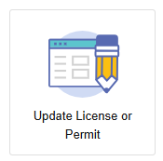
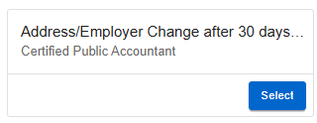
Where to Apply
Visit https://access.cloud.commerce.tn.gov/portal/public
Click Update License or Permit to view applications available to you.
Select “Address/Employer Change After 30 days…”

Slide 3
Application Introduction
This application is for Tennessee CPA licensees to change the address and contact information listed in the Tennessee Accountancy Licensing Records.
TCA § 62-1-125 requires a licensee to notify the board in writing within thirty (30) days of an address change. Notifications made after thirty (30) days are subject to a fee of $25.00.
You will be asked to:
Enter updated information for your home, mailing, or employment details.
Pay an application fee of $25.00.

Slide 4
Function Suitability
Confirm that you have chosen the correct application.
Did your address change more than 30 days ago?
If YES, proceed with application and payment.
If NO cancel this application and choose "Address/Employer Change within 30 days" from the list of applications.

Slide 5
Name and Personal Details
This is an overview of the name listed in your license file.
After completing this application, you may change the name in your license file by selecting "CPA Request for Name Change” from the list of applications.

Slide 6
Contact Information
The Board maintains three addresses for your license.
Click Edit to update any of the following:
- Main Address (preferred mailing address)
- Home Address
- Place of Employment

Slide 7
Summary
View a summary of the information you provided. Click the pencil icon to make necessary changes. Click Submit when complete.
You must agree to a statement that the information and documentation provided is accurate and true to the best of your ability, and that you understand that providing false information may result in the denial, suspension, or revocation of any license, certificate, or permit issued.
You will see a notification that your application has been submitted successfully, and you will see that a shopping cart entry has been created for this transaction.

Slide 8
Payment
Unless exempt from the renewal fee, the application
is not complete until payment is submitted.
Click Pay Now to proceed.
Navigate the payment screens to enter your payment details:
- Select transactions to pay.
- Confirm Payment Details
- Select Payment Type
- Enter Billing Details

Slide 9
Check your Email
Your application submission is complete.
Check your email for summaries of your application and payment.

