Slide 1
Child Abuse and Child Sex Abuse
Model Presentation

Slide 2
TCA 37-1-603
In accordance with TCA 37-1-603, the Jerry F. Agee Tennessee Law Enforcement Training Academy has partnered with the Tennessee Department of Children’s Services to develop Best Practice Guidelines for law enforcement when responding to child abuse and child sexual abuse calls.
The purpose of this endeavor is to endure that best practices are followed when responding to and reporting child abuse and child sexual abuse.

Slide 3
Course Objectives
Define Abuse and Types of Abuse
Define Characteristics of Abused Children and those of possible perpetrators
Guidelines for First Responder Investigations
DCS Referral and Departmental Protocol
Complete DCS On Line Training Video and submit certificate of completion to your GDI.
Handouts of CSA Guidelines will be provided to each officer.

Slide 4
Abuse
Abuse, in general, has been defined as cruel and violent treatment of somebody. It includes the violation of certain fundamental and universal rights of an individual. Abuse is perpetrated by an individual or a group of individuals who are in a superior position of authority to the abused individual(s). There are, thus, many instances of abuse that occur every day but the most persistent abuse is that inflicted on children.

Slide 5
Did you Know:
Most Children are abused by someone they know.
It is a myth that children are abused by a stranger.
Social networking sites and technology have enabled perpetrators to have greater access to potential victims
Often times, children are deemed as lying about a disclosure of child sexual abuse; however, typically they do not about such incidents.
Notes:
The statistics are shocking
1 in 4 girls is sexually abused before the age of 18. (96)
1 in 6 boys is sexually abused before the age of 18. (96)
1 in 5 children are solicited sexually while on the internet. (30, 87)
Nearly 70% of all reported sexual assaults (including assaults on adults) occur to children ages 17 and under. (76)
An estimated 39 million survivors of childhood sexual abuse exist in America today. (1)
Even within the walls of their own homes, children are at risk for sexual abuse
30-40% of victims are abused by a family member. (2, 44, 76)
Another 50% are abused by someone outside of the family whom they know and trust.
Approximately 40% are abused by older or larger children whom they know. (1, 44)
Therefore, only 10% are abused by strangers.
Sexual abuse can occur at all ages, probably younger than you think
The median age for reported abuse is 9 years old. (64)
More than 20% of children are sexually abused before the age of 8. (76)
Nearly 50% of all victims of forcible sodomy, sexual assault with an object, and forcible fondling are children under 12. (74, 76)
Most children don't tell even if they have been asked
Evidence that a child has been sexually abused is not always obvious, and many children do not report that they have been abused.
Over 30% of victims never disclose the experience to ANYONE.
Young victims may not recognize their victimization as sexual abuse.
Almost 80% initially deny abuse or are tentative in disclosing. Of those who do disclose, approximately 75% disclose accidentally. Additionally, of those who do disclose, more than 20% eventually recant even though the abuse occurred.
Fabricated sexual abuse reports constitute only 1% to 4% of all reported cases. Of these reports, 75% are falsely reported by adults and 25% are reported by children. Children only fabricate ½% of the time.
Consequences of child sexual abuse begin affecting children and families immediately. They also affect society in innumerable and negative ways. These effects can continue throughout the life of the survivor so the impact on society for just one survivor continues over multiple decades. Try to imagine the impact of 39 million survivors.
Health and/or Behavioral Problems:
The way a victim's family responds to abuse plays an important role in how the incident affects the victim.
Sexually abused children who keep it a secret or who "tell" and are not believed are at greater risk than the general population for psychological, emotional, social, and physical problems often lasting into adulthood.
Children who have been victims of sexual abuse are more likely to experience physical health problems (e.g., headaches).
Victims of child sexual abuse report more symptoms of PTSD, more sadness, and more school problems than non-victims. (10, 16, 55, 72)
Victims of child sexual abuse are more likely to experience major depressive disorder as adults. (55, 72)
Young girls who are sexually abused are more likely to develop eating disorders as adolescents. (16, 40, 89)
Adolescent victims of violent crime have difficulty in the transition to adulthood, are more likely to suffer financial failure and physical injury, and are at risk to fail in other areas due to problem behaviors and outcomes of the victimization.
Drug and/or Alcohol Problems:
Victims of child sexual abuse report more substance abuse problems. 70-80% of sexual abuse survivors report excessive drug and alcohol use. (10, 16, 89)
Young girls who are sexually abused are 3 times more likely to develop psychiatric disorders or alcohol and drug abuse in adulthood, than girls who are not sexually abused. (16, 40, 89)
Among male survivors, more than 70% seek psychological treatment for issues such as substance abuse, suicidal thoughts and attempted suicide. Males who have been sexually abused are more likely to violently victimize others. (90)
Teenage Pregnancy and Promiscuity:
Children who have been victims of sexual abuse exhibit long-term and more frequent behavioral problems, particularly inappropriate sexual behaviors.
Women who report childhood rape are 3 times more likely to become pregnant before age 18.
An estimated 60% of teen first pregnancies are preceded by experiences of molestation, rape, or attempted rape. The average age of their offenders is 27 years.
Victims of child sexual abuse are more likely to be sexually promiscuous. (39, 59, 60, 70)
More than 75% of teenage prostitutes have been sexually abused.
Crime:
Adolescents who suffer violent victimization are at risk for being victims or perpetrators of felony assault, domestic violence, and property offense as adults.
Nearly 50% of women in prison state that they were abused as children.
Over 75% of serial rapists report they were sexually abused as youngsters.
Most perpetrators don't molest only one child if they are not reported and stopped.
Nearly 70% of child sex offenders have between 1 and 9 victims; at least 20% have 10 to 40 victims. (23)
An average serial child molester may have as many as 400 victims in his lifetime.
Darkness to Light websight

Slide 6
Types of Abuse
Physical
Emotional
Neglect
Sexual

Slide 7
Physical Abuse
Any non-accidental physical injury to the child
Can include striking, kicking, burning or biting
Any action that results in a physical impairment of a child

Slide 8
Signs of Physical Child Abuse
Unexplained burns, cuts, bruises, or welts in the shape of an object
Multiple stages of healing/ Multiple injuries
Injuries that are recent as well as older, this indicates a pattern of abuse.
Problems in school
Continued absences, acting out, anti-social

Slide 9
Emotional Abuse
Emotional abuse causes harm to the child’s mental, emotional and social development of the child.
Though this may be hard to pinpoint, the key to determining emotional abuse is to listen to the child and caregivers.

Slide 10
Signs of Emotional Abuse
Shows extremes in behavior, such as overly compliant or demanding behavior, extreme passivity, or aggression
Is delayed in physical or emotional development
Reports a lack of attachment to the parent
Suicidal thoughts or behaviors

Slide 11
Signs of Emotional Abuse:
Parent or Caregiver
Constantly blames, belittles, or berates the child
Is unconcerned about the child and refuses to consider offers of help for the child’s problems
Overtly rejects the child
Calls the child by “It” or “That”
Examples of emotional Abuse:
“You are worthless and never going to amount to anything”
“I hope your mother dies before I do so I can piss on her grave”
“You are just like your father, worthless.”
Too bad you aren’t like your brother, he is the smart one, not stupid like you.
It is important to report it to DCS. Emotional abuse is detrimental and serious.

Slide 12
Neglect
Child neglect is the failure to provide for the shelter, safety, supervision and nutritional, physical or emotional needs of the child.
This includes drug endangered children.
Child neglect is a frequently reported form of child abuse and while often not immediate can be lethal.

Slide 13
Types of Neglect
Physical neglect includes refusal of or delay in seeking health care, abandonment, expulsion from the home or refusal to allow a runaway to return home, and inadequate supervision.
Emotional neglect includes such actions as marked inattention to the child's needs for affection, refusal of or failure to provide needed psychological care, spouse abuse in the child's presence, and permission of drug or alcohol use by the child.
Educational neglect includes the allowance of chronic truancy, failure to enroll a child of mandatory school age in school, and failure to attend to a special educational need.
Drug Endangered Children includes children exposed to drugs and alcohol.
Resource https://nationaldec.org/training/our-training/

Slide 14
Child Sexual Abuse
Child Sexual Abuse is a form of child abuse in which a child is abused for the sexual gratification or stimulation of an adult or child.
Also includes Sexual Exploitation.
Refer to TCA
Know legal terms such as intimate body parts, authority figures, etc.

Slide 15
Child Abuse Laws:
TCA 39-13-506 Statutory Rape
TCA 39-13-522 Rape of a Child
TCA 39-15-401 Child Abuse and Child Neglect or Endangerment.
TCA 39-17-1003 Sexual Exploitation of a Minor

Slide 16
Signs of Sexual Abuse – Child
Has difficulty walking or sitting
Reports nightmares or bedwetting
Demonstrates bizarre, sophisticated, or unusual sexual knowledge or behavior
Runs away
Signs of Sexual Abuse – Parent or Caregiver
Is unduly protective of the child or severely limits the child’s contact with other children, especially of the opposite sex
Is secretive and isolated
Is jealous or controlling with family members

Slide 17
Accidental vs. Non-Accidental
Accidental Injuries
Bony prominences
Knee
Hands
Elbow
Chin
Forehead
Nose
Non-Accidental
Buttocks
Thighs
Arms
Cheeks, ears, head
Stomach / Torso
Injuries to babies and to those children that are not independently mobile

Slide 18
In cases of Sexual Abuse:
Do Not question the victim about the details of the incident itself; however, it is important to get demographic information for the DCS referral. You will need to know the jurisdiction in which the abuse occurred.
Reassure the child
Refrain from multiple minimal interviews
Refer to CSA Protocol Guidelines 2023

Slide 19
Other Indicators of Abuse:
Is there domestic violence in the home?
Is there Animal Abuse?
Is there substance abuse in the home?
Call history?
Pay attention to clothing, hygiene, etc.

Slide 20
Tennessee Department of Children’s Services

Slide 21
DCS Central Intake
Abuse Hotline
Toll-free numbers:
1-877-237-0004
Law Enforcement:
1-877-237-0026
Someone is available 24/7

Slide 22
Information the Central Intake Hotline Will Ask You
Demographic information on the child, including date of birth, address, and phone number
Names of child’s parents
Names of siblings of the child
Details of the abuse or neglect – any physical evidence – injuries, behaviors, or environmental conditions
Name of the person who may have abused or neglected the child and if that person currently has access to the child
Child’s current whereabouts

Slide 23

Information the Central Intake Hotline Will Ask You (Continued)
How did you come to know about the abuse/neglect?
Is there any danger for the DCS investigator?
Who else knows the circumstances?
Are you able to help this child or family beyond the investigation? (e.g. be a mentor, foster parent, or visiting resource)

Slide 24
How will DCS Respond?
Priority 1 – Within 24 hours. Reports that indicate imminent threat of serious harm or death. If you are requesting immediate assistance be sure to provide a direct number that the on call Supervisor can reach you.
Priority 2 – Within 48 hours
Injuries or risk of injuries that are not life threatening and do not require immediate medical care
Priority 3 – Within 5 working days
Reports that indicate a low risk of harm
Child Abuse Referral And Tracking (tn.gov)
Click to Below to Review DCS On Line
Reporting and Tracking Procedures

Slide 25
What The Law Says
Any person who has knowledge of or suspects abuse or neglect of a child must report it.
The law makes no distinction between professionals and non-professionals on the issue of reporting.
TCA 37-1-403
Tennessee laws protect persons who report abuse or neglect in good faith. The law also provides immunity from civil and criminal liability. Reporters do have the right to remain anonymous.
TCA 37-1-410

Slide 26
Instructor Notes
Provide CSA Guidelines Handout to Students
Have officers individually watch DCS Training Video.
Each officer will provide an email. At completion of video and after answering questions successfully, a certificate of completion will be emailed to the provided email address. The officer shall then print the certificate and provide a copy to their GDI.

Slide 27
CSA/ CA Guidelines for LE References
Child Sexual Abuse and Child Abuse Guidelines for Law Enforcement
Child Abuse and Child Sexual abuse investigations require a multi-disciplinary response. When responding to these cases, law enforcement must work with additional child welfare agencies to ensure that best practice is followed. Department of Children’s Services, Child Advocacy Centers, Medical facilities, and the District Attorney’s office are just a few of those agencies that should be involved when responding to or investigating child cases. It is also imperative that you follow your departmental policy and protocol. Law Enforcement does not have statutory authority to place children in the custody of another. You must work with your DCS investigators when there are custodial or child safety issues. Regarding child abuse and child sexual abuse, Law enforcement has the responsibility to determine if a crime has occurred and if so, hold the perpetrator accountable. Department of Children’s Services has the responsibility to ensure the safety of the child and provide resources. It is the responsibility of all agencies to work together and follow best practice recommendations.
See Complete Handout

Slide 28
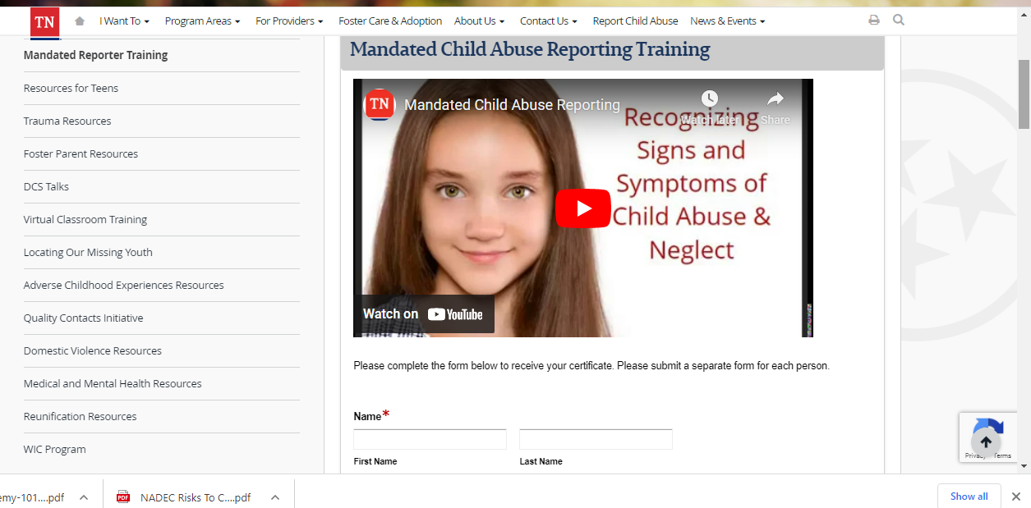
DCS TRAINING VIDEO
https://www.tn.gov/content/tn/dcs/program-areas/training/cw-resources/mandated-reporter-training.html

Slide 29
Questions?

