Slide 1
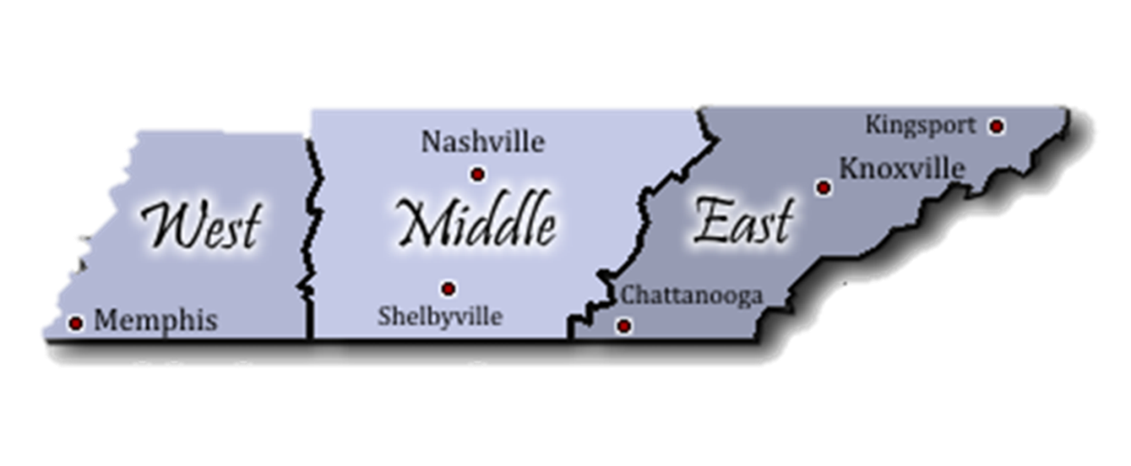
Apprenticeship TN Contacts
www.ApprenticeshipTN.com
Apprenticeship.TN@tn.gov
Jack Laser
Jack.Laser@tn.gov
(731) 697-0290
Tyra Copas
Tyra.Copas@tn.gov
(423) 715-8027
Charlene Sands Russell
Charlene.Russell@tn.gov
(931) 303-7638

Slide 2
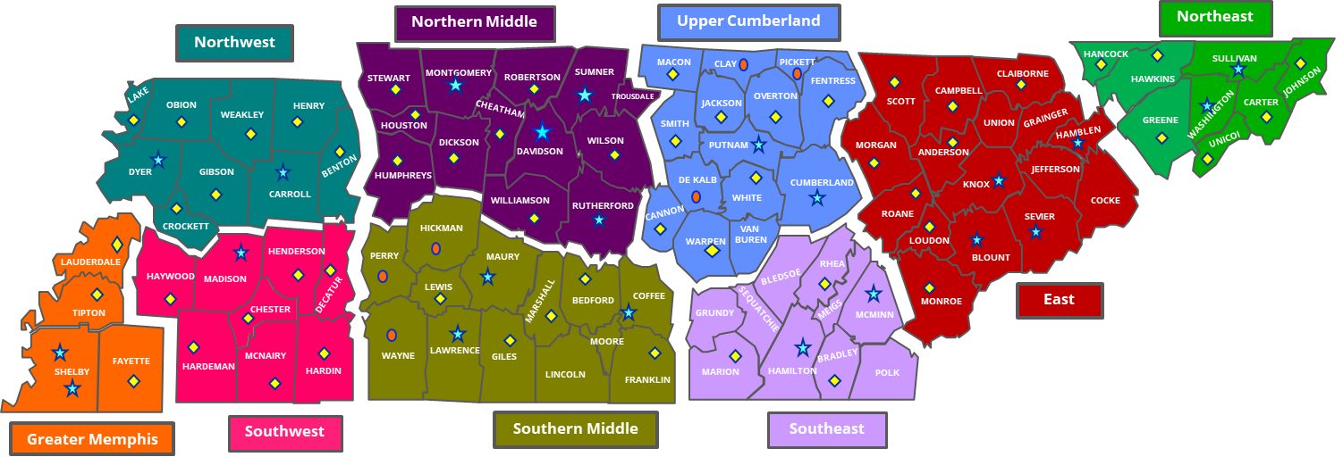
Local Workforce Development Areas
Counties by Region

Slide 3
YOUR LOCAL BUSINESS SERVICE TEAM
West TN
Greater Memphis
Roderick Woody
901-573-1455 / Email
Northwest
Ginger Powell
731.286.3585, ext. 409 / Email
Southwest
Mark Chandler
731.694.5030 / Email
West TN Executive Director’s
Kyla Guyette, GM
kguyette@workforcemidsouth.com
Jennifer Bane, NW
jbane@nwtnworks.org
Vicki Bunch, SW
Vicki.Bunch@swhra.org
Regional Director West TN
Kristie Bennett
Kristie.Bennett@tn.gov
Middle TN
Northern Middle
Freda Herndon
615-533-0635 / Email
Southern Middle
Travis Wilson
931-309-0962 / Email
Upper Cumberland
Caroline Timpson
931-520-9593 / Email
Middle TN Executive Director’s
Marla Rye, NM
mrye@workforceessentials.com
TBD, SM
Selina.Moore@tn.gov
Beck Hull, UC
BHull@ucworkforce.org
Regional Director Middle TN
Selina Moore
Selina.Moore@tn.gov
East TN
Southeast
Beth Keylon
423-643-2328 / Email
East
Ginger Armstrong
865-594-5500 / Email
Northeast
Brian Vaughn
423-610-0222 x 208 / Email
East TN Executive Director’s
Michelle Holt, SE
Michele@sedev.org
Bill Walker, E
Bwalker@ethra.org
Kathy Pierce, NE
kpierce@ab-t.org
Regional Director East TN
Virginia Housey
Virginia.Housey@tn.gov
Business Services Contacts
Local Workforce Board
Contacts

