Slide 1
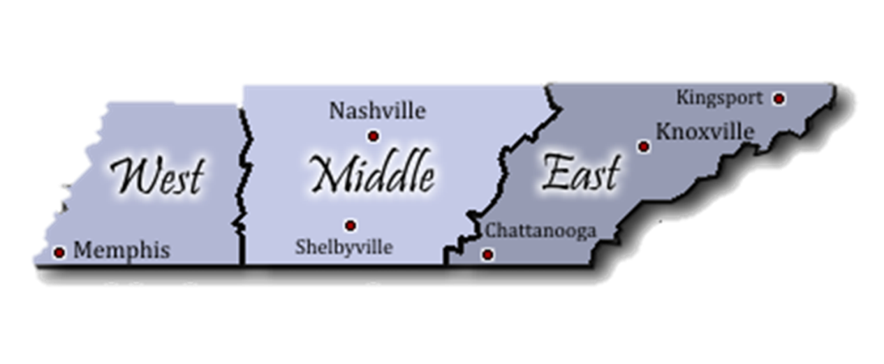
Apprenticeship TN Contacts
State Apprenticeship Director
Holly Free-Ollard
Holly.Free-Ollard@tn.gov
865-973-8157
West TN Regional Apprenticeship Director
Shalondria Shaw
Shalondria.Shaw@tn.gov
731-202-6027
Middle TN Regional Apprenticeship Director
Charlene Sands Russell
Charlene.Russell@tn.gov
931-303-7638
East TN Regional Apprenticeship Director
Jessica Barnett
Jessica.L.Barnett@tn.gov
423-440-0128
State Apprenticeship Assistant Director
Angela Salamy
Angela.Salamy@tn.gov
931-800-8838
Grants Program Manager
LeAnn Blevins
LeAnn.Blevins@tn.gov
615-633-8084
Compliance Officer
Lynn Kirby
Lynn.Kirby@tn.gov
615-330-1631
Apprenticeship Specialist
Steffany Daniel
Steffany.S.Daniel@tn.gov
615-626-3595
Administrative Services Assistant
Monica Crosser
Monica.Crosser@tn.gov
615-393-1137
Notes:
Holly – Slide 3: Progress to Date (1 minute 30 seconds)
6991 Registered Apprentices and 622 completers as of July 22nd

Slide 2
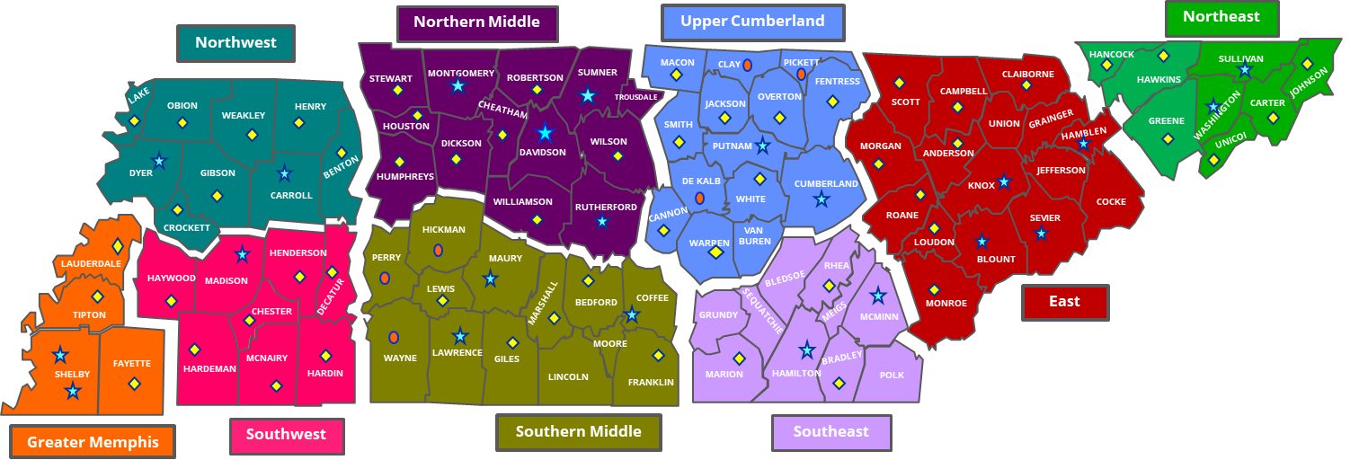
Local Workforce Development Areas
Counties by Region

Slide 3
Your Local Business Service Team
West TN
Regional Director Grand West TN/ Regional Director, Northwest
Kristie Bennett
Kristie.Bennett@tn.gov
Regional Director, Greater Memphis
Dr. Sabra Bledsoe
Sabra.Bledsoe@tn.gov
Regional Director, Southwest
Kristie Bennett
Kristie.Bennett@tn.gov
Middle TN
Regional Director Grand Middle TN/ Regional Director Southern Middle
Selina Moore
Selina.Moore@tn.gov
Regional Director, Upper Cumberland
Sean Monday
Patrick.S.Monday@tn.gov
Regional Director, Northern Middle
John Alexander
John.Alexander@tn.gov
East TN
Regional Director Grand East TN/ Regional Director Southeast
Dr. Jennifer Thacker
Jennifer.Thacker@tn.gov
Regional Director East
Brian Vaughn
Brian.Vaughn@tn.gov
Regional Director Northeast
Brian Decker
Brian.Decker@tn.gov
Regional Directors
West TN
Greater Memphis
Roderick Woody
901-573-1455 / Email
Northwest
Ginger Powell
731-286-3585 ext. 409 / Email
Southwest
Ginger Powell
731-286-3585 ext. 409 / Email
Middle TN
Northern Middle
Andrea Dillard
931-206-1947 / Email
Southern Middle
Regina Locker
931-309-1329 / Email
Upper Cumberland
Jeremiah Miller
931-520-9590 / Email
East TN
Southeast
Maty Partin
423-424-4240 / Email
East
Ginger Armstrong
865-594-5500 / Email
Northeast
Camilla Archer
423-610-0222 ext. 208 / Email
Business Services Contacts

Slide 4
Local Workforce Board Contacts
West TN
Kyla Guyette, Greater Memphis
kguyette@workforcemidsouth.com
901-512-7455
Jennifer Bane, Northwest
jbane@nwtnworks.org
731-286-3585 ext. 406
Jennifer Bane, Southwest
jbane@nwtnworks.org
731-286-3585 ext. 406
Middle TN
Marla Rye, Northern Middle
mrye@workforceessentials.com
931-206-3783 (C)
Barbara Kizer, Southern Middle
bkizer@sctdd.org
931-379-2903
Becky Hull, Upper Cumberland
BHull@ucworkforce.org
931-520-9511 (O)
931-229-0435 (C)
East TN
Michelle Holt, Southeast
Michele@sedev.org
423-424-4210 (O)
423-240-2180 (C)
Tonya Randolph, East
TRandolph@ethra.org
865-590-1052 ext. 7106 (O)
865-705-8168 (C)
Lisa Evans, Northeast
Lisa.Evans@ab-t.org
423-928-0224 (O)
Executive Directors

