Slide 1
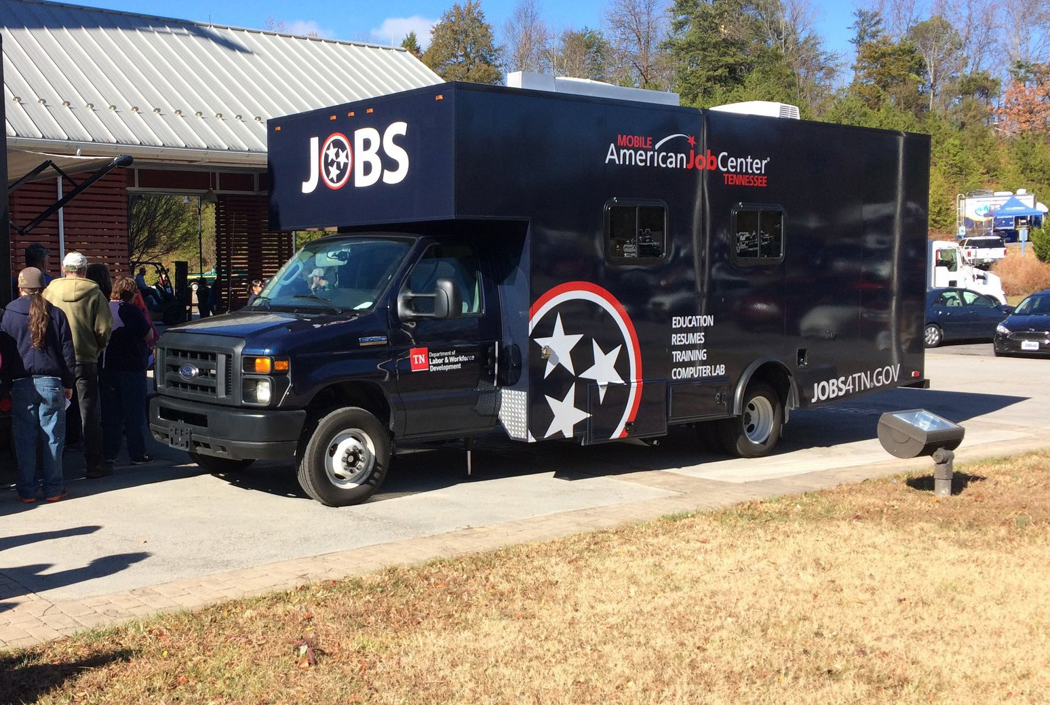
HIRING EVENT
Event Title
Wednesday, January 8, 2020
10:00 a.m. - 2:00 p.m.
More Details
Community Center
123 S. Apple St. City, TN 37219
For more information, email
john.doe@tn.gov or call 555-555-5555.
American Job Center
Tennessee is not responsible for the participation of any advertised employers at our hiring and resource events. We solicit their participation in good faith that they may attend but acknowledge that unexpected events occur, which may prevent their attendance.

