Slide 1

Articulation & Transfer Report:
AY 2013-14
Tennessee Higher Education Commission
Fall Quarterly Meeting
November 20, 2014
www.tn.gov/thec

Slide 2
Tennessee undergraduates are highly mobile
Public bachelor’s graduates (2012-13):
Changed schools at least once: 45.1%
Attended any 2-year college: 34%
Attended a TN comm. college: 29.6%
Fall 2013 undergrads:
Transferred into publics or TICUA: 7.2%
www.tn.gov/thec

Slide 3
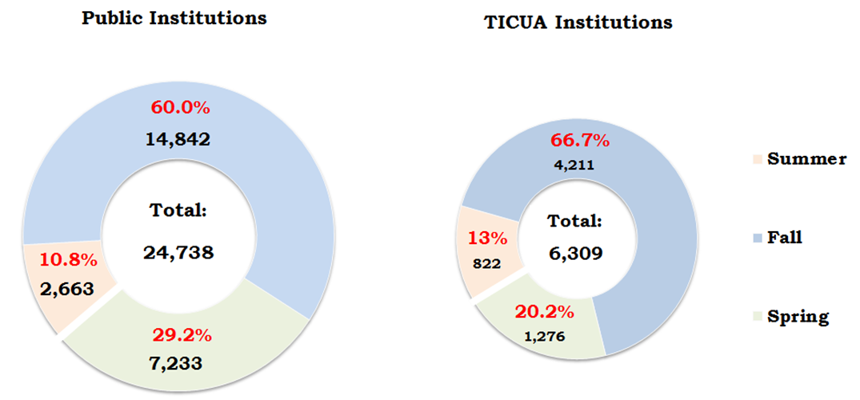
Public & TICUA institutions show similar transfer activity by semester
Student Transfer by Receiving Sector and Semester,
AY 2013-14
www.tn.gov/thec

Slide 4
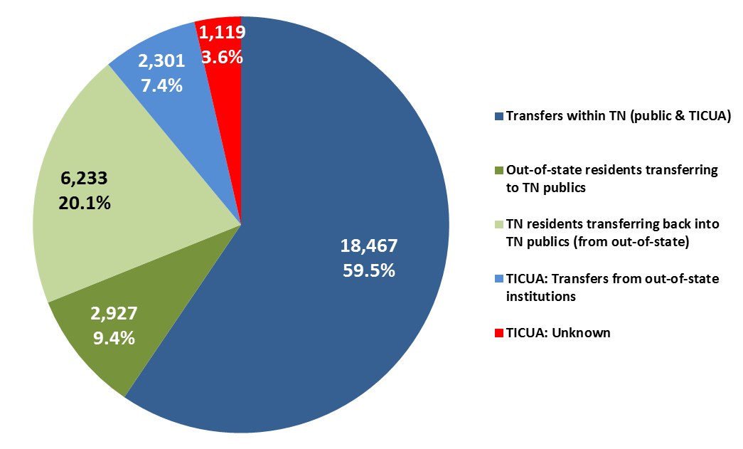
Most transfers take place within Tennessee
N = 31,470
Transfers by Originating Location, AY 2013-14
www.tn.gov/thec

Slide 5

Most out-of-state transfers are returning Tennesseans
N = 31,470
Transfers by Originating Location, AY 2013-14
www.tn.gov/thec

Slide 6
Transfer activity within public sector is more intensive
N = 31,047
Within Public Sector:
13,495
Within TICUA:
352
Out of State: 2,301
Out of State: 9,160
2,537
Unknown: 1,119
2,083 *
Public Transfers: 24,738
Private Transfers: 6,309
Student Transfer Patterns, AY 2013-14
www.tn.gov/thec
* From all independent institutions, including non-TICUA

Slide 7
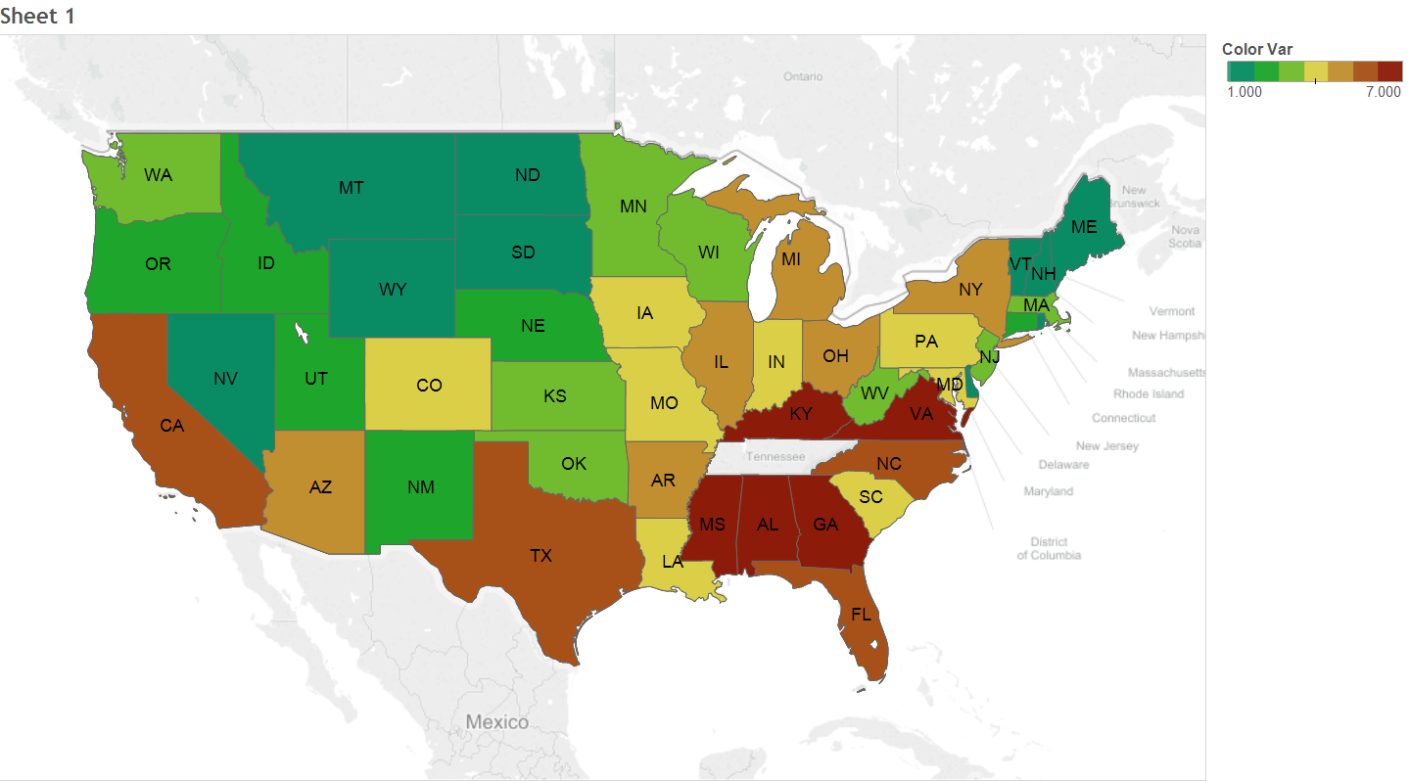
50% of out-of-state transfers arrive from 9 states
Transfer students
1-25
25-50
51-100
101-200
201-400
401-600
> 600
Foreign transfers: 341
Unknown sending state: 1,512
Transfers into TN institutions by State of Origin, AY 2013-14
www.tn.gov/thec

Slide 8
Students from 3 largest providers of transfers are predominantly returning Tennesseans:
Returning TN residents *
Number Percent
FL 359 78.4%
TX 232 63.9%
CA 202 63.9%
* Public institutions only
www.tn.gov/thec

Slide 9
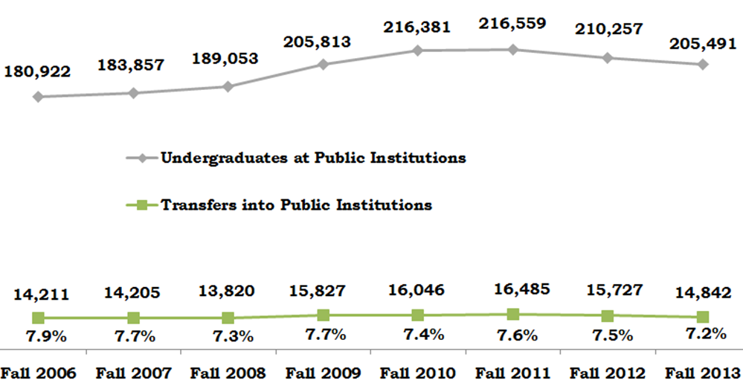
Percent of public UG enrollment accounted for by transfers has been consistent
Transfer & Total UG Headcount, Public Institutions,
Fall 2006 – Fall 2013
www.tn.gov/thec

Slide 10
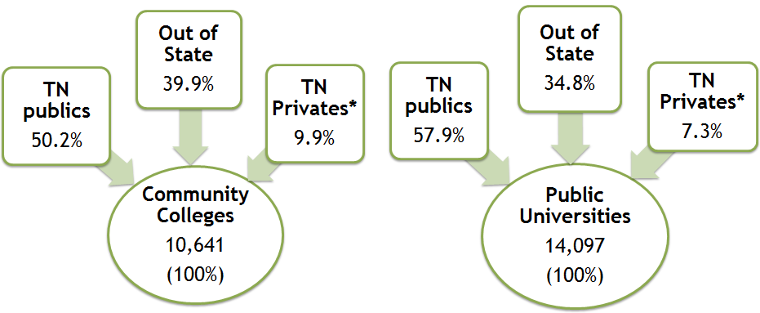
Most public transfers move from in-state public & out-of-state institutions
Transfers into Public Institutions, AY 2013-14
www.tn.gov/thec
* Includes TICUA, non-TICUA, private for-profits

Slide 11
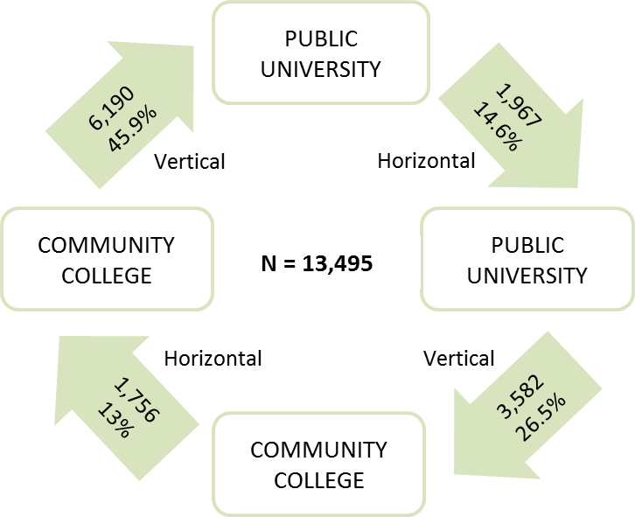
Most public transfer activity is vertical & reciprocal
Public Transfer Activity, AY 2013-14
www.tn.gov/thec

Slide 12
Difference in average GPA among groups is not large
Mean GPA:
2.89
Mean GPA:
2.85
Mean GPA:
2.90
Mean GPA:
2.81
Mean GPA:
2.81
Public Transfer Activity, AY 2012-13
www.tn.gov/thec

Slide 13
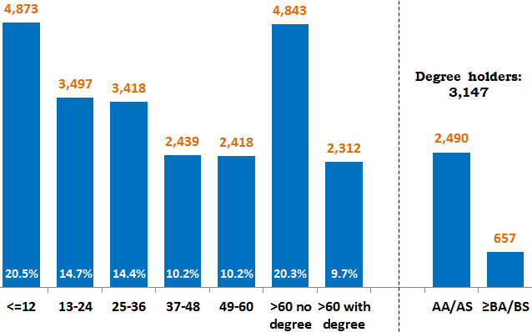
Many students transfer with 60+ credits but no degree
Credit Hours & Degrees at Transfer, AY 2013-14 *
www.tn.gov/thec
* Excluding 938 students with missing data on credits

Slide 14
Many students transfer with 60+ credits but no degree
Credit Hours & Degrees at Transfer, AY 2013-14 *
www.tn.gov/thec
* Excluding 938 students with missing data on credits

Slide 15
Many students transfer with 60+ credits but no degree
Credit Hours & Degrees at Transfer, AY 2013-14 *
www.tn.gov/thec
* Excluding 938 students with missing data on credits

Slide 16
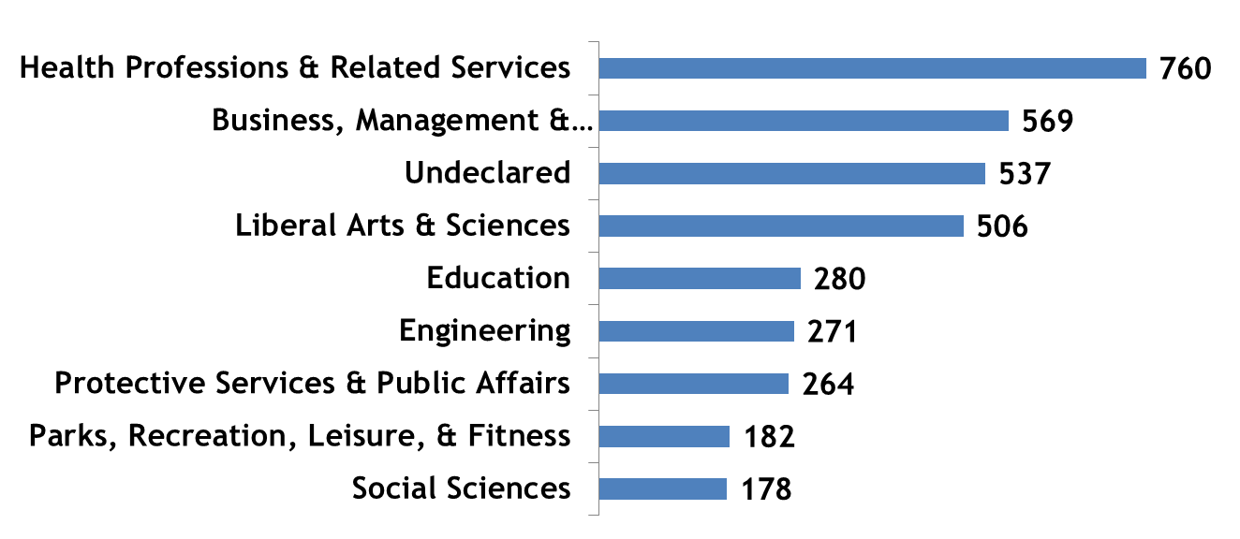
Most transfers with 60+ credits but no degree choose among 5 major fields
N = 4,843
Major at transfer with >60 credits & no prior degree,
AY 2013-14
www.tn.gov/thec

Slide 17
Most TCAT transfers are actually returning to their institution of origin
Returning: 257
Readmitted: 173
First-timers (new at institution): 204
Transfer: 75
Pre-college: 50
Other first-timers: 26
TOTAL: 785
Student Registration Types of TCAT Transfers, AY 2013-14
www.tn.gov/thec

Slide 18
Most TCAT transfers move to community colleges
Colleges of Applied Technology
from 22 TCATs
from 27 TCATs
N = 785
167 students
618 students
Public Universities
Community Colleges
Migration of TCAT students, AY 2013-14
www.tn.gov/thec

Slide 19
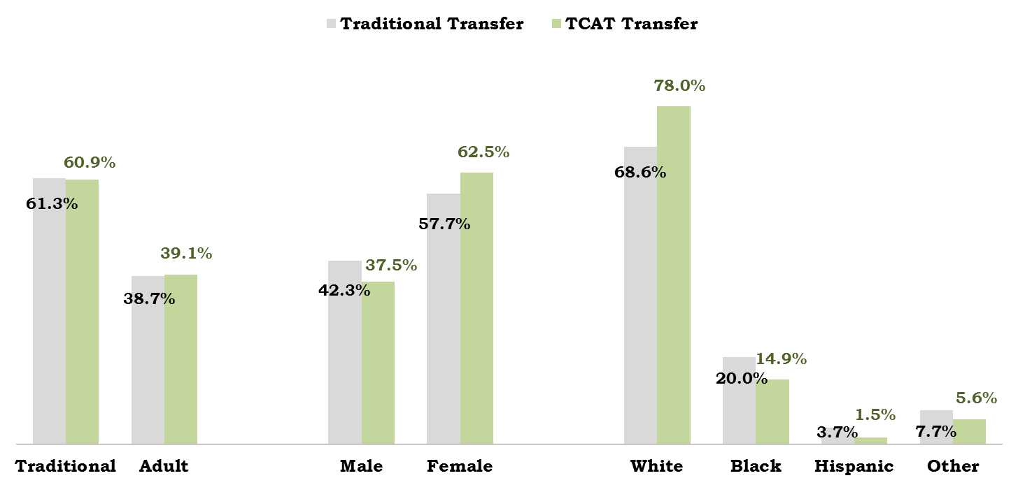
TCAT transfers are generally similar to regular transfers
TCAT transfers vs. regular transfers, AY 2013-14
www.tn.gov/thec

Slide 20
73% of TCAT students change fields after transfer
Post-transfer Major Change of TCAT students
www.tn.gov/thec

Slide 21
Many TCAT transfers are program completers
Completers:
192 students
24.5% of TCAT transfers
Completers changing major at transfer:
111 students
58% of completers
www.tn.gov/thec

Slide 22
Things to remember:
TN undergraduates: Mobile
Publics & TICUA: Similar activity by term
Public sector: Intensive internal transfer
Most transfers: Within TN
Most out-of-state transfers: Returning TN residents
9 states: Half of out-of-state transfers
www.tn.gov/thec

Slide 23
Things to remember:
Public transfers: Consistent over time
Internal public transfer: Mostly vertical
Transfer students: Low degree efficiency
TCAT transfers: Mostly returning students
TCAT transfers: More white & female students
TCAT transfers: Prone to change fields
www.tn.gov/thec

Slide 24
2014 Articulation & Transfer Report
available at:
www.tn.gov/thec/Legislative/Reports.html
www.tn.gov/thec

